Slide 1

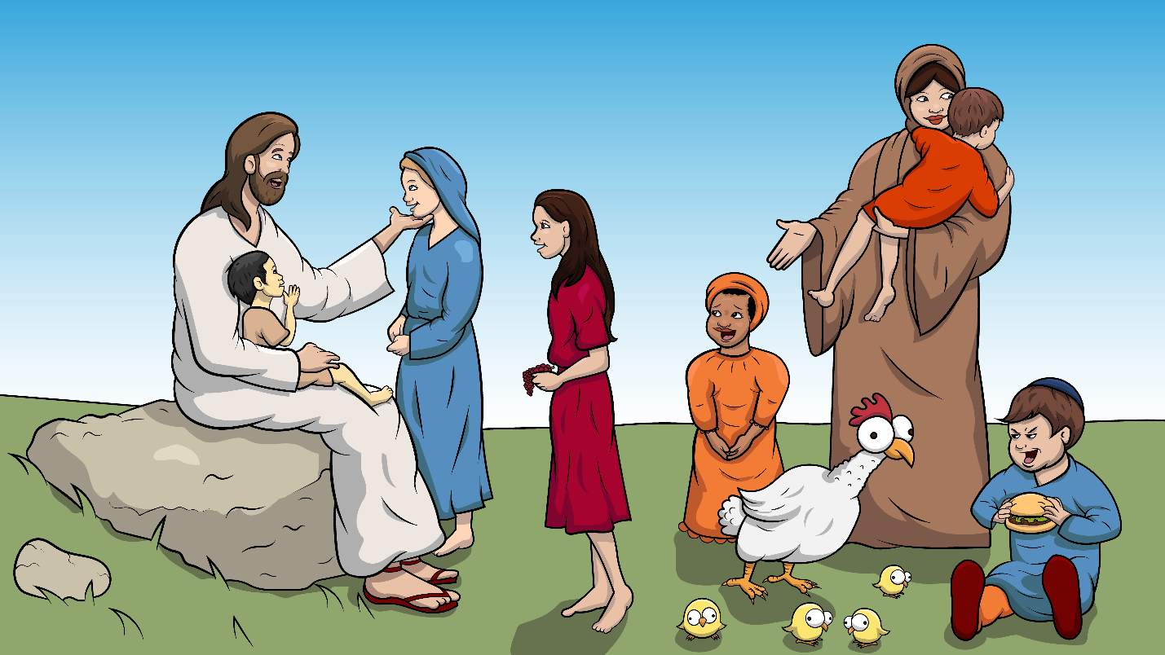
Story 1.8 Jesus Loves Children a Bunch
Jesus and the
Little Children
Mark 10:13-16 (ch)

Slide 2
New Words to Read
children chins
chat chest

Slide 3
which rich
such much

Slide 4
lunch munch
bunch crunch

Slide 5
chicks chicken

Slide 6
Sight Words
Jesus picnic like
bless my me so

Slide 7
Rule Breakers
(Read and Spell)
loves put said to
do the come his

Slide 8
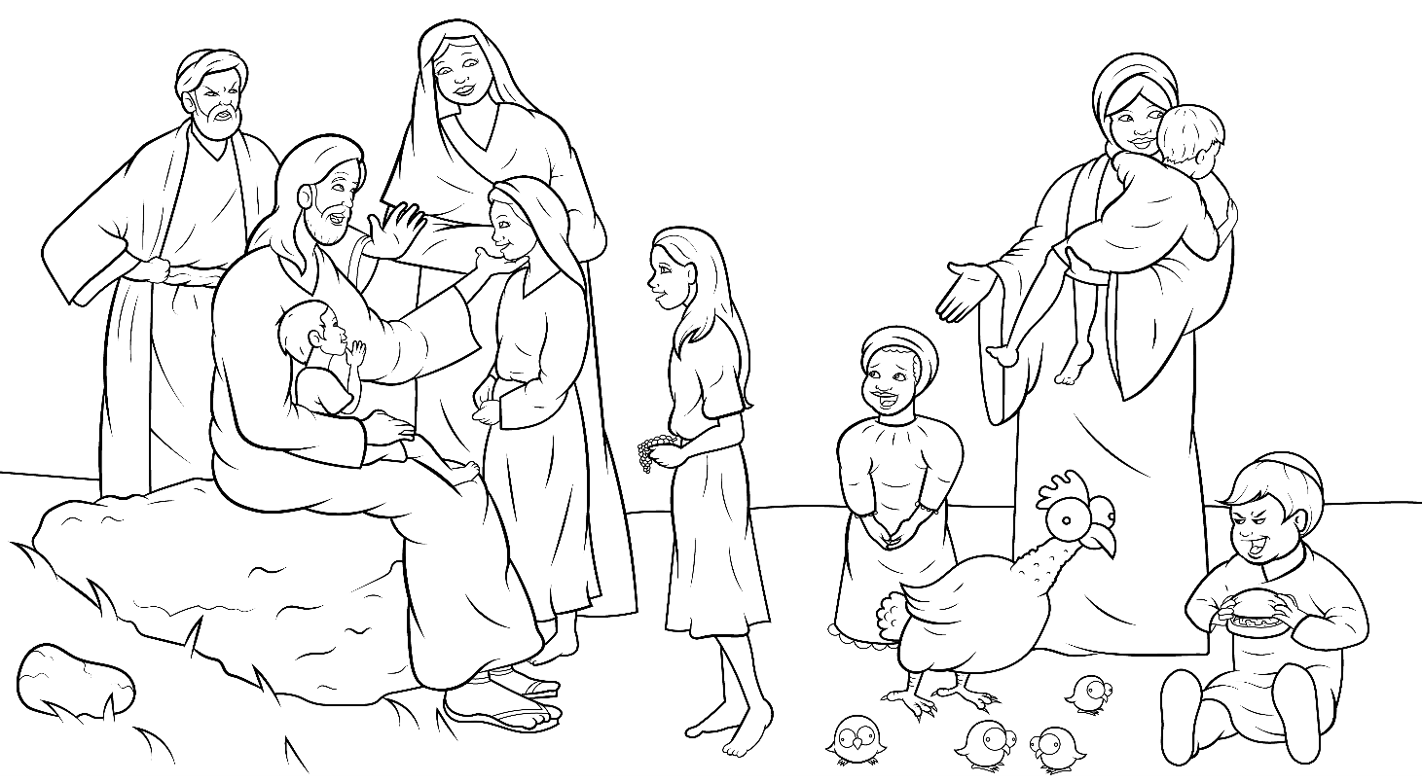
Story 1.8 Jesus Loves Children a Bunch
I Read,
You Read
Bible Story
Jesus and the
Little Children
Mark 10:13-16 (ch)

Slide 9
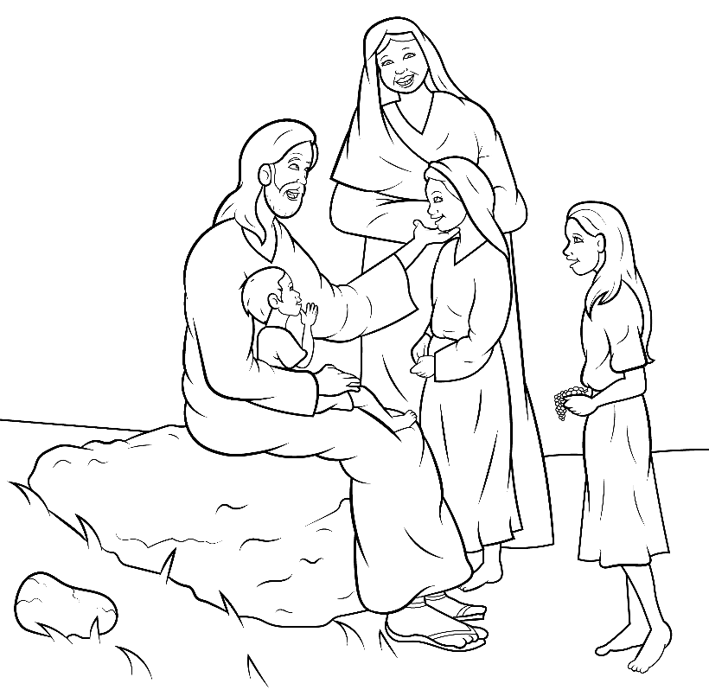
What a good day it was.
Jesus was in town!

Slide 10
At a picnic, moms
and kids had lunch.
Chat, chat, chat.

Slide 11
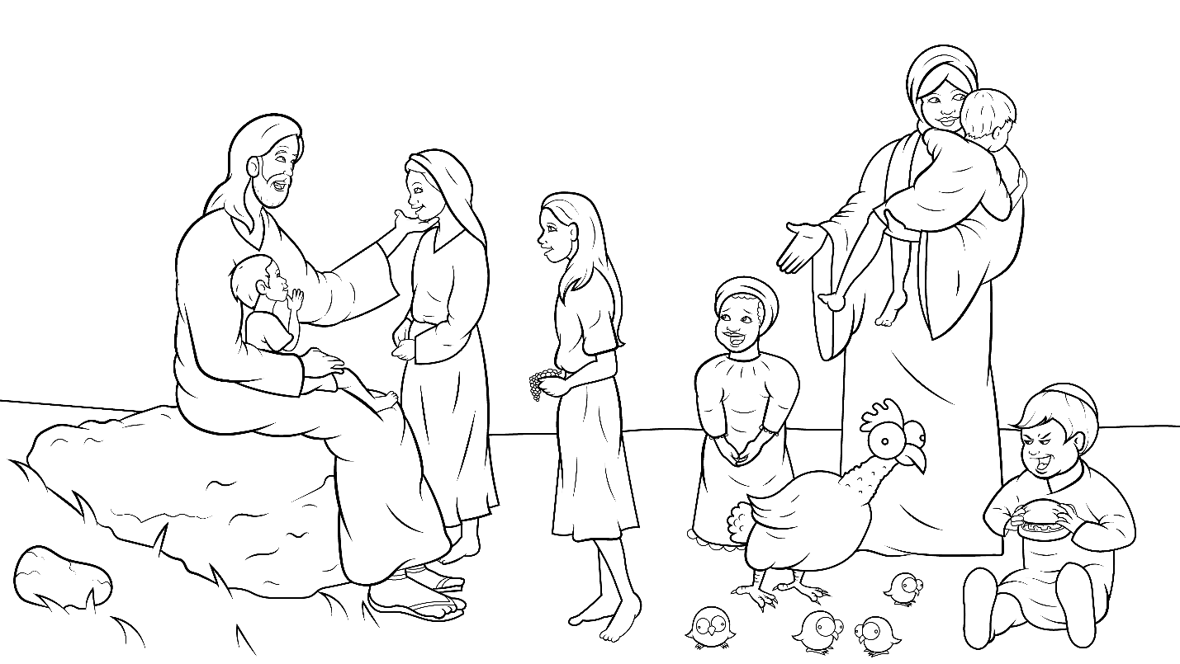
Munch, munch, crunch…
such a glad lunch.

Slide 12
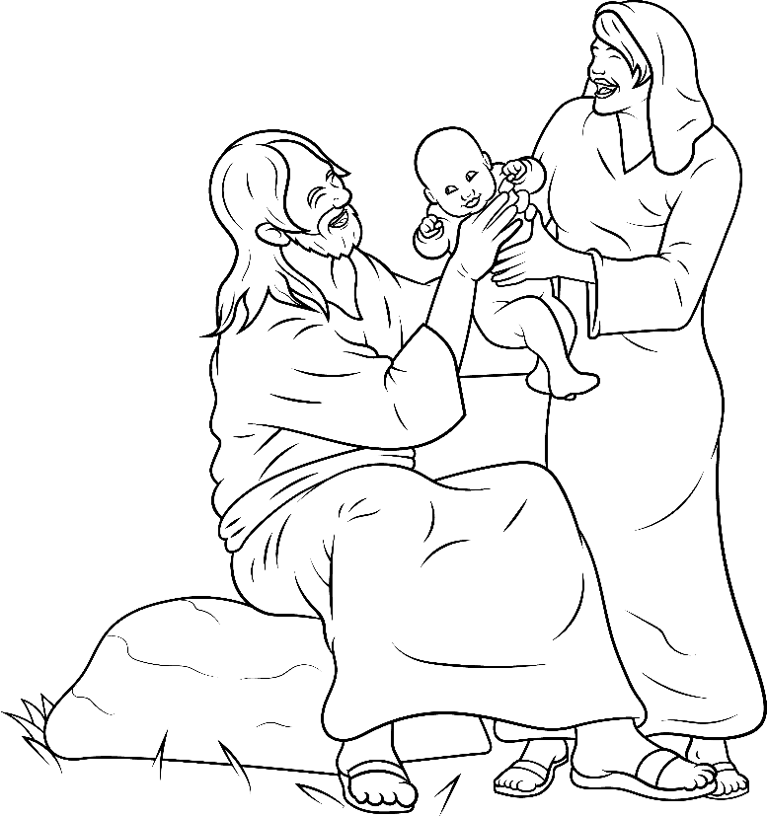
“Jesus is here. Let’s go see him,”
the moms said.

Slide 13
Kids went with moms.
“Jesus will bless them,”
moms said.

Slide 14
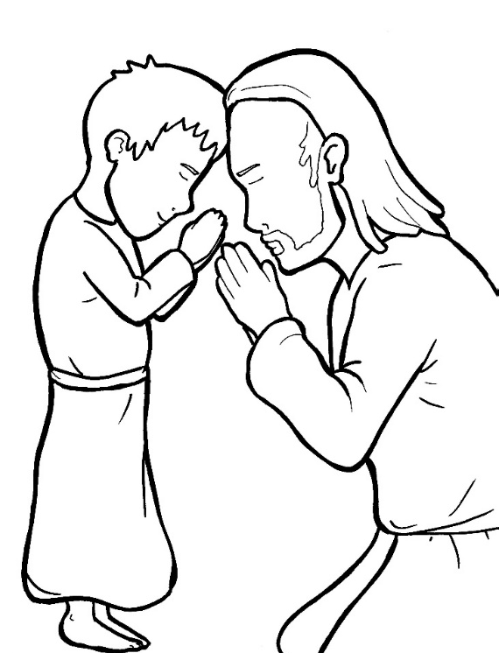
Jesus loves children so much…
a bunch!

Slide 15
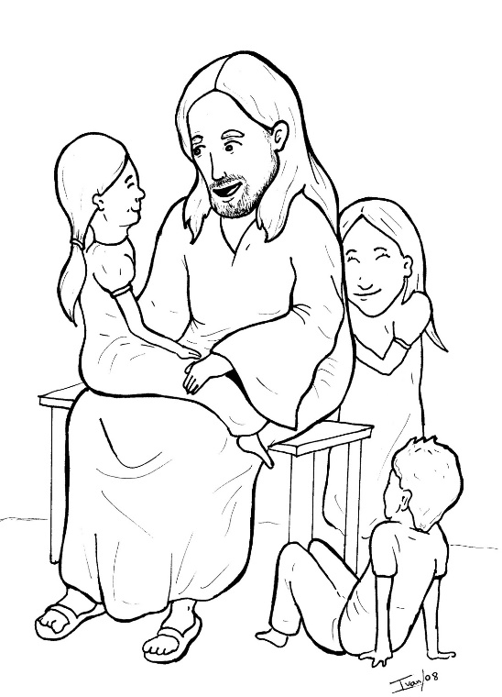
He hugged the babies and prayed for the boys and girls.

Slide 16
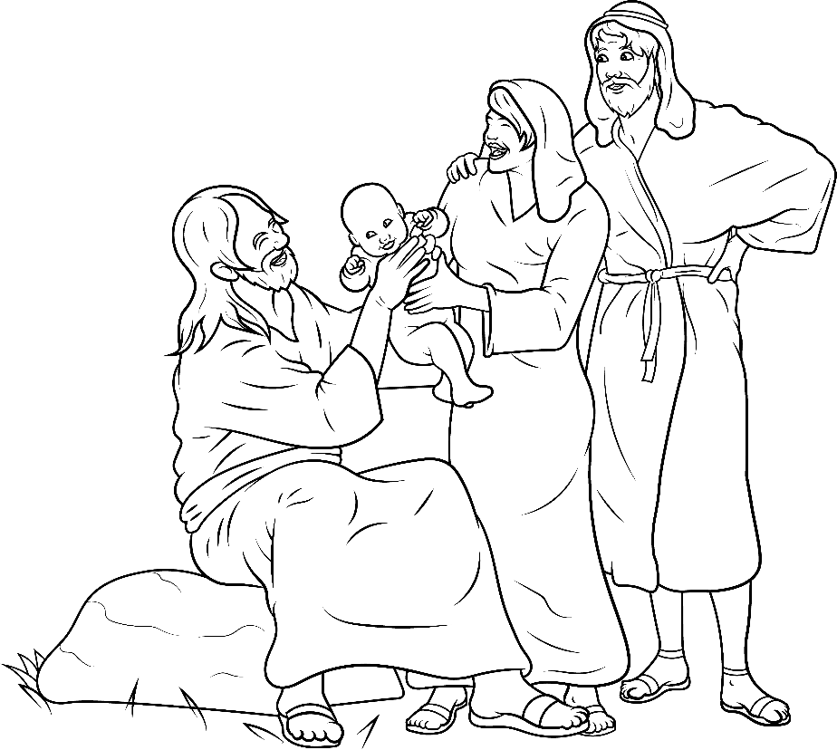
“Jesus, bless my children,”
a dad said.
But…

Slide 17
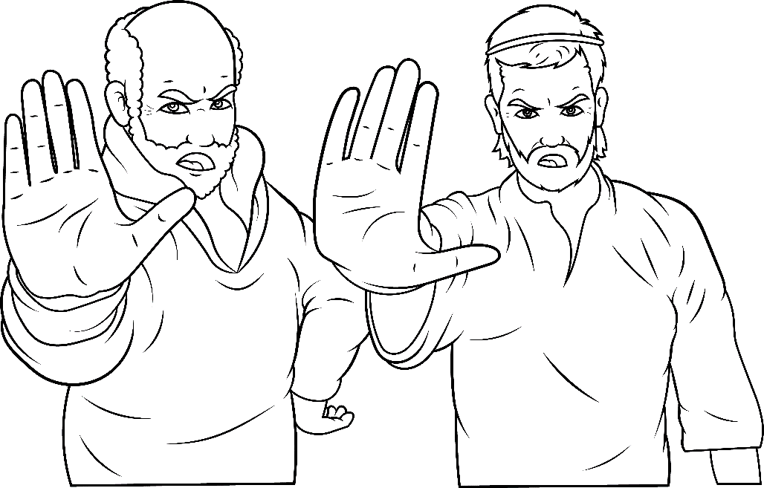
The disciples said, “Stop! Go away.
No, don’t bother Jesus.”

Slide 18
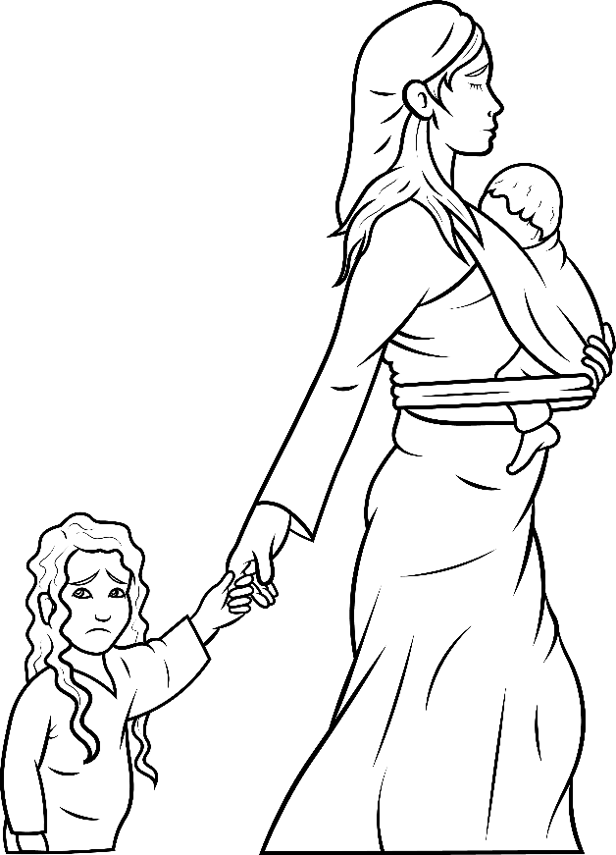
The children got sad.
Jesus got mad.
He said,
“Let the children
come to me.”

Slide 19
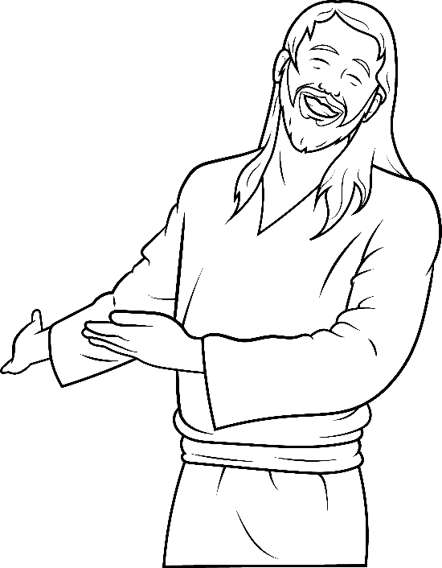
“Do not stop them.”
Jesus said
that the
Kingdom of Heaven
belongs to them.

Slide 20
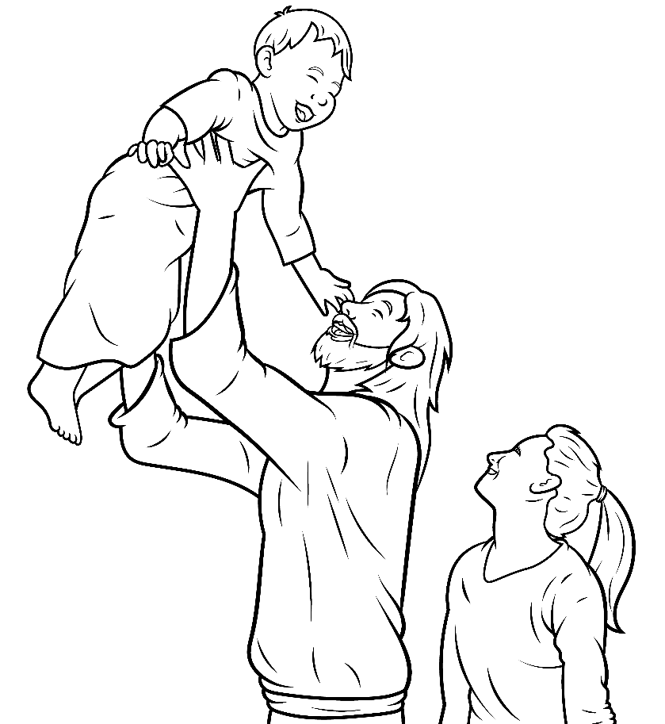
Children just trust God.
Jesus said, “Come back!”

Slide 21
Like a chicken with chicks, Jesus loves children. Which children?

Slide 22
He loves rich children and not rich, big and not big.

Slide 23
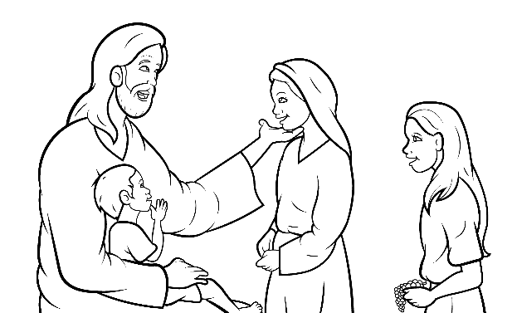
He put his hands on the children’s chins to bless them.

Slide 24
He touched each
little cheek

Slide 25
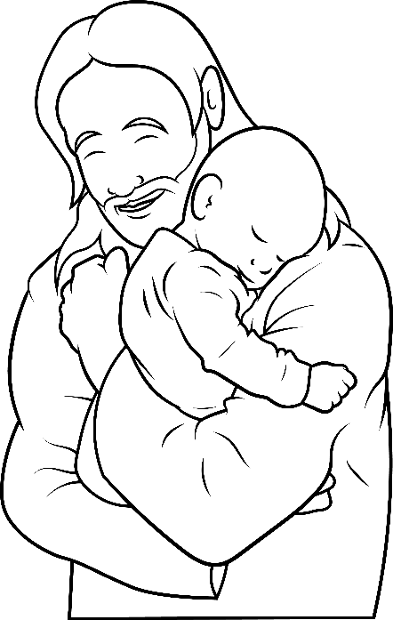
Every baby he set on his lap next to his chest.

Slide 26
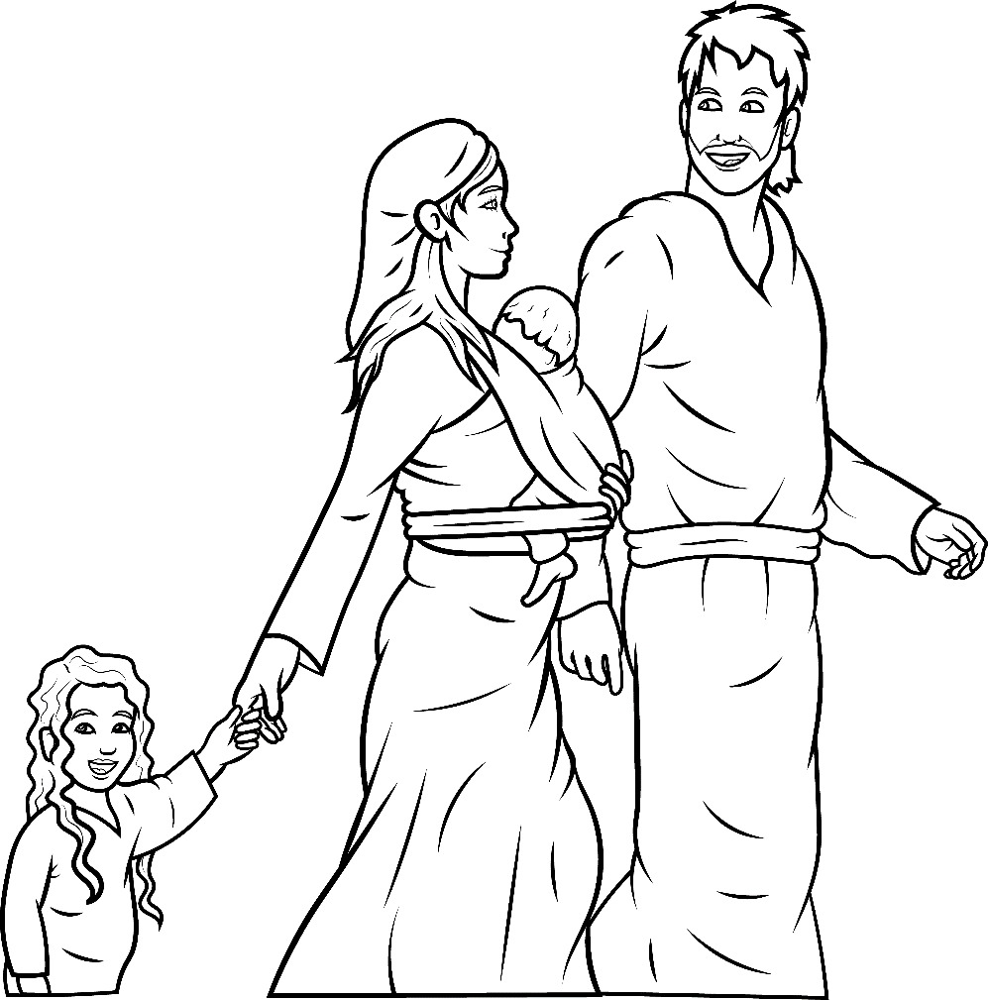
Children, moms, and dads went home happy and blessed.

Slide 27
The End

Slide 28
1.8 Story Without Illustrations
Jesus Loves
Children a Bunch!
Mark 10:13-16

Slide 29
What a good day it was.
Jesus was in town!
At a picnic, moms and kids had lunch. Chat, chat, chat.

Slide 30
Munch, munch, crunch…
such a glad lunch. “Jesus is here.
Let’s go see him,” the moms said.
Kids went with moms.
“Jesus will bless them,” moms said.

Slide 31
Jesus loves children so much…
a bunch!
He hugged the babies and prayed for the boys and girls.

Slide 32
“Jesus, bless my children,” a dad said. But…
The disciples said,
“Stop! Go away.
No, don’t bother Jesus.”

Slide 33
The children got sad. Jesus got mad.
He said, “Let the children come to me. Do not stop them.”
Jesus said that the Kingdom of Heaven belongs to them.

Slide 34
Children just trust God.
Jesus said, “Come back!”
Like a chicken with chicks,
Jesus loves children.
Which children?

Slide 35
He loves rich children and not rich,
big and not big.
He put his hands on the children’s chins to bless them.
He touched each little cheek.

Slide 36
Every baby he set on his lap
next to his chest.
Children, moms, and dads went
home happy and blessed.

Slide 37
The End

Slide 38
Story: Carol Hale
Illustrations: Ivan Mader
Power Point arrangements: Steve March
www.EasyReadEnglish.com
www.EZReadEnglish.org/lower-levels

Slide 39
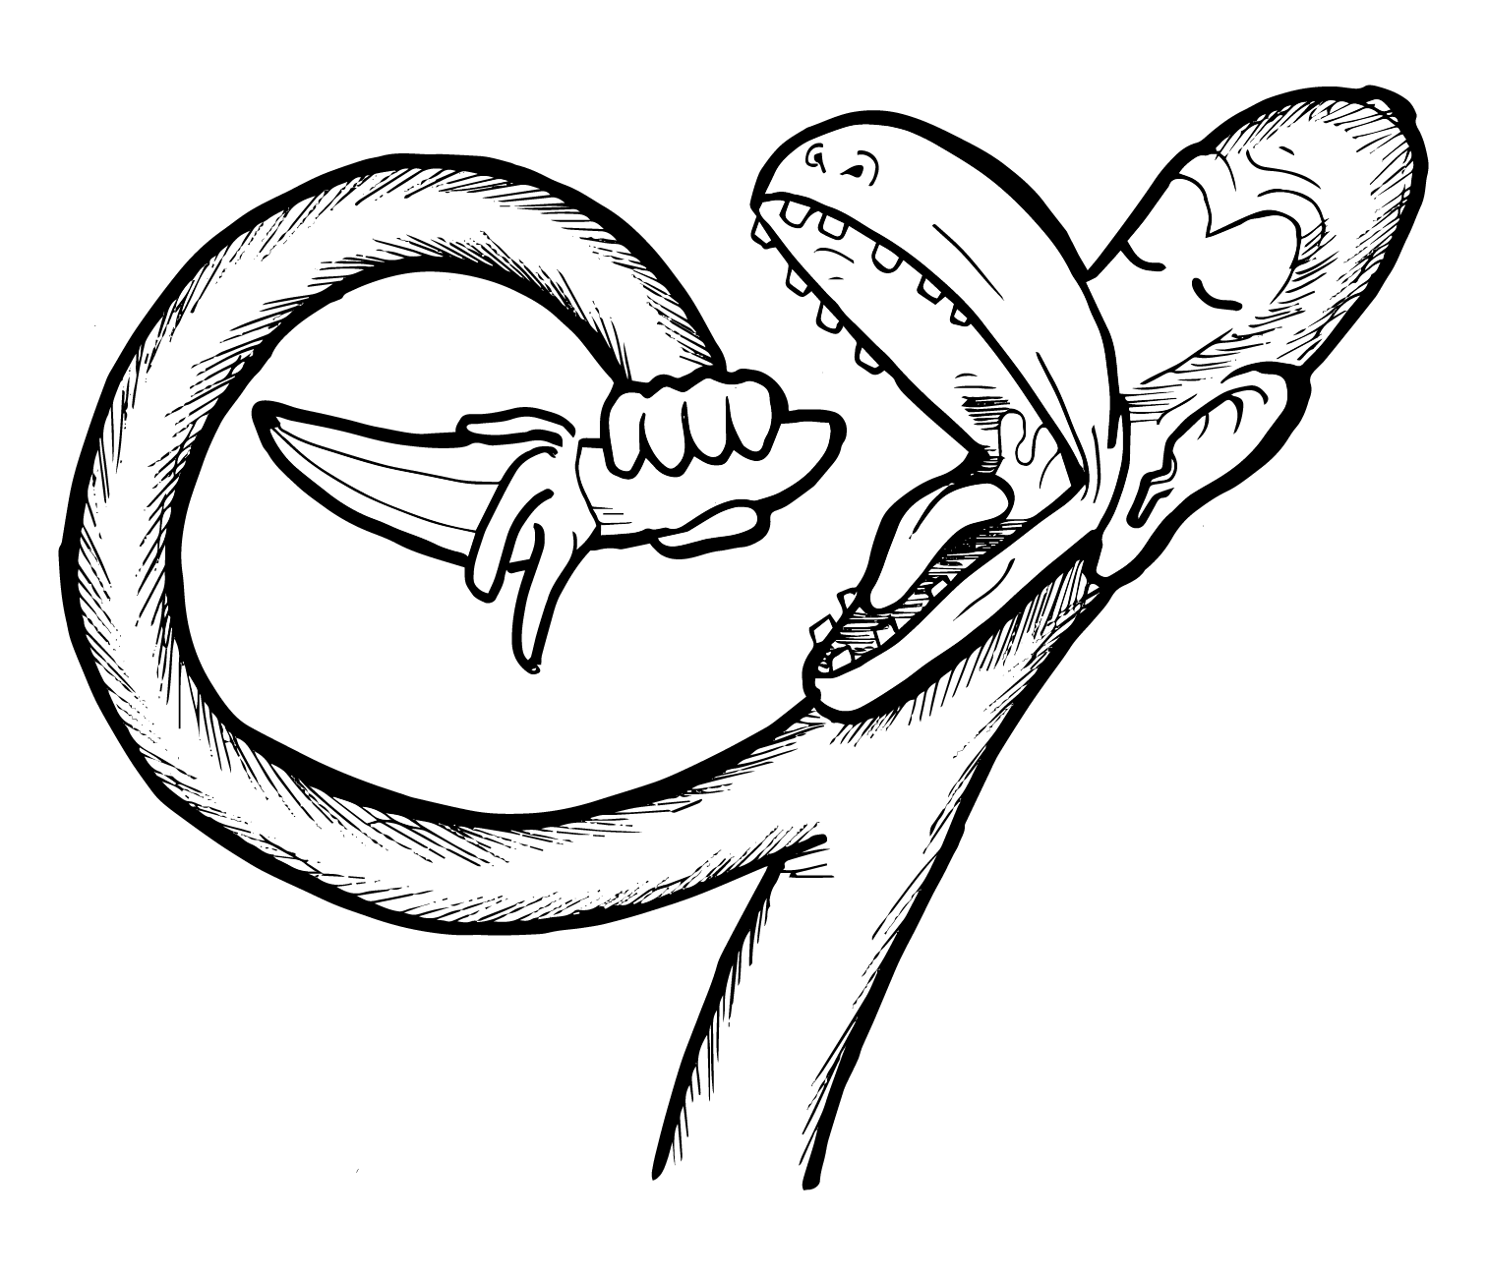
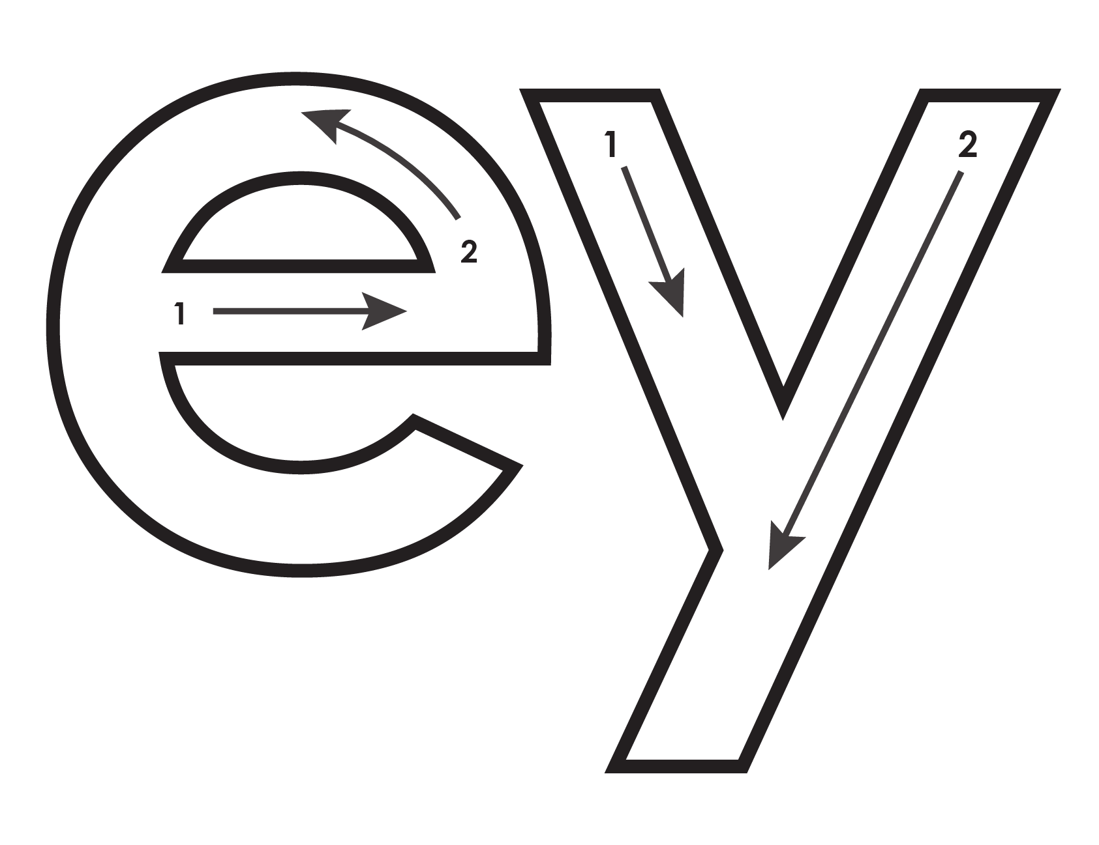
Another important teaching tool…
Easy Breezy Reading (https://www.easybreezyreading.com)
Designed to help new, struggling, and especially dyslexic learners, Easy Breezy Reading is broken up into Laughing Letters and Funny Phonograms. Both tools use illustrated patterns that mimic the shapes of the letters to give your students one more sense to link the phonetic sound of the letters.
ey
monk
Our scope and sequence matches Easy Read English Lower Levels. Progressing through the Easy Breezy Reading curriculum is sure to accelerate your students’ comprehension of the written English language.
You can procure Laughing Letters or Funny Phonograms through our website.
https://www.easybreezyreading.com/curriculum

