Slide 1
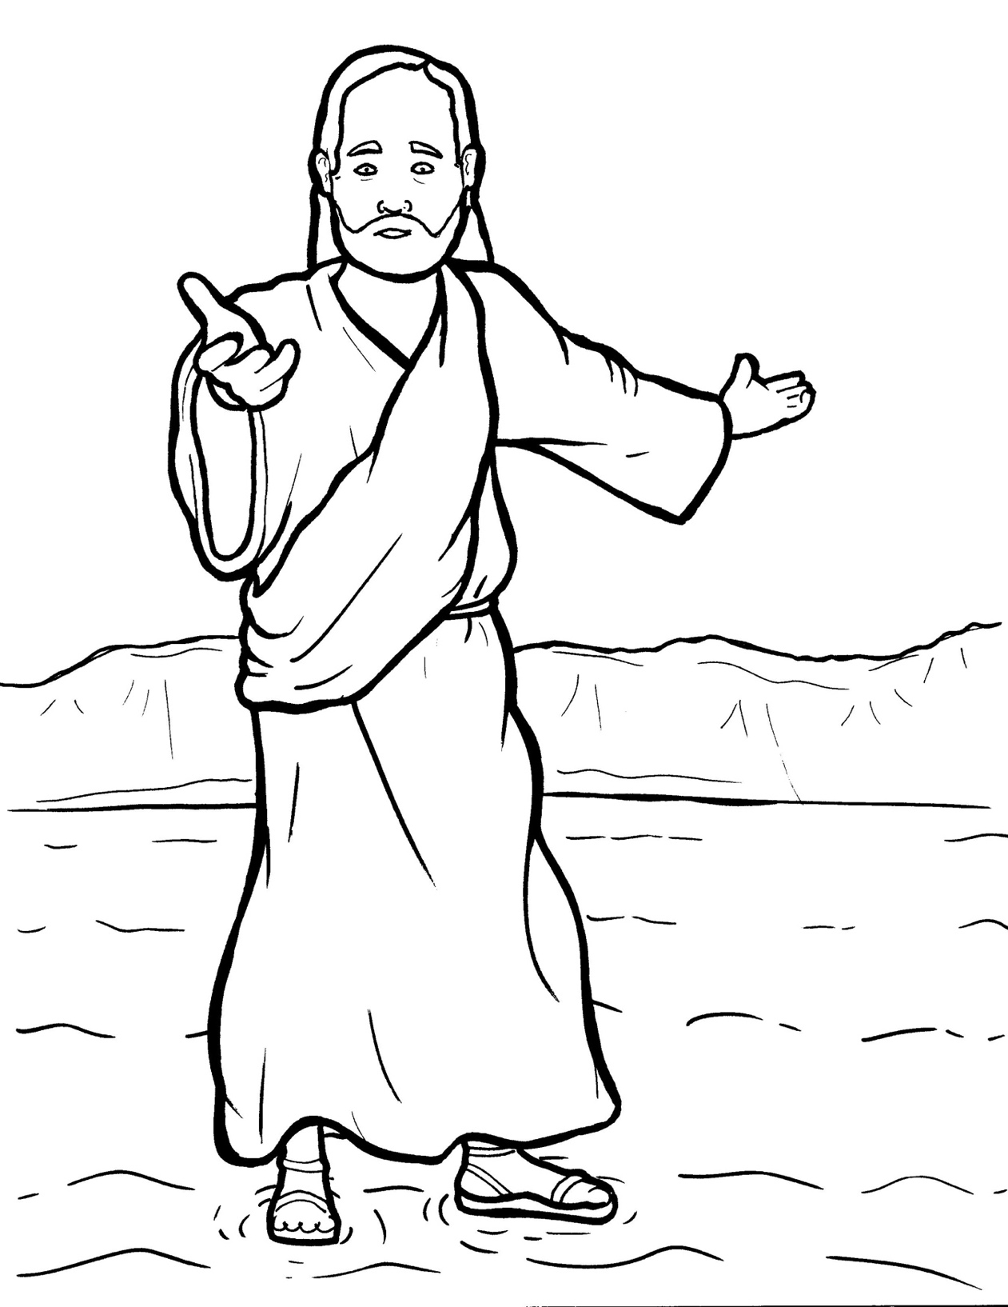
19. Jesus Walks on the Water
Part 5
Vocabulary
Original Bible Story

Slide 2
Vocabulary

Slide 3
immediately
(im – ME – di – ate – ly):
right away

Slide 4
contrary
(con - TRAR - y):
against

Slide 5
multitude
(MUL – ti – tude):
a crowd

Slide 6
doubt
(doubt):
to not believe

Slide 7
distressed
(dis – TRESS – ed):
in trouble

Slide 8
cease
(cease):
to stop

Slide 9
Jesus Walks on the Water
Matthew 14:22-32
World English Bible (WEB)

Slide 10
Immediately, Jesus made the disciples get into the boat and go ahead of him to the other side, while he sent the multitudes away.

Slide 11
After he had sent the multitudes away, he went up into the mountain by himself to pray.

Slide 12
When evening had come, he was there alone. But the boat was now in the middle of the sea, distressed by the waves, for the wind was contrary.

Slide 13
In the fourth watch of the night, Jesus came to them, walking on the sea.

Slide 14
When the disciples saw him walking on the sea, they were troubled, saying, “It’s a ghost!” and they cried out for fear.

Slide 15
But immediately Jesus spoke to them, saying,
“Cheer up! It is I! Don’t be afraid.”

Slide 16
Peter answered him and said, “Lord, if it is you, command me to come to you on the waters.”
He said, “Come!”

Slide 17
Peter stepped down from the boat and walked on the waters to come to Jesus.

Slide 18
But when he saw that the wind was strong, he was afraid, and beginning to sink, he cried out, saying, “Lord, save me!”

Slide 19
Immediately, Jesus stretched out his hand, took hold of him, and said to him, “You of little faith, why did you doubt?”

Slide 20
When they got up into the boat, the wind ceased.

Slide 21
Those who were in the boat came and worshipped him, saying, “You are truly the Son of God!”

