Slide 1
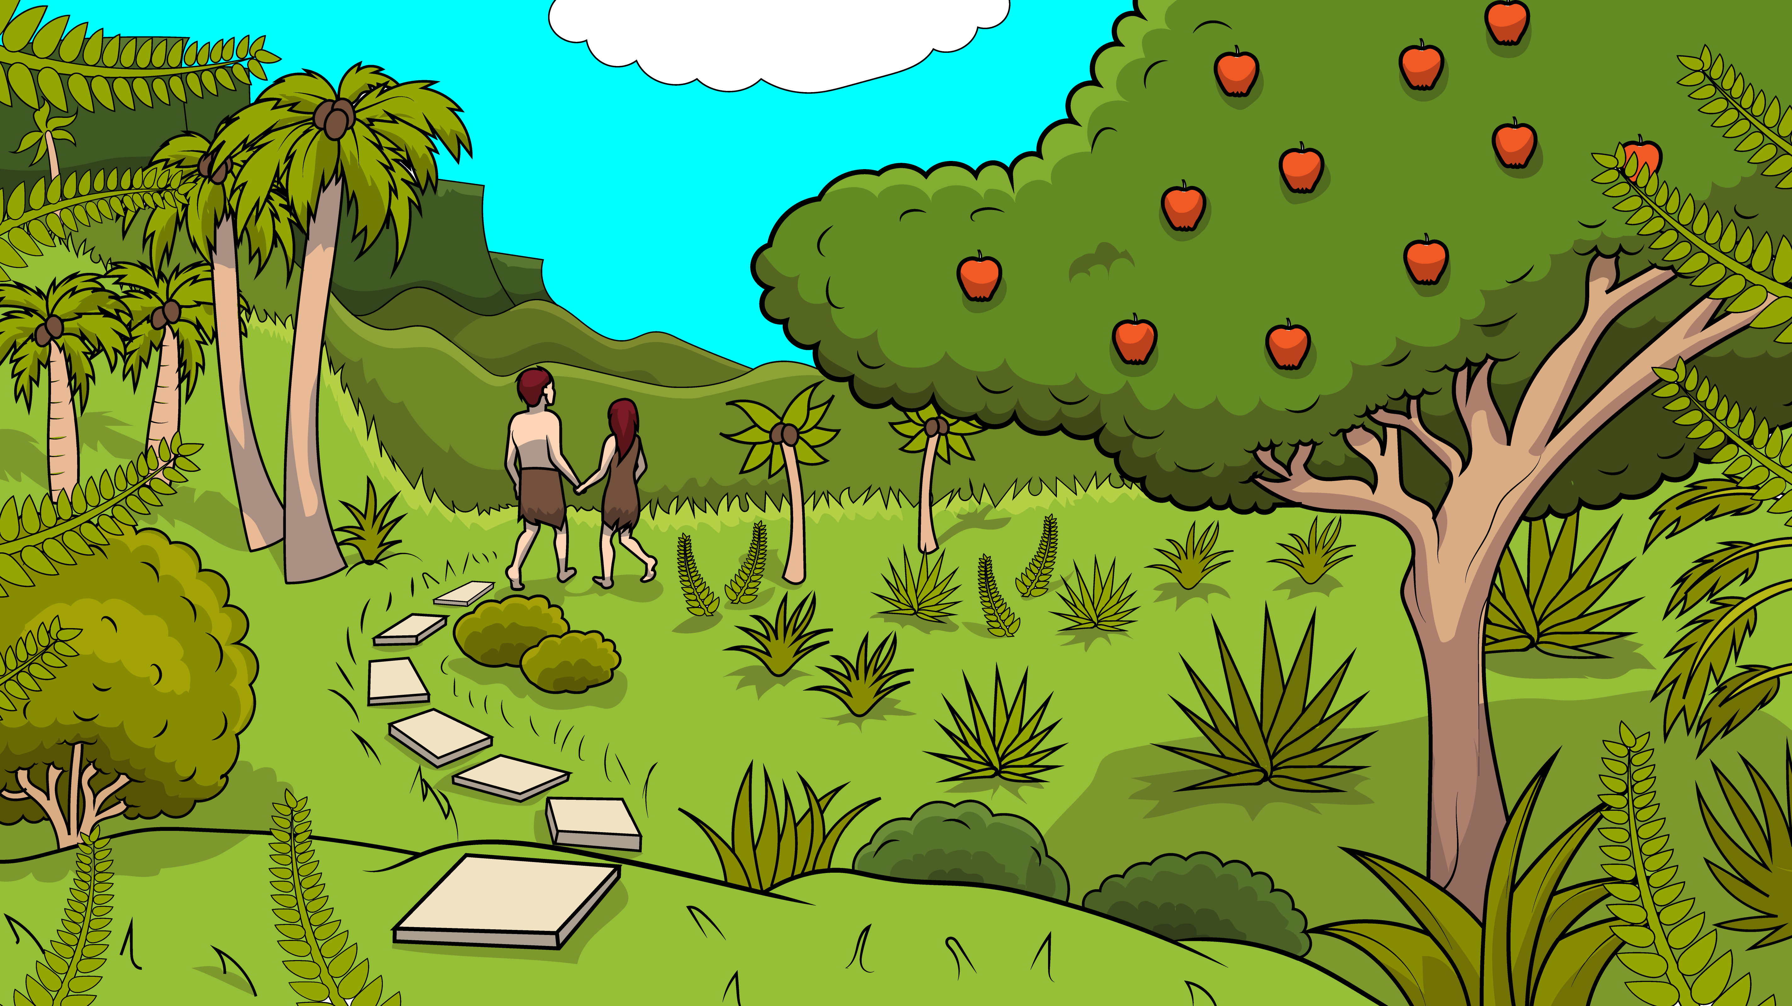
1.1 Song
Bad, Mad, Sad
(Adam and Eve, Part One)

Slide 2
God said, “Do not have an apple.”

Slide 3
But, the woman
had an apple.

Slide 4
And the man had an apple too.

Slide 5
And the man had an apple too.

Slide 6
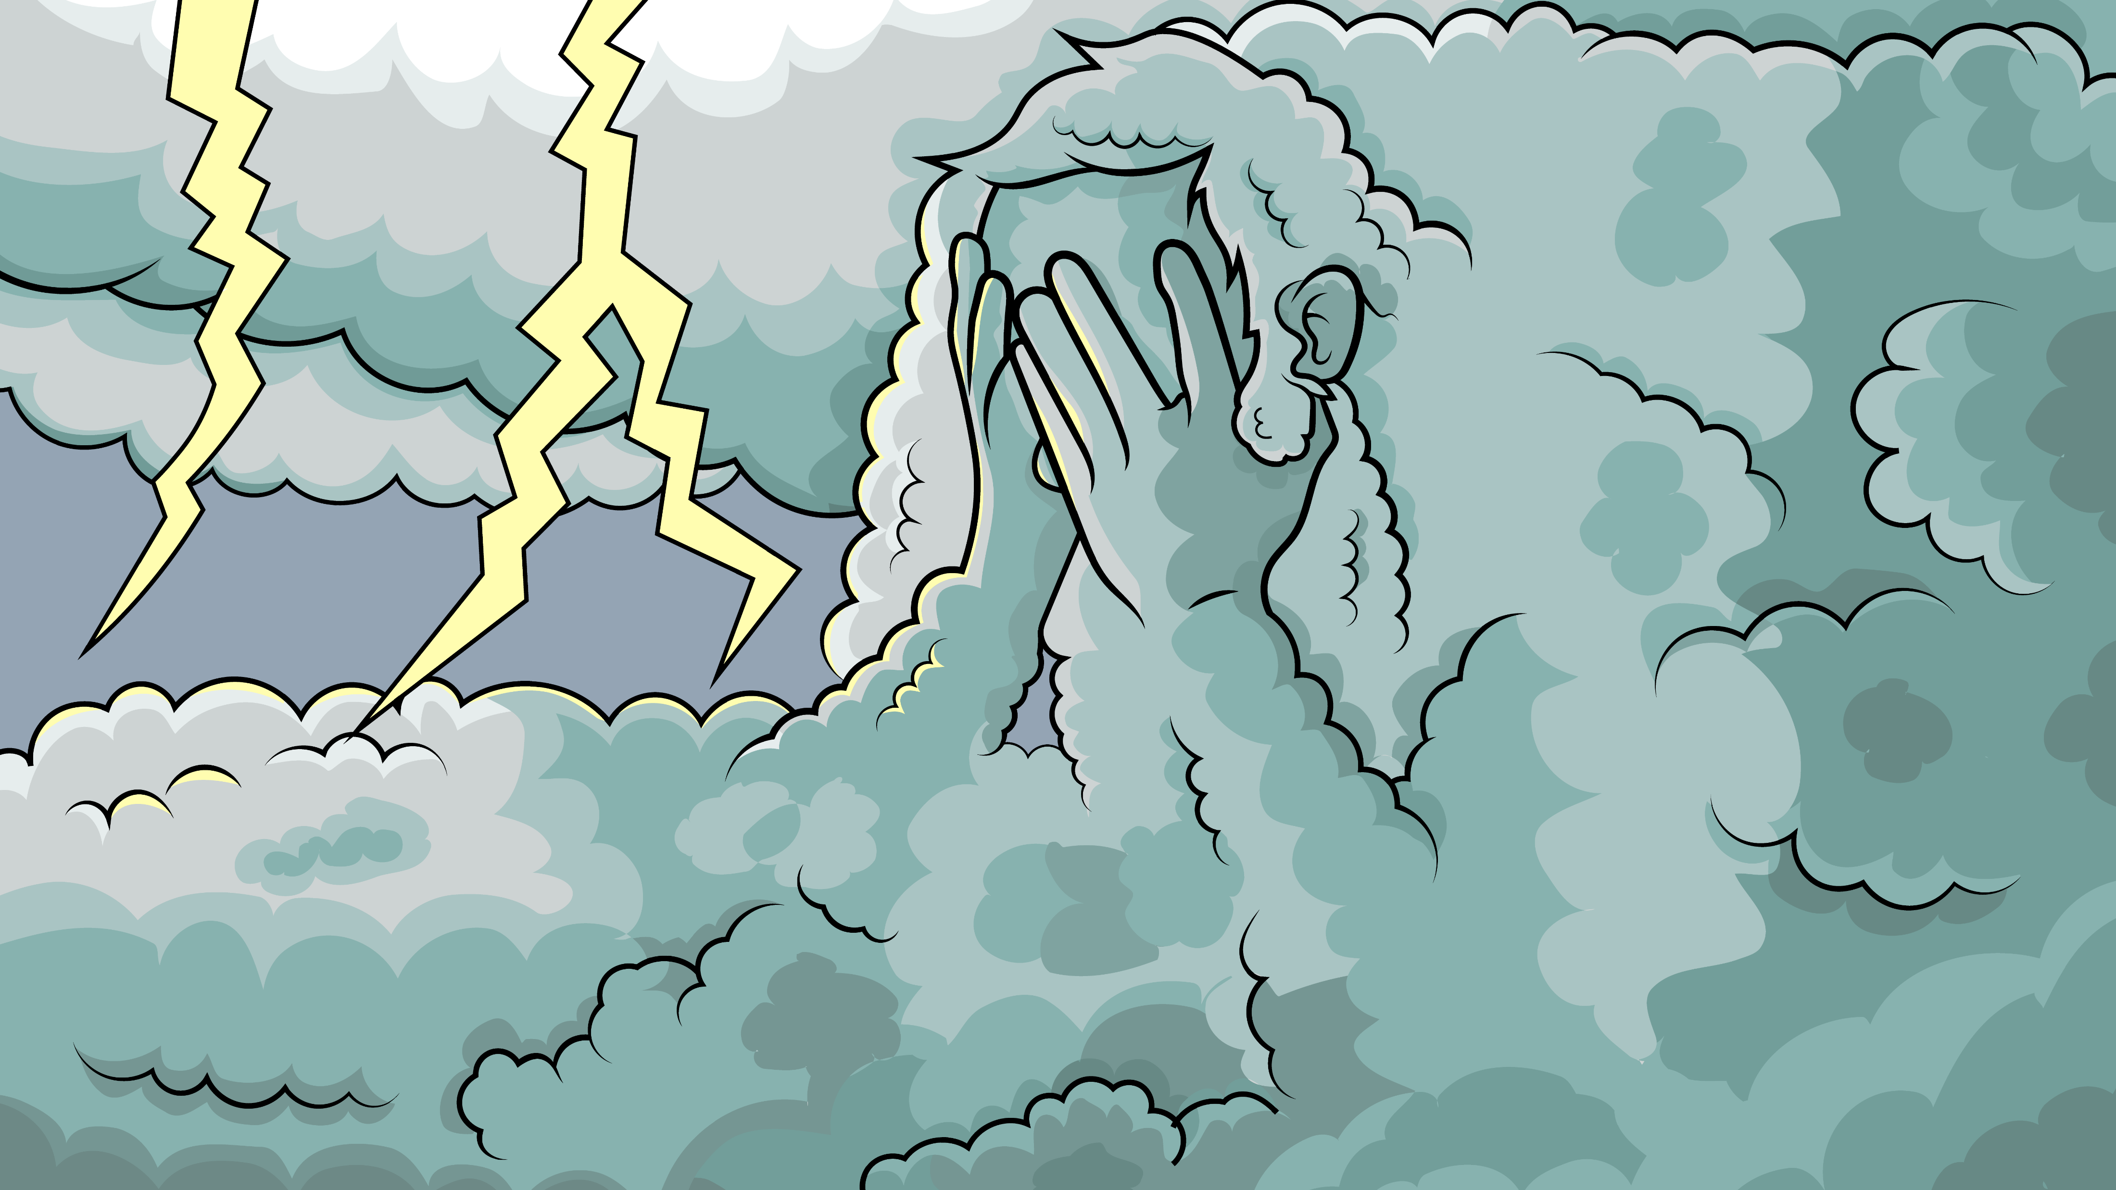
God said, “Oh no. That is bad, bad, bad.”

Slide 7
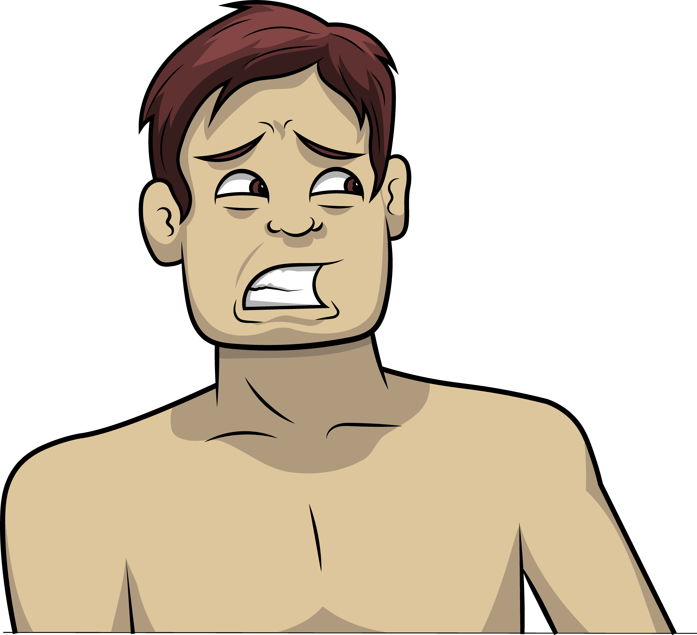
“I am mad.
I am mad at Adam.”

Slide 8
I am mad
at Eve.

Slide 9
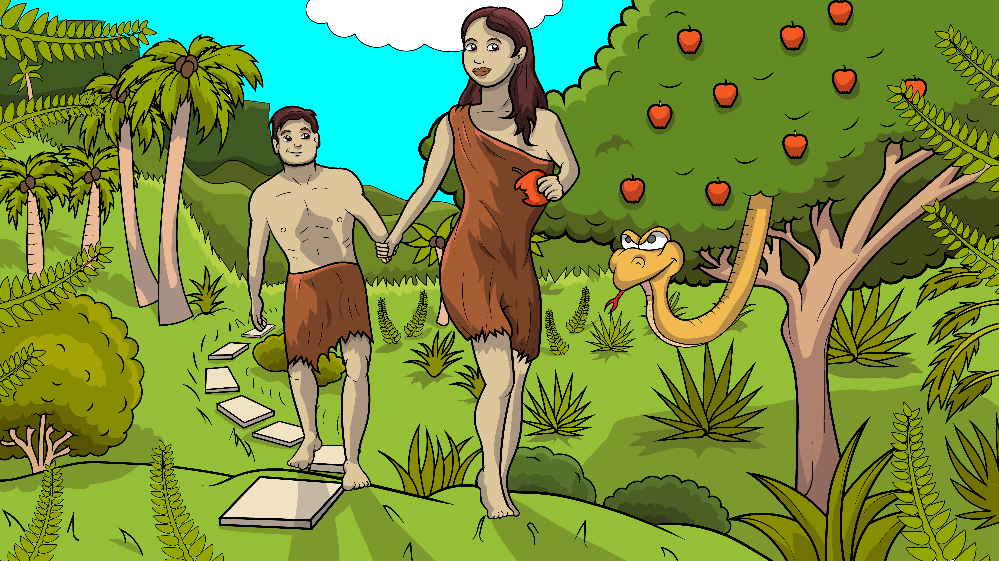
So, they had to leave.

Slide 10
God said, “Do not have an apple.”

Slide 11
But, the woman
had an apple.

Slide 12
And the man had an apple too.

Slide 13
And the man had an apple too.

Slide 14
God said, “Oh no. That is bad, bad, bad.”

Slide 15
“I am mad.
I am mad at Adam.”

Slide 16
I am mad
at Eve.

Slide 17
So, they had to leave.

Slide 18
So, they had to leave.

Slide 19
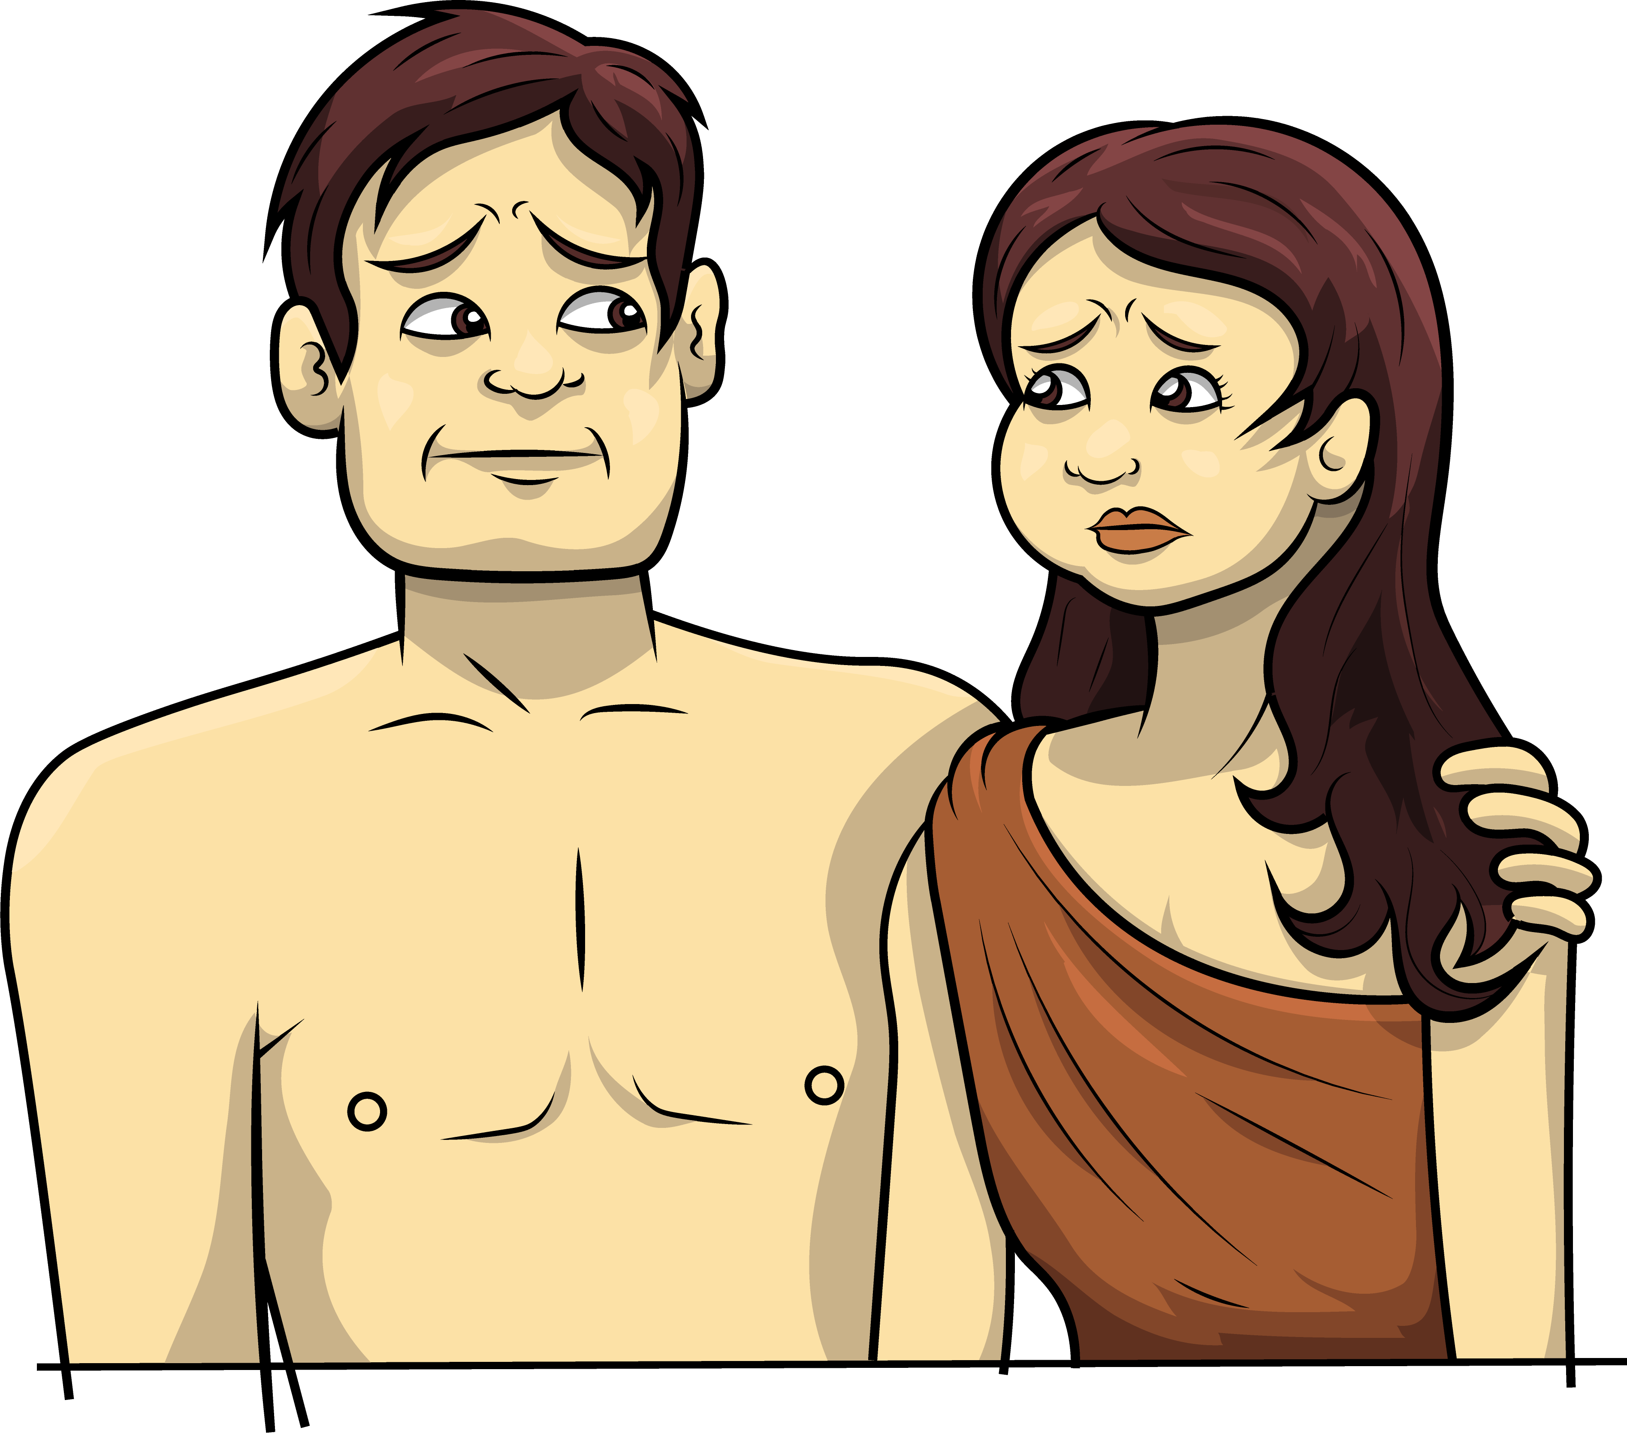
They were bad and so God was mad
and sad, and now they were all sad.

Slide 20
Sin makes us bad, mad, and sad.
b
d
m
d
s
d

Slide 21
The End

Slide 22
Song Lyrics: Carol Hale
Song Melody, Arrangements, and Singer: Steffi VornBerger
Illustrations: Ivan Mader
Power Point Arrangements: Steve March
www.EasyReadEnglish.com

Slide 23
God said, “Oh no. That is bad, bad, bad.”

