Slide 1
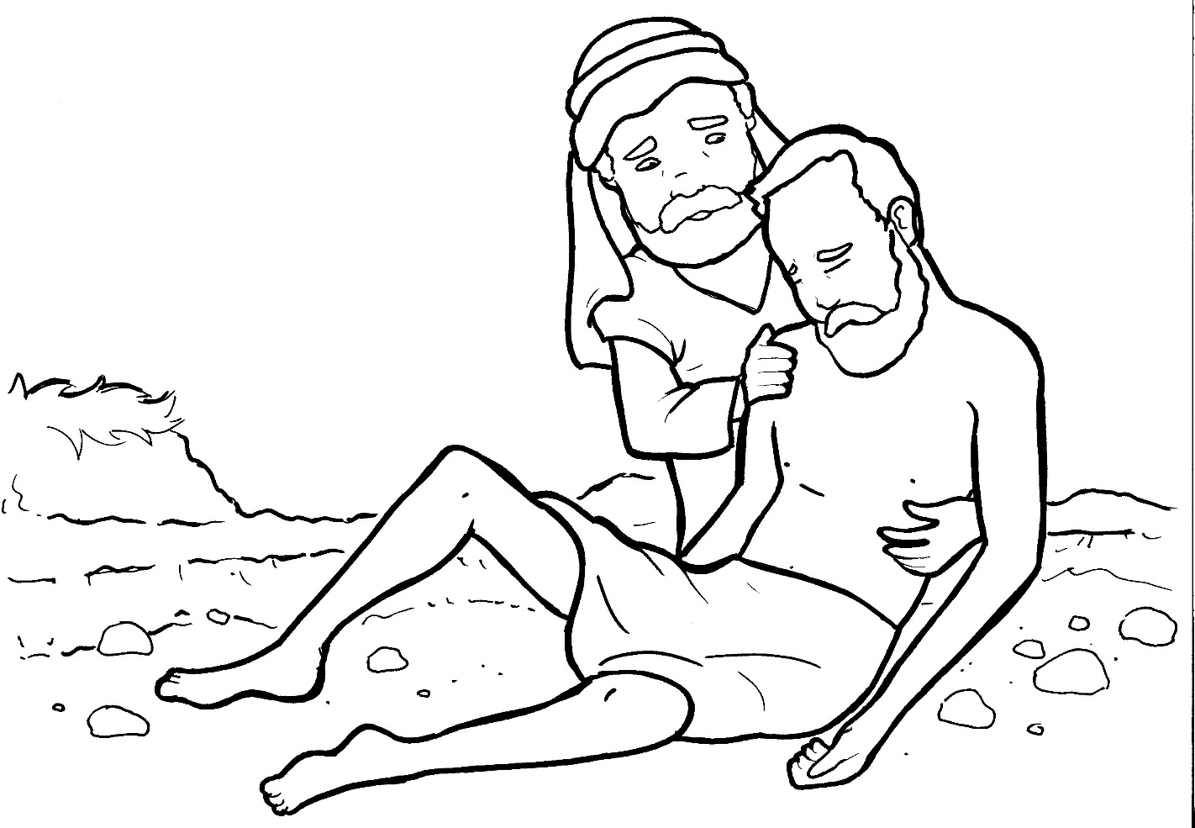
Part 4
25. The Good Samaritan
Story in Easy Read English
Questions
Story in Phrases

Slide 2
A Jewish teacher asked Jesus, “Who is
my neighbor?”

Slide 3
So, Jesus told him a story:

Slide 4
A man was going to Jericho, but
robbers beat him up!

Slide 5
They stole his clothes.

Slide 6
When the robbers left, he was almost
dead.

Slide 7
A Jewish priest walked by and saw
the man lying there.

Slide 8
The priest just walked to the other
side of the road.

Slide 9
A Levite also passed by on the other
side of the road.

Slide 10
But a Samaritan saw the hurting man
and felt bad for him.

Slide 11
The Samaritan took care of him.

Slide 12
He cleaned his sores.

Slide 13
He put the man on his donkey and
took him to an inn.

Slide 14
He gave the innkeeper money to
help the hurting man.

Slide 15
Jesus asked, “Which man in the story
was the true neighbor –

Slide 16
the priest, the Levite, or the
Samaritan?”

Slide 17
“The Samaritan,” said the teacher.

Slide 18
Jesus replied, “Go and do the same.”

Slide 19
Question 1
Why was the Samaritan in this story praised by Jesus?

Slide 20
Question 2
What did Jesus tell the teacher to do at the end of the story?

Slide 21
Question 3
What do good neighbors do for each other?

Slide 22
Question 4
Think about someone who is hurting on the inside or the outside. What can you do to help?

Slide 23
Prayer
Dear Jesus,
I am sorry for the times that I could have helped someone and did not. Please help me to become a better helper.
Amen

Slide 24
The Good Samaritan
Phrased for Fluency

Slide 25
A Jewish teacher
asked Jesus,
“Who is my neighbor?”

Slide 26
So,
Jesus told him
a story:

Slide 27
A man
was going
to Jericho,
but robbers
beat him up!

Slide 28
They stole
his clothes.

Slide 29
When the robbers left,
he was
almost dead.

Slide 30
A Jewish priest
walked by
and saw the man
lying there.

Slide 31
The priest
just walked
to the other side
of the road.

Slide 32
A Levite also
passed by
on the other side
of the road.

Slide 33
But
a Samaritan
saw
the hurting man
and felt bad
for him.

Slide 34
The Samaritan
took care of him.
He cleaned
his sores.

Slide 35
He put the man
on his donkey
and took him
to an inn.

Slide 36
He gave
the innkeeper
money to help
the hurting man.

Slide 37
Jesus asked,
“Which man
in the story
was the true neighbor -
the priest,
the Levite,
or the Samaritan?”

Slide 38
“The Samaritan,”
said the teacher.

Slide 39
Jesus replied,
“Go
and do the same.”

