Slide 1

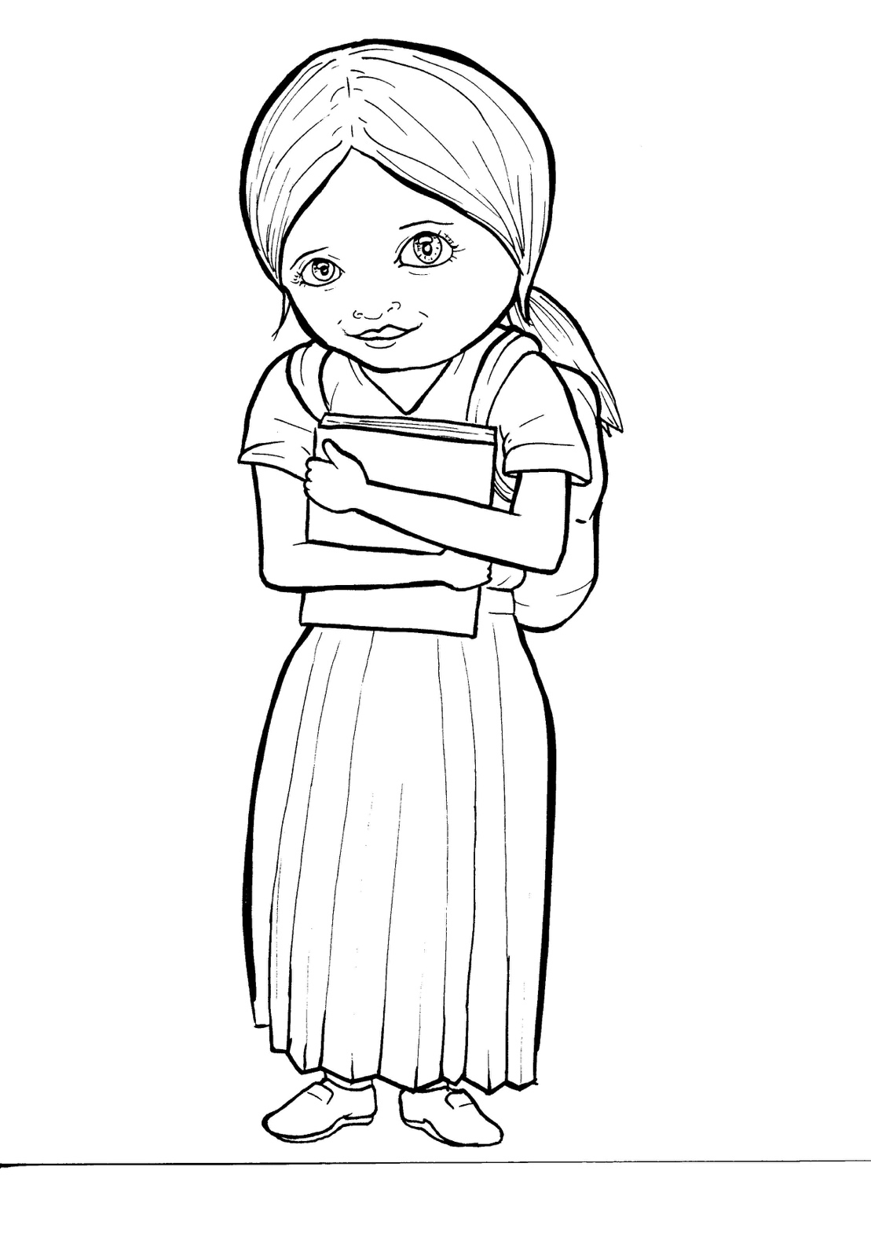
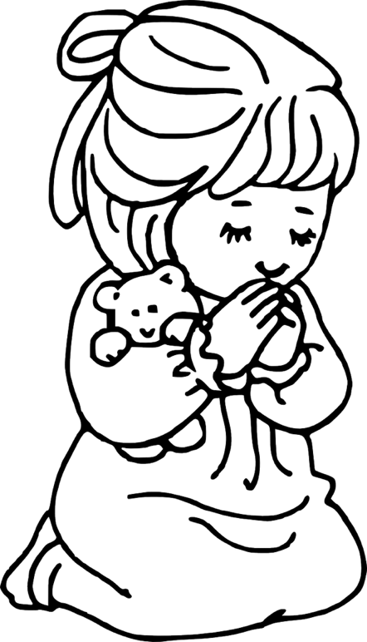
49. Growing as a Christian
Part 3
Syllable Divisions

Slide 2
Dividing Words
Into Syllables

Slide 3
Rabbit Words
When you see two consonants
between two vowels,
divide between the consonants.
ra it
bb
rab bit

Slide 4
ef fort
effort

Slide 5
sis ters
sisters

Slide 6
Chris tian
Christian

Slide 7

Tiger Words
When you see one consonant
between two vowels,
divide after the first vowel.
Try this pattern first.
ti er
g
ti ger

Slide 8
e ven
even

Slide 9
Je sus
Jesus

Slide 10
be liev ers
believers

Slide 11
si lent
silent

Slide 12
o pen
open

Slide 13
Camel Words
When you see one consonant
between two vowels,
divide after the first consonant.
Try this pattern second.
ca el
m
cam el

Slide 14
prob ab ly
probably

Slide 15
Turtle Words
When you see consonant-le,
count back three and divide.
tur
t
l
e
tur tle

Slide 16
Bi ble
Bible

Slide 17
Anteater Words
These compound words are made up of two smaller words.
ant
eater
1
2
ant eater

Slide 18
with out
without

Slide 19
any time
anytime

Slide 20
sun shine
sunshine

Slide 21
any where
anywhere

Slide 22
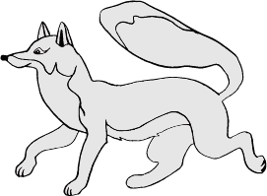
Foxes Suffixes
Focus on your base word.
fox es
fox es

Slide 23
need y
needy

Slide 24
pray er
prayer

Slide 25

teach er
teacher

Slide 26
church es
churches

Slide 27
grow ing
growing

Slide 28
believ ing
believing

Slide 29
closed
closed

Slide 30
called
called

Slide 31
Other Syllable Divisions
Some words don’t fit so neatly
into standard syllable division patterns.

Slide 32
a bout
about

