Slide 1
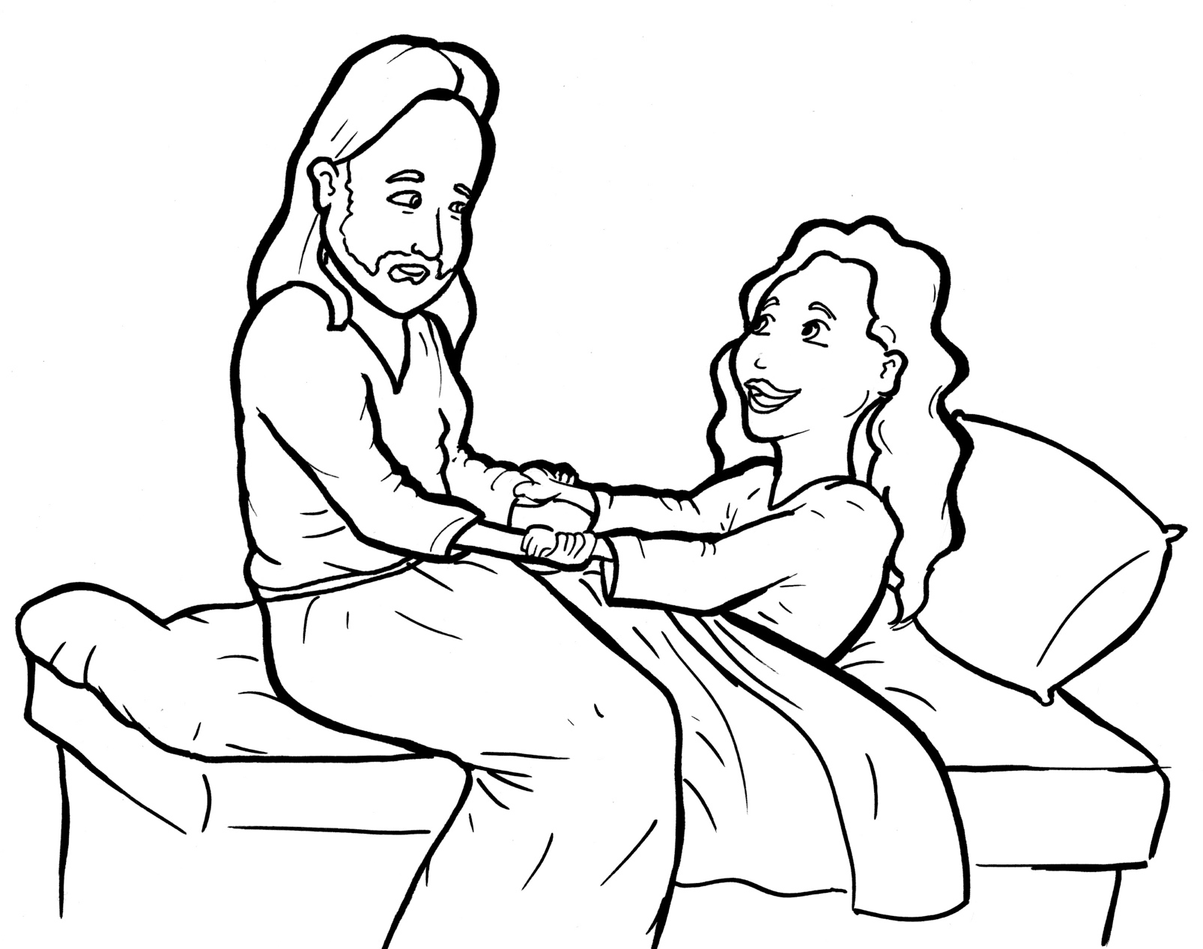
Part 2
30. Jesus Raises a Dead Girl to Life
New Words
Rule Breakers

Slide 2
Other Sounds – Soft C
ce, ci, cy make the soft sound
cent
city
fancy

Slide 3
since
face

Slide 4
Silent Letters
daughter

Slide 5
Contractions
The first word stays the same,
and the apostrophe takes the place
of the missing letters in the second word.
do
n’t
=
do
not

Slide 6
Possessives
Timing
Box
Jairus’ home

Slide 7
New Words
daughter
Jairus

Slide 8
Rule Breakers
Words like these do not follow phonetic patterns.
to
you
said
could
two
f
from

Slide 9
is
of
do
the
to
was

Slide 10
put
your
were
walk
you
only

Slide 11
come
father
some
everyone
course
anymore

Slide 12
laughed
don’t
live
said
many
they

