Slide 1
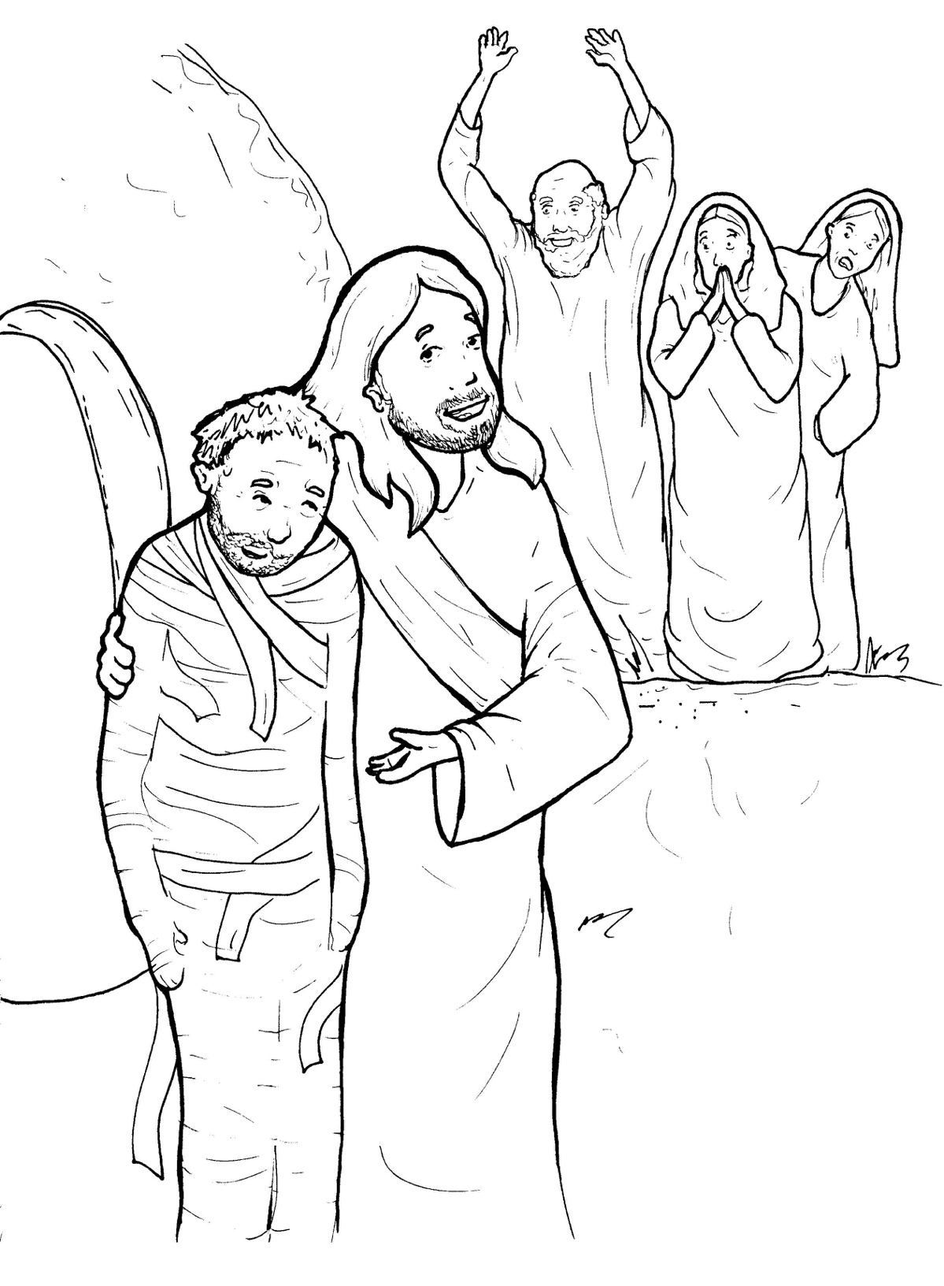
Part 4
33. Lazarus Lives Again
Story in Easy Read English
Questions
Story in Phrases

Slide 2
Jesus’ friend Lazarus became
very sick.

Slide 3
His sisters were Mary and
Martha.

Slide 4
Jesus said, “This sickness will
not end in death but will
bring glory to God.”

Slide 5
When Jesus got to Lazarus, he
had been buried for four days.

Slide 6
Martha said, “Lord, if you
had been here,

Slide 7
my brother would not
have died.”

Slide 8
“Your brother will rise again,”
Jesus said.

Slide 9
“I am the resurrection
and the life.

Slide 10
Whoever believes in me,
will live again.

Slide 11
Do you believe this?”
“Yes, Lord,” she said,

Slide 12
“I believe that you are the
Messiah, the Son of God.”

Slide 13
Many people wept for Lazarus.
Jesus wept.

Slide 14
The body was in a cave
with a big rock in front.

Slide 15
Jesus said, “If you believe,
you’ll see the glory of God.”

Slide 16
Jesus commanded,
“Take away the rock.”

Slide 17
The men rolled away the rock.

Slide 18
Jesus prayed and called
in a loud voice,
“Lazarus, come out.”

Slide 19
The dead man came to life!

Slide 20
He walked out of the tomb!

Slide 21
Lazarus was still wrapped
in his grave clothes.

Slide 22
After this powerful miracle,
many of the Jews
believed in Jesus.

Slide 23
Question 1
What did Jesus do that showed the glory of God?

Slide 24
Question 2
How did he do it?

Slide 25
Question 3
How are people healed today?

Slide 26
Question 4
How can you use the power of God to help someone who is sick or hurt?

Slide 27
Prayer
Dear Lord,
I believe you are God Almighty and have the power to heal sicknesses as well as to raise the dead. Please help my friend get over his or her illness. Thank you.
Amen

Slide 28
Lazarus
Lives Again
Phrased for Fluency

Slide 29
Jesus’ friend
Lazarus
became very sick.

Slide 30
His sisters were
Mary and Martha.

Slide 31
Jesus said,
“This sickness
will not end
in death
but will bring
glory to God.”

Slide 32
When Jesus got
to Lazarus,
he had been buried
for four days.

Slide 33
Martha said,
“Lord,
if you had been here,

Slide 34
my brother
would not
have died.”

Slide 35
“Your brother
will rise again,”
Jesus said.

Slide 36
“I am
the resurrection
and the life.

Slide 37
Whoever
believes in me,
will live again.

Slide 38
Do you
believe this?”
“Yes, Lord,”
she said,

Slide 39
“I believe that you
are the Messiah,
the Son of God.”

Slide 40
Many people
wept
for Lazarus.
Jesus wept.

Slide 41
The body
was in a cave
with a big rock
in front.

Slide 42
Jesus said,
“If you believe,
you’ll see
the glory of God.”

Slide 43
Jesus commanded,
“Take away
the rock.”

Slide 44
The men
rolled away
the rock.

Slide 45
Jesus prayed
and called
in a loud voice,
“Lazarus,
come out.”

Slide 46
The dead man
came to life!

Slide 47
He walked
out of the tomb!

Slide 48
Lazarus was
still wrapped
in his grave clothes.

Slide 49
After this
powerful miracle,
many of the Jews
believed in Jesus.

