Slide 1

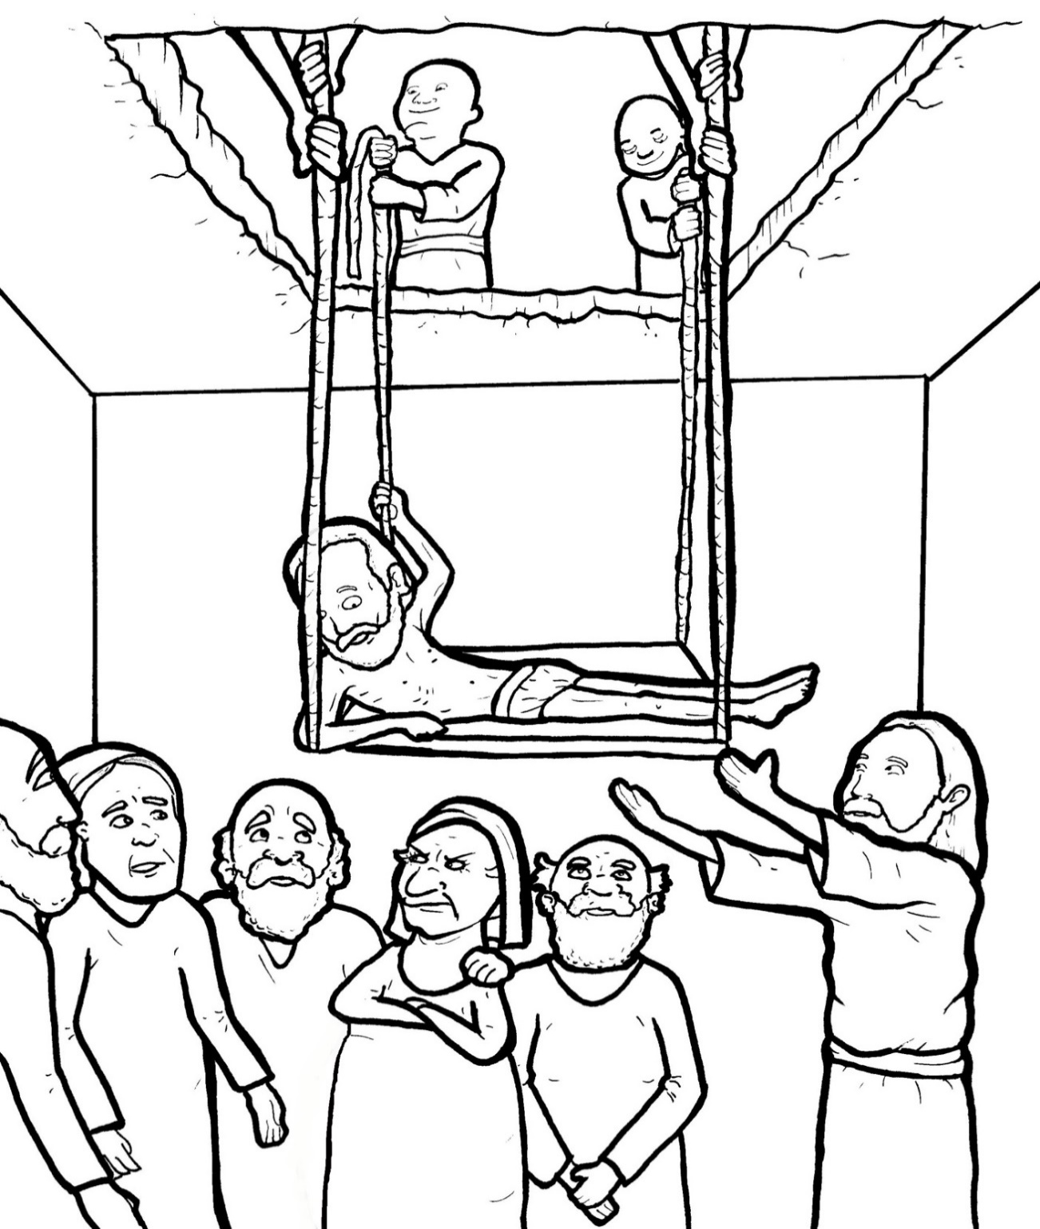
Part 5
29. Friends Bring a Crippled Man to Jesus
Vocabulary
Original Bible Story

Slide 2

Vocabulary

Slide 3
paralyzed
(PAR - a - lyzed)
not being
able to move

Slide 4
multitude
(MUL - ti - tude)
a crowd

Slide 5
perceive
(per - CEIVE)
to
understand

Slide 6
authority
(au- THOR- i- ty)
power to make decisions

Slide 7
departed
(de - PART - ed)
went away

Slide 8
sought
(sought)
looked for

Slide 9
Friends Bring a Crippled Man to Jesus
Luke 5:17-26
World English Bible (WEB)

Slide 10
On one of those days,
he was teaching;

Slide 11
and there were Pharisees and
teachers of the law sitting by,

Slide 12
who had come out of every
village of Galilee, Judea,
and Jerusalem.

Slide 13
The power of the Lord
was with him to heal them.

Slide 14
Behold, men brought a
paralyzed man on a cot,

Slide 15
and they sought to bring him in
to lay before Jesus.

Slide 16
Not finding a way to bring him in
because of the multitude,
they went up to the housetop,

Slide 17
and let him down through the tiles
with his cot into the middle
before Jesus.

Slide 18
Seeing their faith, he
said to him, “Man,
your sins are forgiven you.”

Slide 19
The scribes and the Pharisees
began to reason, saying,

Slide 20
“Who is this who speaks
blasphemies?

Slide 21
Who can forgive sins,
but God alone?”

Slide 22
But Jesus,
perceiving their thoughts,
answered them,

Slide 23
“Why are you reasoning
so in your hearts?

Slide 24
Which is easier to say,
‘Your sins are forgiven you;’
or to say, ‘Arise and walk?’

Slide 25
But that you may know that
the Son of Man has authority
on earth to forgive sins

Slide 26
(he said to the paralyzed man),
“I tell you,
arise, take up your cot,
and go to your house.”

Slide 27
Immediately
he rose up before them, and

Slide 28
took up that
which he was laying on,

Slide 29
and departed to his house,
glorifying God.

Slide 30
Amazement took hold on all,
and they glorified God.

Slide 31
They were filled with fear,
saying, “We have seen
strange things today.”

