Slide 1
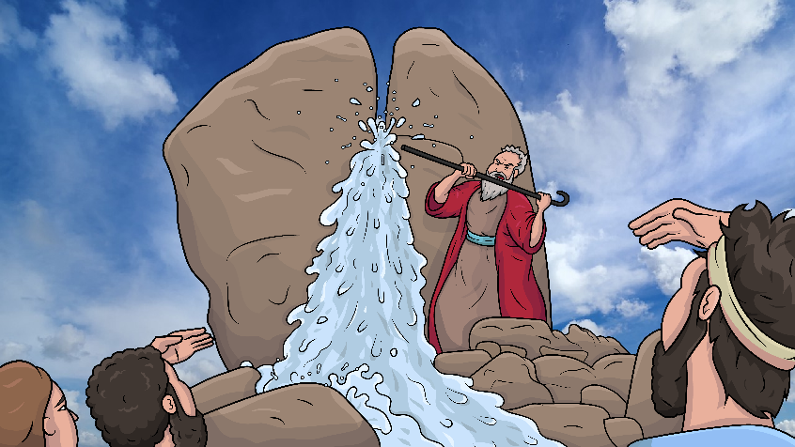
Story 1.12
A Stick Struck the Rock
Story of God’s water miracle in the desert
Numbers 20:1-13 (-ck)
www.EasyReadEnglish.com

Slide 2
New Words to Read
pack smack whack
back black crack
clack lack (what you do not have)

Slide 3
quick sick stick
brick trick chicks
rock flock check

Slide 4
luck yuck suck
stuck struck

Slide 5
Sight Words
like water
our Moses

Slide 6
Rule Breakers (Read and Spell)
they said have
are his to
give

Slide 7
you again from
pulled was what

Slide 8
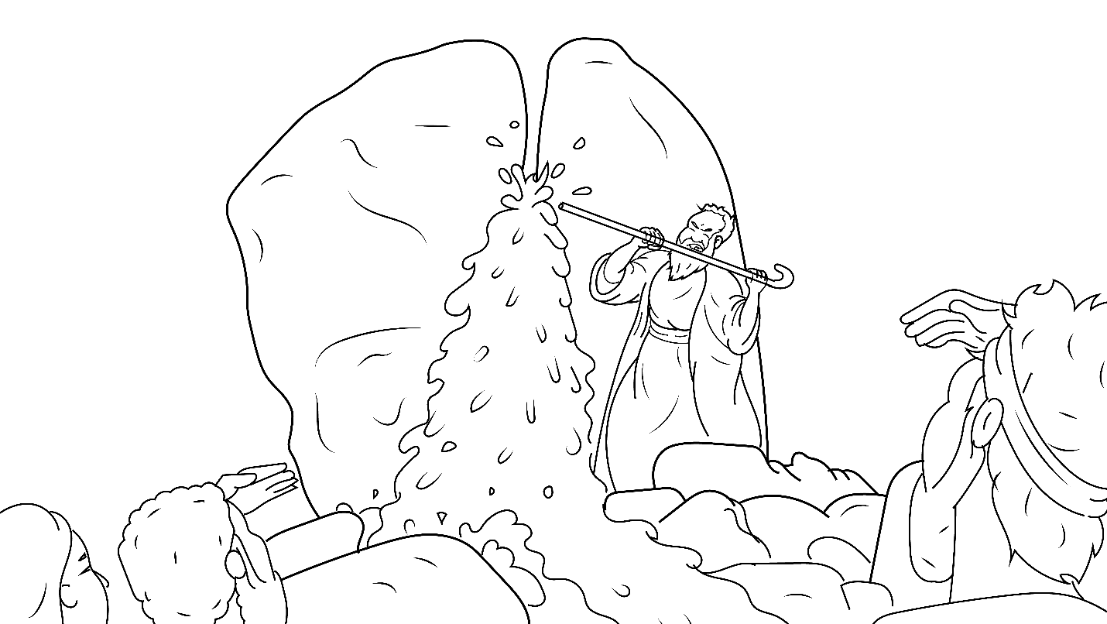
Story 1.12
A Stick Struck the Rock
I Read,
You Read
Bible Story
Story of God’s water miracle in the desert
Numbers 20:1-13 (-ck)
www.EasyReadEnglish.com

Slide 9
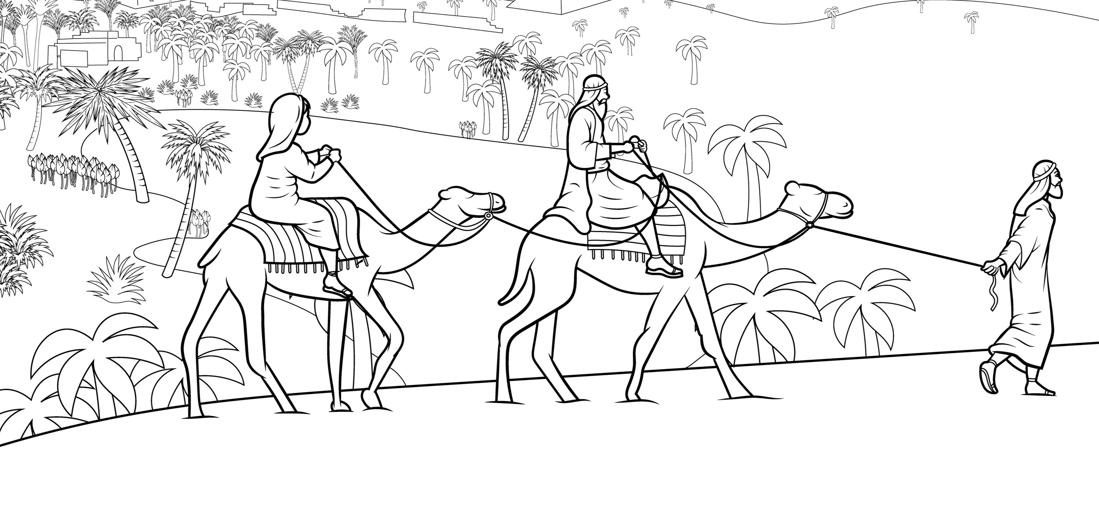
Moses led the Jews into the desert to go to their new home.

Slide 10
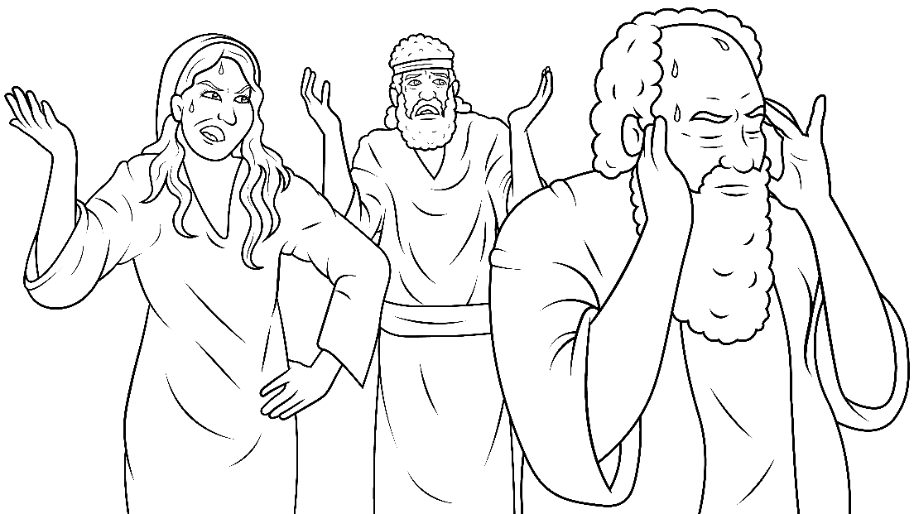
But they said, “We will pack and go back.”

Slide 11
“We lack water and all the good food we had in Egypt.”

Slide 12
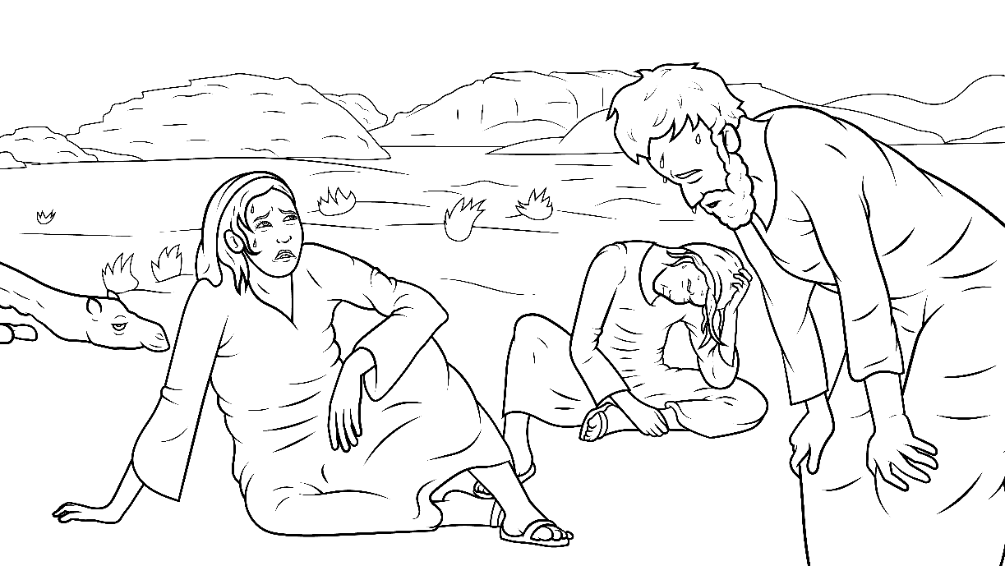
“Yuck. We have no luck. We are stuck in this hot
desert.”

Slide 13
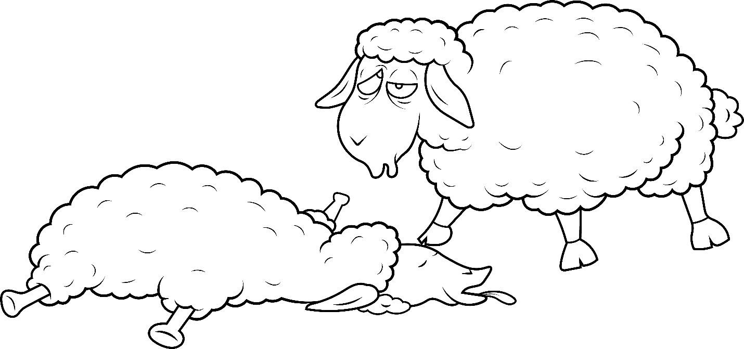
“We are thirsty. Our animals are thirsty.”

Slide 14
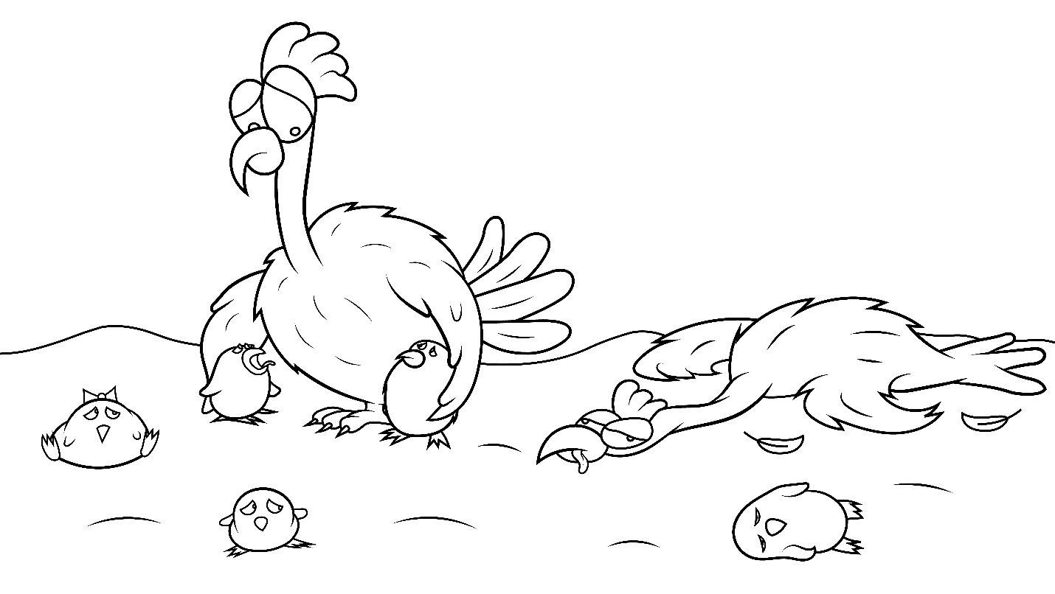
“Quick! Chicks are sick. Our flocks are sick. They will kick.”

Slide 15
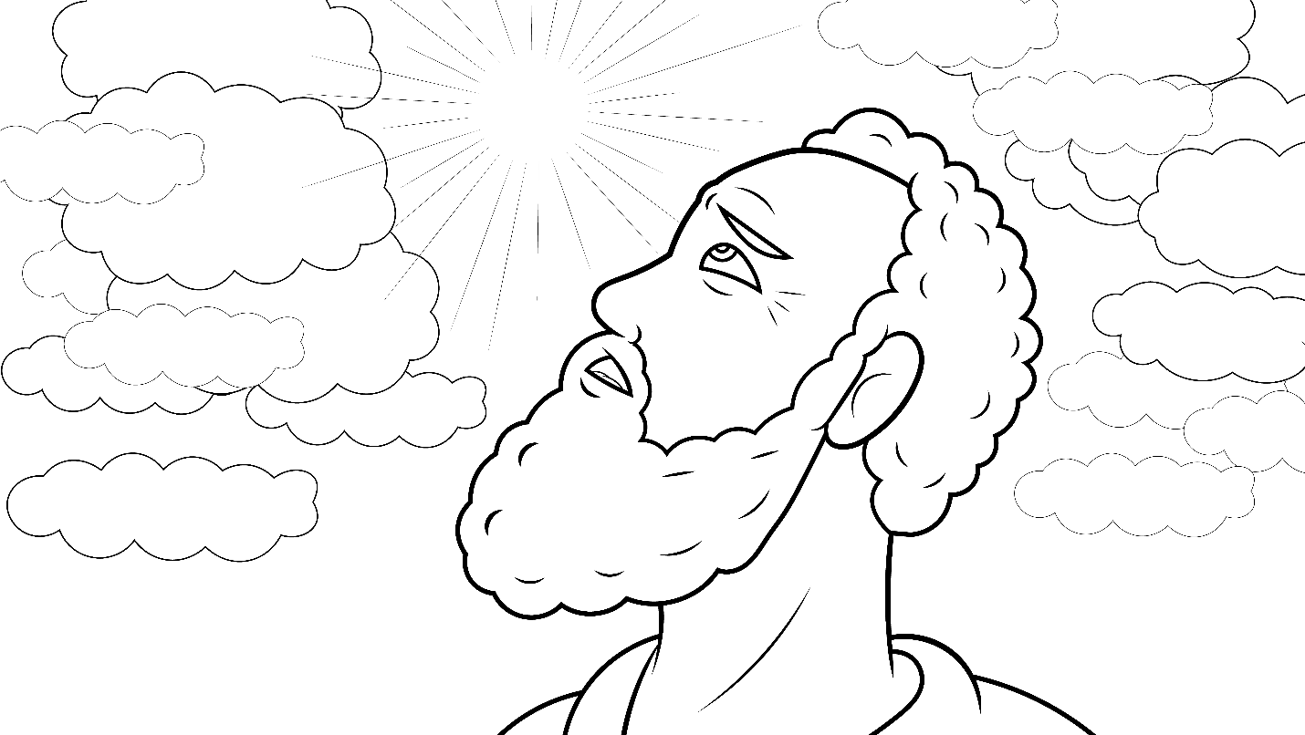
Moses went back to check with God, “Help us!”

Slide 16
God said to Moses, “I will help you. You must tell a big rock to give you water.”
What?
A rock?
Yes.

Slide 17
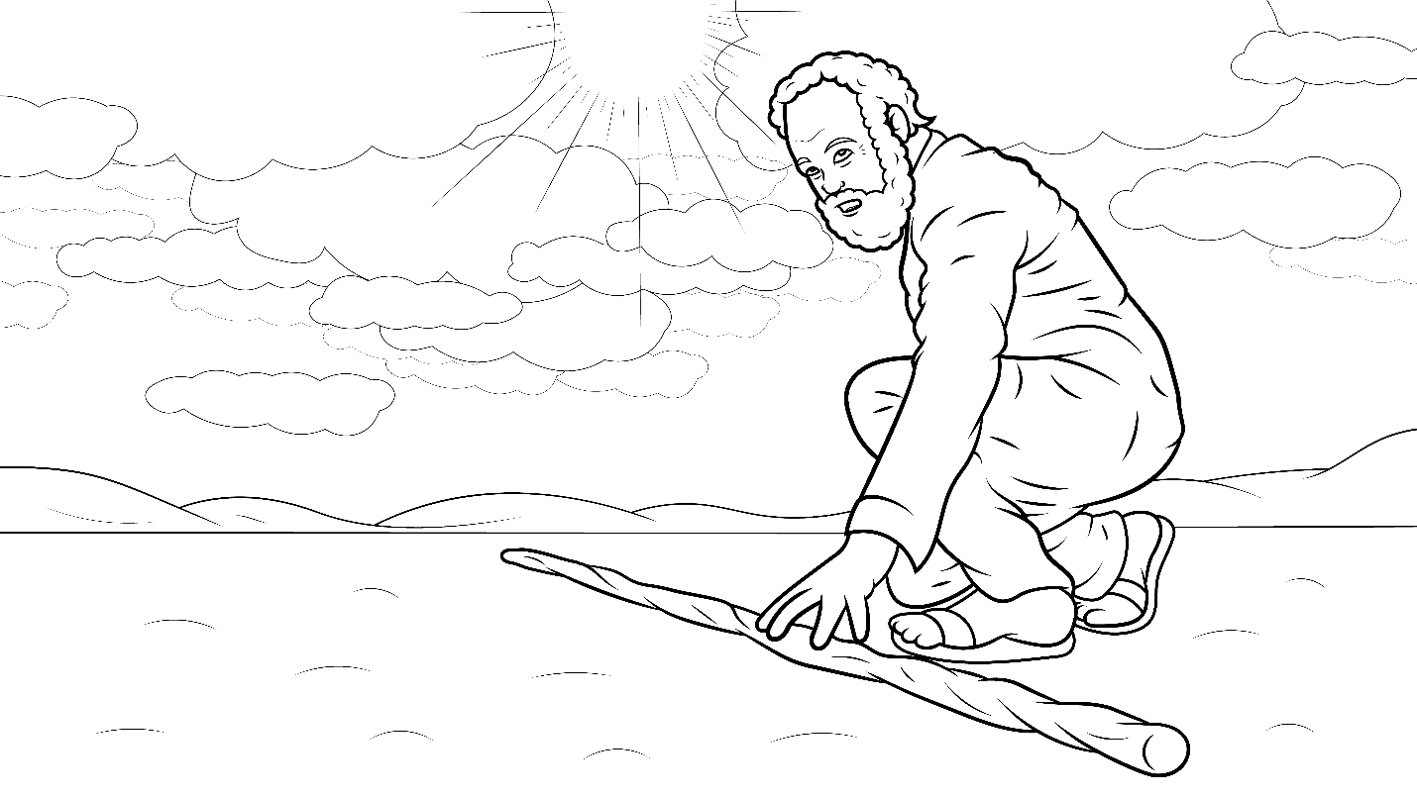
Moses did pick a big, black stick.

Slide 18
Moses said to the men, “Must I get you water from this rock?”

Slide 19
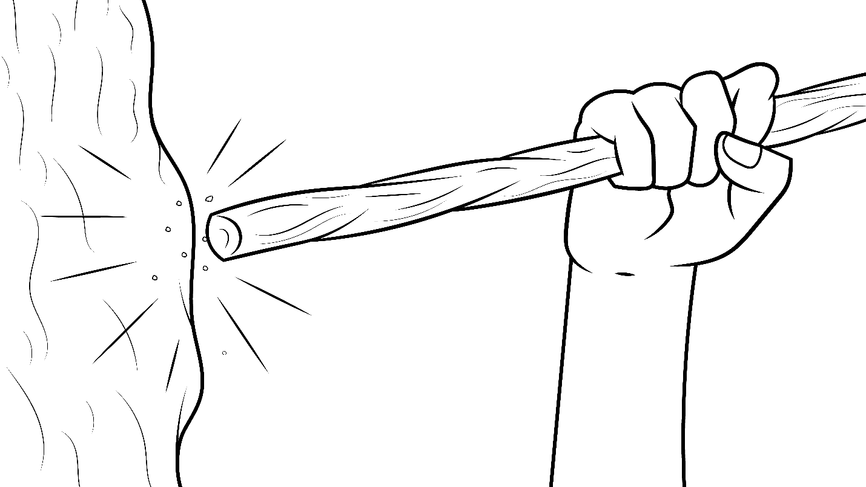
Moses pulled back. He struck the rock…
smack, whack, clack. It felt like a brick.

Slide 20
Moses struck the rock again.…
smack, whack, crack.

Slide 21
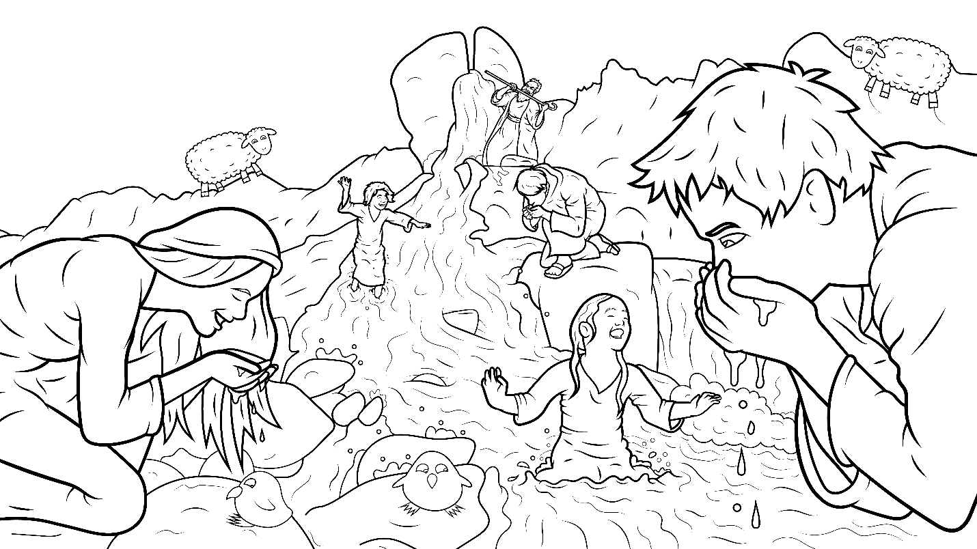
Fresh, clean, wet water came flowing out of the rock.

Slide 22
It was not a trick. “We have luck!” The men sucked water.

Slide 23
So did the women and children and animals.

Slide 24
But God was mad at Moses.
Why?
He did not speak to the rock.

Slide 25
He struck the rock – whack, whack!

Slide 26
The End

Slide 27
1.12 Story Without Illustrations
A Stick
Struck the Rock
Numbers 20:1-13

Slide 28
Moses led the Jews into the desert
to go to their new home.
But they said,
“We will pack and go back.”

Slide 29
“We lack water and all the good food
we had in Egypt. Yuck.
We have no luck.
We are stuck in this hot desert.
We are thirsty. Our animals are thirsty.”

Slide 30
“Quick! Chicks are sick.
Our flocks are sick. They will kick.”
Moses went back to check with God, “Help us!”

Slide 31
God said to Moses,
“I will help you. You must tell a big rock to give you water.”
What? A rock? Yes.
Moses did pick a big, black stick.

Slide 32
Moses said to the men, “Must I get you water from this rock?”
Moses pulled back.
He struck the rock…
smack, whack, clack. It felt like a brick.

Slide 33
Moses struck the rock again.…
smack, whack, crack.
Fresh, clean, wet water came
flowing out of the rock.

Slide 34
It was not a trick. “We have luck!”
The men sucked water.
So did the women and children
and animals.

Slide 35
But God was mad at Moses. Why?
He did not speak to the rock.
He struck the rock –
whack, whack!

Slide 36
The End

Slide 37
Story: Carol Hale
Illustrations: Ivan Mader
Power Point arrangements: Steve March
www.EasyReadEnglish.com
www.EZReadEnglish.org/lower-levels

Slide 38
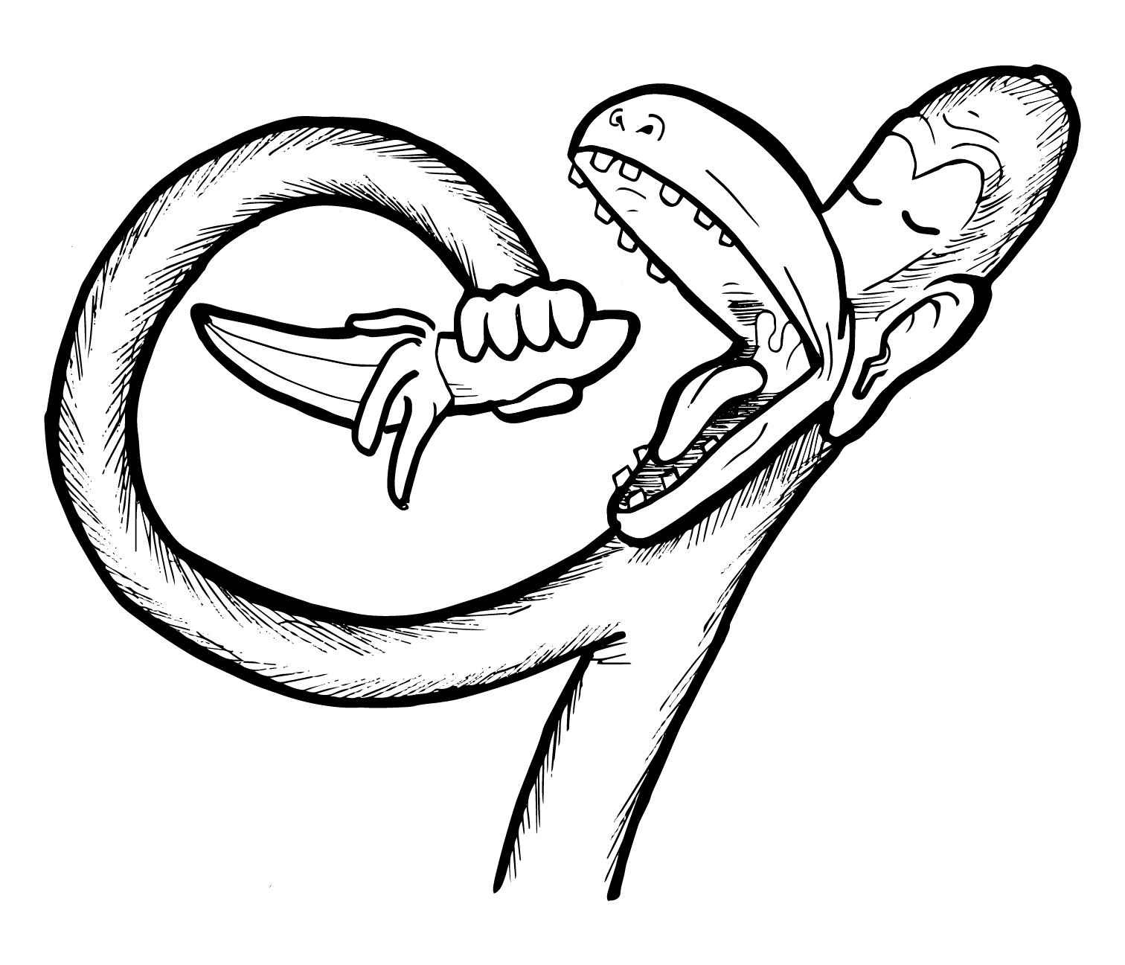
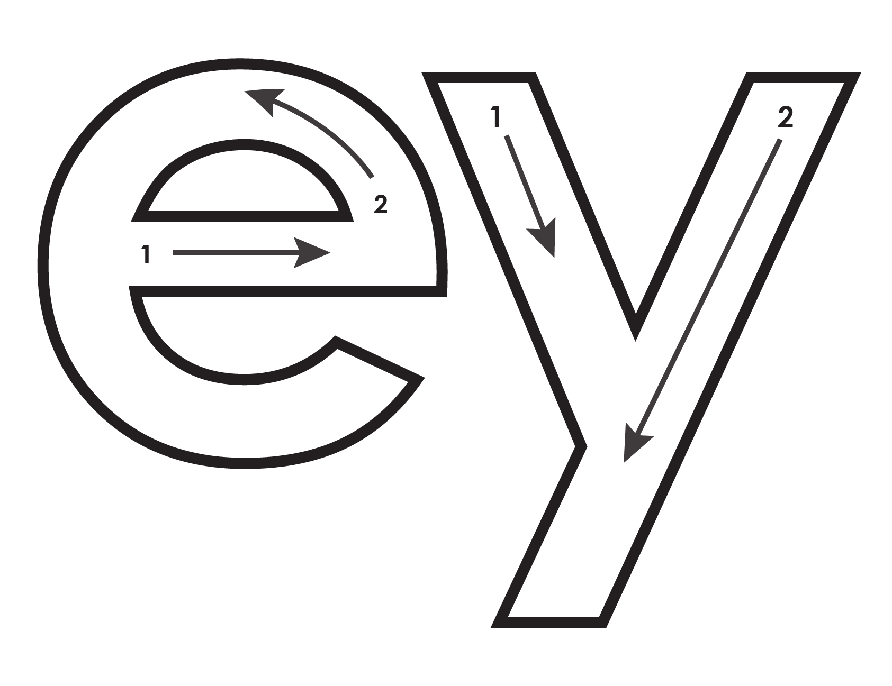
Another important teaching tool…
Easy Breezy Reading (https://www.easybreezyreading.com)
Designed to help new, struggling, and especially dyslexic learners, Easy Breezy Reading is broken up into Laughing Letters and Funny Phonograms. Both tools use illustrated patterns that mimic the shapes of the letters to give your students one more sense to link the phonetic sound of the letters.
ey
monk
Our scope and sequence matches Easy Read English Lower Levels. Progressing through the Easy Breezy Reading curriculum is sure to accelerate your students’ comprehension of the written English language.
You can procure Laughing Letters or Funny Phonograms through our website.
https://www.easybreezyreading.com/curriculum

