Slide 1

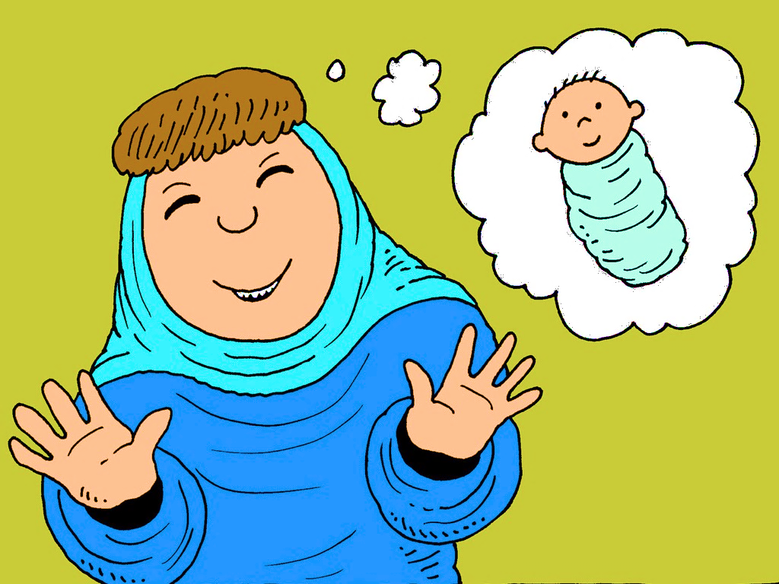
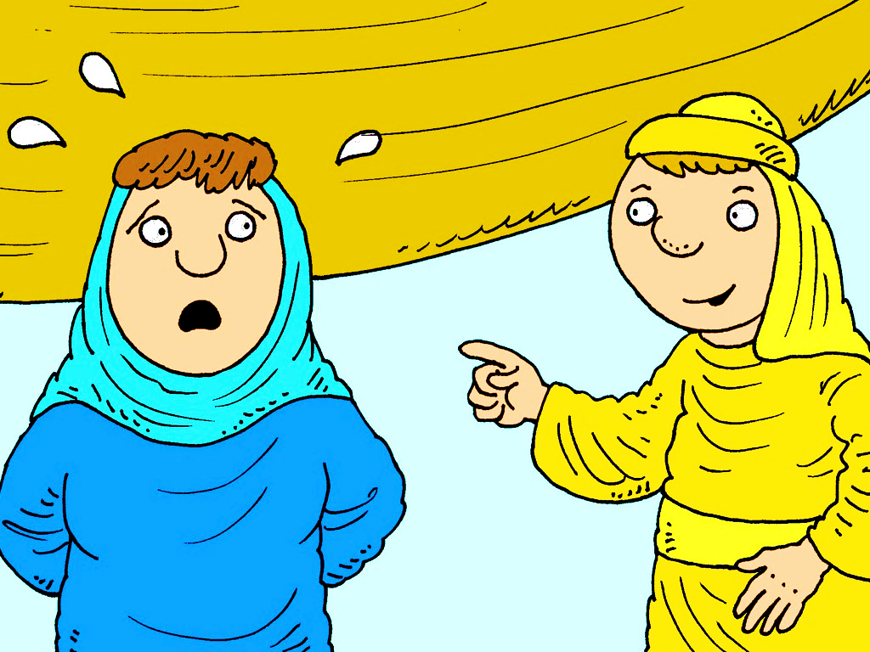
7. Level 2 Sad, Old Sarah
Part 1 GET READY...
Introducing o-l-d

Slide 2
o-l-d says /old/ in hold

Slide 3
h

Slide 4
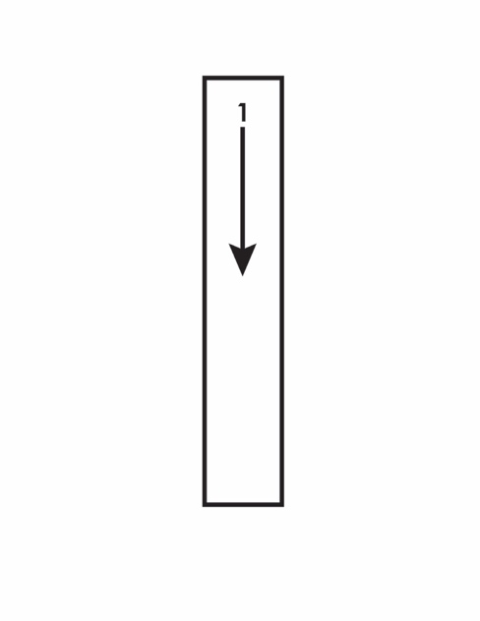
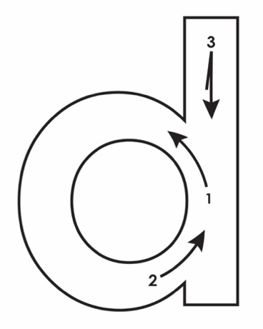
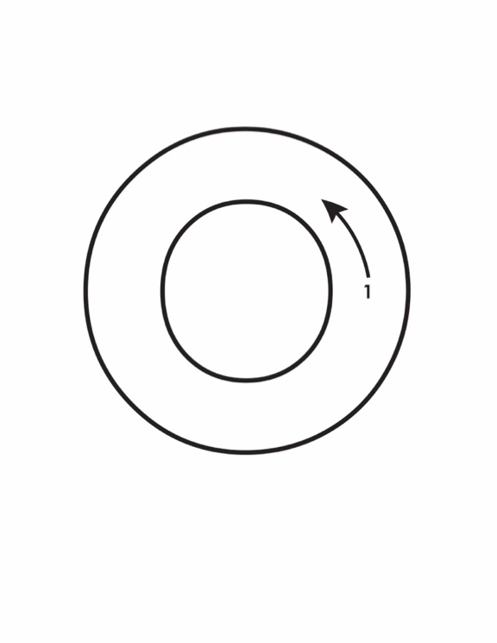
h

Slide 5
hold

Slide 7
reading
h
hold

Slide 8
spelling
h
hold

Slide 9
Other Sounds – Long Vowel
These syllables or words are closed,
so the vowel should be short,
but the vowel is long.
−
cold

Slide 10

hold
Hold my hand.

Slide 11
_ _ _ _ my hand.

Slide 12
gold
I see lots of gold.

Slide 13
I see lots of _ _ _ _.

Slide 14
old
The man is old.

Slide 15
The man is _ _ _.

Slide 16
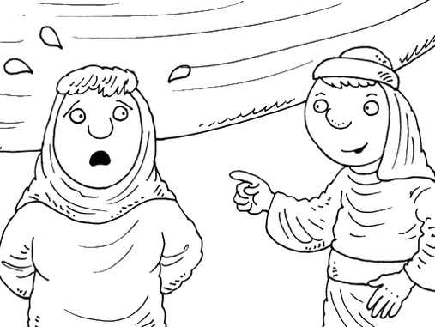
told
He told her no.

Slide 17
He _ _ _ _ her no.

Slide 18
old
told

Slide 19
old
told

Slide 21
old
told

Slide 22
hold
gold

Slide 23
hold
gold

Slide 25
hold
gold

Slide 26
hold
gold
old
told

Slide 29
hold
gold
told
old

Slide 30
hold
gold
old
told

Slide 31
Hold my hand.
I see lots of gold.
He told her no.
The man is old.

