Slide 1
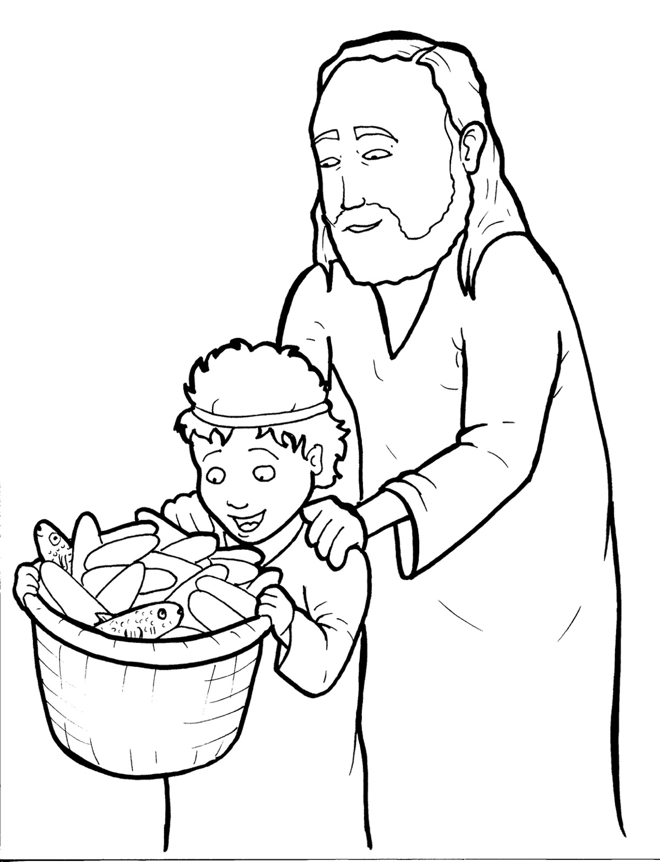
18. Jesus Feeds Five Thousand
Part 5
Vocabulary
Original Bible Story

Slide 2
Vocabulary

Slide 3
multitude
(MUL -
ti -
tude):
a crowd

Slide 4
sign
(sign):
a miracle

Slide 5
denarii
AR - ii ):
(den -
Roman money used in Israel

Slide 6
sufficient
(suf-
FI -
cient):
enough

Slide 7
distribute
(dis -
TRIB -
ute):
to pass around

Slide 8
prophet
(PROPH -
et):
a person who speaks for God

Slide 9
Jesus Feeds Five Thousand
John 6:1-14
World English Bible (WEB)

Slide 10
After these things, Jesus went away to the other side of the Sea of Galilee, which is also called the Sea of Tiberias.

Slide 11
A great multitude followed him, because they saw his signs which he did on those who were sick.

Slide 12
Jesus went up into the mountain, and he sat there with his disciples.

Slide 13
Now, the Passover, the feast of the Jews, was at hand.

Slide 14
Jesus therefore lifting up his eyes, and seeing that a great multitude was coming to him,

Slide 15
said to Philip, “Where are we to buy bread, that these may eat?”

Slide 16
He said this to test him, for he himself knew what he would do.

Slide 17
Philip answered him, “Two hundred denarii worth of bread is not sufficient for them, that every one of them may receive a little.”

Slide 18
One of his disciples, Andrew, Simon Peter’s brother, said to him,

Slide 19
“There is a boy here who has five barley loaves and two fish, but what are these among so many?”

Slide 20
Jesus said, “Have the people sit down.”
Now, there was much grass in that place.

Slide 21
So the men sat down, in number about five thousand.

Slide 22
Jesus took the loaves; and having given thanks, he distributed to the disciples,

Slide 23
and the disciples to those who were sitting down; likewise also of the fish as much as they desired.

Slide 24
When they were filled, he said to his disciples, “Gather up the broken pieces which are left over, that nothing be lost.”

Slide 25
So they gathered them up, and filled twelve baskets with broken pieces from the five barley loaves,

Slide 26
which were left over by those who had eaten.

Slide 27
When therefore the people saw the sign which Jesus did, they said, “This is truly the prophet who comes into the world.”

