Slide 1

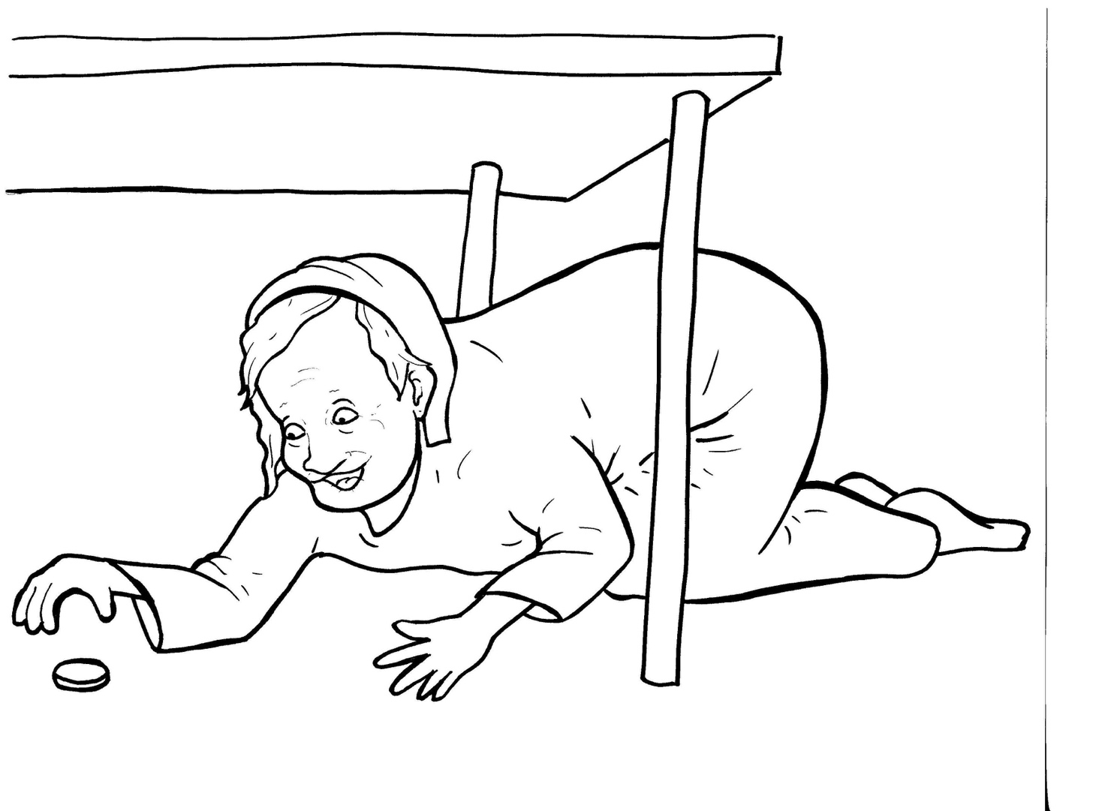
Part 2
23. The Lost Coin
New Words
Rule Breakers

Slide 2

Other Sounds – Soft G
ge, gi, gy often make the soft sound
gentle
giant
gym

Slide 3
Timing
Box
angels
huge

Slide 4
Silent letters
neighbors

Slide 5
New Words
angels
special

Slide 6
Rule Breakers
Words like these do not follow phonetic patterns.
to
you
said
could
two
f
from

Slide 7
of
was
is
one
to
have

Slide 8
from
comes
what
friends
there
sorry

Slide 9
money
woman
special

