Slide 1

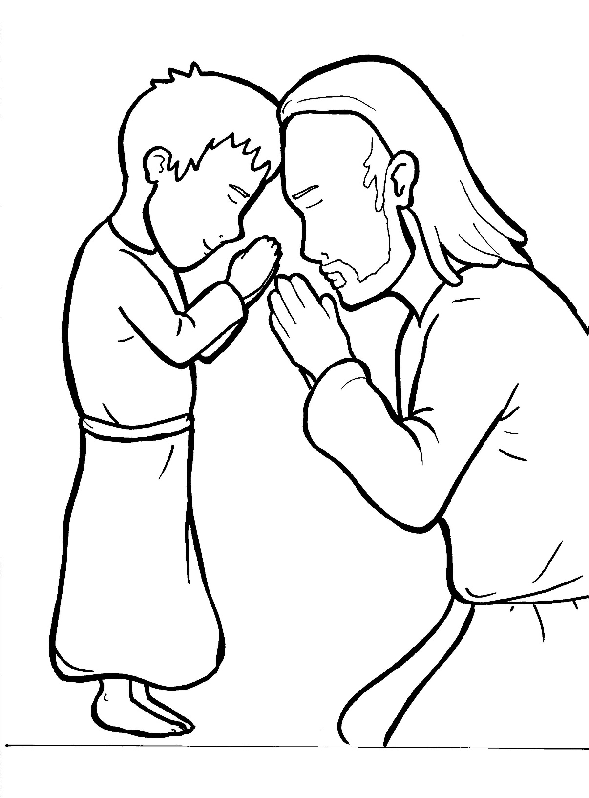
Part 3
26. The Lord’s Prayer
Syllable Divisions

Slide 2

Dividing Words
Into Syllables

Slide 3
Rabbit Words
When you see two consonants
between two vowels,
divide between the consonants.
ra it
bb
rab bit

Slide 4
hap pen
happen

Slide 5
real ly
really

Slide 6
Tiger Words
When you see one consonant
between two vowels,
divide after the first vowel.
Try this pattern first.
ti er
g
ti ger

Slide 7
e vil
evil

Slide 8
Je sus
Jesus

Slide 9
ho ly
holy

Slide 10
disci ples
disciples

Slide 11
a men
amen

Slide 12
Camel Words
When you see one consonant
between two vowels,
divide after the first consonant.
Try this pattern second.
ca el
m
cam el

Slide 13
ev er y
every

Slide 14
pow er
power

Slide 15
glor y
glory

Slide 16
heav en
heaven

Slide 17
Turtle Words
When you see consonant-l-e,
count back three and divide.
tur
t
l
e
tur tle

Slide 18
disci ples
disciples

Slide 19

Foxes Suffixes
Focus on your base word.
fox es
fox es

Slide 20
tempted
tempted

Slide 21
asked
asked

Slide 22
real ly
really

Slide 23
king dom
kingdom

Slide 24
pray er
prayer

Slide 25
Other Syllable Divisions
Some words don’t fit so neatly
into standard syllable division patterns.

Slide 26
a part
apart

Slide 27
a gainst
against

Slide 28

Anteater Words
These compound words are made up of two smaller words.
ant
eater
1
2
ant eater

Slide 29
for give
forgive

Slide 30
for ever
forever

