Slide 1
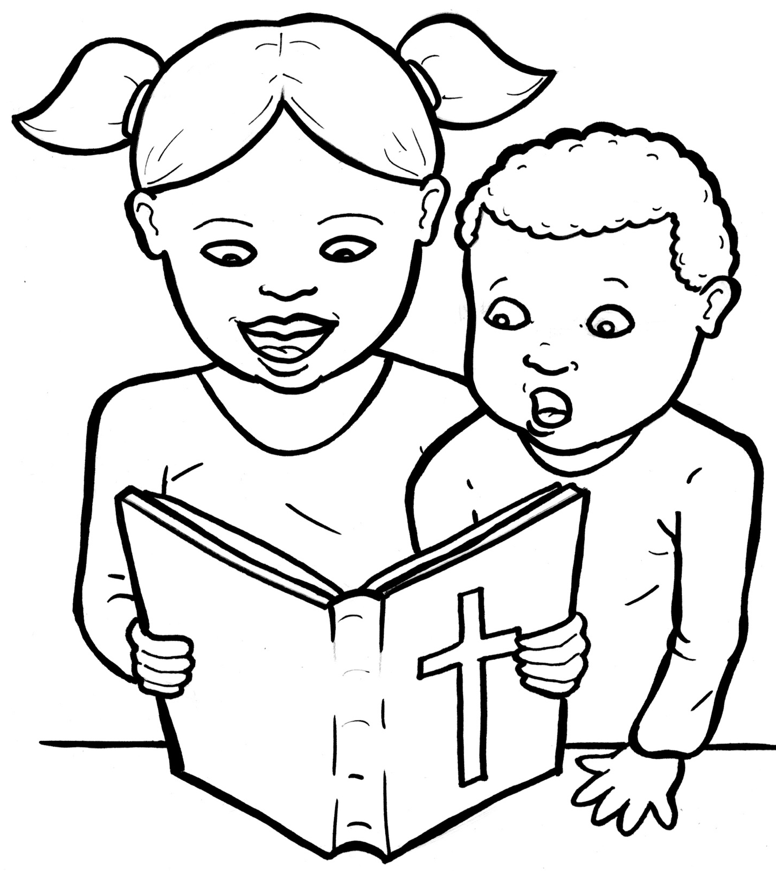
Part 4
51. I am Alive:
the Bible
Story in Easy Read English
Questions
Story in Phrases

Slide 2
We talk to God in prayer.

Slide 3
He talks to us in the Bible.

Slide 4
The Holy Bible is the most amazing book ever written.

Slide 5
From the first page until the last, it is God’s love story.

Slide 6
He is looking for a family on earth to be his own.

Slide 7
For more than 1,500 years, God spoke to 40 men.

Slide 8
God told them what to write down in the Bible.

Slide 9
Every word is from God’s heart to yours.

Slide 10
Every word is true.

Slide 11
The Old Testament starts with God creating the world.

Slide 12
It tells stories about God calling a family to himself.

Slide 13
These are the Jewish people in Israel.

Slide 14
The Old Testament is full of tales about good and bad people.

Slide 15
God asked them to obey.

Slide 16
When they failed and were sorry, he forgave them.

Slide 17
You can find prayers, songs, poems, and funny sayings in these books.

Slide 18
The New Testament starts with Jesus coming to earth.

Slide 19
The first four books – Matthew, Mark, Luke, and John – called the gospels, tell about the life of Jesus.

Slide 20
The book of Acts explains how the Christian church started.

Slide 21
The New Testament also has letters written to these young churches.

Slide 22
It is the ongoing story of God’s plan.

Slide 23
The New Testament invites the whole world to join God’s great big, loving family.

Slide 24
That includes you!

Slide 25
Question 1
What is the Bible?

Slide 26
Question 2
What are the two main parts?

Slide 27
Question 3
How can you be a part of God’s story?

Slide 28
Question 4
Do you have your own Bible? How much have you read?

Slide 29
Prayer
Dear Lord Jesus,
Thank you for writing the Bible. Thank you that I can trust it. Please help me to read some of it every day. Please help me listen as you talk to me in the Word of God.
Amen

Slide 30
I am Alive:
the Bible
Phrased for Fluency

Slide 31
We talk to God
in prayer.

Slide 32
He
talks to us
in the Bible.

Slide 33
The Holy Bible
is the most
amazing book
ever written.

Slide 34
From the first page
until the last,
it is
God's
love story.

Slide 35
He
is looking
for a family
on earth
to be his own.

Slide 36
For more than
1,500 years,
God spoke
to 40 men.

Slide 37
God told them
what to write down
in the Bible.

Slide 38
Every word
is from
God's heart
to yours.

Slide 39
Every word
is true.

Slide 40
The Old Testament
starts with God
creating the world.

Slide 41
It tells
stories
about God
calling a family
to himself.

Slide 42
These are
the Jewish people
in Israel.

Slide 43
The Old Testament
is full
of tales
about good
and bad
people.

Slide 44
God asked them
to obey.

Slide 45
When they failed
and were sorry,
he
forgave them.

Slide 46
prayers,
You can find
songs,
poems,
and funny sayings
in these books.

Slide 47
The New Testament
starts with Jesus
coming to earth.

Slide 48
The first four books –
Matthew,
Mark,
Luke,
and John –
called the gospels,
tell about the life
of Jesus.

Slide 49
The book of Acts
explains how
the Christian church
started.

Slide 50
The New Testament
also has letters
written to
these young churches.

Slide 51
The New Testament
invites
the whole world
to join
God's great big,
loving family.

Slide 52
That
includes you!

