Slide 1

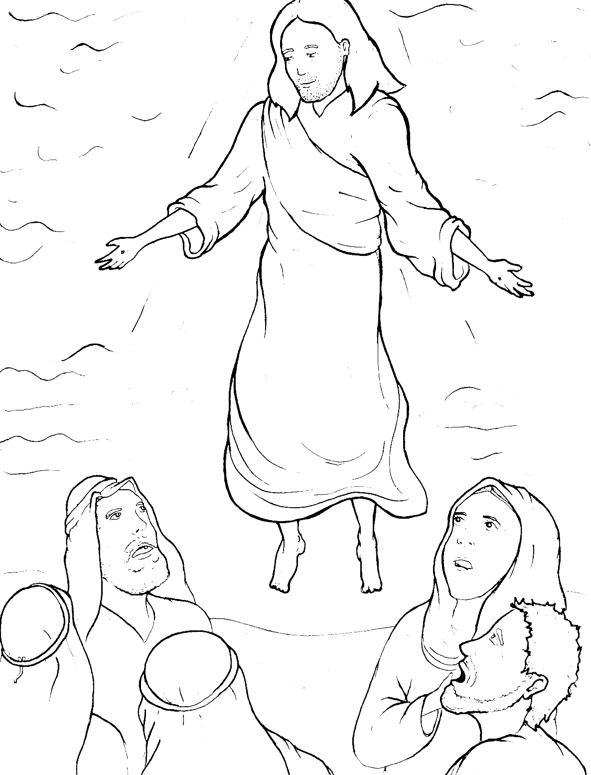
Part 1
44. Jesus Goes Back to Heaven
Syllable Charts

Slide 2

Words in
Syllable Types

Slide 3
Closed – Short Vowel
A closed syllable has one vowel
followed by one or more consonants,
and the vowel is short.
st
o
p
˘

Slide 4
Timing
Box
af-
ask
bap-
back
than
that

Slide 5
Timing
Box
yes
end
felt
went
then
them

Slide 6
Timing
Box
-ev-
-ven
-en
-gels
Mes-
-ten

Slide 7
Timing
Box
Chris-
fish
dis-
with
writ-
hid

Slide 8
Timing
Box
on
not
fol-
God

Slide 9
Timing
Box
up
-sus
must

Slide 10
Open – Long Vowel
An open syllable has one vowel
with no consonant after it,
and the vowel is long.
−
go

Slide 11
Timing
Box
na tions

Slide 12
Timing
Box
he
we
be
e ven
me
Je sus

Slide 13
Timing
Box
Pe ter
be lieve

Slide 14
Timing
Box
ever y

Slide 15
Timing
Box
I
Messi ah
disci ple

Slide 16
Timing
Box
by
my

Slide 17
Timing
Box
go
o bey

Slide 18
Silent e – Long Vowel
A silent e syllable has one vowel,
followed by one consonant
and a silent e at the end.
The vowel is long.
−
ca
e
v

Slide 19
Timing
Box
take
care
same
make

Slide 20
Timing
Box
these

Slide 21
Timing
Box
life
bap tize
wide

Slide 22
Timing
Box
rose
wrote

Slide 23
Other Sounds – Long Vowel
These syllables or words are closed,
so the vowel should be short,
but the vowel is long.
−
cold

Slide 24
Timing
Box
hold
told

Slide 25
Vowel Teams – Long Vowel
Many vowel teams follow this rule:
When two vowels get together,
the first one names its letter.
So the first vowel will make its long sound,
and the second vowel is silent.
−
e
a
t

Slide 26
Timing
Box
day
way
a way

Slide 27
Timing
Box
o bey

Slide 28
Timing
Box
sheep

Slide 29
Timing
Box
real
each
teach
beach
eat ing

Slide 30
Timing
Box
be lieve

Slide 31
Timing
Box
peo ple

Slide 32
Timing
Box
might
sight

Slide 33
Timing
Box
know
fol low ers

Slide 34
Timing
Box
goes

Slide 35
Vowel Teams – Other Sounds
Sometimes vowel teams make other sounds.
oil

Slide 36
Timing
Box
all

Slide 37
Timing
Box
saw

Slide 38
Timing
Box
dead
meant
heav en

Slide 39
Timing
Box
books

Slide 40
Timing
Box
down

Slide 41
Timing
Box
cloud

Slide 42
Timing
Box
joy

Slide 43
R - Controlled
R-controlled syllables have one or more vowels
followed by an “r.”
The “r” changes the sound of the vowel.
o
r
ange

Slide 44
Timing
Box
start

Slide 45
Timing
Box
for ever

Slide 46
Timing
Box
more

Slide 47
Timing
Box
af ter
Pe ter
forev er

Slide 48
Timing
Box
ev er y
believ ers
follow ers

Slide 49
Timing
Box
church

Slide 50
Timing
Box
world

Slide 51
Timing
Box
miracles

Slide 52
Consonant – l-e
When you see consonant l-e at the end of a word,
count back three.
The “l-e” makes the /–le/ sound.
pur
p
l
e

Slide 53
Timing
Box
peo ple
disci ples

Slide 54
Timing
Box
mira cles

Slide 55
Other Sounds – -nk/-ng
The “-nk” and “-ng”
change the sound of the vowel.
bank
thing

Slide 56
Timing
Box
believing
everything
eating

Slide 57
Other Sounds – endings
-tion, -sion, -cian, -tian
action
mission

Slide 58
Timing
Box
nations

Slide 59
Timing
Box
Chris tian

Slide 60

Other Sounds – schwa
The schwa syllable has an “a” that sounds
like the /u/ in banana.
The banana is even shaped like a short u.
ba nan a

Slide 61
Timing
Box
a gain
mir a cles
Messi ah

