Slide 1
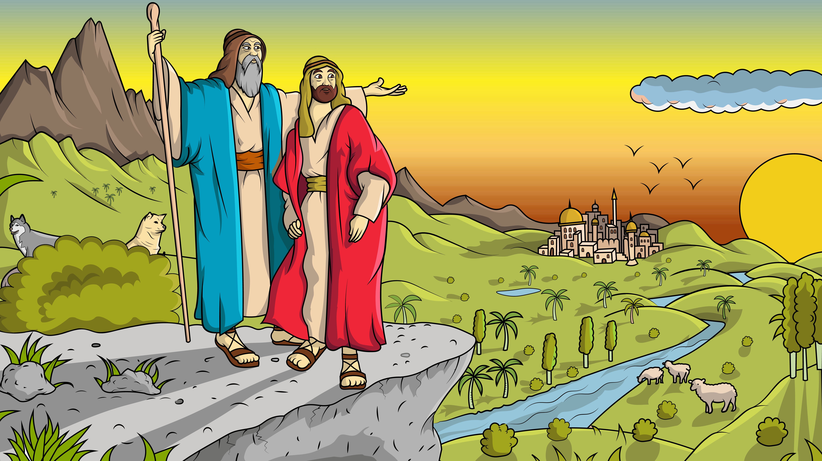
1.4 Song
LOT GOT A LOT!

Slide 2
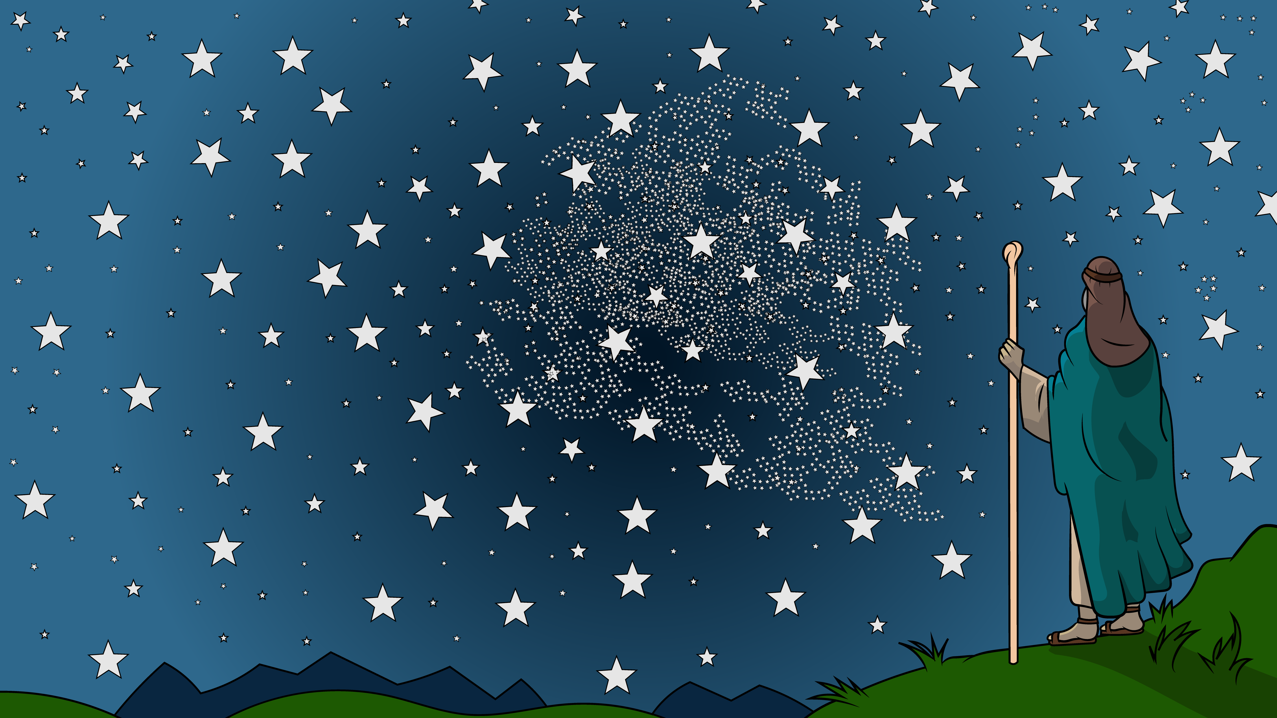
God said to Abram go.
God said to Abram go.

Slide 3
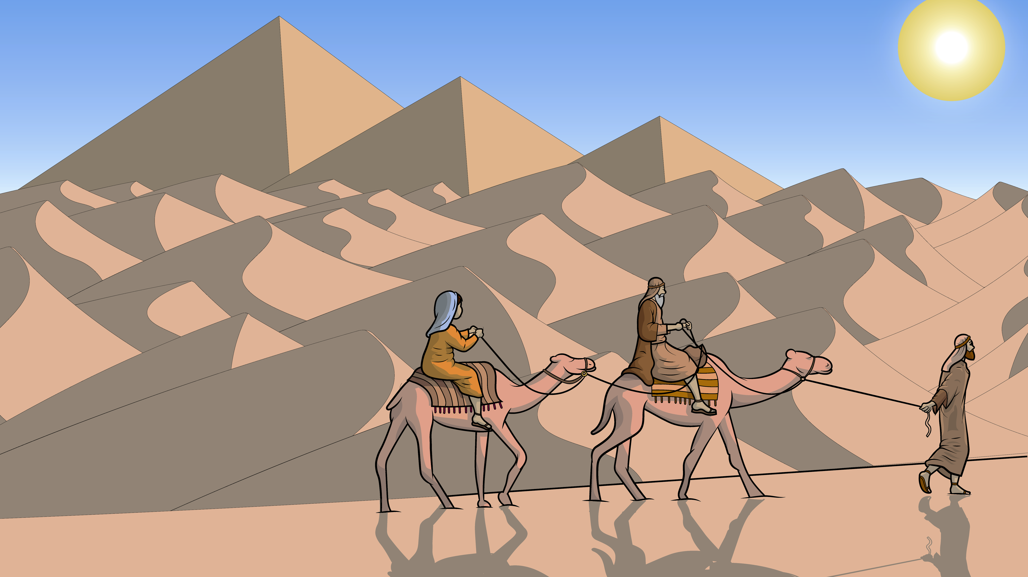
Where will we go?
I do not know.

Slide 4
But, God said, “Go!” We’ll go!
But, God said, “Go!” We’ll go!

Slide 5
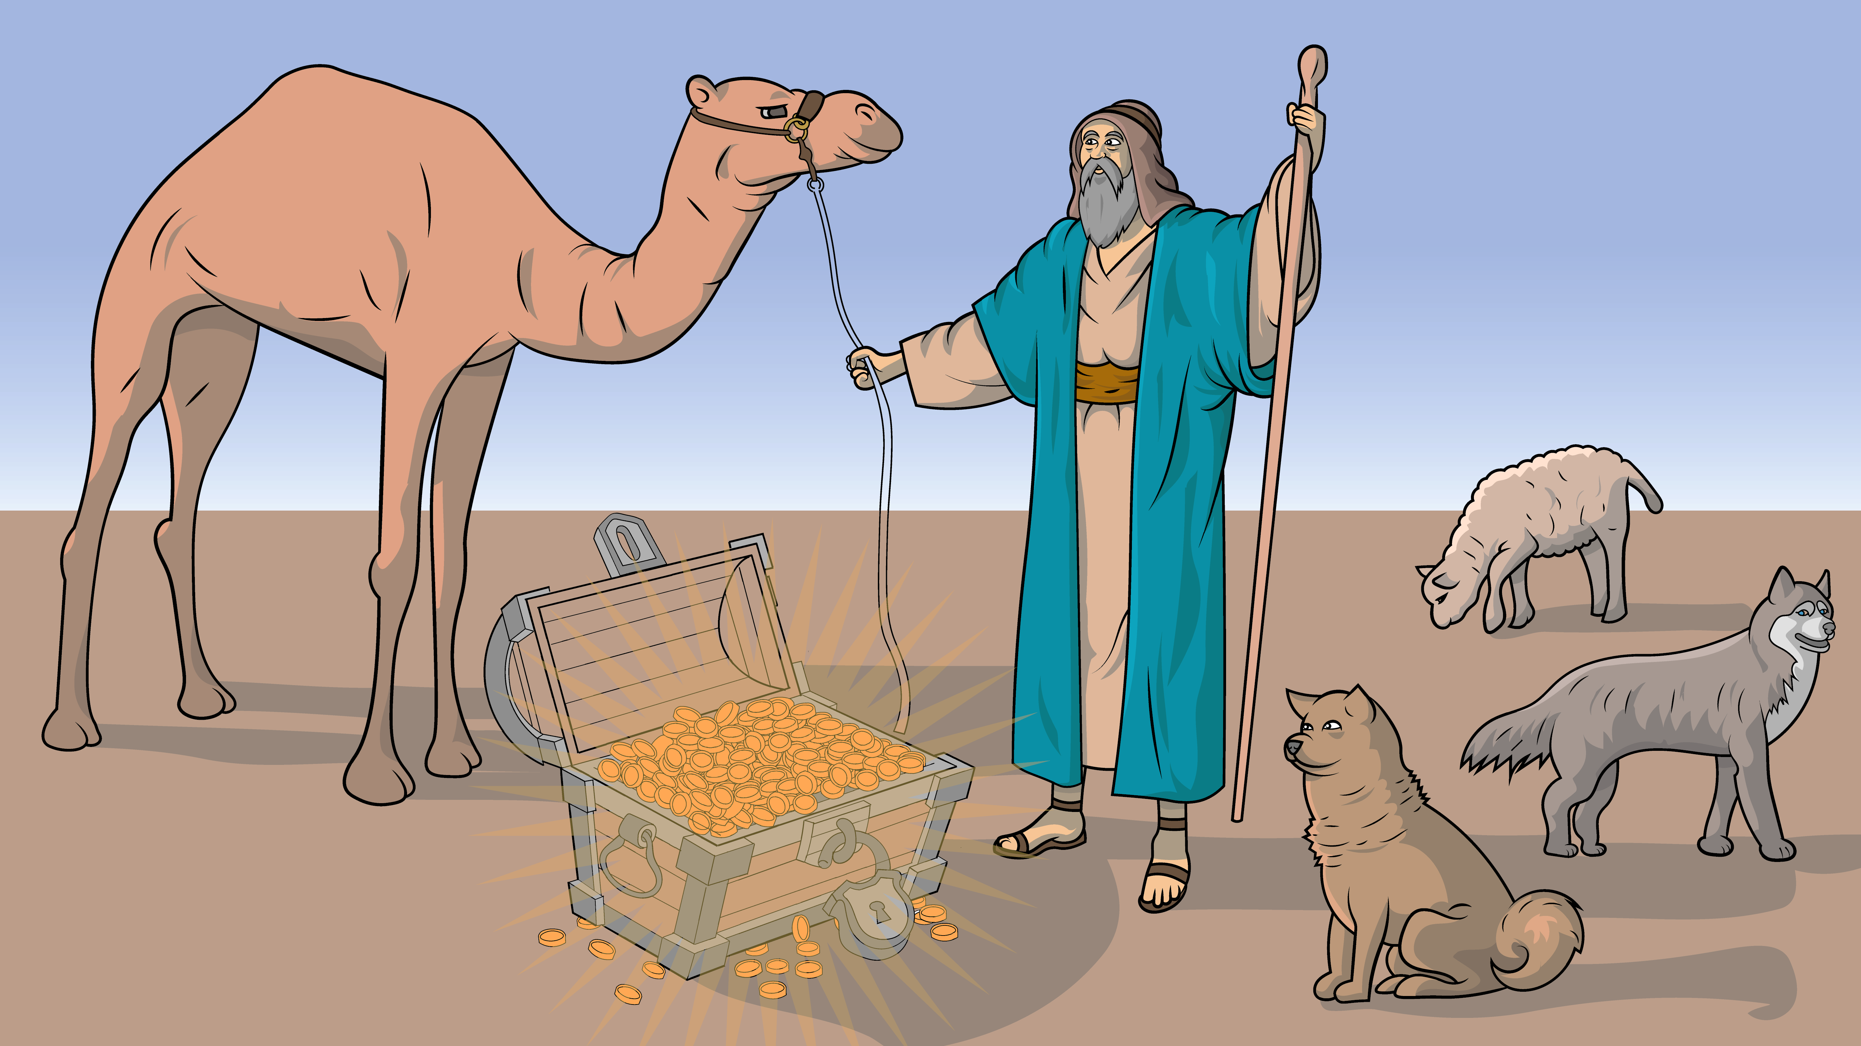
Abram had a lot.
Abram had a lot.

Slide 6
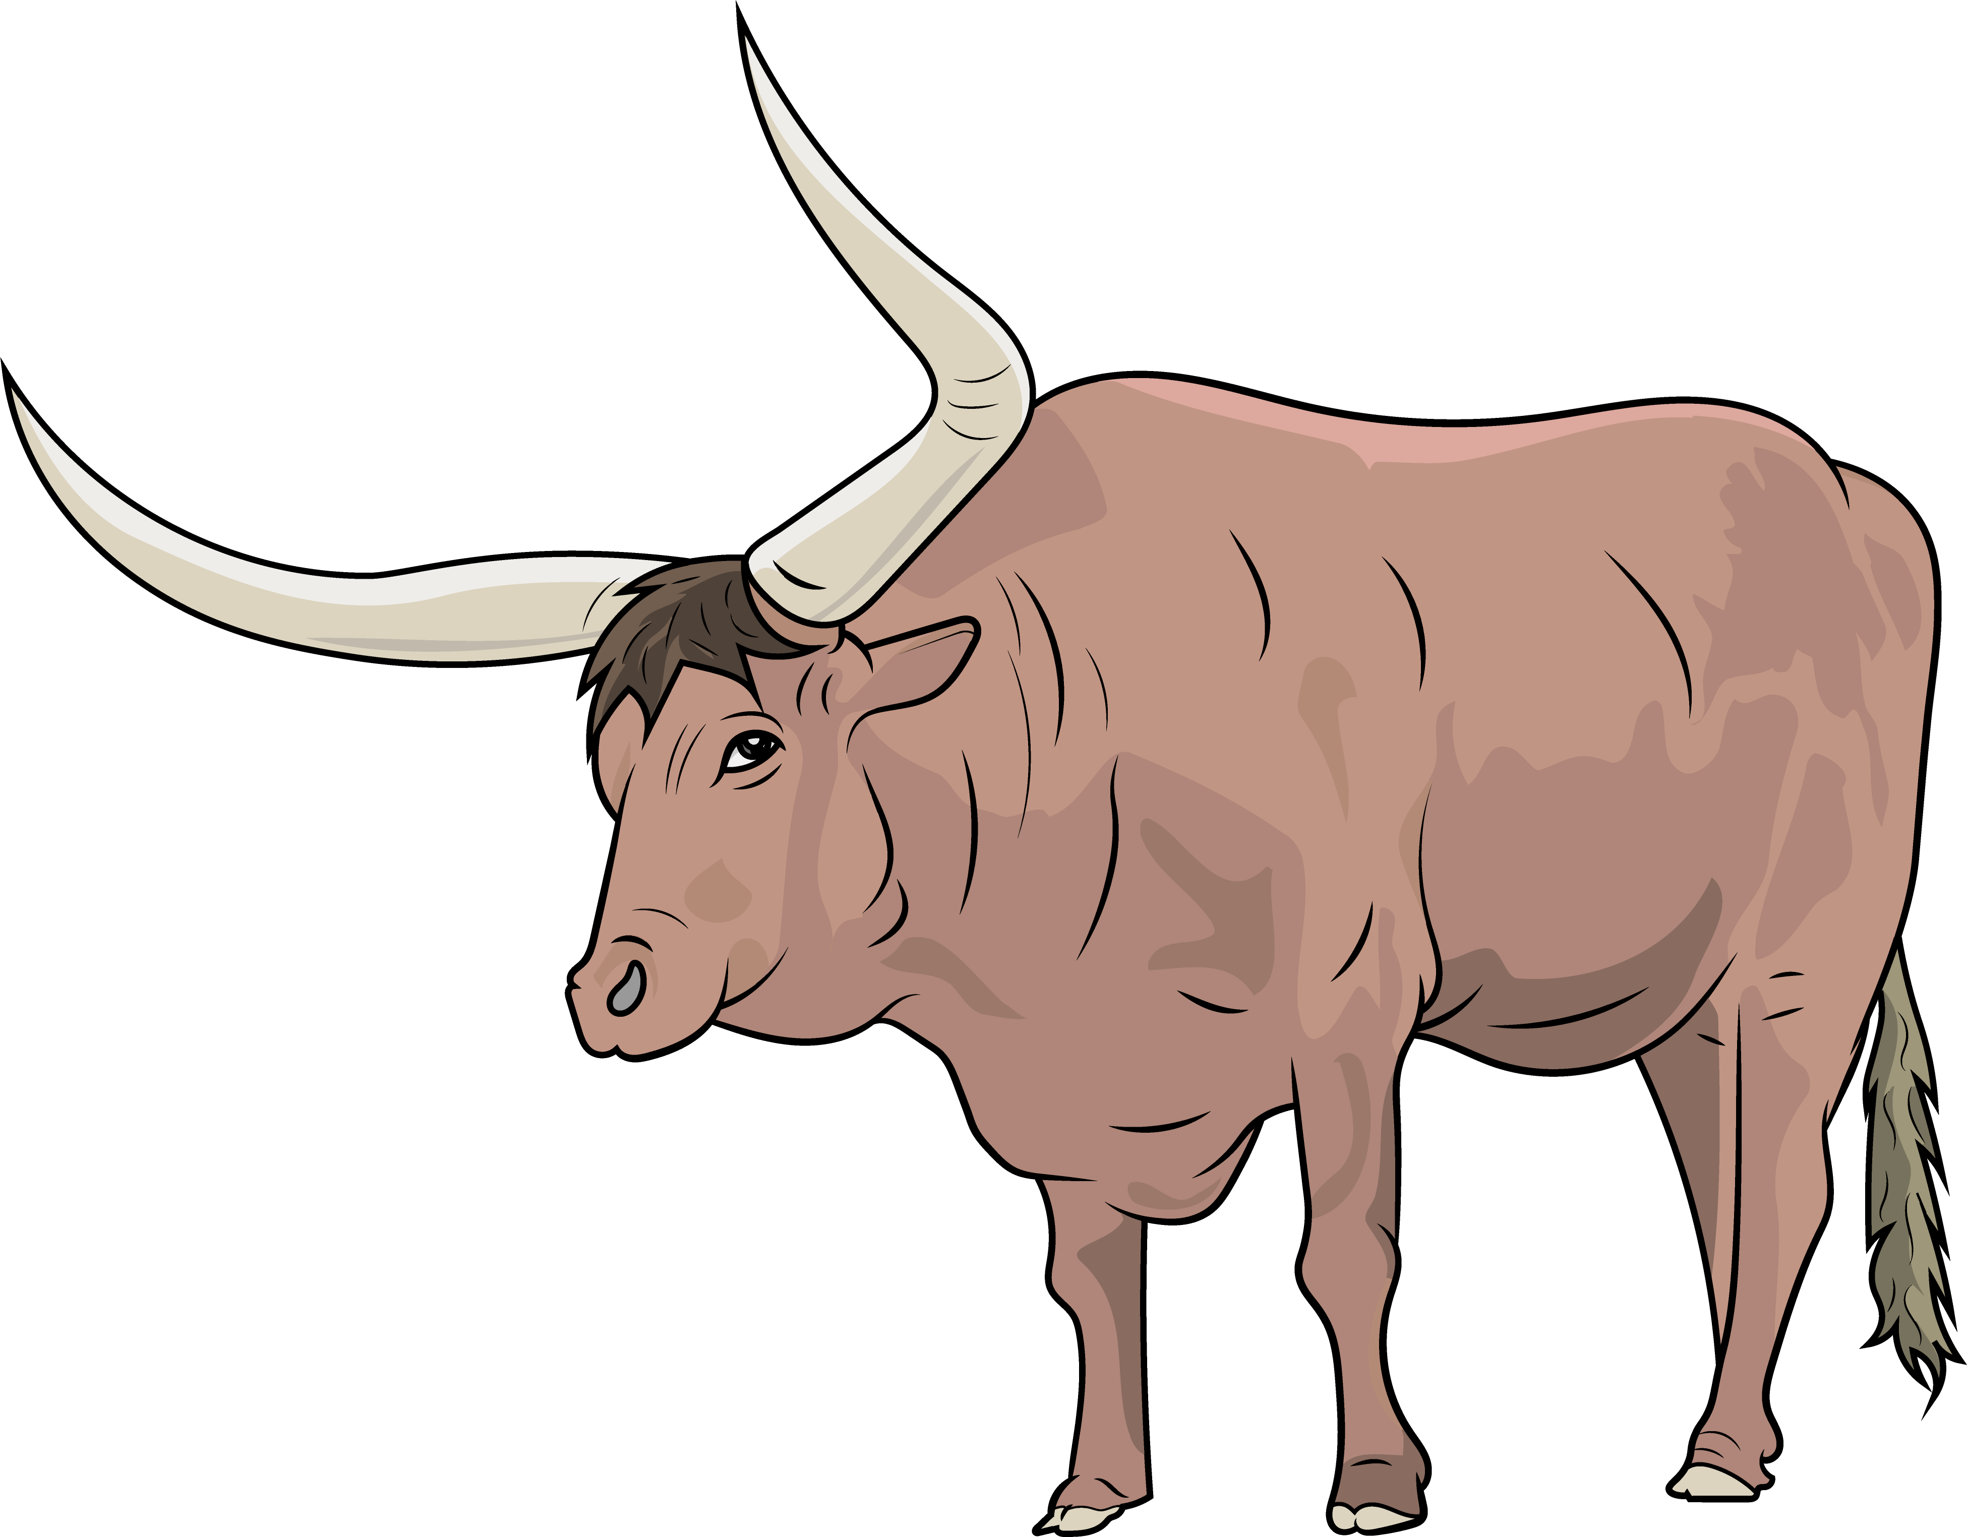
An ox and dogs and pots of gold.

Slide 7
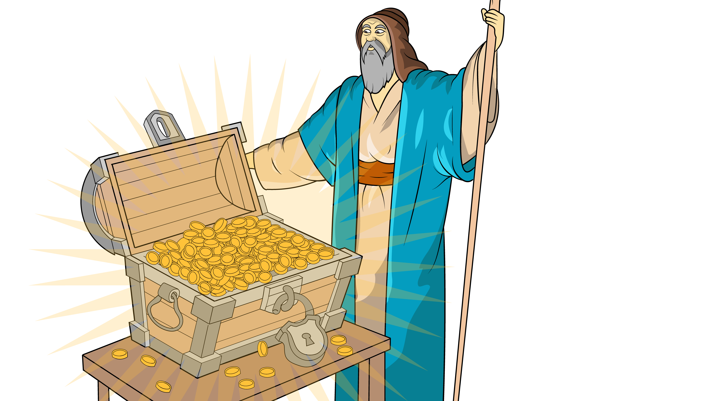
More than he could hold.
More than he could hold.

Slide 8
Lot also had a lot.
Lot also had a lot.

Slide 9
An ox and dogs, sheep in a fold.

Slide 10
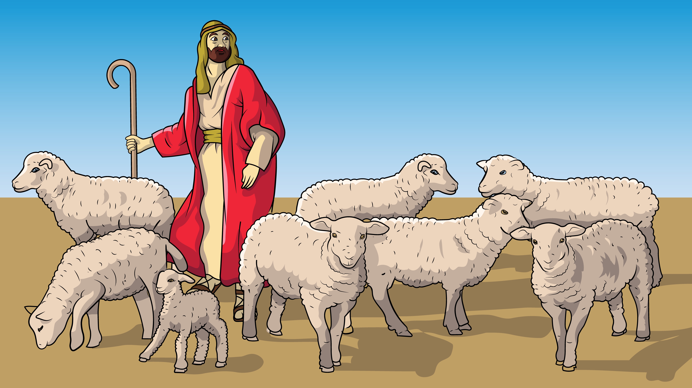
More than he
could hold.
More than he
could hold.

Slide 11
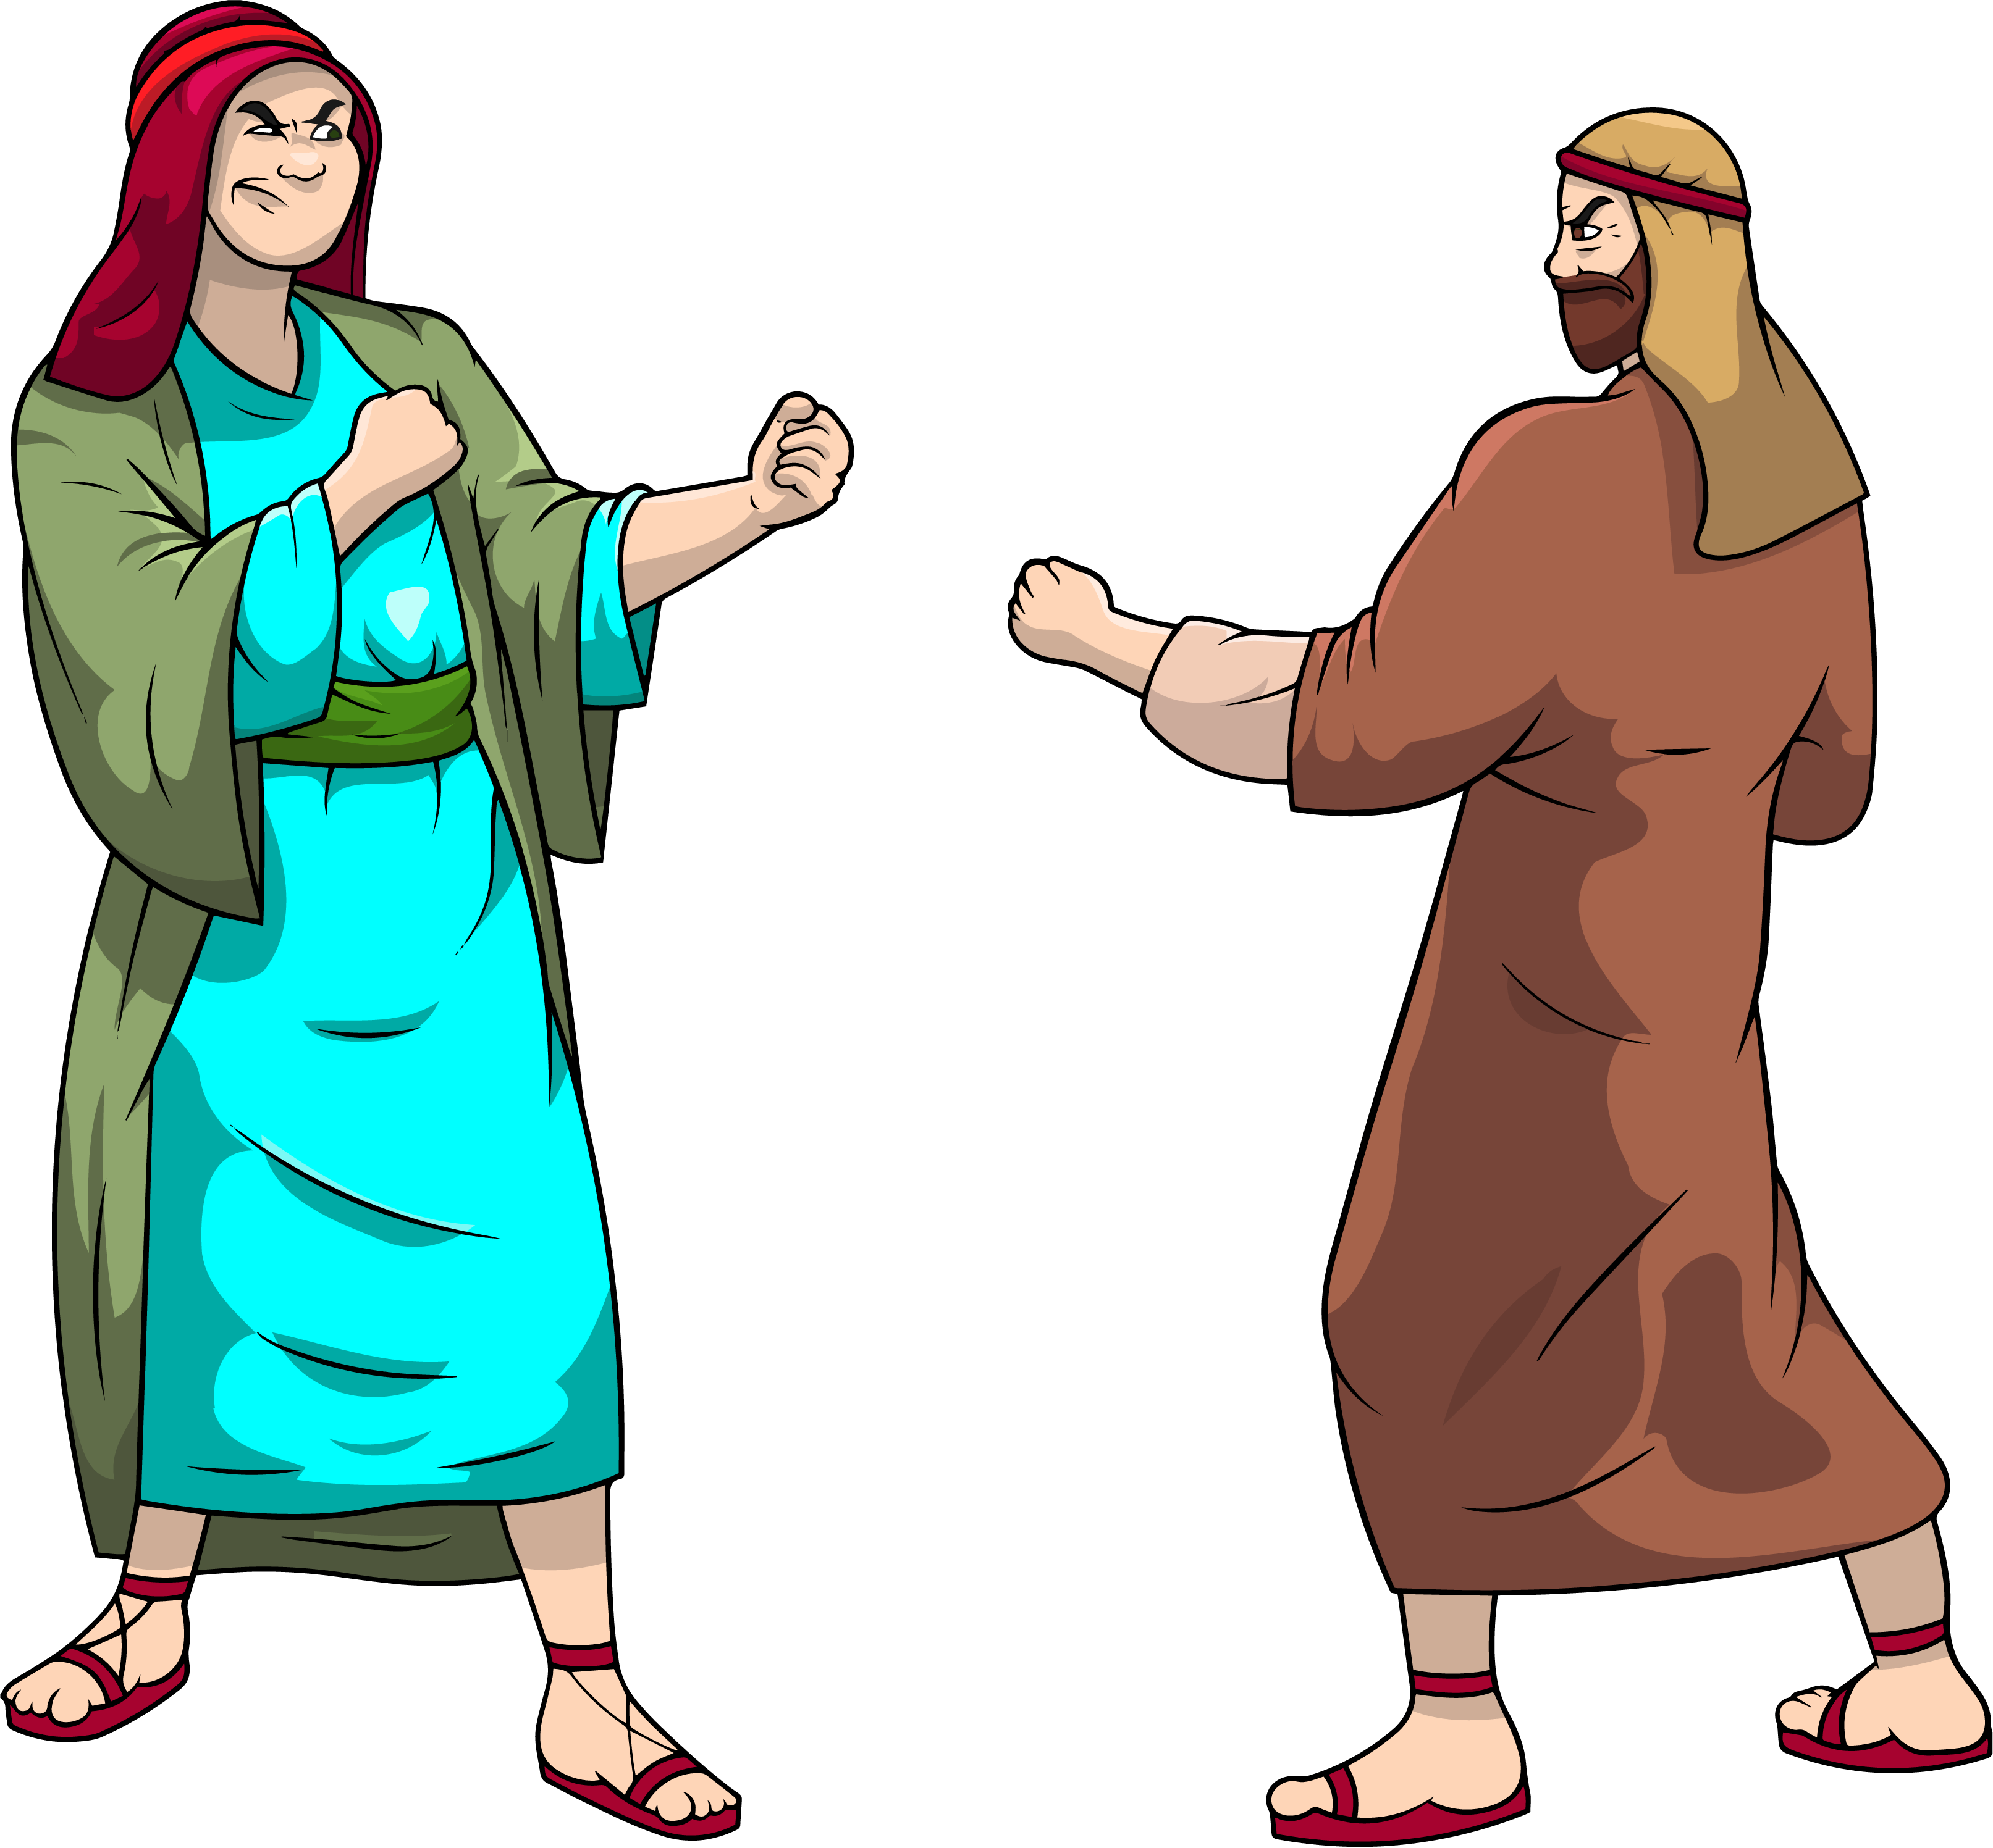
Their men began to fight.

Slide 12
Their men began to fight.

Slide 13
“Stop, you go left,
and I’ll go right.”

Slide 14
Their men began to fight.

Slide 15
Their men began to fight.

Slide 16
“Stop, you go left,
and I’ll go right.”

Slide 17
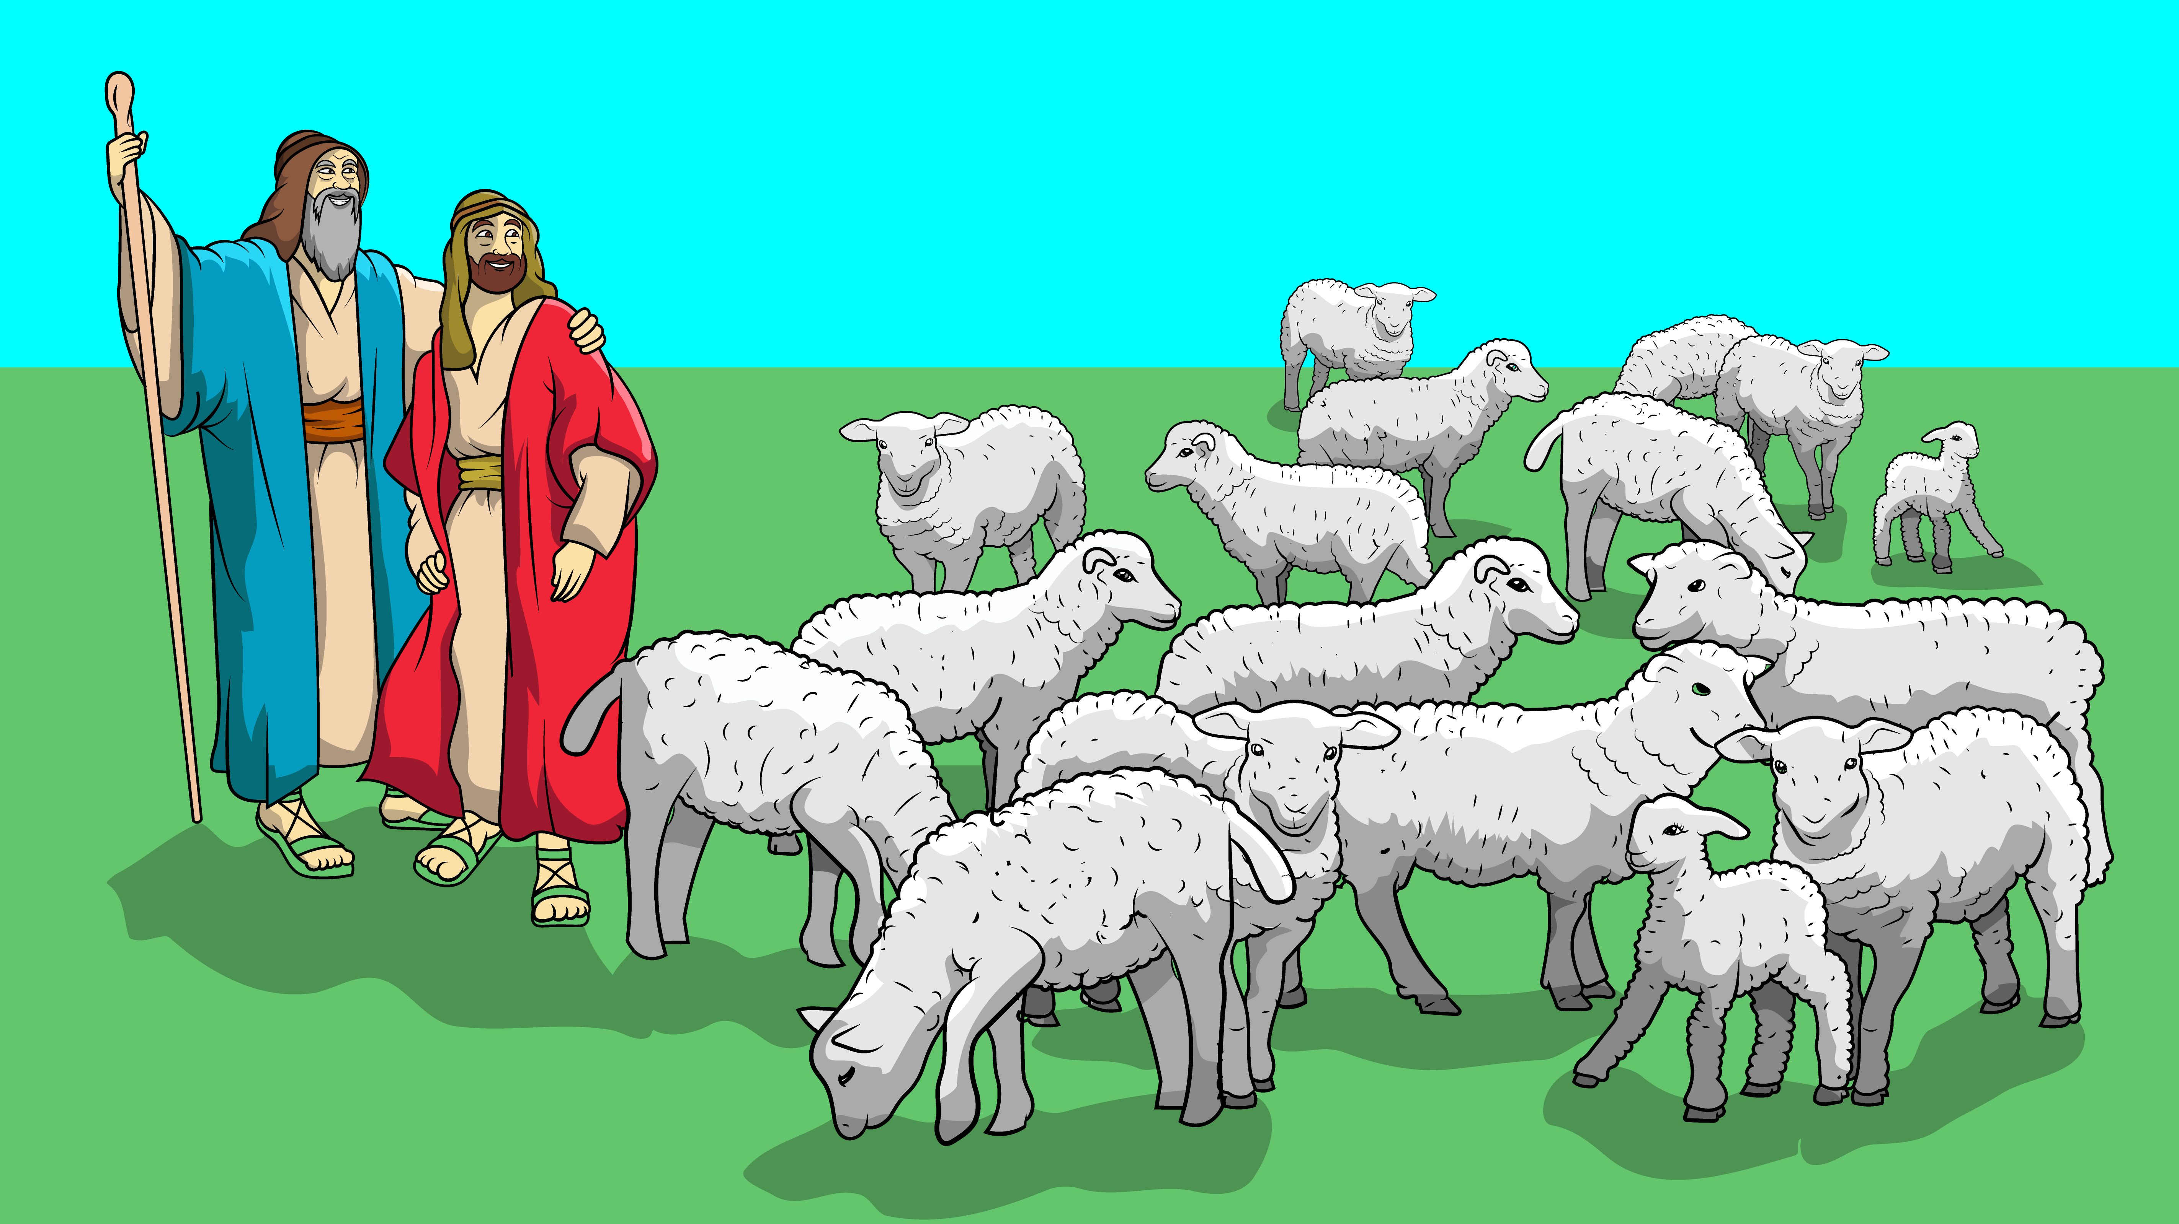
That will stop the fights.
That will stop the fights.

Slide 18
Lot got a lot.
Lot got a lot.

Slide 19
Lot got the best
of all the spots.

Slide 20
Lot got a lot.
Lot got a lot.

Slide 21
Lot got the best
of all the spots.

Slide 22
Lot got a lot.
Lot got a lot.

Slide 23
The story of Lot and Abram
is found in Genesis 13:1-18
in the Bible.

Slide 24
CREDITS
Song ……………………….……………………………Carol Hale
Music/Vocals………….………………….Steffi Vornberger
Illustrations ………….………………...………….Ivan Mader
Colorization ………………...SziSzi Leveleki/Ivan Mader
PowerPoint ………….…Steve March/Michael Bannon
www.EasyReadEnglish.com
Go to www.EZReadEnglish.org/LowerLevel

