Slide 1

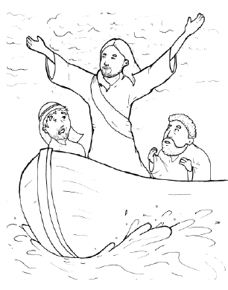

17. Jesus Stops a Storm
Part 3
Syllable Divisions

Slide 2
Dividing Words
Into Syllables

Slide 3
Rabbit Words
When you see two consonants
between two vowels,
divide between the consonants.
ra it
bb
rab bit

Slide 4
Mas ter
Master

Slide 5
al most
almost

Slide 6
dis ci ple
disciple

Slide 7
Tiger Words
When you see one consonant
between two vowels,
divide after the first vowel.
Try this pattern first.
ti er
g
ti ger

Slide 8
Je sus
Jesus

Slide 9
o ver
over

Slide 10
o bey
obey

Slide 11
e ven
even

Slide 12
Turtle Words
When you see consonant-l-e,
count back three and divide.
tur
t
l
e
tur tle

Slide 13
dis ci ples
disciples

Slide 14
gen tle
gentle

Slide 15
Lion Words
If a word has two vowels together
that make two different sounds,
divide between the two vowels.
lion
li on

Slide 16
qui et
quiet

Slide 17

Anteater Words
These compound words are made up of two smaller words.
ant
eater
1
2
ant eater

Slide 18
up on
upon

Slide 19
be came
became

Slide 20

Foxes Suffixes
Focus on your base word.
fox es
fox es

Slide 21
rocked
rocked

Slide 22
tossed
tossed

Slide 23
crashed
crashed

Slide 24
splashed
splashed

Slide 25
asked
asked

Slide 26
stopped
stopped

Slide 27
sleep ing
sleeping

Slide 28
soak ing
soaking

Slide 29
howl ing
howling

Slide 30
Other Syllable Divisions
Some words don’t fit so neatly
into standard syllable division patterns.

Slide 31
a sleep
asleep

Slide 32
a fraid
afraid

Slide 33
a mazed
amazed

Slide 34
terr i fied
terrified

