Slide 1

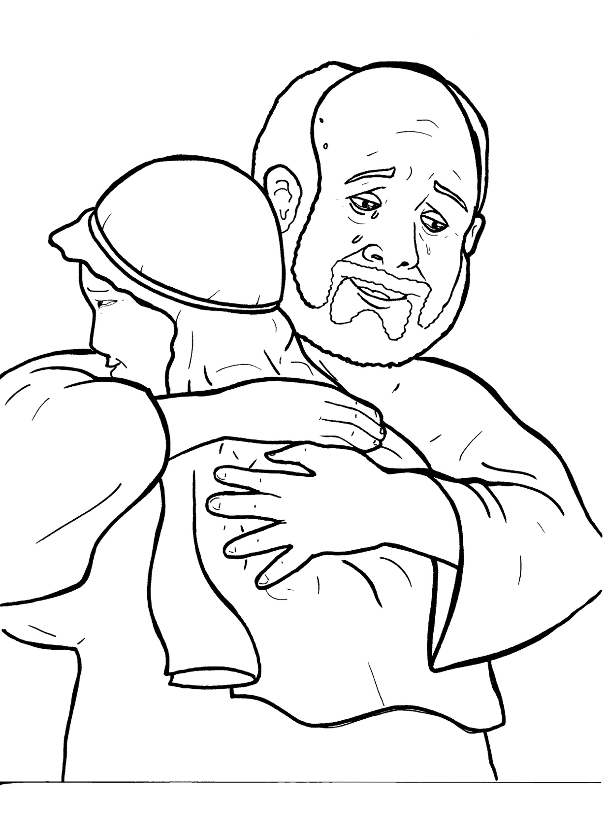
Part 3
24. The Lost Son
Syllable Divisions

Slide 2

Dividing Words
Into Syllables

Slide 3
Rabbit Words
When you see two consonants
between two vowels,
divide between the consonants.
ra it
bb
rab bit

Slide 4
un til
until

Slide 5
nas ty
nasty

Slide 6
hap py
happy

Slide 7
par ty
party

Slide 8
Tiger Words
When you see one consonant
between two vowels,
divide after the first vowel.
Try this pattern first.
ti er
g
ti ger

Slide 9
Je sus
Jesus

Slide 10
mu sic
music

Slide 11
e ven
even

Slide 12
Camel Words
When you see one consonant
between two vowels,
divide after the first consonant.
Try this pattern second.
ca el
m
cam el

Slide 13
cit y
city

Slide 14
stor y
story

Slide 15

Foxes Suffixes
Focus on your base word.
fox es
fox es

Slide 16
old er
older

Slide 17
farm er
farmer

Slide 18
young er
younger

Slide 19
com ing
coming

Slide 20
asked
asked

Slide 21
yelled
yelled

Slide 22
kissed
kissed

Slide 23
sinned
sinned

Slide 24
walked
walked

Slide 25
looked
looked

Slide 26
Other Syllable Divisions
Some words don’t fit so neatly
into standard syllable division patterns.

Slide 27
a live
alive

Slide 28
a way
away

Slide 29
hung ry
hungry

Slide 30

Anteater Words
These compound words are made up of two smaller words.
ant
eater
1
2
ant eater

Slide 31
any thing
anything

