Slide 1
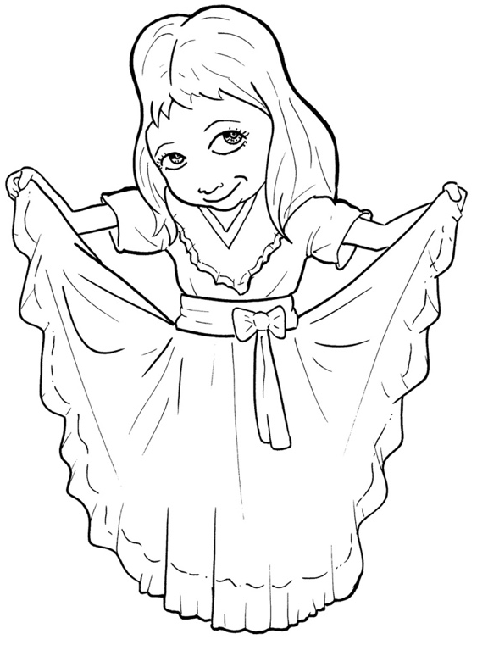
47. Now, the Good News – Jesus Saves
Part 1
Syllable Charts

Slide 2
Words in Syllable Types

Slide 3
Closed – Short Vowel
A closed syllable has one vowel
followed by one or more consonants,
and the vowel is short.
st
o
p
˘

Slide 4
can
and
that

Slide 5
tells
help
ev-
-ken

Slide 6
nev-
-ment
en-
-men

Slide 7
fix
this
him
- ish -
will
with

Slide 8
God
not
fol-
cross

Slide 9
us
pun-
trusts

Slide 10
Open – Long Vowel
An open syllable has one vowel
with no consonant after it,
and the vowel is long.
−
go

Slide 11
sa ving
a men

Slide 12
we
me
be cause
be lieve

Slide 13
Bi ble
smi ling

Slide 14
go
o bey
so
bro ken

Slide 15
su per

Slide 16
my
dy ing

Slide 17
real ly
par ty
ev er y

Slide 18
Silent e – Long Vowel
A silent e syllable has one vowel,
followed by one consonant
and a silent e at the end.
The vowel is long.
−
a
c ve

Slide 19
came
gave
save
made

Slide 20
life
smile
price

Slide 21
rose

Slide 22
use

Slide 23
Vowel Teams – Long Vowel
Many vowel teams follow this rule:
When two vowels get together,
the first one names its letter.
So the first vowel will make its long sound,
and the second vowel is silent.
−
e
a
t

Slide 24
say
pay
pray

Slide 25
raise

Slide 26
o bey

Slide 27
deep

Slide 28
dear
real ly
clean

Slide 29
be lieve

Slide 30
die

Slide 31
own
throw ing
fol low

Slide 32
news

Slide 33
Vowel Teams – Other Sounds
Sometimes vowel teams make other sounds.
oi
l

Slide 34
be cause

Slide 35
dead
meant
heav en

Slide 36
took
good

Slide 37
our
mouth
with out

Slide 38
now

Slide 39
en joy

Slide 40
R - Controlled
R-controlled syllables have one or more vowels
followed by an “r.”
The “r” changes the sound of the vowel.
or
ange

Slide 41
par ty

Slide 42
for
Lord
for ever
or

Slide 43
nev er
ev er y
for ev er
su per
pray er

Slide 44
heard

Slide 45
words
world

Slide 46
Consonant – l-e
When you see consonant l-e at the end of a word,
count back three.
The “l-e” makes the /–le/ sound.
pur
p
l
e

Slide 47
Bi ble

Slide 48
Other Sounds – Long Vowel
These syllables or words are closed,
so the vowel should be short,
but the vowel is long.
−
cold

Slide 49
child

Slide 50
Other Sounds – -nk/-ng
The “-nk” and “-ng”
change the sound of the vowel.
b
ank
th
ing

Slide 51
thank

Slide 52
wrongs

Slide 53
dy ing
sa ving
smi ling

