Slide 1
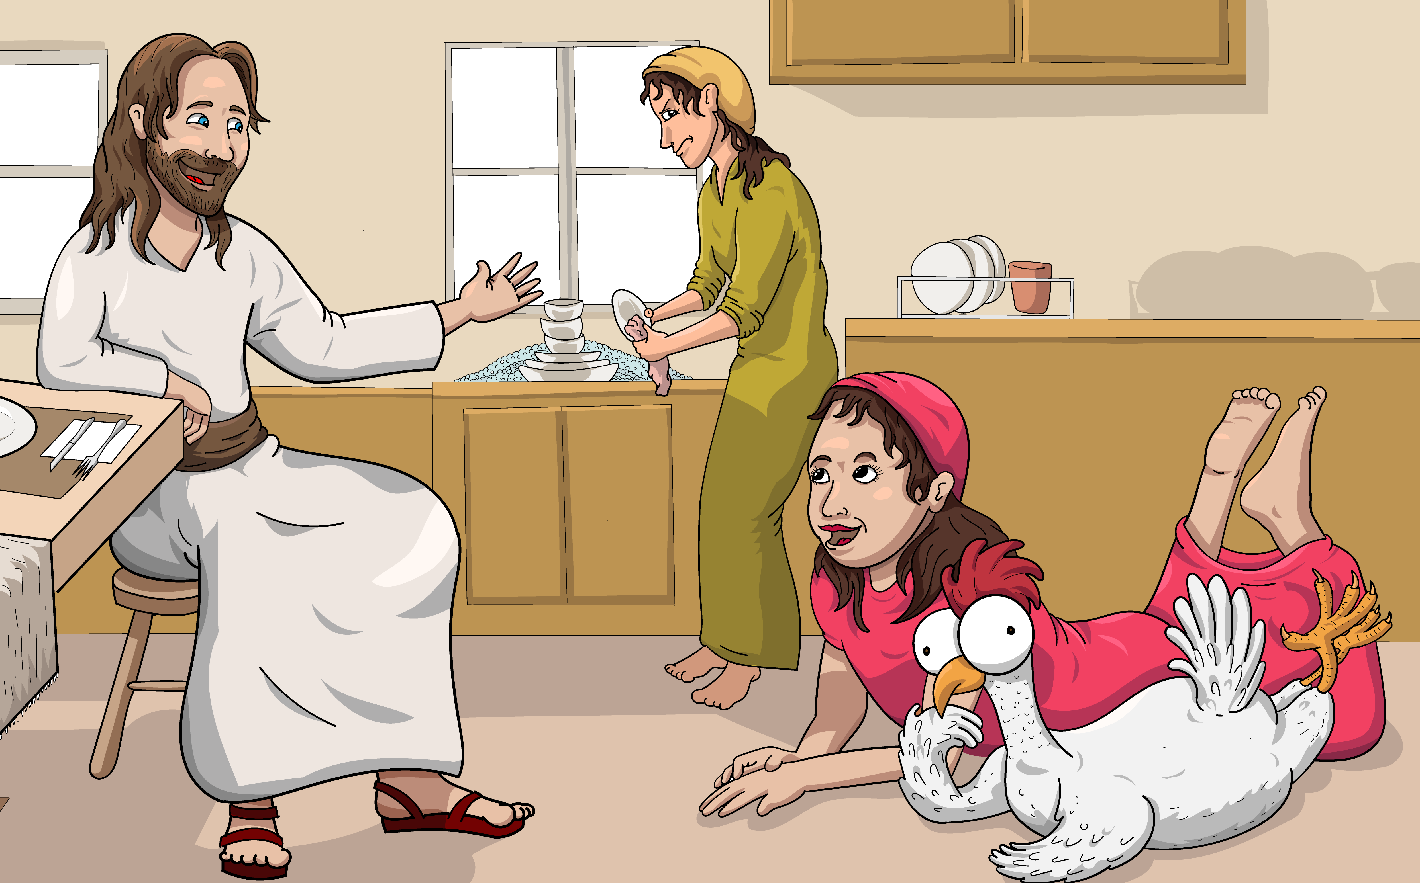
1.2 No Help Yet
Song

Slide 2
Jesus is coming, quick!

Slide 3
She ran to the pen.
Get the hen.

Slide 4
Get the eggs! Get, get, get.

Slide 5
She said, “Help!”

Slide 6
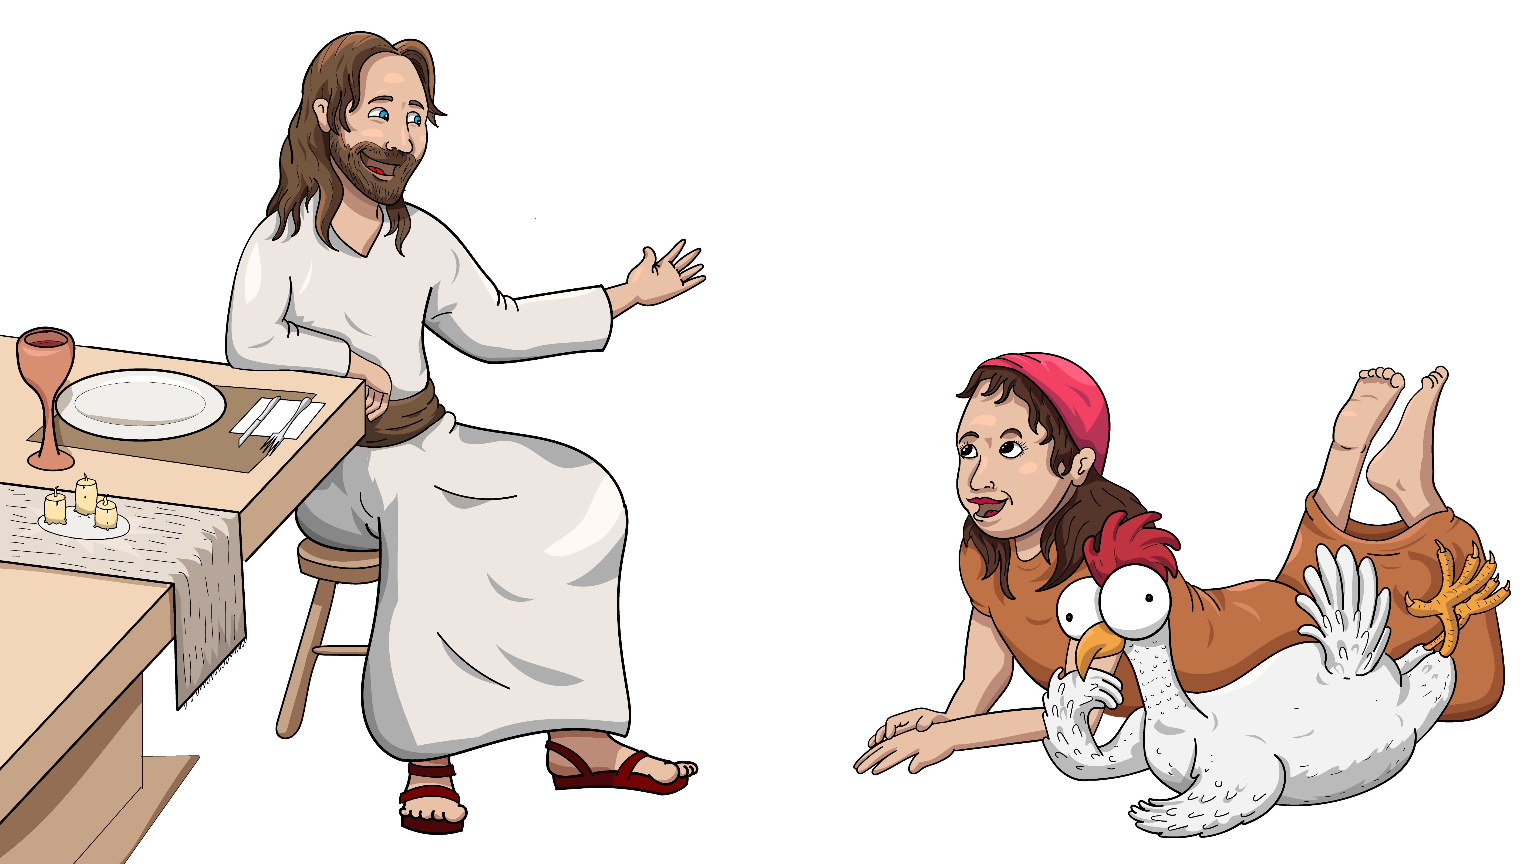
No help yet.

Slide 7
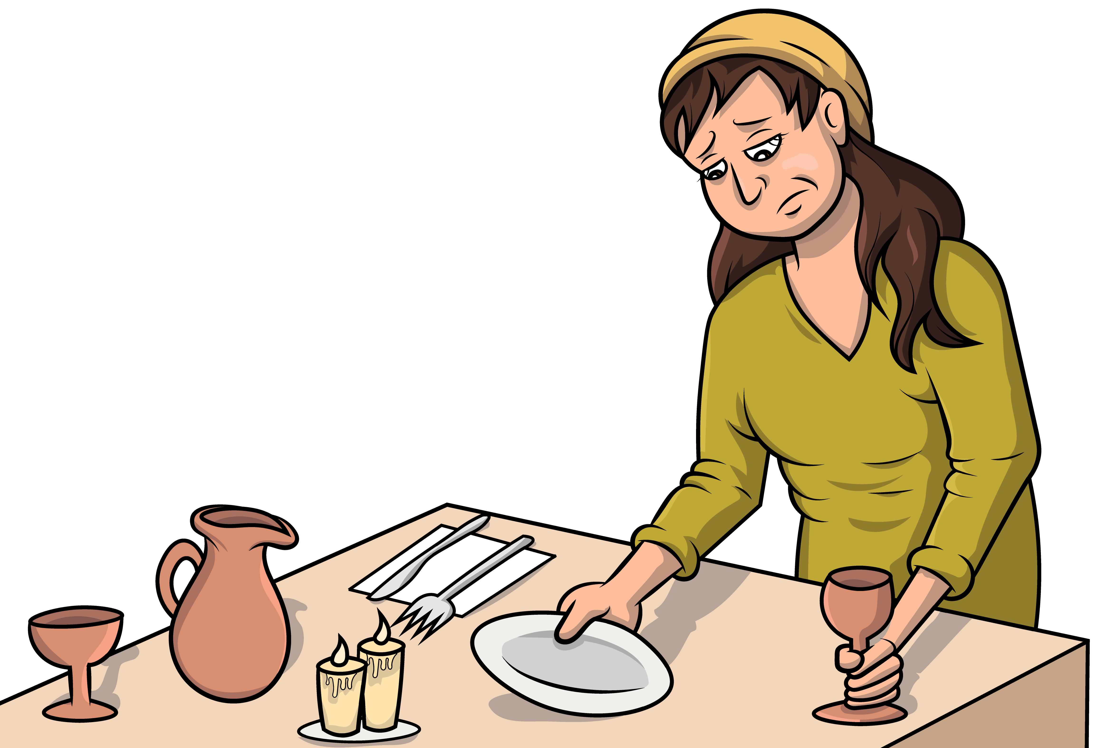
She set the table.
Set, set, set.

Slide 8
She said, “Help!”

Slide 9
No help yet.

Slide 10
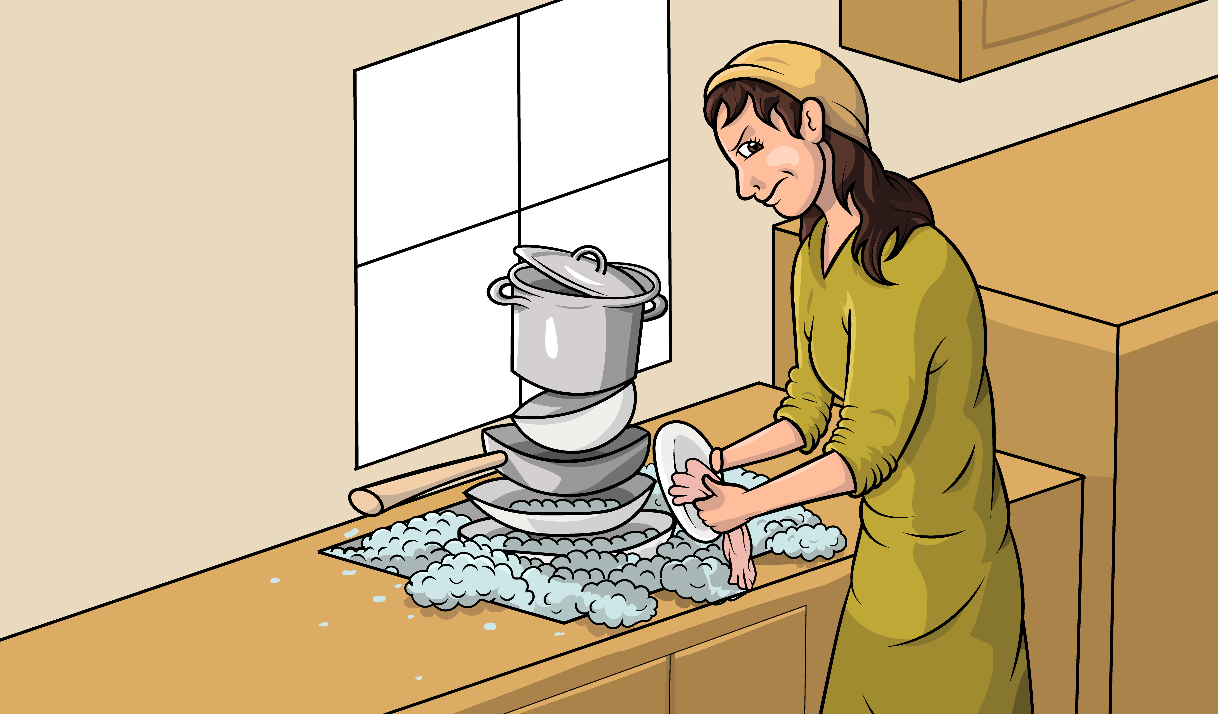
She washed the pan.
Wet,
wet,
wet.

Slide 11
She said, “Help!”

Slide 12
No help yet.

Slide 13
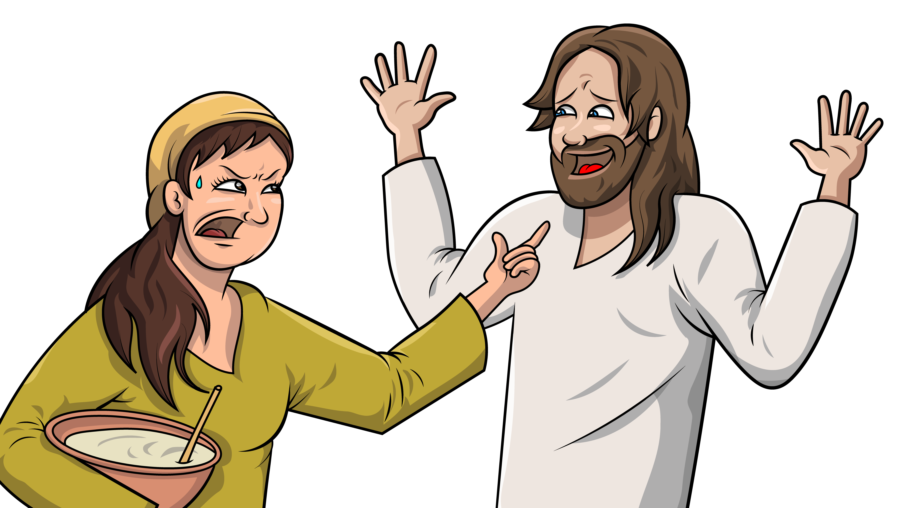
Jesus said, “Stop!
Do not fret.”

Slide 14
Let us sit.
Let us just sit together.

Slide 15
Let us sit.
Let us just sit together.

Slide 16
And so they did what Jesus said.

Slide 17
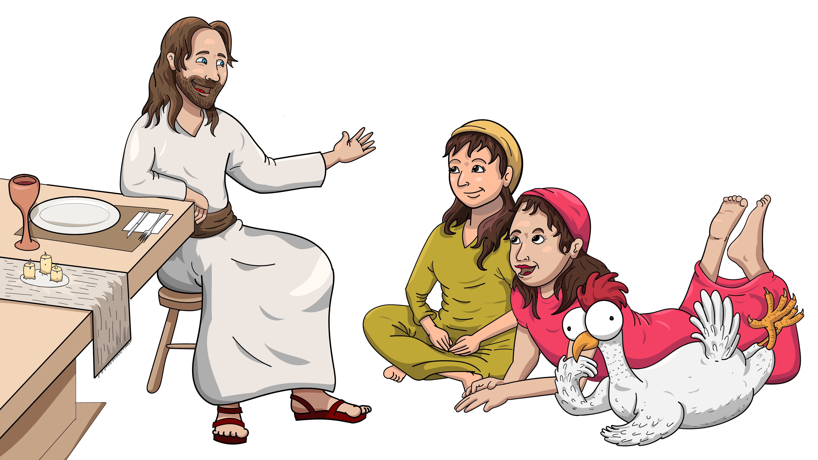
They just sat and sat.

Slide 18
Oh, they just sat and sat.

Slide 19
Let us sit.
Let us just sit together.

Slide 20
Let us sit.
Let us just sit together.

Slide 21
And so they did what Jesus said.

Slide 22
They just sat and sat.

Slide 23
Oh, they just sat and sat.

Slide 24
The End

Slide 25
Song lyrics and melody: Carol Hale
Song arrangements and singer: Steffi VornBerger
Illustrations: Ivan Mader
Power Point arrangements: Steve March
www.EasyReadEnglish.com
www.EZreadenglish.org/lower-levels

