Slide 1

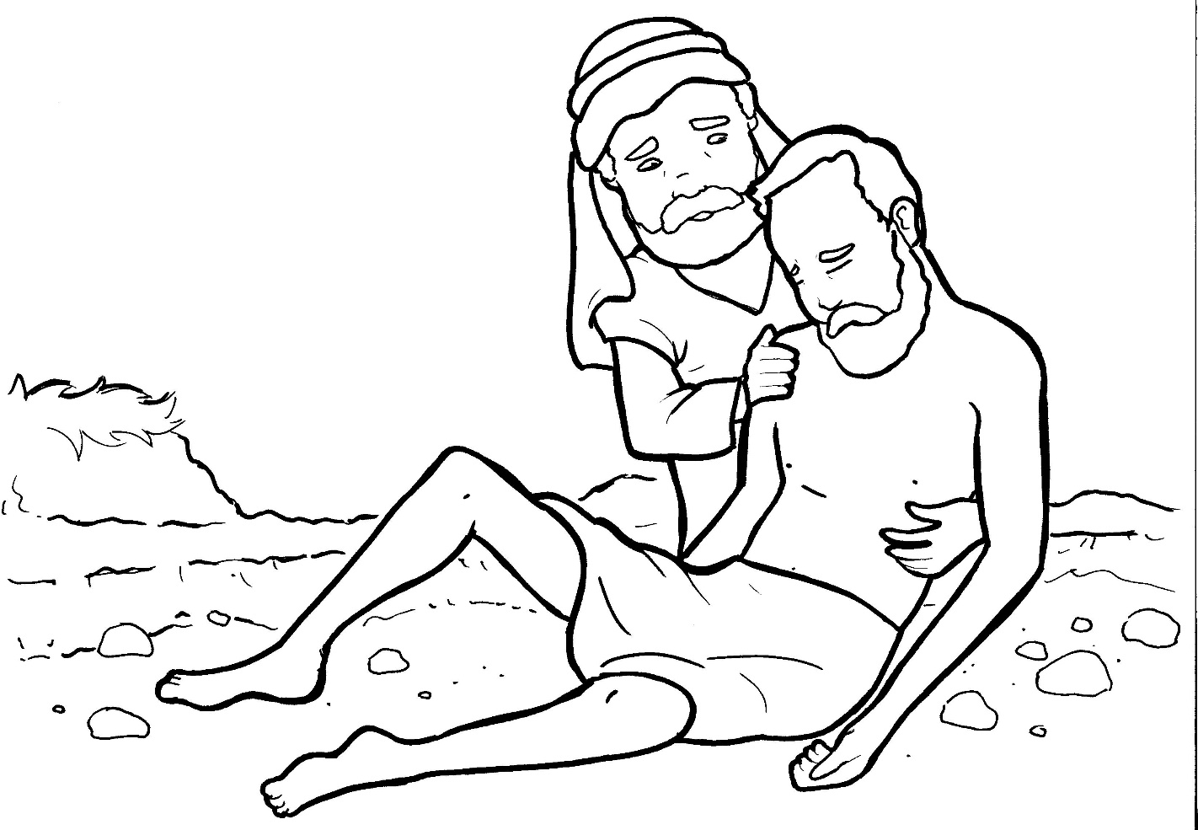
Part 3
25. The Good Samaritan
Syllable Divisions

Slide 2

Dividing Words
Into Syllables

Slide 3
Rabbit Words
When you see two consonants
between two vowels,
divide between the consonants.
ra it
bb
rab bit

Slide 4
rob ber
robber

Slide 5
al so
also

Slide 6
al most
almost

Slide 7
Tiger Words
When you see one consonant
between two vowels,
divide after the first vowel.
Try this pattern first.
ti er
g
ti ger

Slide 8
Je sus
Jesus

Slide 9
Le vite
Levite

Slide 10
Camel Words
When you see one consonant
between two vowels,
divide after the first consonant.
Try this pattern second.
ca el
m
cam el

Slide 11
Samar it an
Samaritan

Slide 12
stor y
story

Slide 13

Foxes Suffixes
Focus on your base word.
fox es
fox es

Slide 14
passed
passed

Slide 15
asked
asked

Slide 16
walked
walked

Slide 17
replied
replied

Slide 18
cleaned
cleaned

Slide 19
teach er
teacher

Slide 20
rob ber
robber

Slide 21
innkeep er
innkeeper

Slide 22
go ing
going

Slide 23
hurt ing
hurting

Slide 24
ly ing
lying

Slide 25
Jew ish
Jewish

Slide 26
Other Syllable Divisions
Some words don’t fit so neatly
into standard syllable division patterns.

Slide 27
Sa maritan
Samaritan

Slide 28
neigh bor
neighbor

Slide 29
donk ey
donkey

Slide 30

Anteater Words
These compound words are made up of two smaller words.
ant
eater
1
2
ant eater

Slide 31
inn keeper
innkeeper

