Slide 1
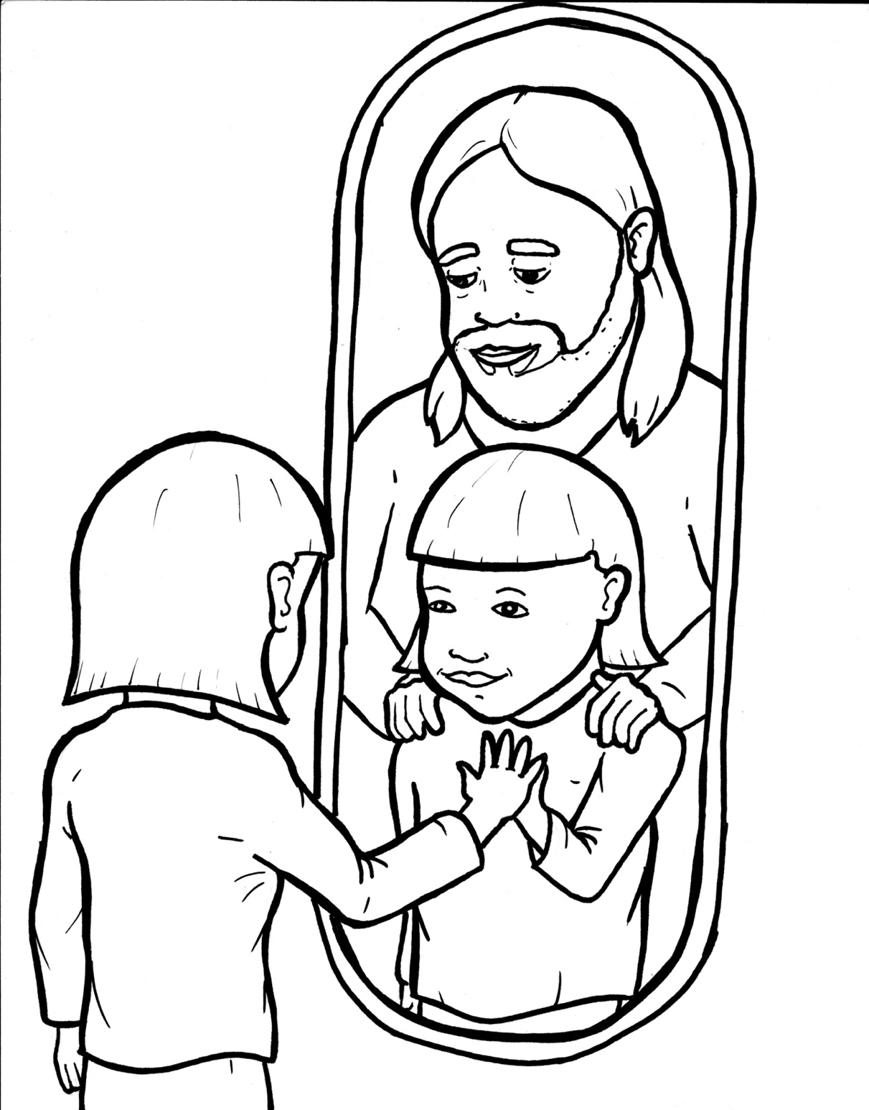
48. Wow, I'm a Christian Now!
Part 5
Vocabulary
Original Bible Story

Slide 2
Vocabulary

Slide 3
foundation
(foun –
DA –
tion):
the beginning; everything else is built upon it

Slide 4
defect
(DE –
fect):
something wrong or missing

Slide 5
pleasure
(PLEA
– sure):
enjoyment and happiness

Slide 6
favor
(FA –
vor):
approval, blessing

Slide 7
abound
(a –
BOUND):
to be filled with

Slide 8
mystery
(MYS –
y):
ter –
secret or a puzzle without an answer

Slide 9
Wow, I'm a
Christian Now!
Ephesians 1:3-10
World English Bible (WEB)

Slide 10
Blessed be the God and Father of our Lord Jesus Christ, who has blessed us with every spiritual blessing in the heavenly places in Christ,

Slide 11
even as he chose us in him before the foundation of the world, that we would be holy and without defect before him in love,

Slide 12
having predestined us for adoption as children through Jesus Christ to himself, according to the good pleasure of his desire,

Slide 13
to the praise of the glory of his grace, by which he freely gave us favor in the beloved,

Slide 14
in whom we have our redemption through his blood, the forgiveness of our trespasses, according to the riches of his grace,

Slide 15
which he made to abound toward us in all wisdom and prudence,

Slide 16
making known to us the mystery of his will, according to his good pleasure which he purposed in him

Slide 17
to an administration of the fullness of the times, to sum up all things in Christ, the things in the heavens and the things on the earth, in him.

