Slide 1
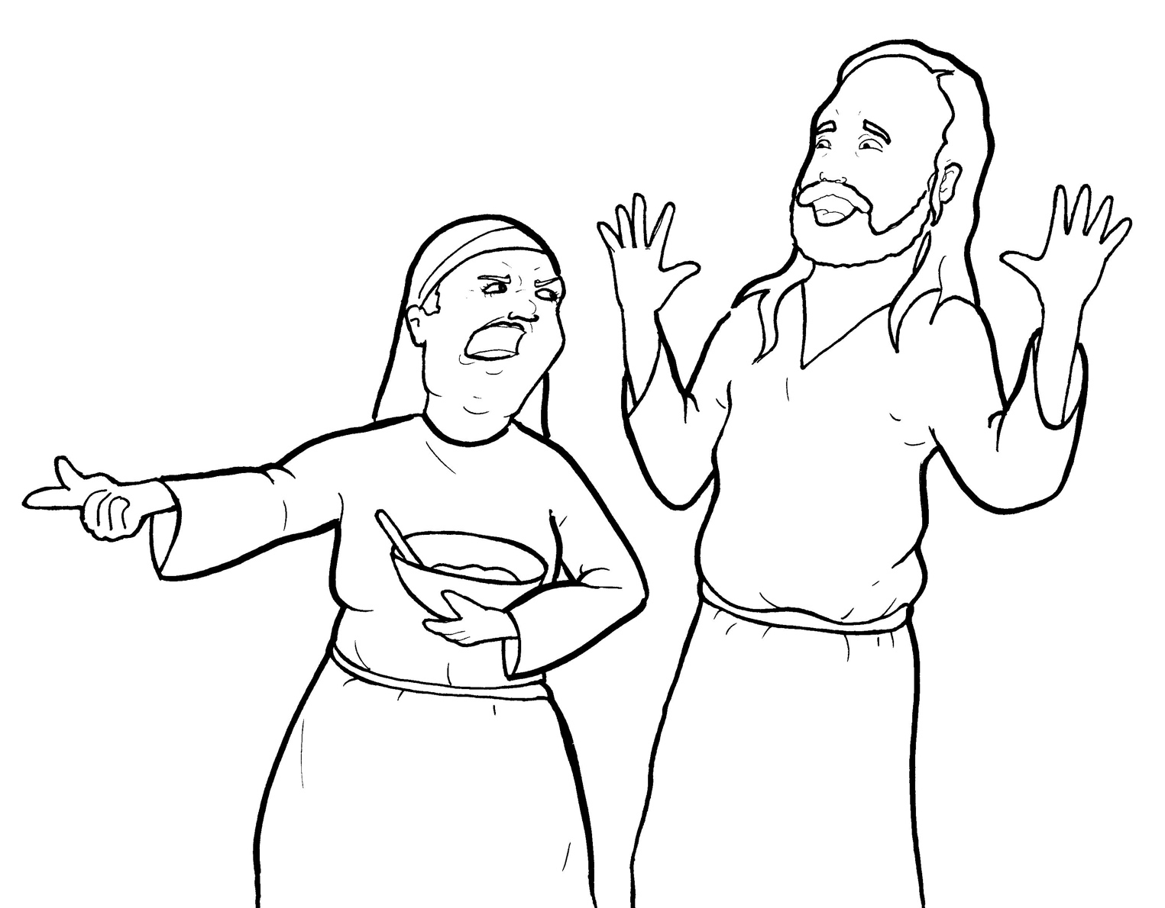
13. Martha Gets Mad
Part 1
Syllable Charts

Slide 2
Words in Syllable Types

Slide 3
Closed – Short Vowel
A closed syllable has one vowel
followed by one or more consonants,
and the vowel is short.
st
o
p
˘

Slide 4
at
sat
mad
ask

Slide 5
-sen
-ken
-self
help
ques-
swept

Slide 6
sis-
lit
dis-
fish

Slide 7
got
not

Slide 8
up-
-sus
grum-
just

Slide 9
Open – Long Vowel
An open syllable has one vowel
with no consonant after it,
and the vowel is long.
−
go

Slide 10
ta ken

Slide 11
be
re plied
she
Je sus

Slide 12
dis ci ples

Slide 13
no
cho sen

Slide 14
by
my self

Slide 15
Mar y

Slide 16
Silent e – Long Vowel
A silent e syllable has one vowel,
followed by one consonant
and a silent e at the end.
The vowel is long.
−
ca
e
v

Slide 17
came
name
make
care

Slide 18
time
nice
fire
tired

Slide 19
home

Slide 20
Vowel Teams – Long Vowel
Many vowel teams follow this rule:
When two vowels get together,
the first one names its letter.
So the first vowel will make its long sound,
and the second vowel is silent.
−
e
a
t

Slide 21
a way

Slide 22
meet
need

Slide 23
meal

Slide 24
worried

Slide 25
fried
re plied

Slide 26
Vowel Teams – Other Sounds
Sometimes vowel teams make other sounds.
oil

Slide 27
saw

Slide 28
a bout

Slide 29
R - Controlled
R-controlled syllables have one or more vowels
followed by an “r.”
The “r” changes the sound of the vowel.
o
r
ange

Slide 30
Mar tha

Slide 31
her
sis ter
ser ving

Slide 32
or
for
Lord

Slide 33
hurt

Slide 34
Mar y

Slide 35
care

Slide 36
learn ing

Slide 37
work ing
wor ried

Slide 38
Consonant – l-e
When you see consonant l-e at the end of a word,
count back three.
The “l-e” makes the /–le/ sound.
pur
p
l
e

Slide 39
dis ci ples

Slide 40
grum bled

Slide 41
Other Sounds – -nk/-ng
The “-nk” and “-ng”
change the sound of the vowel.
bank
thing

Slide 42
learn ing
serv ing
work ing

Slide 43
ques tions

Slide 44
Other Sounds – schwa
The schwa syllable has an “a” that sounds
like the /u/ in banana.
The banana is even shaped like a short u.
ba nan a

Slide 45
a way
a bout
Marth a

Slide 46
loved

