Slide 1
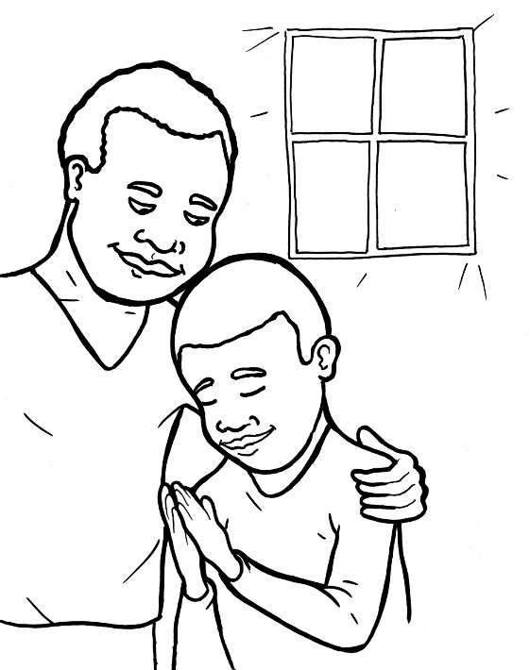
Timing
Box
50. I Am Alive: Prayer
Part 5
Vocabulary
Original Bible Story

Slide 2
Vocabulary
Timing
Box

Slide 3
Timing
Box
cherish
(CHER –
ish):
hold as dearly loved

Slide 4
Timing
Box
Yahweh
(YAH -
weh):
the Hebrew name of God

Slide 5
Timing
Box
cease
(cease):
stop

Slide 6
Timing
Box
boldness
(BOLD -
ness):
being brave

Slide 7
Timing
Box
grace
(grace):
special kindness

Slide 8
Timing
Box
commandments
(com –
MAND –
ments):
God’s laws for humans

Slide 9
Timing
Box
I am Alive: Prayer-I P-R-A-Y
Ephesians 6:18 and others
World English Bible (WEB)

Slide 10
Timing
Box
When Jesus finished praying in a certain place,
one of his disciples said to him, “Lord, teach us
to pray...”
Luke 11:1a

Slide 11
Timing
Box
I am sorry.
If I cherished sin in my heart, the Lord wouldn’t
have listened.
Psalm 66:18

Slide 12
Timing
Box
Praise
Praise him!
Yahweh, how many are your works! In wisdom,
you have made them all. The earth is full of your
riches.
Psalm 104: 24

Slide 13
Timing
Box
Rejoice!
Always rejoice. Pray without ceasing.
In everything give thanks, for this is the will of
God in Christ Jesus toward you.
1 Thessalonians 5:16-18

Slide 14
Timing
Box
Ask
Ask him for help and for what you would like.
Let’s therefore draw near with boldness
to the throne of grace,

Slide 15
Timing
Box
that we may receive mercy and may find
grace for help in time of need.
Hebrews 4:16

Slide 16
Timing
Box
Yes.
“Yes, God, I want to obey.”
If you love me, keep my commandments.
John 14:15

Slide 17
Timing
Box
Pray at all times in the Spirit.
Ephesians 6:18b

