Slide 1
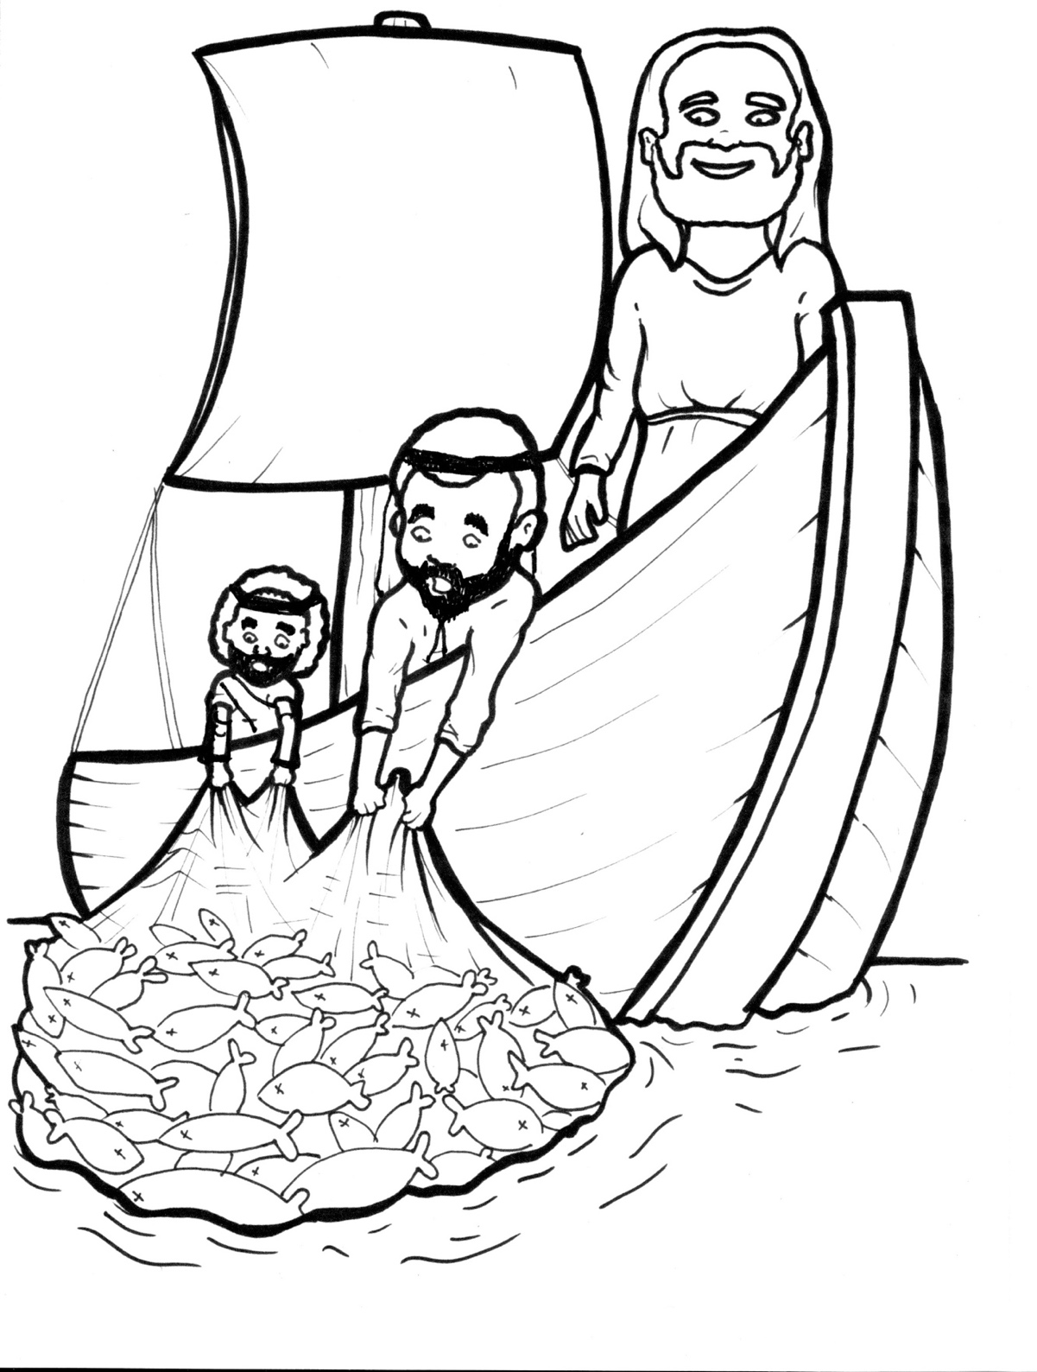
16. Jesus Commands Fish
Part 2
New Words
Rule Breakers

Slide 2
Silent Letters
John

Slide 3
Contractions
The first word stays the same,
and the apostrophe takes the place
of the missing letters in the second word.
do
n’t
=
do
not

Slide 4
New Words
Simon Peter
sardines
Master
barbels

Slide 5
Rule Breakers
These words do not follow phonetic patterns.

Slide 6
from
two

Slide 7
into
of
one
pull
put
said

Slide 8
there
you
your
was
were
laugh

