Slide 1
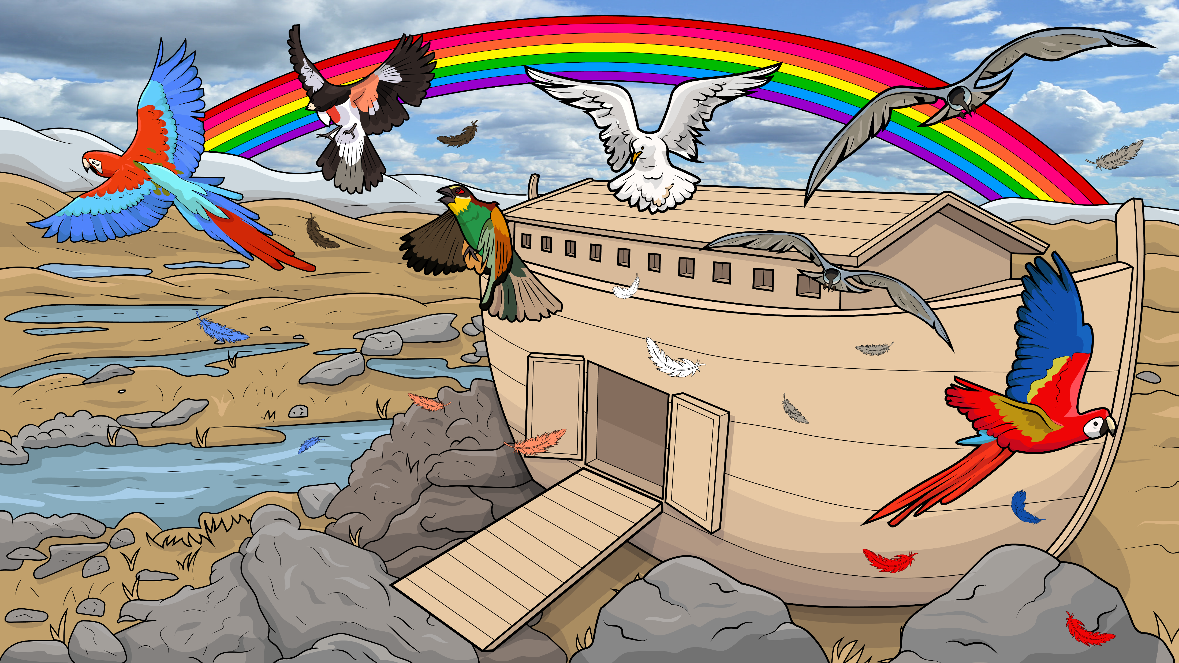
Story 1.11
Drip, Drop, Stomp, Clomp
Noah’s Ark, Part 3
Genesis 8
( Blends )

Slide 2
New Words to Read
plip plop drip drop flip flop flap clip clap

Slide 3
splash crash last
blast frogs ponds
glad stop shrimps

Slide 4
squids clams swam
snip snap jump
bump trump thump

Slide 5
flock fresh smells
romp stomp clomp tromp
grand grass plants

Slide 6
Sight Words
old came

Slide 7
Rule Breakers (Read and Spell)
the what
into they

Slide 8
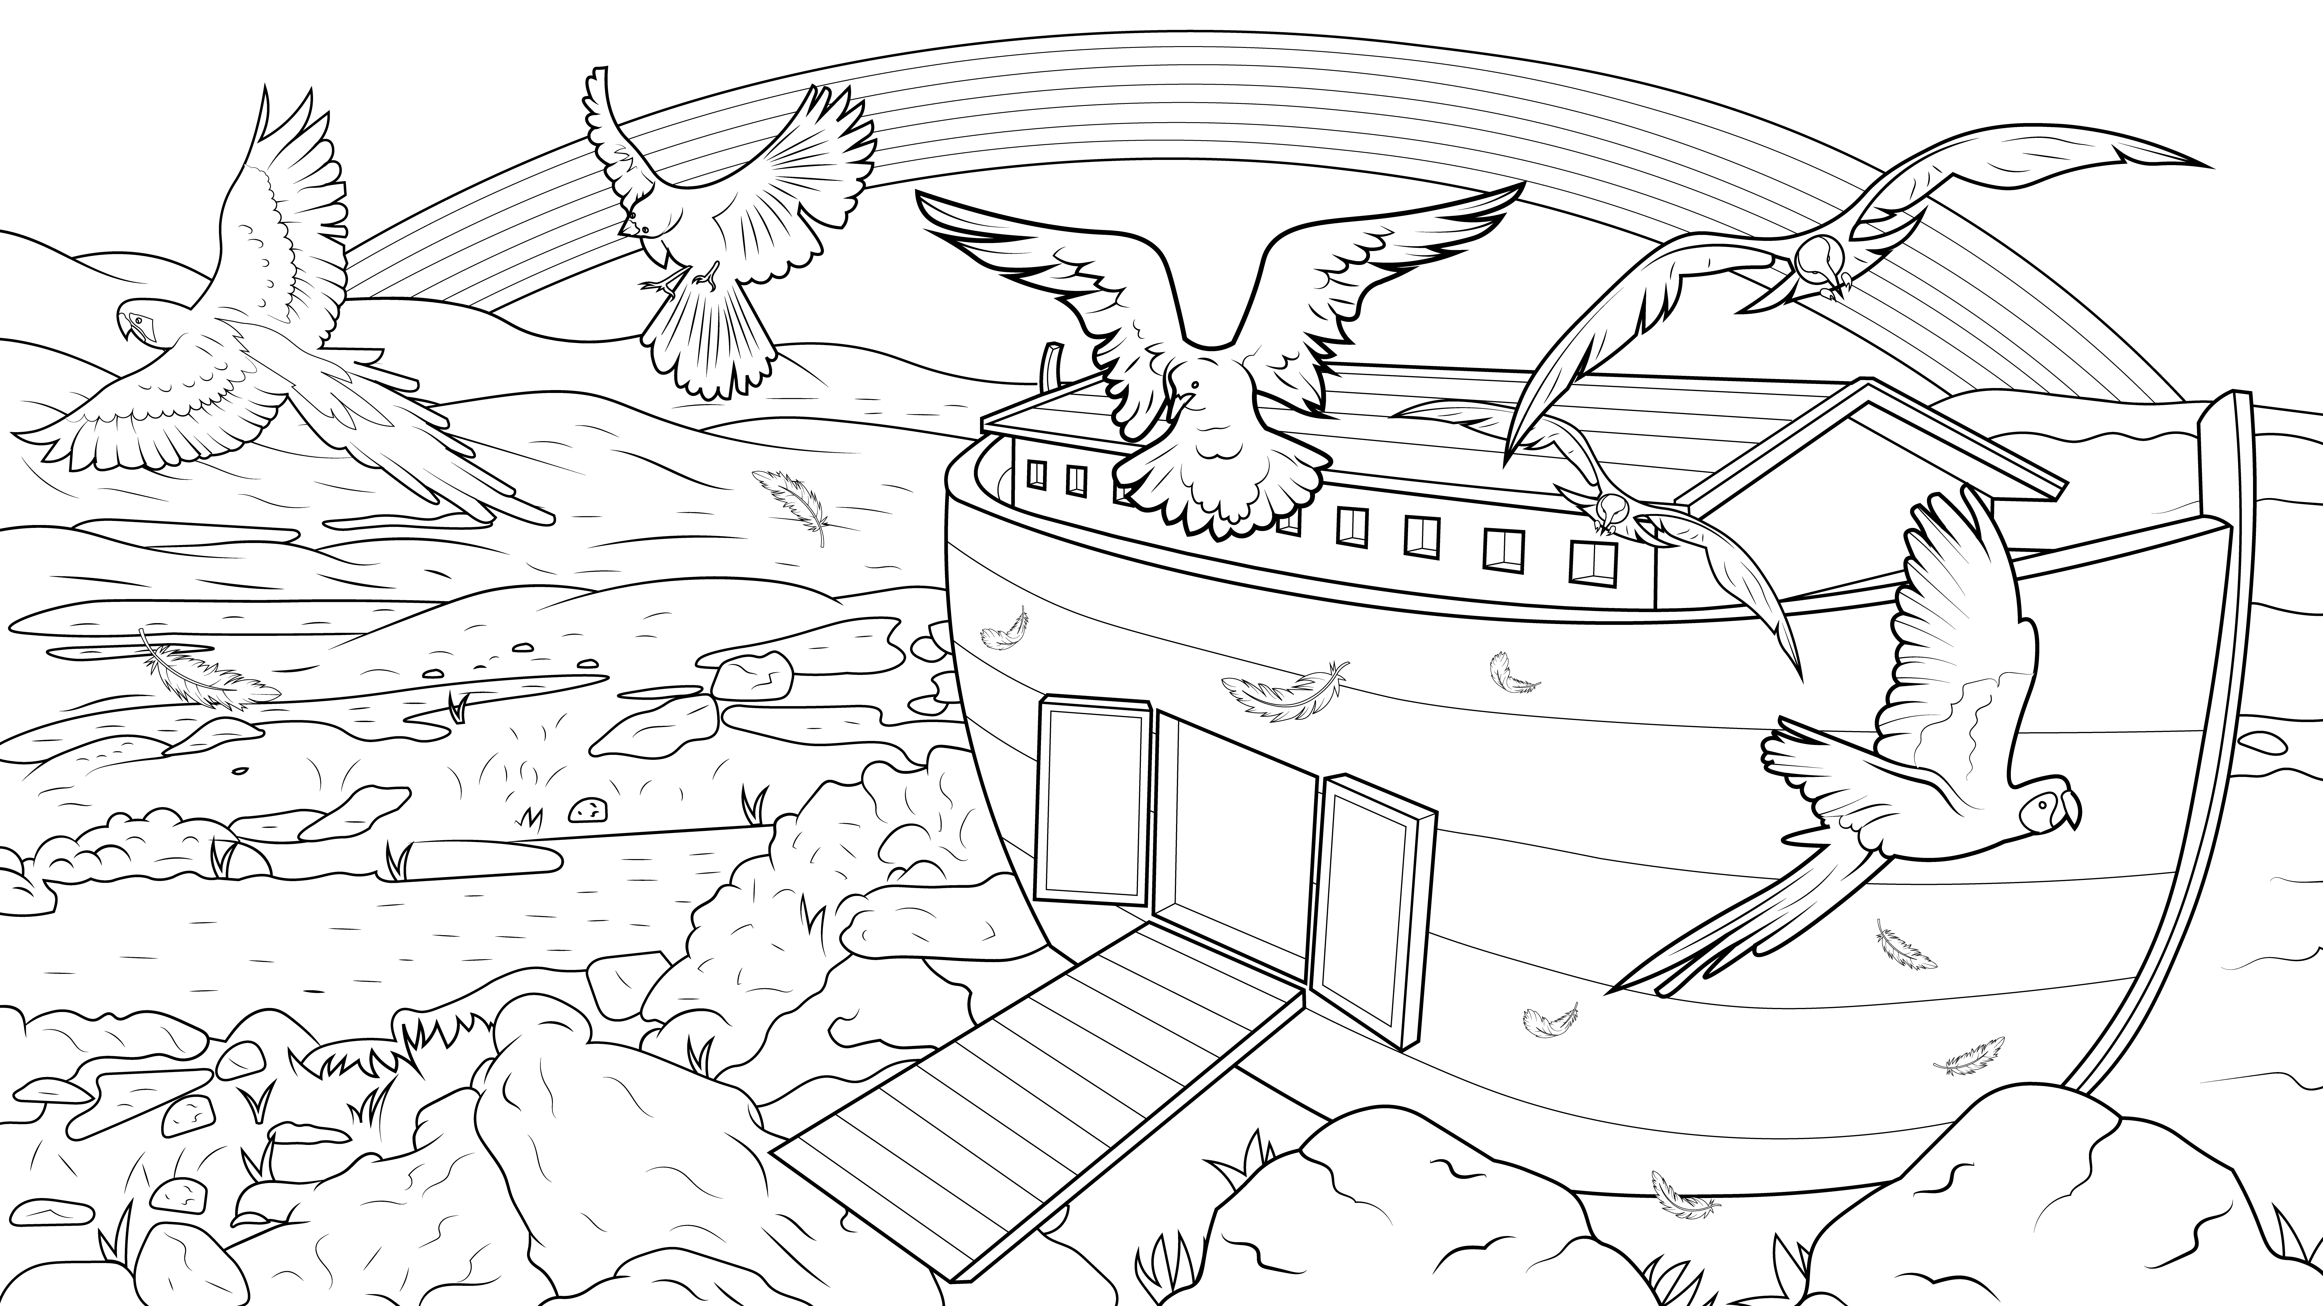
I Read, You Read Bible Story
Story 1.11
Drip, Drop, Stomp, Clomp

Slide 9
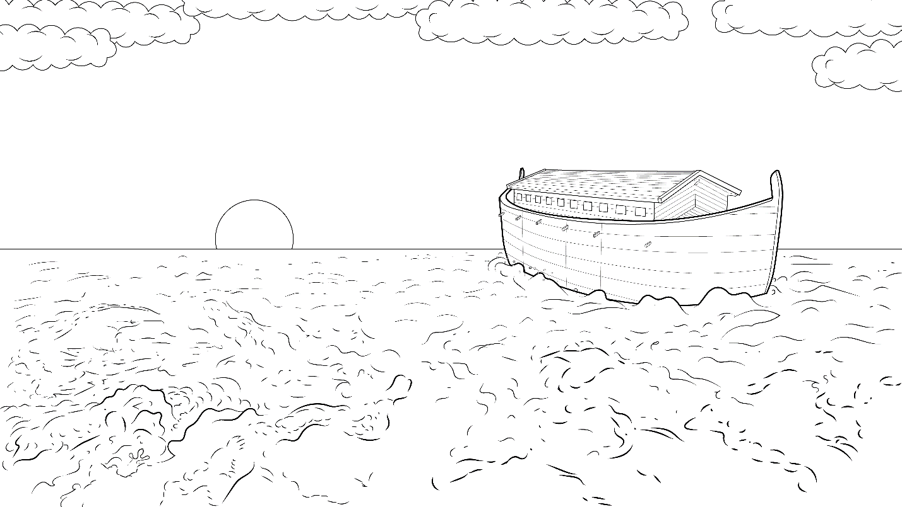
God remembered that ark floating alone upon the waters.

Slide 10
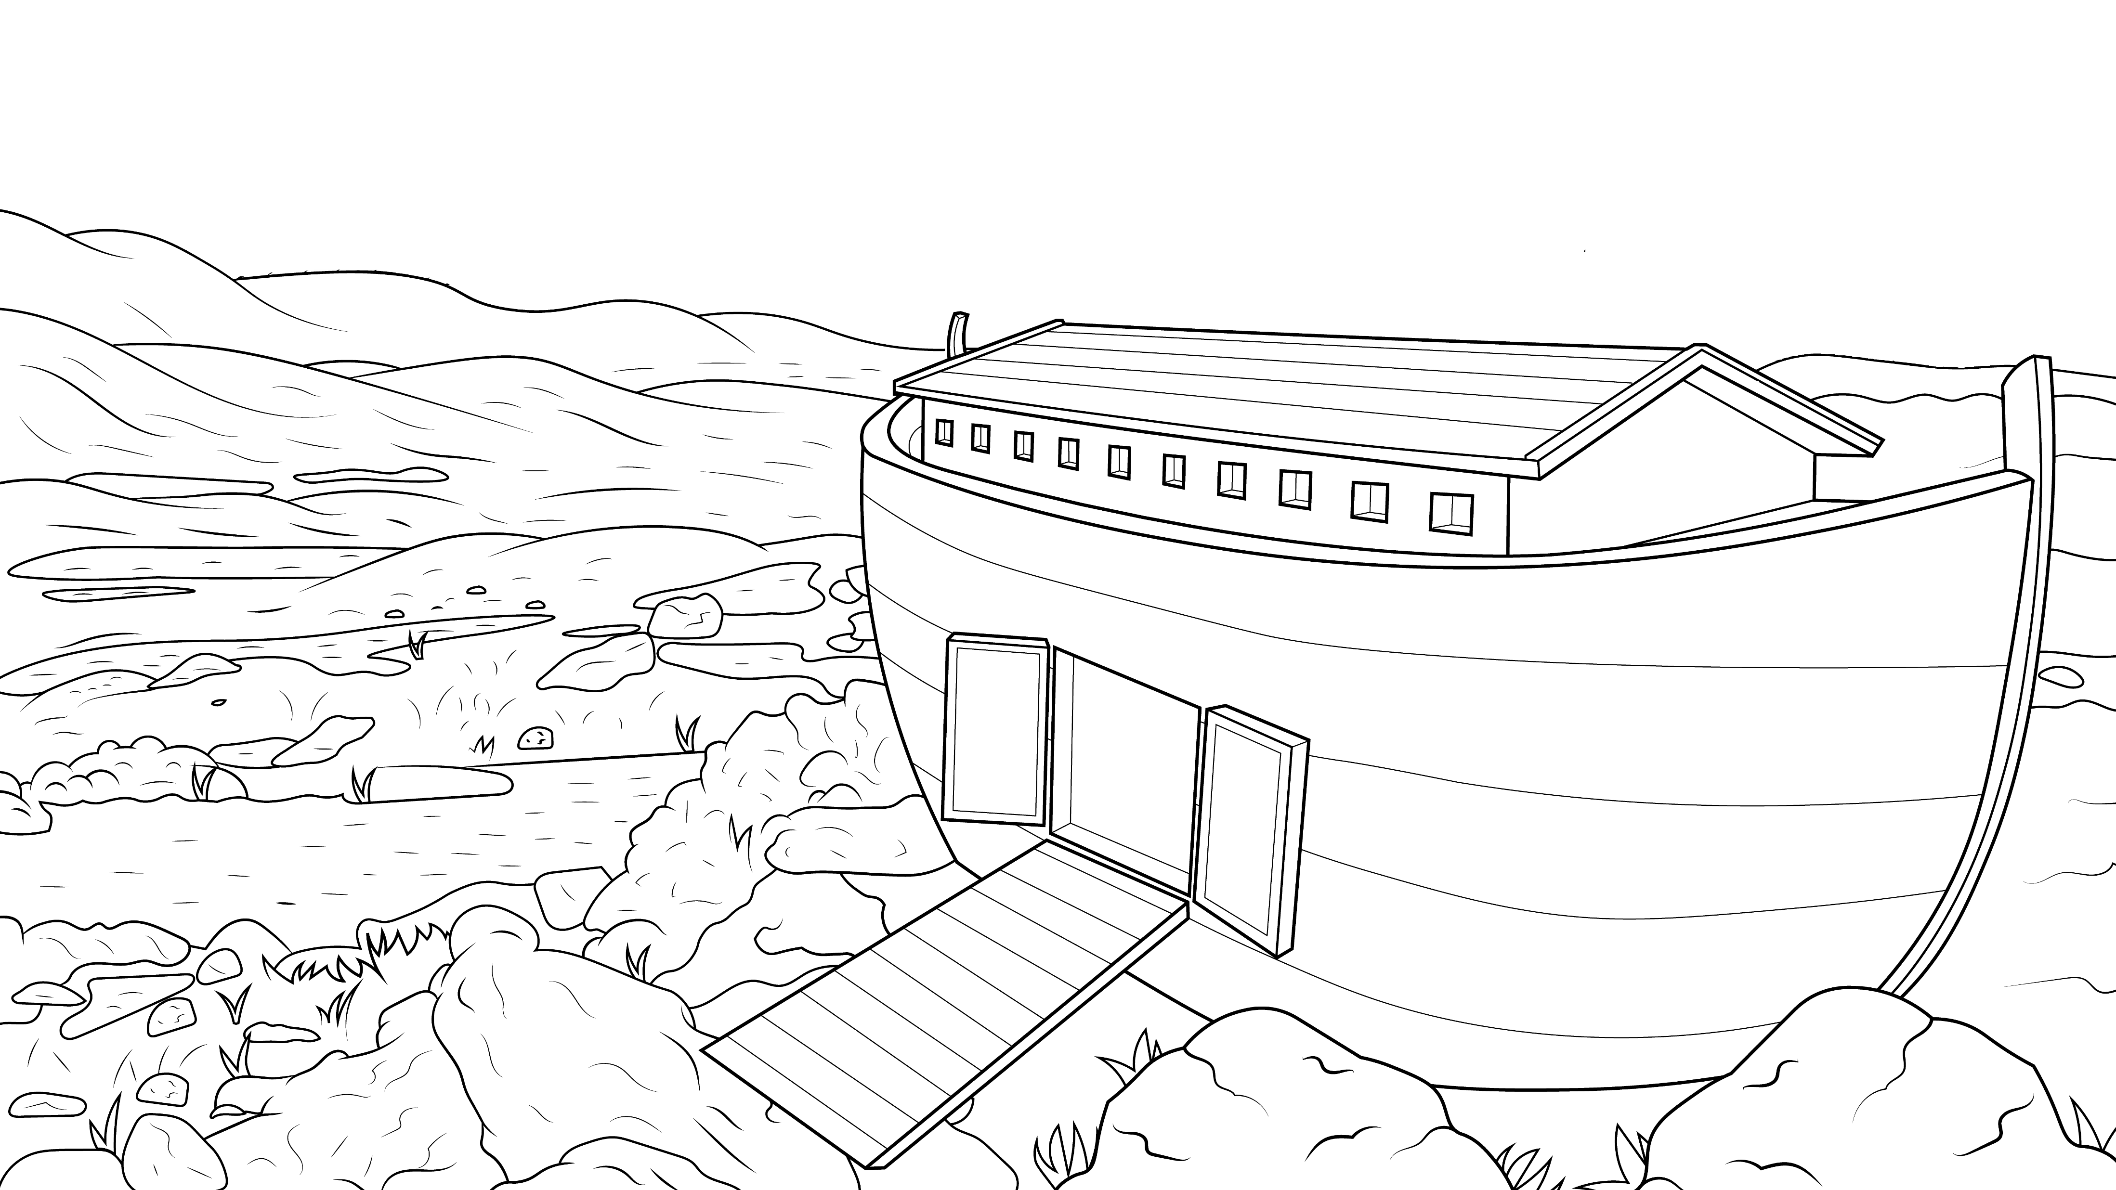
With a plip and a plop and drip and a drop, that big, old ship came to a stop.

Slide 11
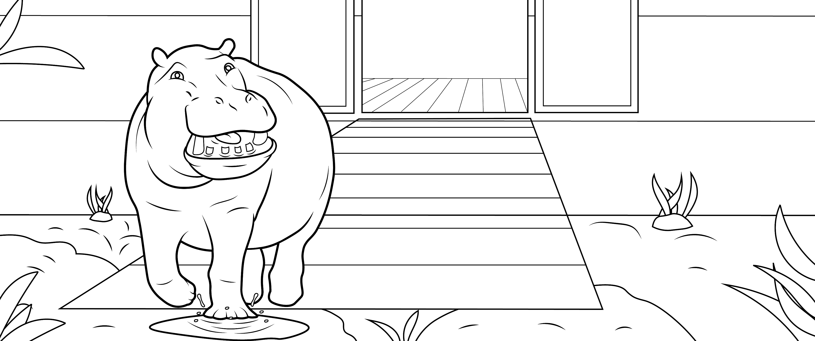
Noah opened the ark door, and God said, “Come out.”

Slide 12
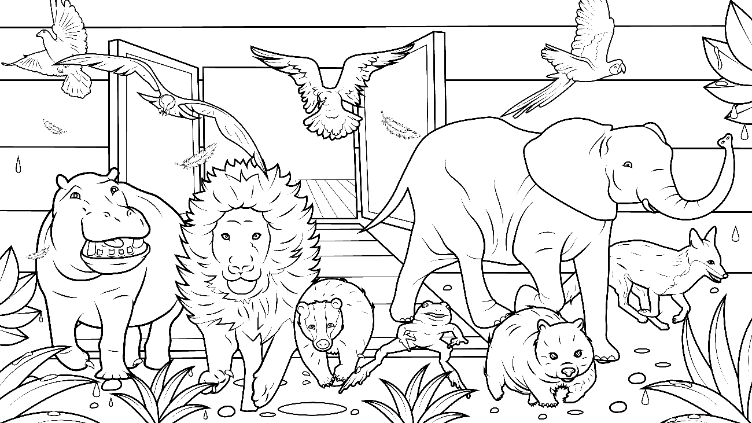
Splash, crash – off at last.
What a blast! So glad!

Slide 13
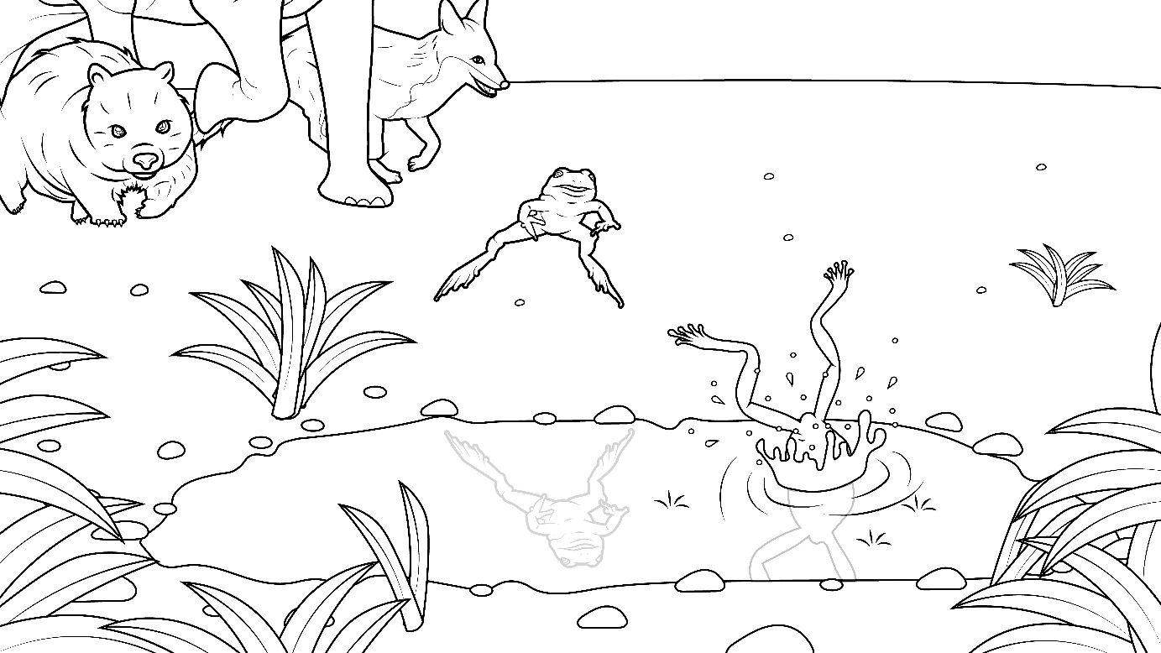
With a flip and a flop, the frogs did hop into the ponds
and swim off.

Slide 14
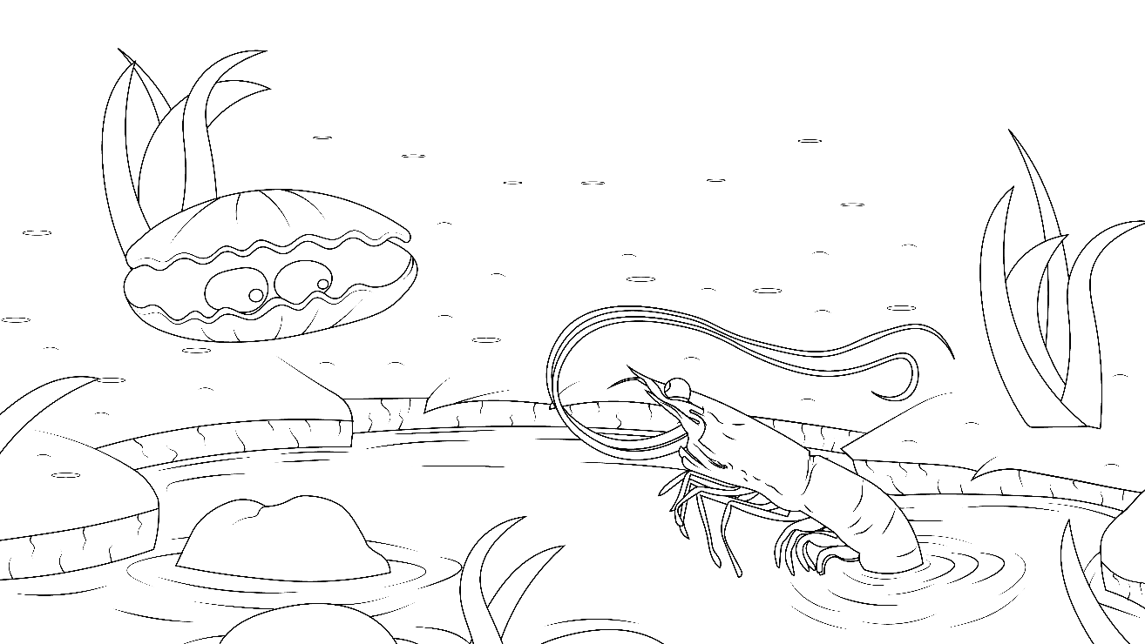
The shrimps, squids, and clams, off they swam.

Slide 15
The elephants and baby calves did almost
jump with a trump and a bump - off they did thump.

Slide 16
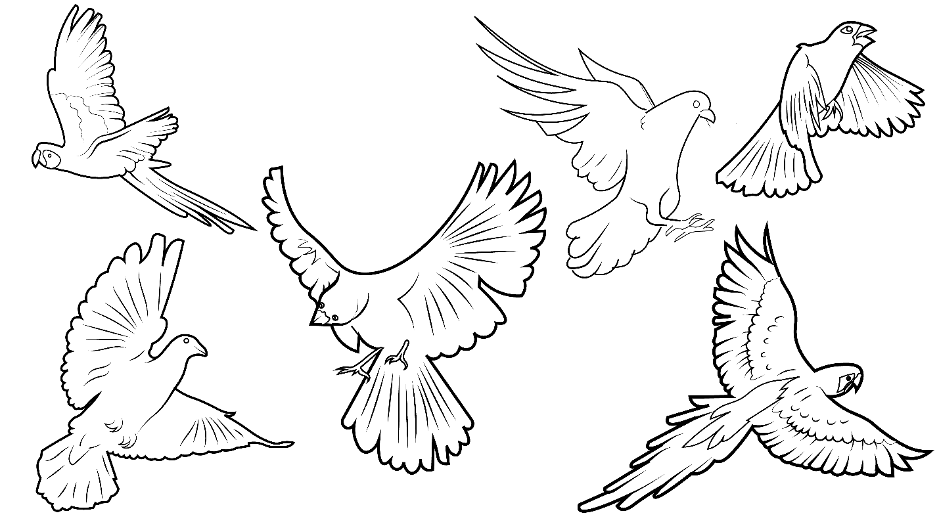
With their wings, flamingos and flying things –
off in a flock with a flip they did flap.

Slide 17
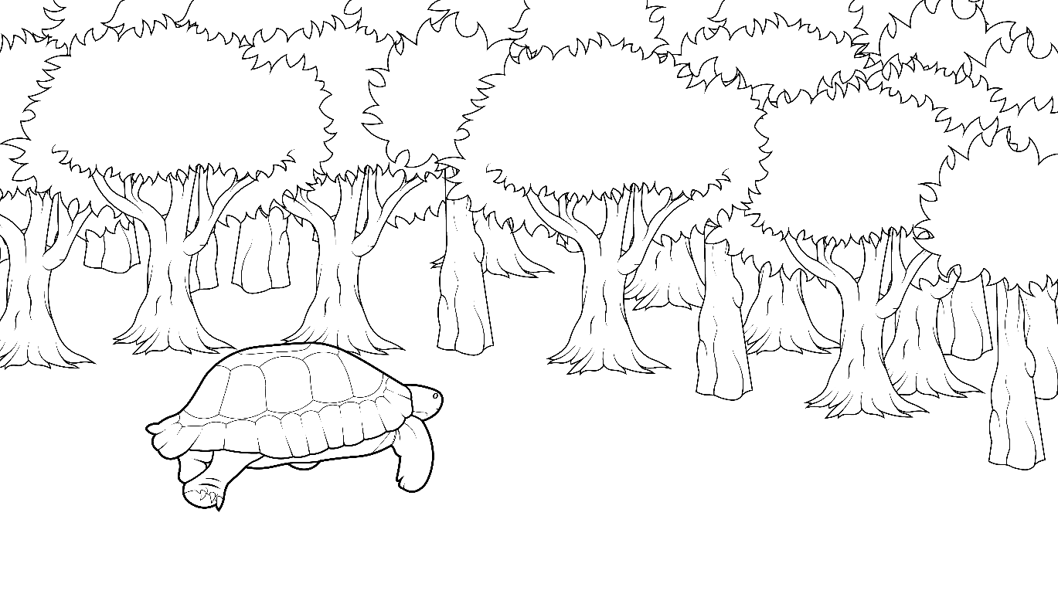
With a snip and a snap and a clip and a clap the turtles crept into the woods.

Slide 18
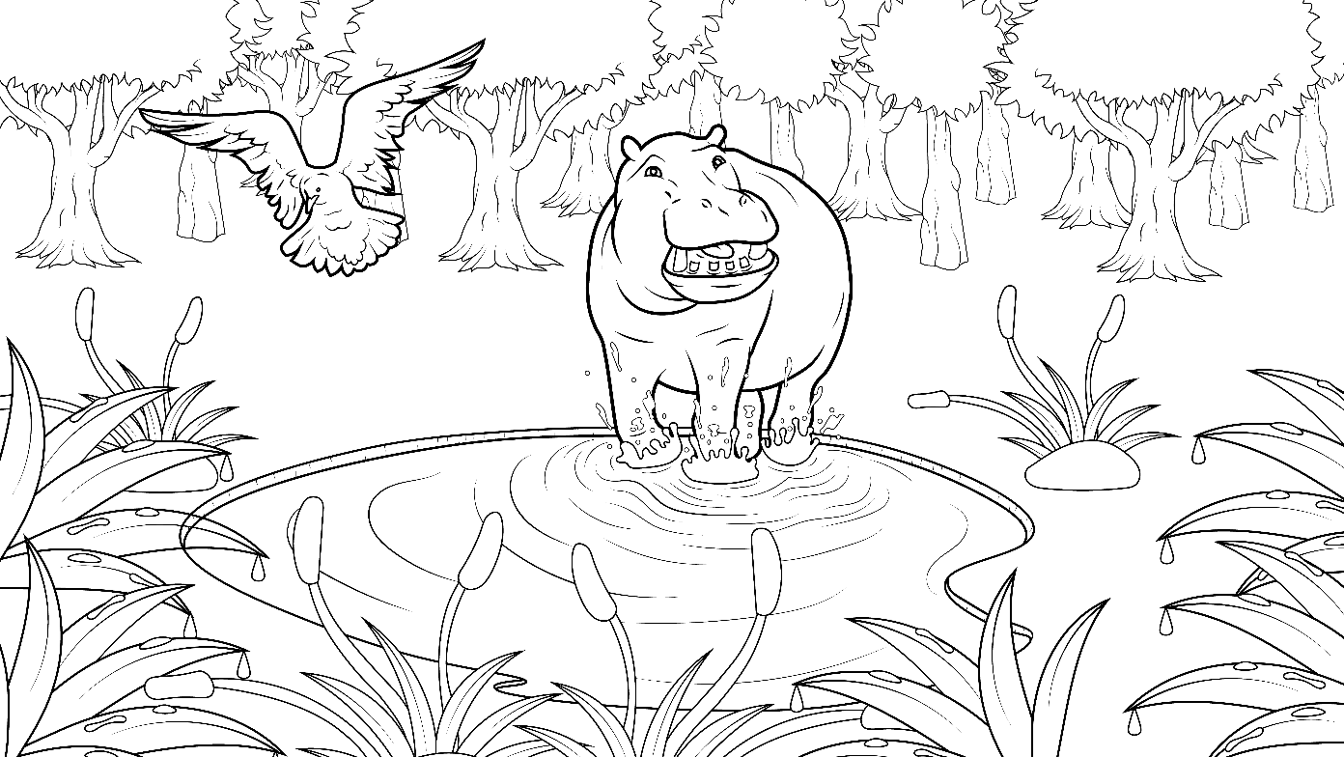
Romp, tromp, stomp, clomp -
the hippopotamuses did tromp into the ponds.

Slide 19
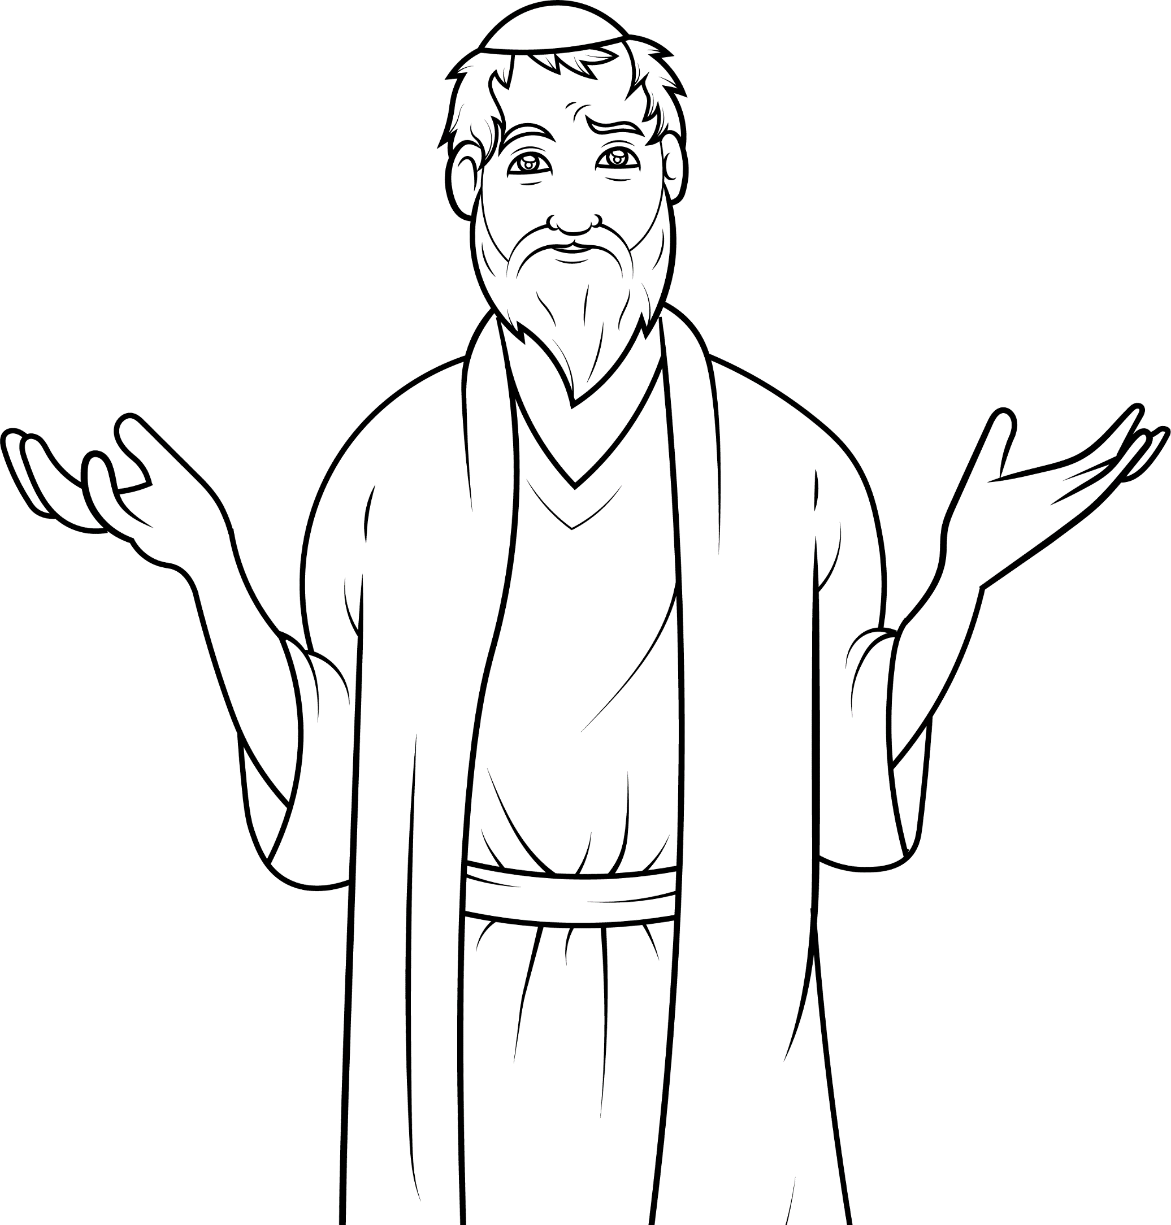
Noah and his family gasped at the new world
with fresh smells, fresh grass, and grand plants.

Slide 20
God promised he would never again flood
the earth.

Slide 21
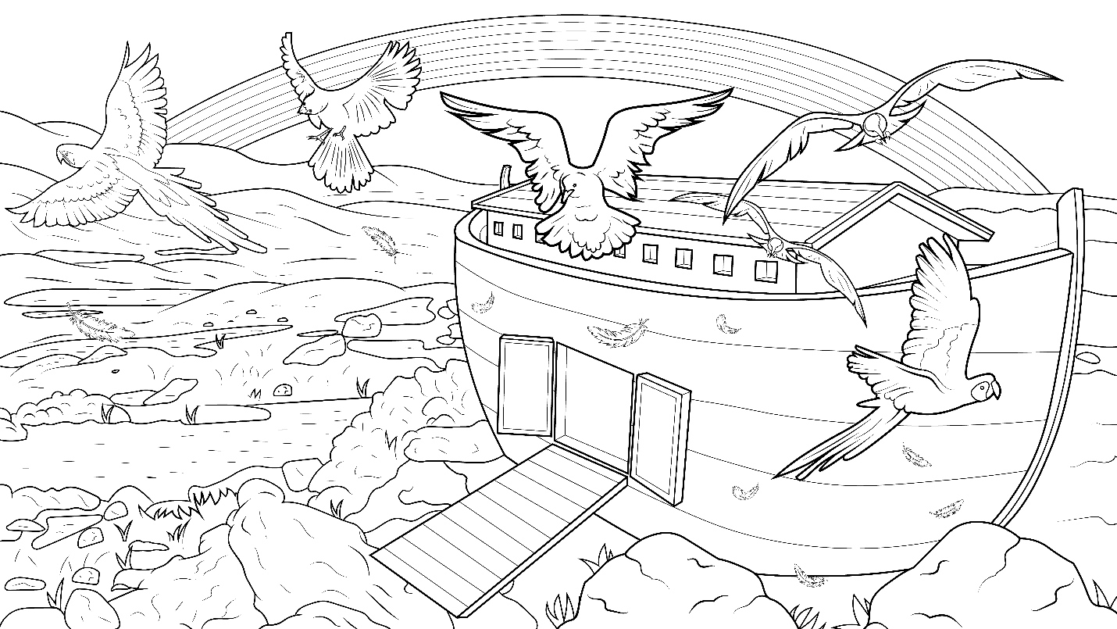
He smiled on the new world
with a big, beautiful rainbow.

Slide 22
The End

Slide 23
1.11 Story Without Illustrations
Drip, Drop,
Stomp, Clomp

Slide 24
God remembered that ark floating alone upon the waters.
With a plip and a plop
and drip and a drop,
that big, old ship came to a stop.

Slide 25
Noah opened the ark door, and God said, “Come out.” Splash, crash – off at last.
What a blast! So glad!
With a flip and a flop, the frogs did hop into the ponds and swim off.

Slide 26
The shrimps, squids, and clams,
off they swam.
The elephants and baby calves did almost jump with a trump and a bump off they did thump.

Slide 27
With their wings, flamingos and flying things - off in a flock with a flip they did flap.
With a snip and a snap and a clip and a clap, the turtles crept into the woods.

Slide 28
Romp, tromp, stomp, clomp –
the hippopotamuses did tromp into
the ponds.
Noah and his family gasped at the new world with fresh smells, fresh grass, and grand plants.

Slide 29
God promised he would never again flood the earth.
He smiled on the new world with a big, beautiful rainbow.

Slide 30
The End

Slide 31
Story: Carol Hale
Illustrations: Ivan Mader
Power Point arrangements: Steve March
www.EasyReadEnglish.com
www.EZReadEnglish.org/lower-levels

Slide 32
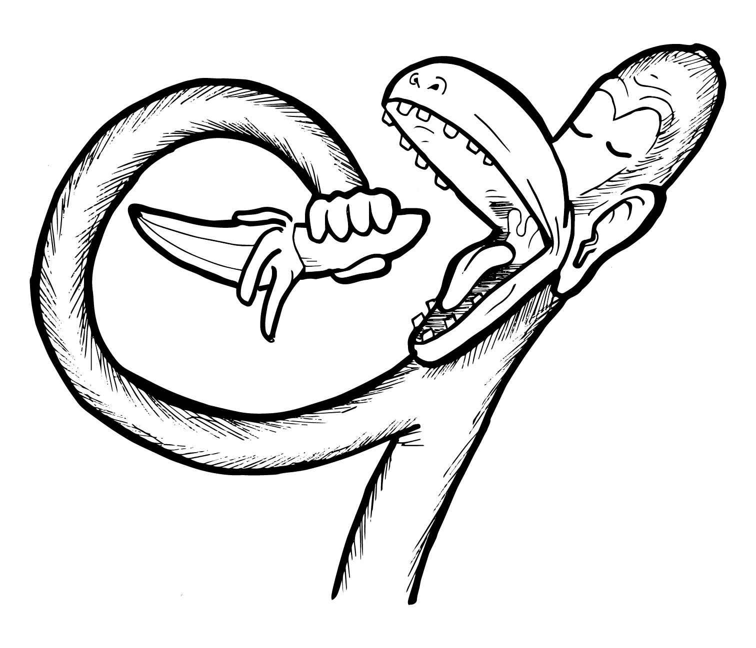
Another important teaching tool…
Easy Breezy Reading (https://www.easybreezyreading.com)
Designed to help new, struggling, and especially dyslexic learners, Easy Breezy Reading is broken up into Laughing Letters and Funny Phonograms. Both tools use illustrated patterns that mimic the shapes of the letters to give your students one more sense to link the phonetic sound of the letters.
ey
monk
Our scope and sequence matches Easy Read English Lower Levels. Progressing through the Easy Breezy Reading curriculum is sure to accelerate your students’ comprehension of the written English language.
You can procure Laughing Letters or Funny Phonograms through our website.
https://www.easybreezyreading.com/curriculum

