Slide 1
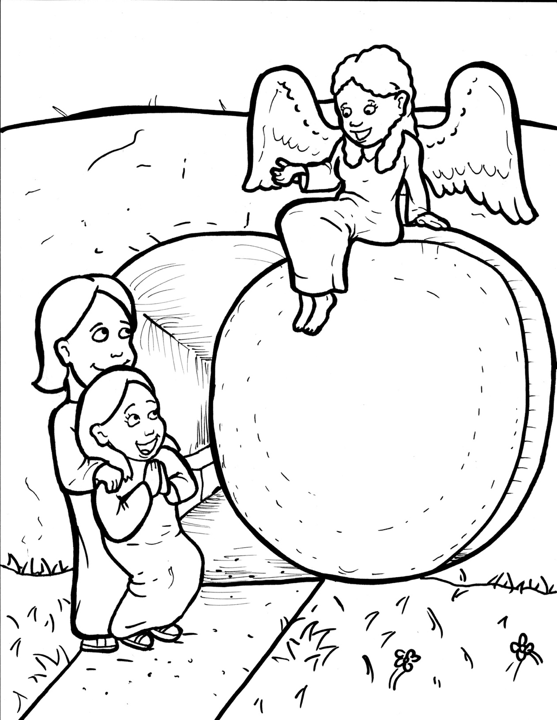
Part 1
41. Jesus is Alive!
Syllable Charts

Slide 2
Words in Syllable Types

Slide 3
Closed – Short Vowel
A closed syllable has one vowel
followed by one or more consonants,
and the vowel is short.
st
o
p
˘

Slide 4
Timing
Box
af-
that
had
ran
hap-
and

Slide 5
Timing
Box
men
-en
-mem-
-den

Slide 6
Timing
Box
yes
fell
emp-
tell
went
smell

Slide 7
Timing
Box
in
it
ris-
dis-
liv-
did

Slide 8
Timing
Box
with
strips
lin-
will
pick
-ship

Slide 9
Timing
Box
bod-
not
fol-
rocks

Slide 10
Timing
Box
just
-sus
sud-
but

Slide 11
Open – Long Vowel
An open syllable has one vowel
with no consonant after it,
and the vowel is long.
−
go

Slide 12
Timing
Box
he
Je sus
me
Pe ter
be
be lieve

Slide 13
Timing
Box
be came
re member

Slide 14
Timing
Box
go
al so

Slide 15
Timing
Box
tru ly

Slide 16
Timing
Box
tru ly
bod y
real ly
emp ty
hap py

Slide 17
Timing
Box
disci ple

Slide 18
Timing
Box
my
why

Slide 19
Silent e – Long Vowel
A silent e syllable has one vowel,
followed by one consonant
and a silent e at the end.
The vowel is long.
−
ca
e
v

Slide 20
Timing
Box
take
care
be came

Slide 21
Timing
Box
here

Slide 22
Timing
Box
rise
like
spice
a live
in side

Slide 23
Timing
Box
stone

Slide 24
Timing
Box
huge

Slide 25
Other Sounds – Long Vowel
These syllables or words are closed,
so the vowel should be short,
but the vowel is long.
−
cold

Slide 26
Timing
Box
told

Slide 27
Timing
Box
roll

Slide 28
Vowel Teams – Long Vowel
Many vowel teams follow this rule:
When two vowels get together,
the first one names its letter.
So the first vowel will make its long sound,
and the second vowel is silent.
−
e
a
t

Slide 29
Timing
Box
day
a way

Slide 30
Timing
Box
a fraid

Slide 31
Timing
Box
they

Slide 32
Timing
Box
see
feet

Slide 33
Timing
Box
real ly
fear
ap pear

Slide 34
Timing
Box
be lieve

Slide 35
Timing
Box
died

Slide 36
Timing
Box
glow ing
fol low

Slide 37
Timing
Box
news

Slide 38
Timing
Box
true

Slide 39
Vowel Teams – Other Sounds
Sometimes vowel teams make other sounds.
oil

Slide 40
Timing
Box
look
shook

Slide 41
Timing
Box
joy

Slide 42
Timing
Box
all

Slide 43
Timing
Box
dead

Slide 44
R - Controlled
R-controlled syllables have one or more vowels
followed by an “r.”
The “r” changes the sound of the vowel.
o
r
ange

Slide 45
Timing
Box
guards

Slide 46
Timing
Box
for

Slide 47
Timing
Box
af ter
Pe ter
remem ber

Slide 48
Timing
Box
third

Slide 49
Timing
Box
earth

Slide 50
Timing
Box
wor ship

Slide 51
Consonant – l-e
When you see consonant l-e at the end of a word,
count back three.
The “l-e” makes the /–le/ sound.
pur
p
l
e

Slide 52
Timing
Box
disci ples

Slide 53
Other Sounds – -nk/-ng
The “-nk” and “-ng”
change the sound of the vowel.
bank
thing

Slide 54
Timing
Box
glow ing
liv ing

Slide 55
Timing
Box
angel

Slide 56
Other Sounds – schwa
The schwa syllable has an “a” that sounds
like the /u/ in banana.
The banana is even shaped like a short u.
ba nan a

Slide 57
Timing
Box
a way
a live

Slide 58
Timing
Box
a fraid
a mong

Slide 59
Timing
Box
ap peared

