Slide 1
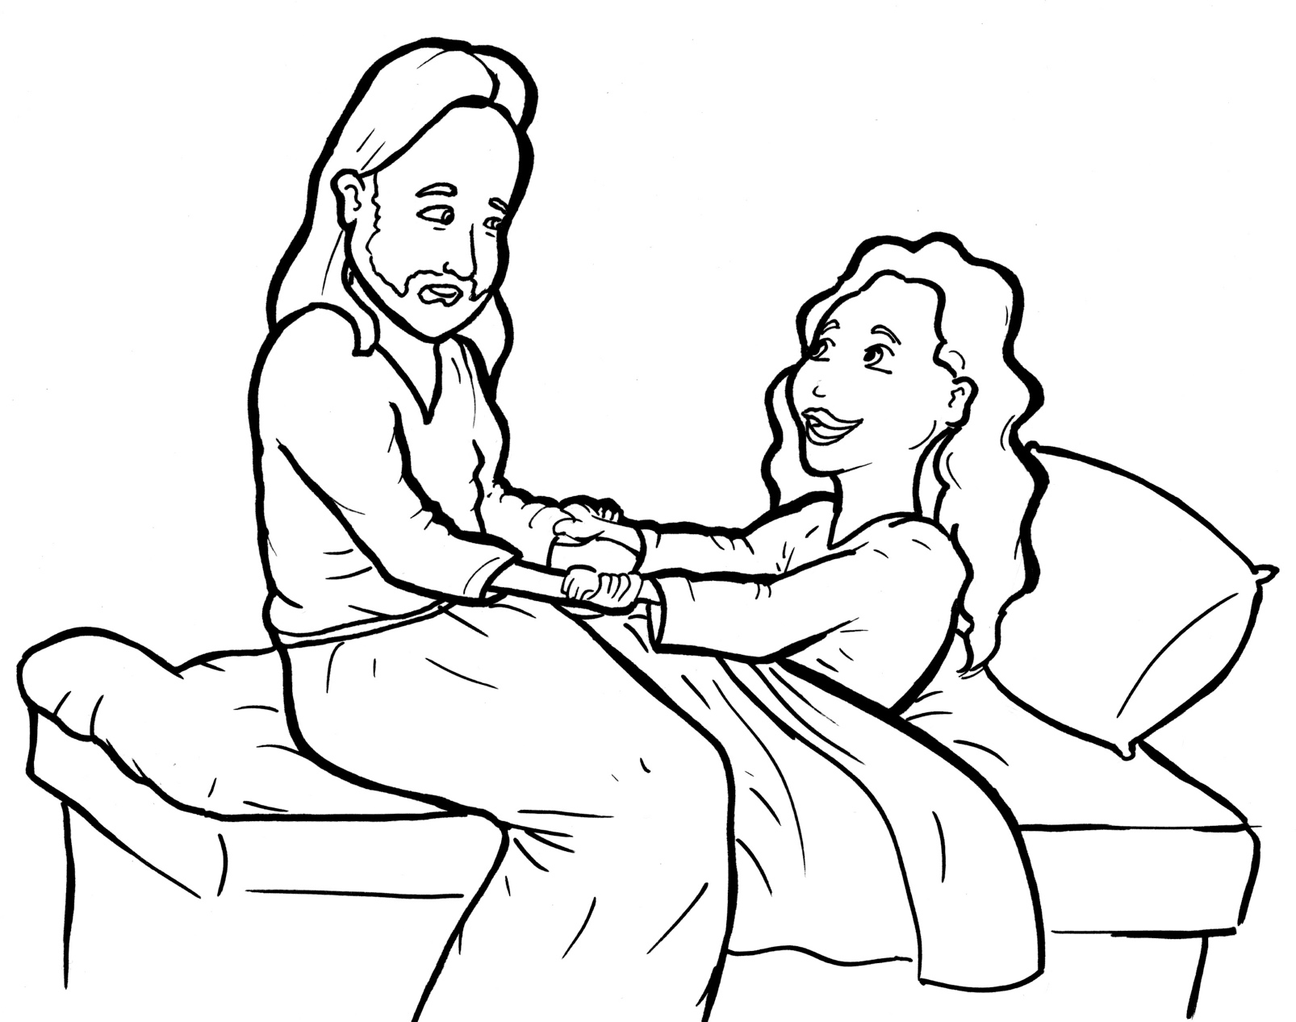
Part 1
30. Jesus Raises a Dead Girl to Life
Syllable Charts

Slide 2
Words in Syllable Types

Slide 3
Closed – Short Vowel
A closed syllable has one vowel
followed by one or more consonants,
and the vowel is short.
st
o
p
˘

Slide 4
Timing
Box
sad
and
hap-
hands

Slide 5
Timing
Box
beg
bed
get
fell
ev-
went

Slide 6
Timing
Box
fill
will
lit-
-ish
in-
-sic

Slide 7
Timing
Box
on
got
not
stop
both-

Slide 8
Timing
Box
up
-us
just
-sus

Slide 9
Open – Long Vowel
An open syllable has one vowel
with no consonant after it,
and the vowel is long.
−
go

Slide 10
Timing
Box
he
Je sus
she
be lieve

Slide 11
Timing
Box
I

Slide 12
Timing
Box
mu sic

Slide 13
Timing
Box
my
cry ing
dy ing

Slide 14
Timing
Box
ever y
hap py
loud ly

Slide 15
Silent e – Long Vowel
A silent e syllable has one vowel,
followed by one consonant
and a silent e at the end.
The vowel is long.
−
ca
e
v

Slide 16
Timing
Box
came
face
a maze

Slide 17
Timing
Box
life
in side

Slide 18
Timing
Box
home

Slide 19
Vowel Teams – Long Vowel
Many vowel teams follow this rule:
When two vowels get together,
the first one names its letter.
So the first vowel will make its long sound,
and the second vowel is silent.
−
e
a
t

Slide 20
Timing
Box
raises
a fraid
air

Slide 21
Timing
Box
say
a way

Slide 22
Timing
Box
feet
a sleep

Slide 23
Timing
Box
be lieve

Slide 24
Timing
Box
lead er
heal
please

Slide 25
Timing
Box
tears
year

Slide 26
Timing
Box
peo ple

Slide 27
Timing
Box
died
cried

Slide 28
Timing
Box
right

Slide 29
Timing
Box
news
Jew-

Slide 30
Vowel Teams – Other Sounds
Sometimes vowel teams make other sounds.
oil

Slide 31
Timing
Box
all

Slide 32
Timing
Box
daugh ter

Slide 33
Timing
Box
dead

Slide 34
Timing
Box
took

Slide 35
Timing
Box
loud ly
a round

Slide 36
Timing
Box
down

Slide 37
R - Controlled
R-controlled syllables have one or more vowels
followed by an “r.”
The “r” changes the sound of the vowel.
o
r
ange

Slide 38
Timing
Box
more

Slide 39
Timing
Box
her
lead er
both er

Slide 40
Timing
Box
daugh ter
ev er y

Slide 41
Timing
Box
girl

Slide 42
Consonant – l-e
When you see consonant l-e at the end of a word,
count back three.
The “l-e” makes the /–le/ sound.
pur
p
l
e

Slide 43
Timing
Box
peo ple

Slide 44
Timing
Box
lit tle

Slide 45
Other Sounds – Long Vowel
These syllables or words are closed,
so the vowel should be short,
but the vowel is long.
−
cold

Slide 46
Timing
Box
old
told

Slide 47
Other Sounds – -nk/-ng
The “-nk” and “-ng”
change the sound of the vowel.
bank
thing

Slide 48
Timing
Box
cry ing
dy ing

Slide 49
Other Sounds – schwa
The schwa syllable has an “a” that sounds
like the /u/ in banana.
The banana is even shaped like a short u.
ba nan a

Slide 50
Timing
Box
a fraid
a way
a sleep

Slide 51
Timing
Box
a round
a mazed

