Slide 1
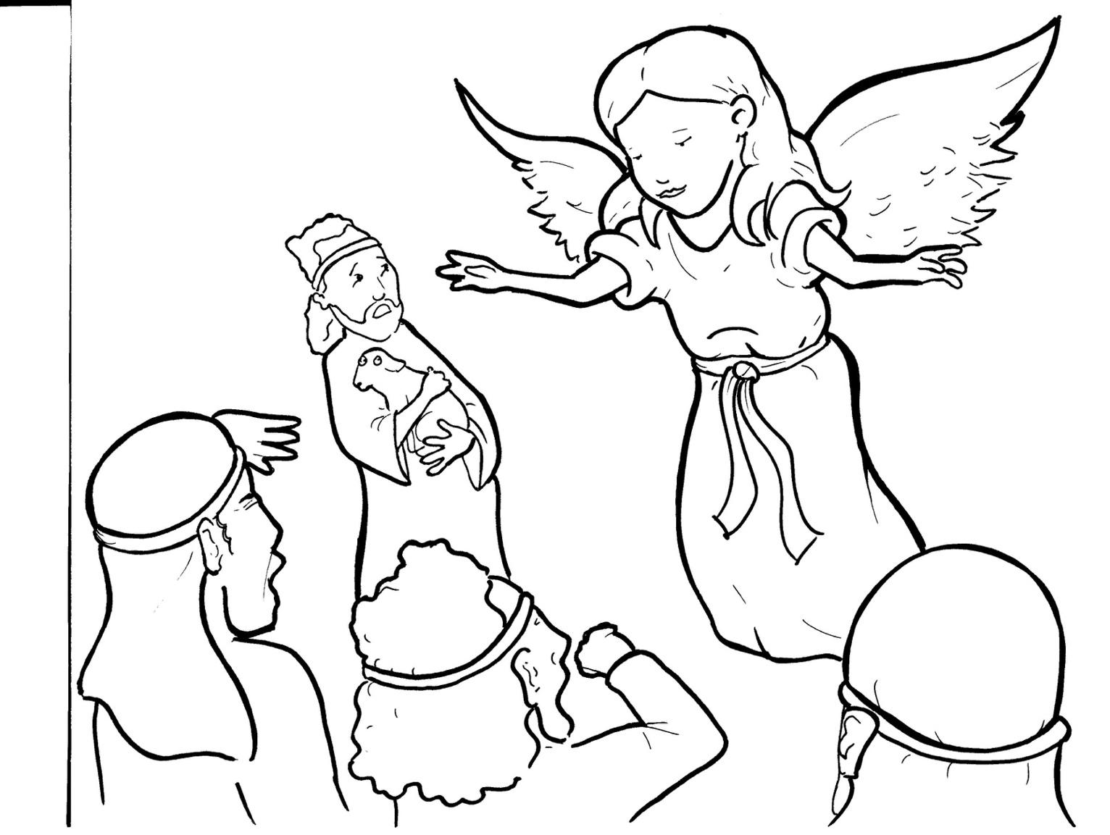
3. Shepherds Share the Good News
Part 5
Vocabulary
Original Bible Story

Slide 2
Vocabulary

Slide 3
trough
(trough):
a box that holds food for barn animals

Slide 4
behold
HOLD):
(be -
see!

Slide 5
haste
(haste):
in a hurry

Slide 6
Savior
vior):
(SA -
God who saves

Slide 7
multitude
(MUL -
ti -
tude):
a crowd

Slide 8
publicized
(PUB -
li -
cized):
made known

Slide 9
Shepherds Share the Good News
Luke 2:8-18
World English Bible (WEB)

Slide 10
There were shepherds in the same country staying in the field, and keeping watch by night over their flock.
The angel said to them, “Don’t be afraid, for behold, I bring you good news of great joy which will be to all the people.

Slide 11
For there is born to you today, in David’s city, a Savior, who is Christ the Lord.
This is the sign to you: you will find a baby wrapped in strips of cloth, lying in a feeding trough.”

Slide 12
Suddenly, there was with the angel a multitude of the heavenly army praising God, and saying,
“Glory to God in the highest, on earth peace, good will toward men.”

Slide 13
When the angels went away from them into the sky, the shepherds said to one another,
“Let’s go to Bethlehem, now, and see this thing that has happened, which the Lord has made known to us.”

Slide 14
They came with haste, and found both Mary and Joseph; and the baby was lying in the feeding trough.
When they saw it, they publicized widely the saying which was spoken to them about this child.

Slide 15
All who heard it wondered at the things which were spoken to them by the shepherds.

