Slide 1
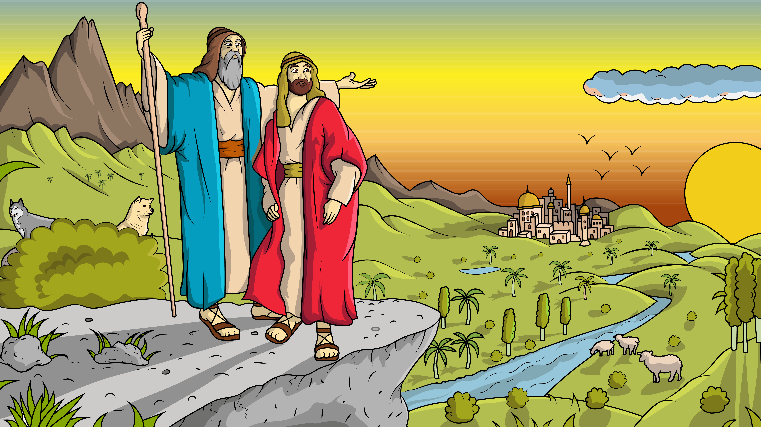
Post Test
1.4 Lot Got a Lot

Slide 2


What does this word begin with? Click the correct answer.
1. t
2. l
3. g
4. o

Slide 3
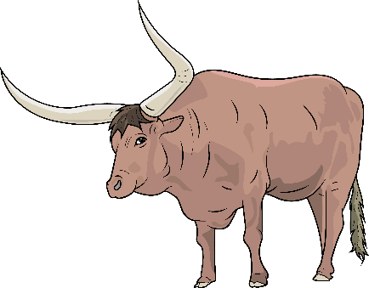
What does this word begin with? Click the correct answer.
1. r
2. o
3. d
4. h

Slide 4

What does this word begin with? Click the correct answer.
1. b
2. e
3. d
4. p

Slide 5
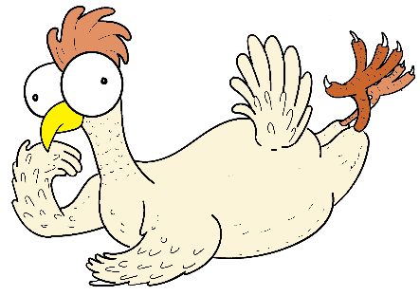
What does this word begin with? Click the correct answer.
1. i
2. w
3. e
4. h

Slide 6
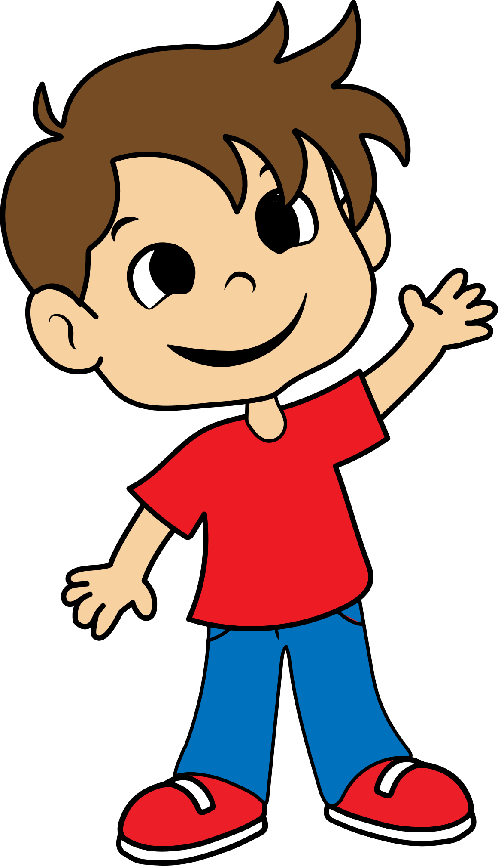
What does this word begin with? Click the correct answer.
1. k
2. c
3. qu
4. d
Notes:
This word follows the “cats/kittens” spelling rule that says: When a word starts with the /k/ sound, use c unless the vowel after is an e or i: came, cut, cop, crash, clean; kit, key (and sky)

Slide 7
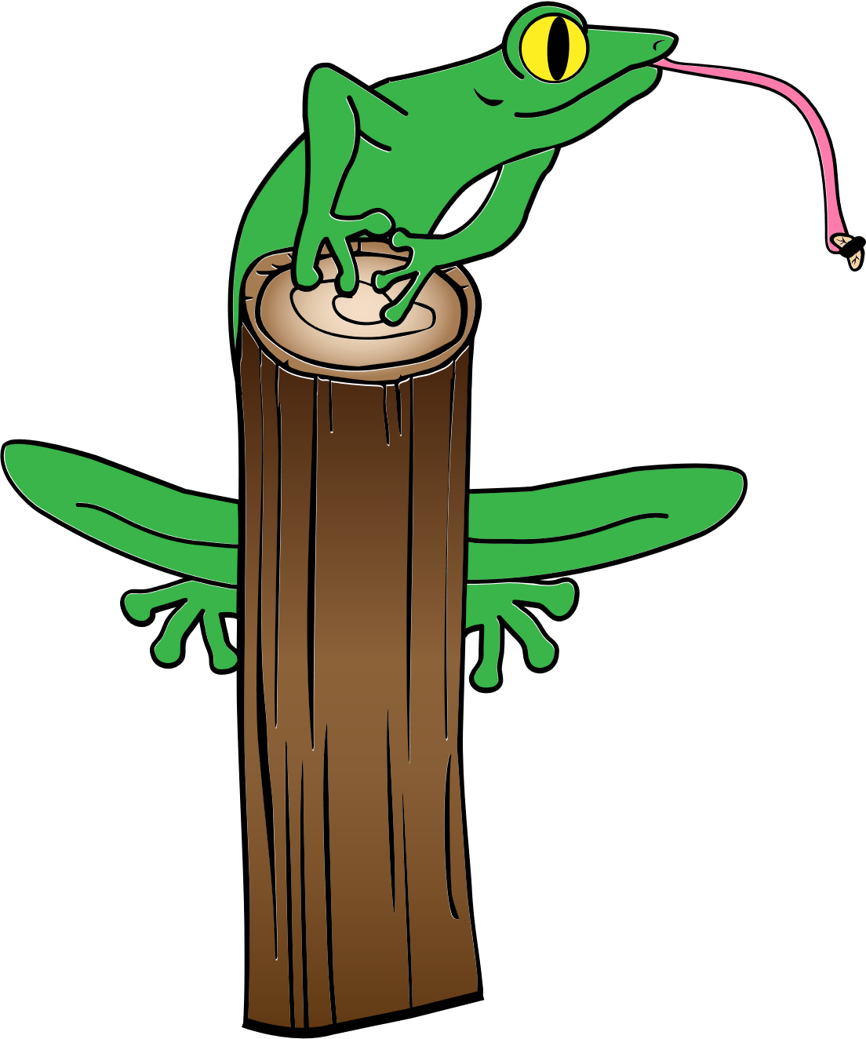
Which vowel is in the middle of this word? Click the correct answer.
1. a
2. e
3. i
4. o

Slide 8
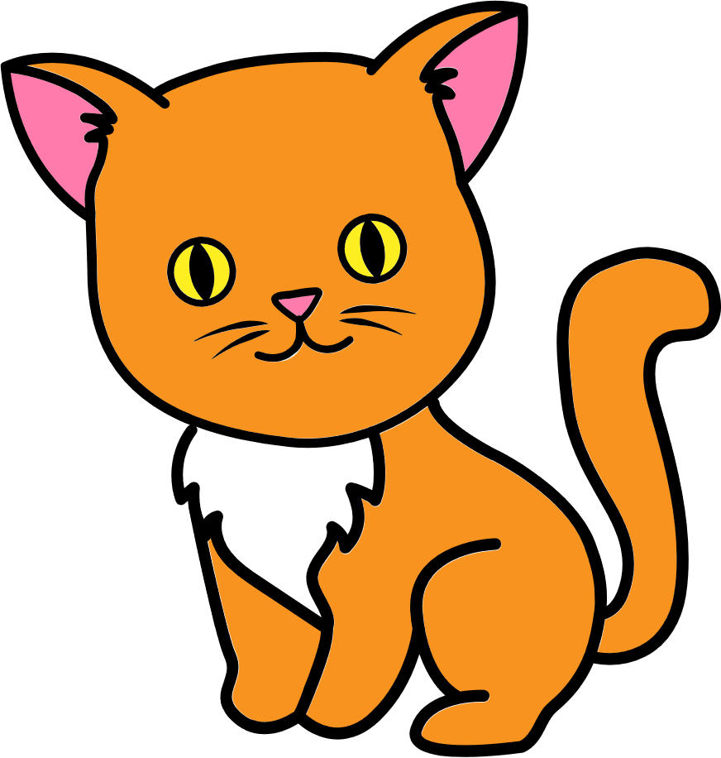
Which vowel is in the middle of this word? Click the correct answer.
1. a
2. e
3. i
4. o

Slide 9

Which vowel is in the middle of this word? Click the correct answer.
1. a
2. e
3. i
4. o

Slide 10
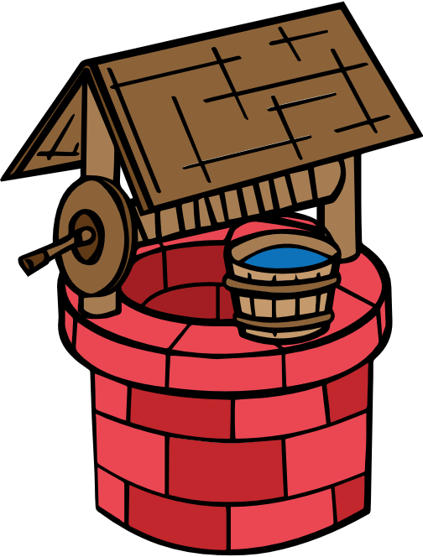
Which vowel is in the middle of this word? Click the correct answer.
1. a
2. e
3. i
4. o

Slide 11

Which vowel is in the middle of this word? Click the correct answer.
1. a
2. e
3. i
4. o

Slide 12

Which word matches this picture? Click the correct answer.
yes
yell
yet
Notes:
One –syllable words that end in /f/, /l/, /s/, or /z/ right after the short vowel are spelled with ff, ll, ss, or zz.
Will you get off the grass, Jazz?

Slide 13

Which word matches this picture? Click the correct answer.
stop
pot
pops

Slide 14
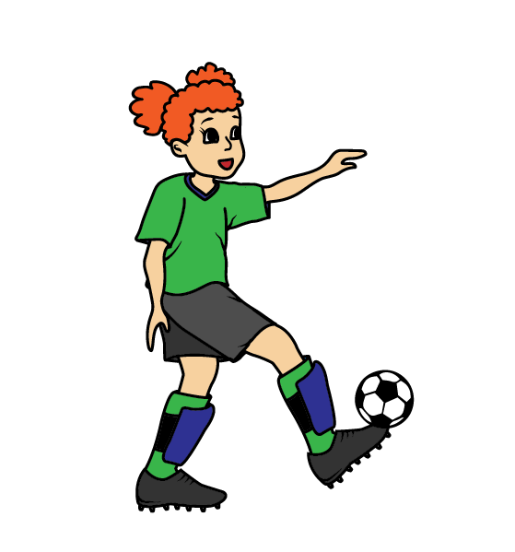
Which word matches this picture? Click the correct answer.
kid
kiss
kick
Notes:
For one-syllable, short-vowel words that end in -ack, -eck, -ick, -ock, or -uck, use c-k.
Quick! Tuck him in. Rock him. Check back often.

Slide 15

Which word matches this picture? Click the correct answer.
bad
cat
bat

Slide 16

Which word matches this picture? Click the correct answer.
pop
top
pat

Slide 17
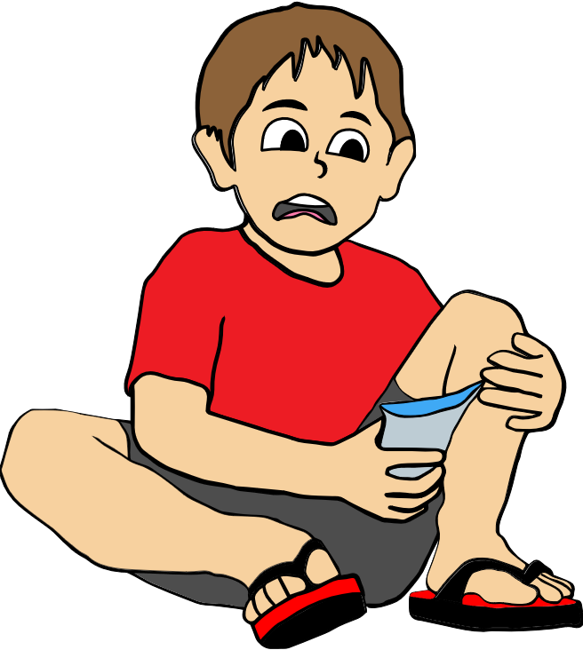

Which sentence matches this picture? Click the correct answer.
The kid cut his hand.
The kid fell on the grass.

Slide 18
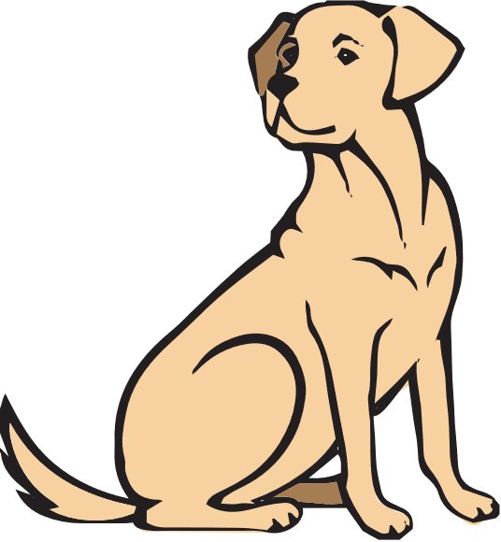
Which sentence matches this picture? Click the correct answer.
The pop is on the dog.
The dog is on the log.

Slide 19
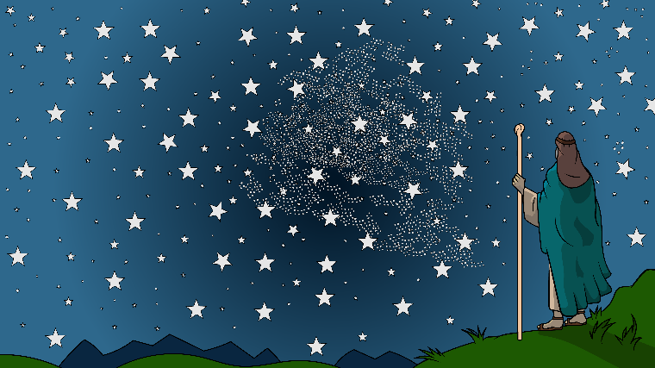
Which sentence matches this picture? Click the correct answer.
I see a lot.
I do not see a lot.

Slide 20
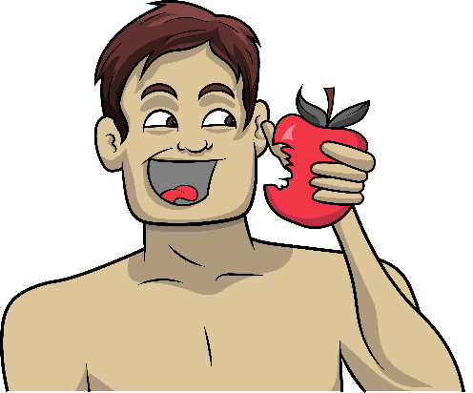
Which sentence matches this picture? Click the correct answer.
The man had an egg.
The man had an apple.

Slide 21
Which sentence matches this picture? Click the correct answer.
The frog is off the log.
The frog is on the log.

Slide 22

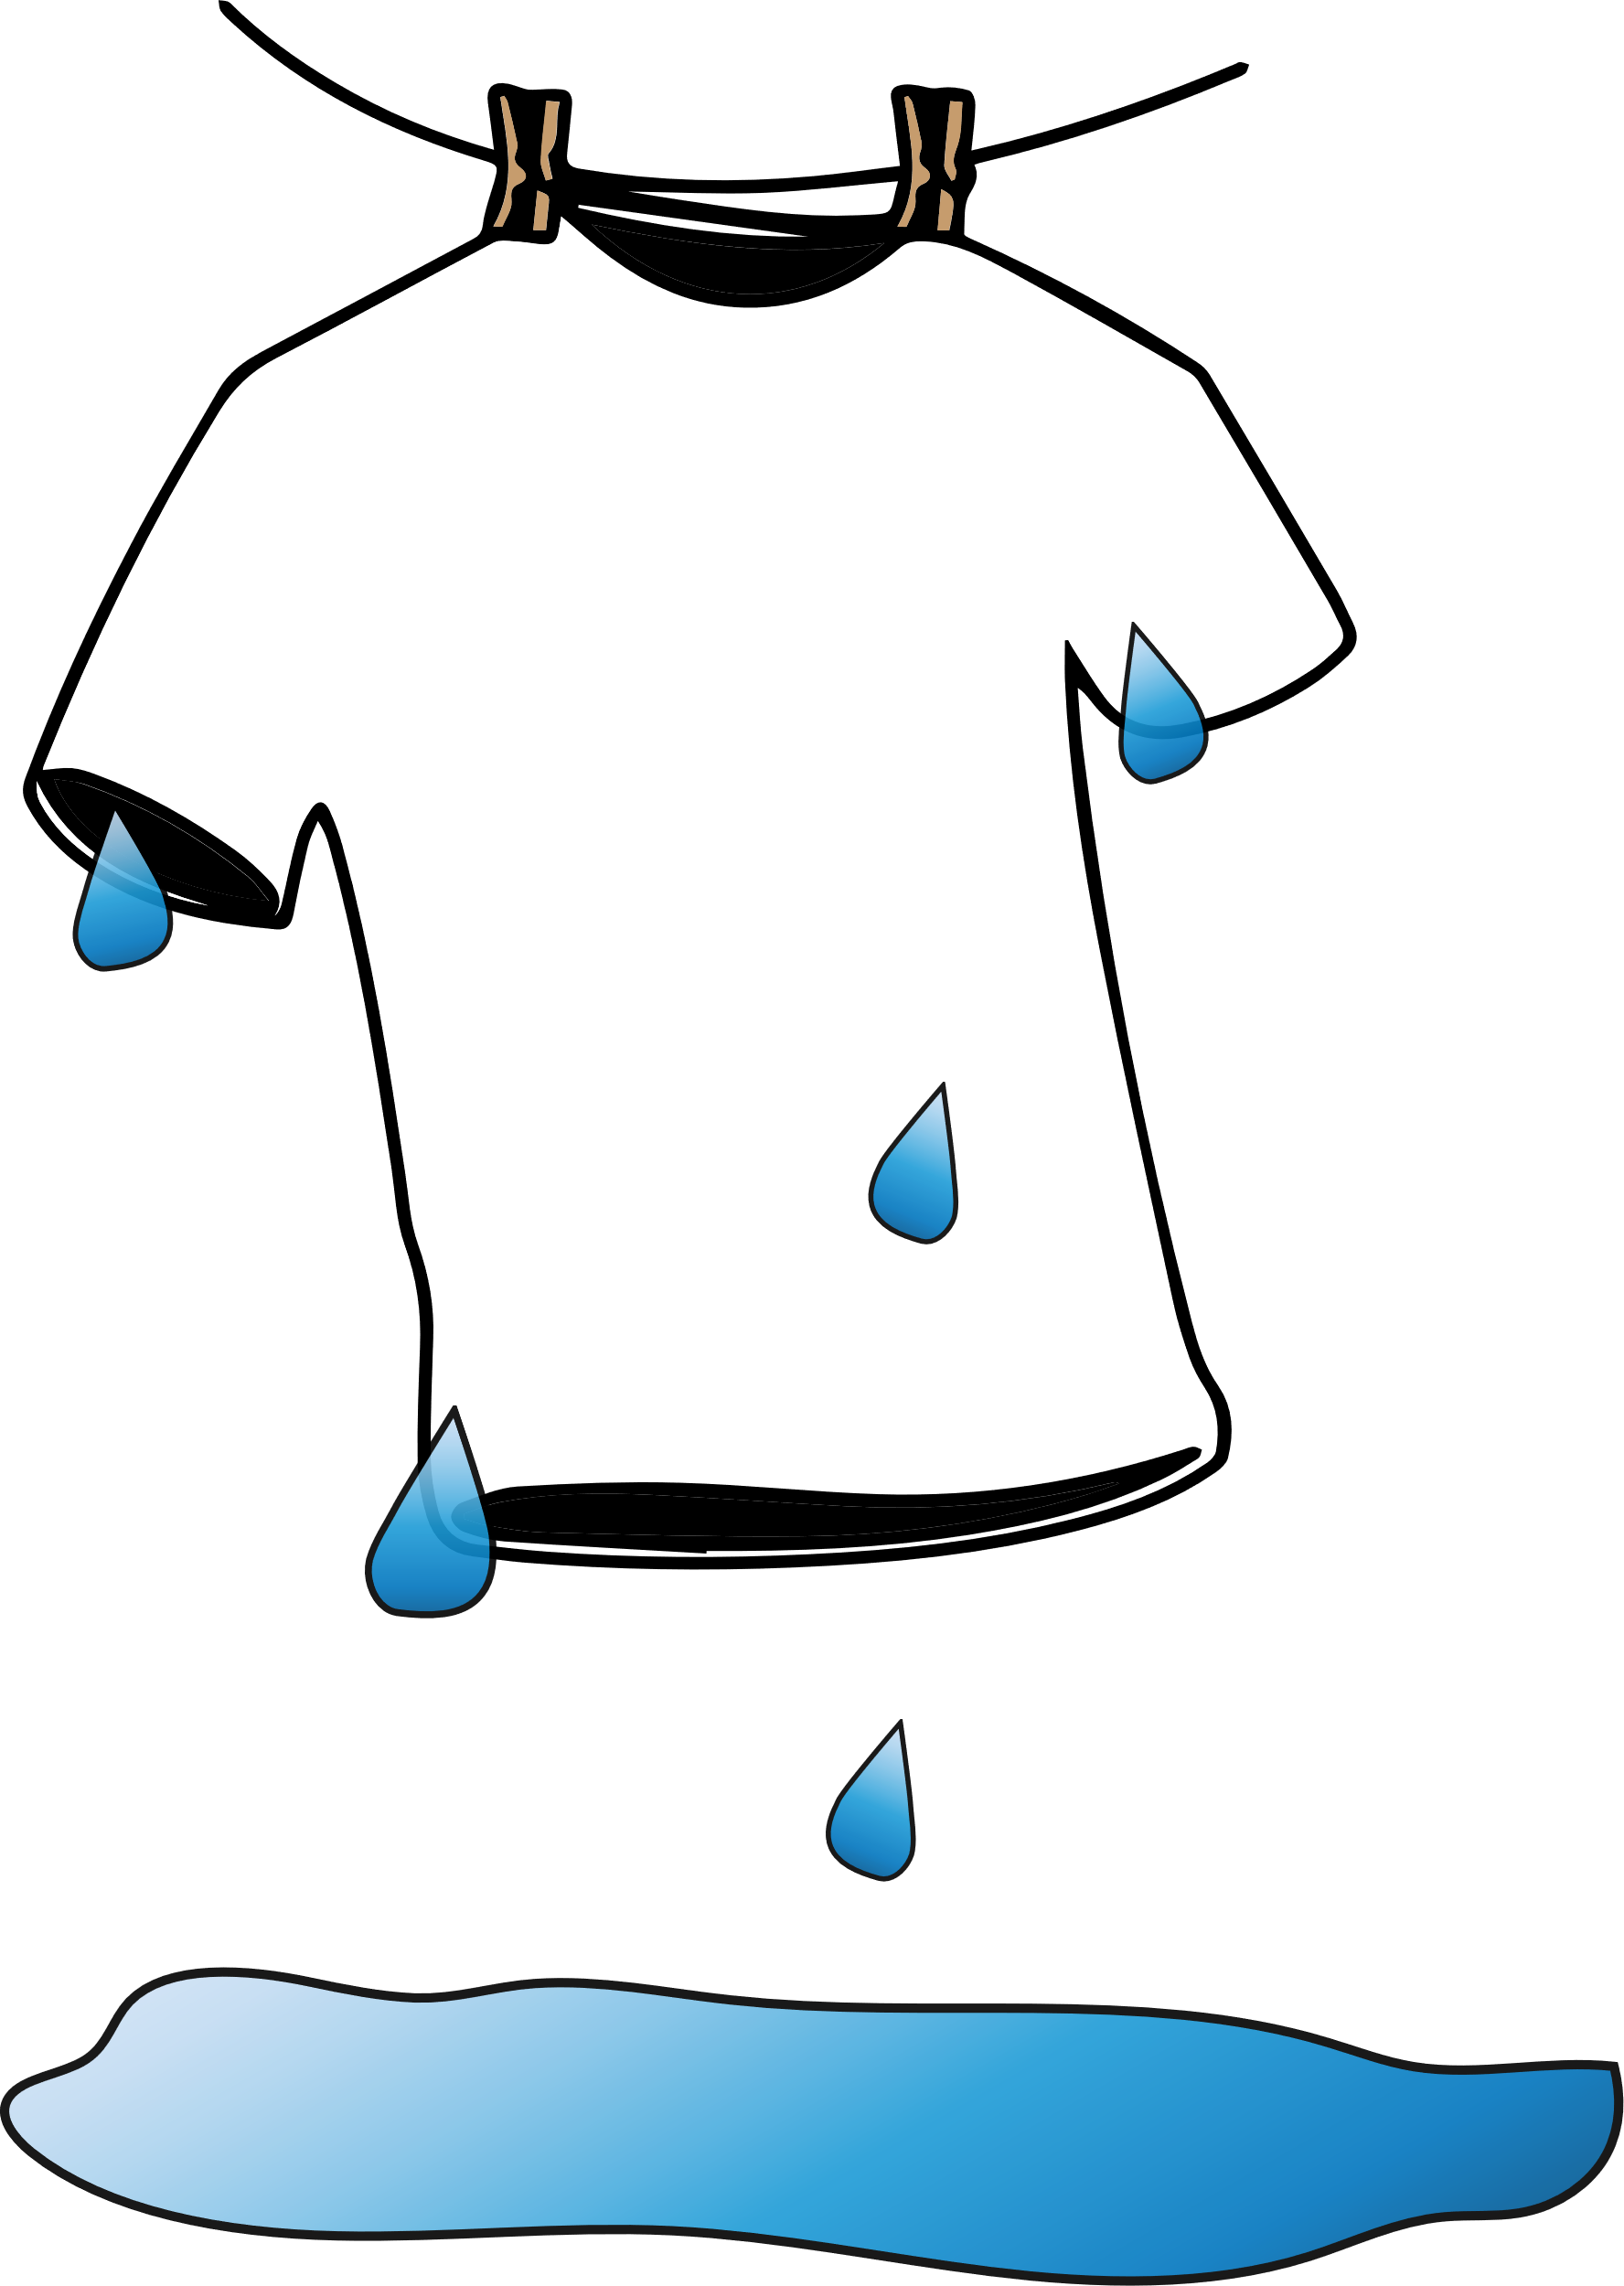

Write in the missing letters.
1. _x
2. _pple
3. k_ss
4. w_t

Slide 23
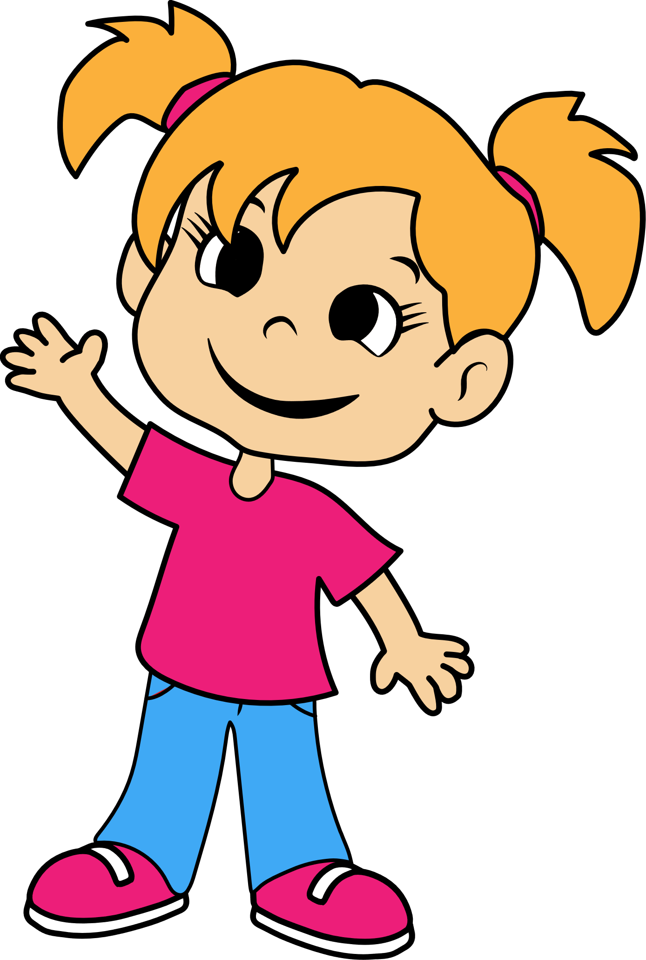
Write in the missing letters.
5. p_t
6. f_ll
7. _id
8. _en
Notes:
This word follows the “cats/kittens” spelling rule that says: When a word starts with the /k/ sound, use c unless the vowel after is an e or i: came, cut, cop, crash, clean; kit, key (and sky)

Slide 24
Spell this word:
_ _ _ _
Notes:
One –syllable words that end in /f/, /l/, /s/, or /z/ right after the short vowel are spelled with ff, ll, ss, or zz.
Will you get off the grass, Jazz?

Slide 25
Spell this word:
_ _

Slide 26
Spell this word:
_ _ _

Slide 27
Spell this word:
_ _ _

Slide 28
Spell this word:
_ _ _ _
Notes:
This word follows the “cats/kittens” spelling rule that says: When a word starts with the /k/ sound, use c unless the vowel after is an e or i: came, cut, cop, crash, clean; kit, key (and sky)

Slide 29
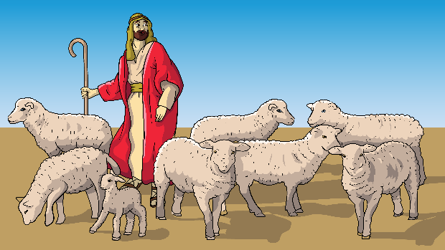
Listen and write the sentence.

Slide 30
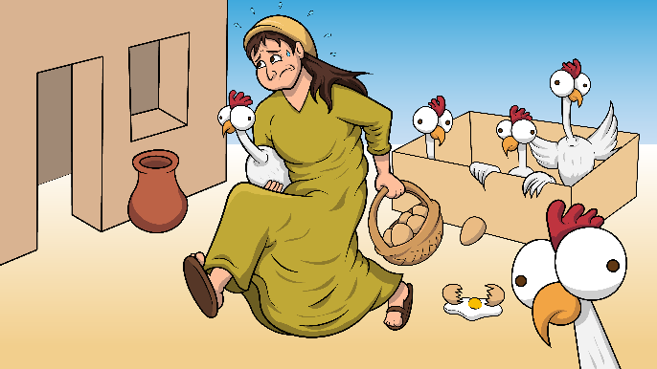
Listen and write the sentence.

Slide 31
Listen and put each rule breaker in the correct color box.
do the said of to

Slide 32

Listen and spell the following rule breakers:
_ _
_ _
_ _ _ _
_ _ _
_ _

Slide 33
Listen and put each rule breaker in the correct color box.
is was as his has

Slide 34

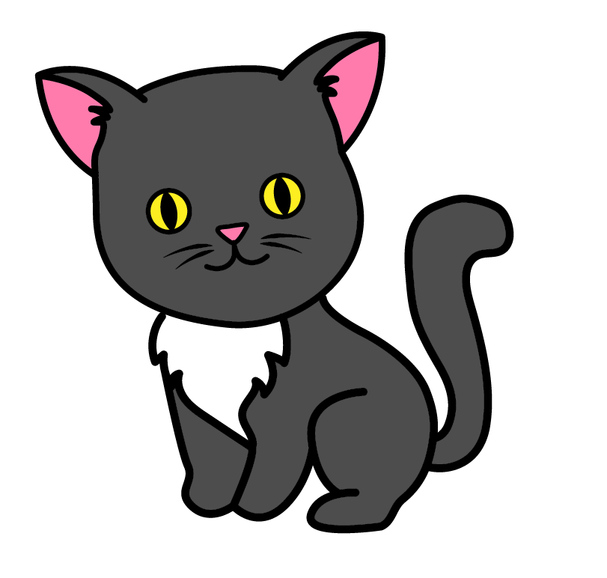
Listen and spell the following rule breakers:
_ _
_ _
_ _ _
_ _
_ _ _

Slide 35
Answers 1.4 PPT Lot Got a Lot
1. ___
2. l/log
3. o/ox
4. b/bed
5. h/hen
6. k/kid
7. o/frog
8. a/cat
9. i/spill
10. e/well
11. o/dots
12. yell
13. pot
14. kick
15. bat
16. pop
17. The kid fell on the grass.
18. The dog is on the log.
19. I see a lot.
20. The man had an apple.
21. The frog is on the log.

Slide 36
Answers 1.4 PPT Lot Got a Lot
22. 1) o/ox 2) a/apple 3) i/kiss 4) e/wet
23. 5) o/pot 6) e/fell 7) k/kid 8) h/hen
24. well
25. ox
26. dog
27. hen
28. kids
29. The man got a lot.
30. Get the eggs in the pen.

Slide 37
Answers 1.4 PPT Lot Got a Lot
31. of/green; the/red; said/blue; do/pink; to/orange
32. 1) of 2) to 3) said 4) the 5) do
33. his/green; as/red; has/blue; was/pink;
is/orange
34. 1) as 2) his 3) was 4) is 5) has

Slide 38
Spelling Rule: FLoSS
This is sometimes called the ff, ll, ss rule.
One –syllable words that end in /f/, /l/, /s/, or /z/ right after the short vowel are spelled with ff, ll, ss, or zz. Will you get off the grass, Jazz?

Slide 39
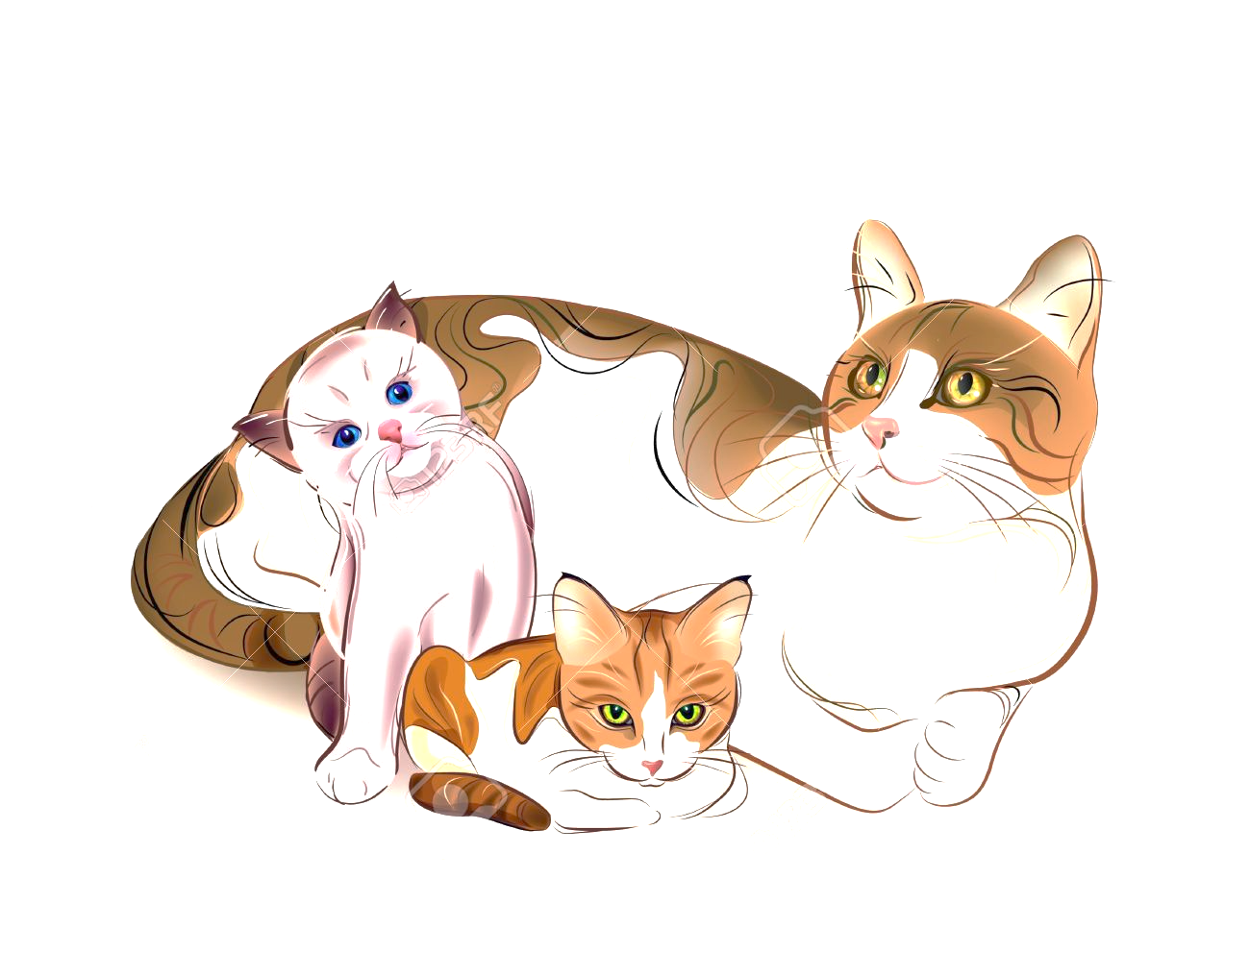
Spelling Rule: Cats or Kittens
(Use c except for ke-, ki- words.)
Do I use k or c at the beginning of a word?
Use k before an i or e. Use c before the other three (a,o,u). To spell even better, use c before the
rotten letters (r, l).
ki, ke, ky ca, co, cu cr, cl
kitten, kept, sky cat, cop, cute crash, clip

Slide 40
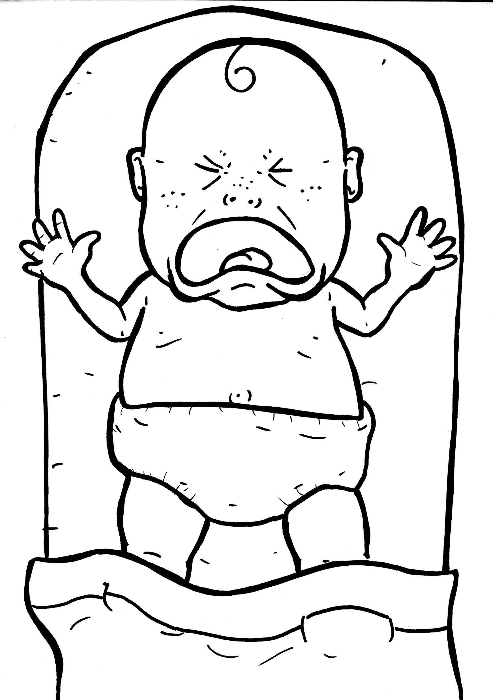
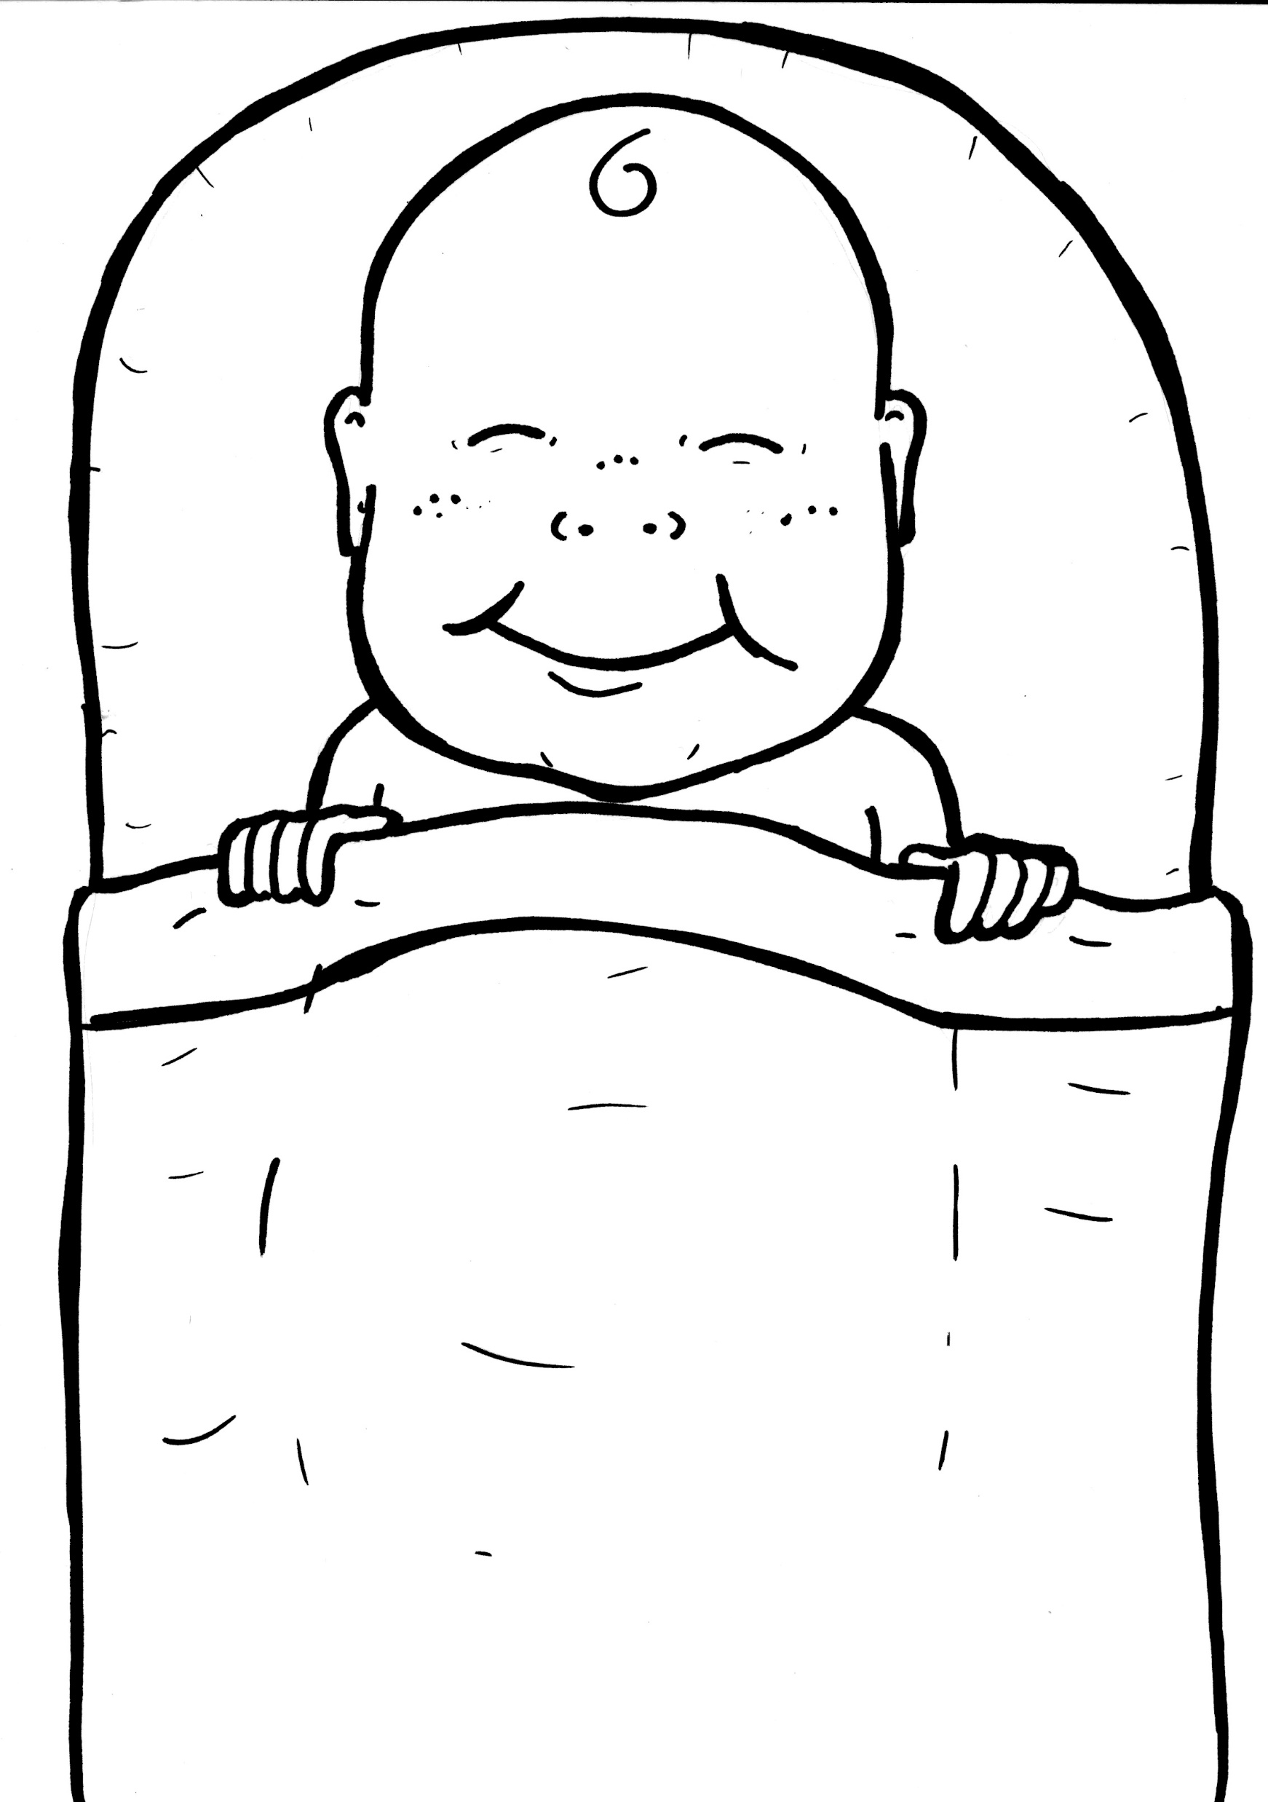
Spelling Rule: -ck
-ck
-ack, -eck, -ick,
-ock, -uck
For one-syllable, short-vowel words that end in -ack, -eck, -ick, -ock, or -uck, use c-k.
Quick! Tuck him in. Rock him.
Check back often.

