Slide 1

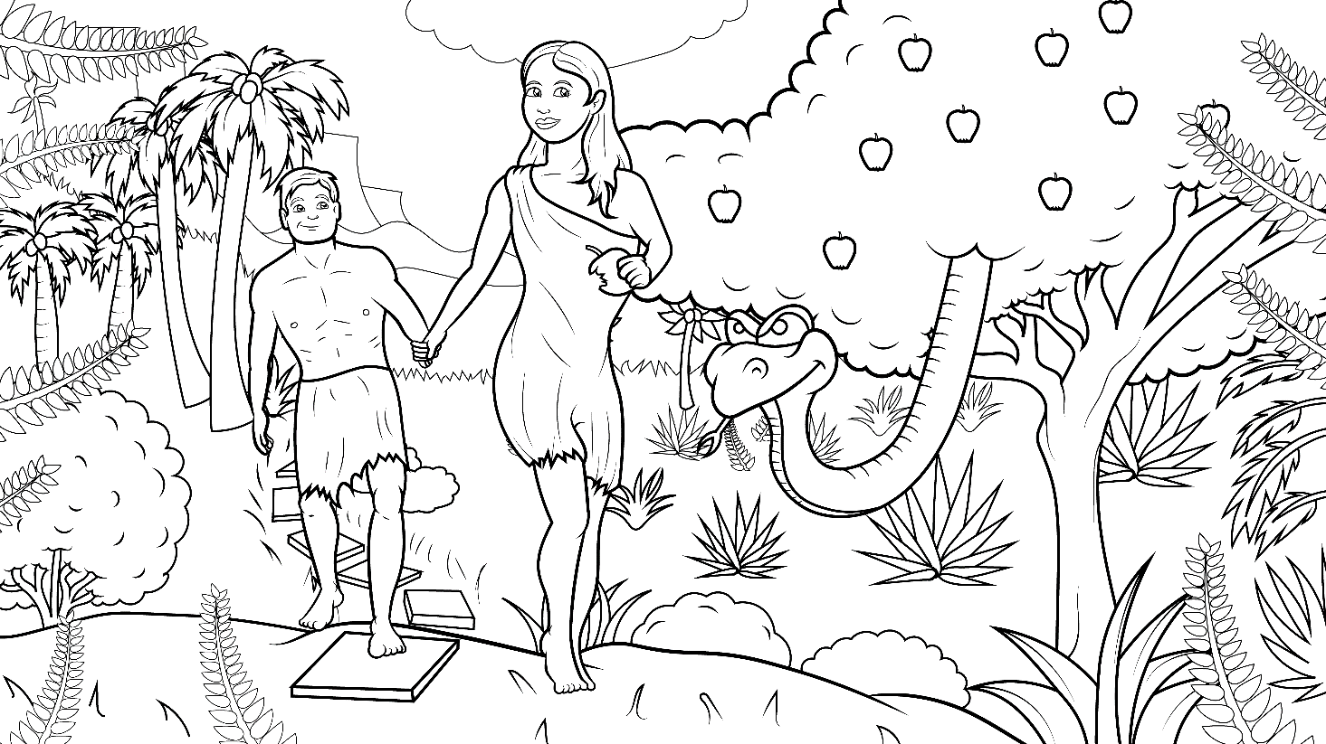
1.3 The Big Fib Story
Genesis 2-3 (Genesis 2:15-17; 3:1-13, 21-24)

Slide 2
New Words to Read
it bit did hid
in sin skin if
big fib (lie) hiss will
Notes:
You can add translations here:

Slide 3
Rule Breakers
(Read and Spell)
the to
said you

Slide 4
Sight Words
and then Adam
so go
he Eve

Slide 5
1.3 The Big Fib
I Read, You Read Bible Story

Slide 6
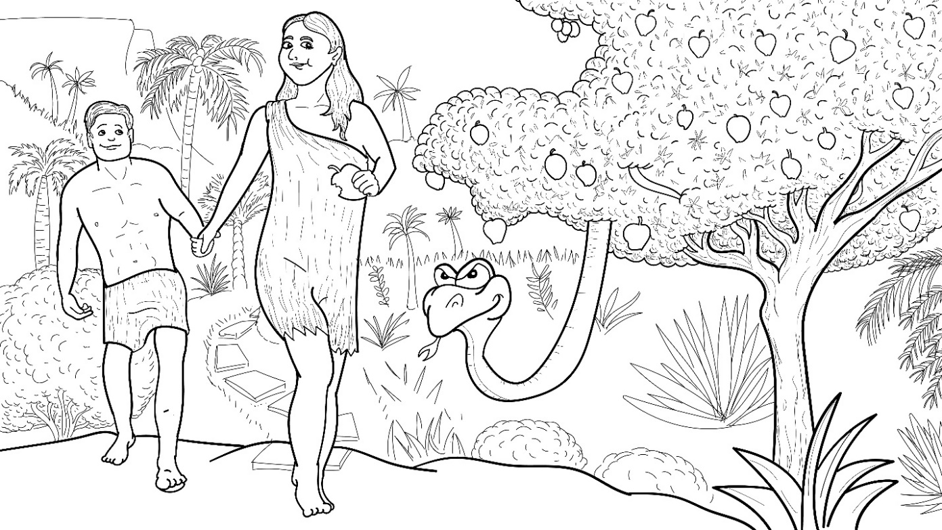
The sneaky
snake
said a big,
bad, fib.

Slide 7
“Hiss, hiss, hiss,”
he said a fib.

Slide 8
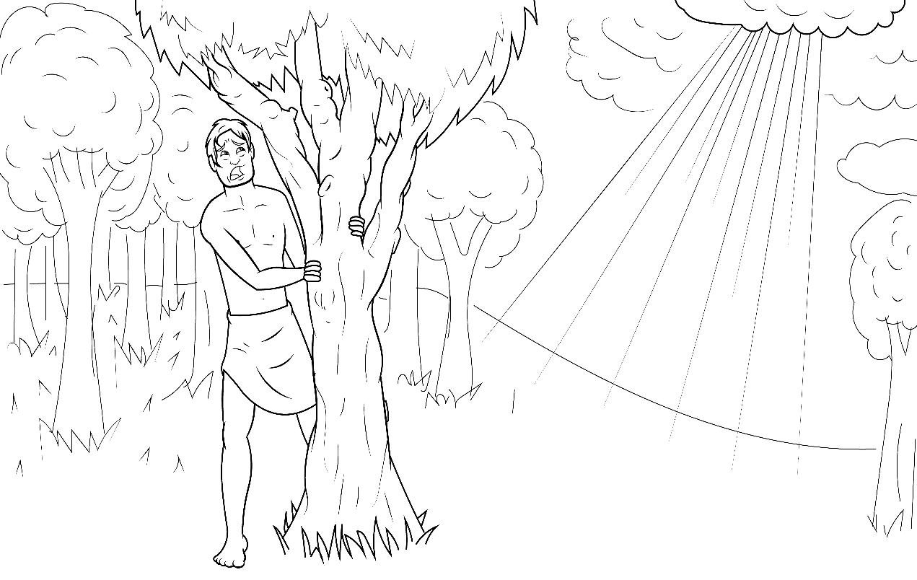
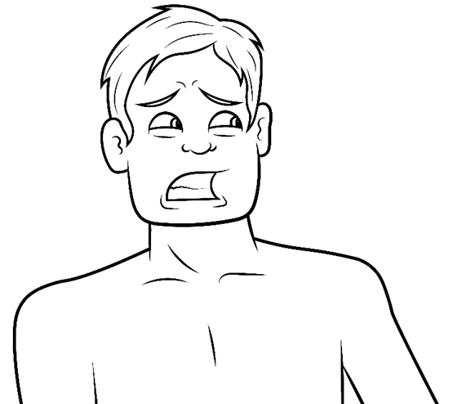
“You will not die,” came the lie.

Slide 9
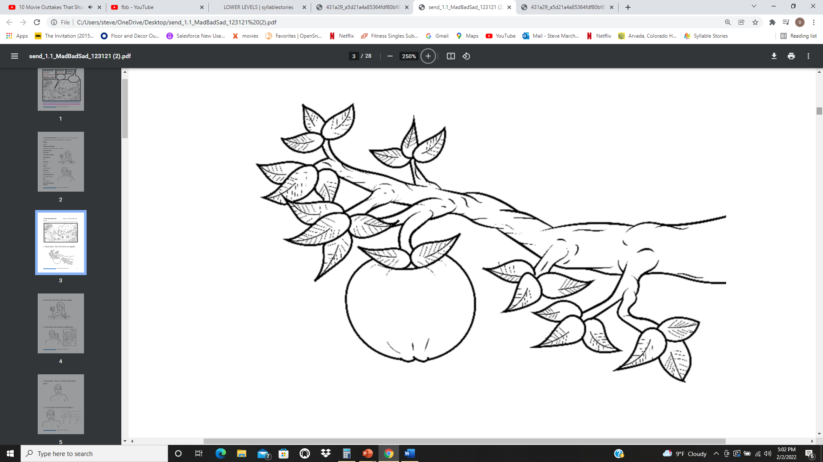
“If you bit it, you will be like God.”

Slide 10
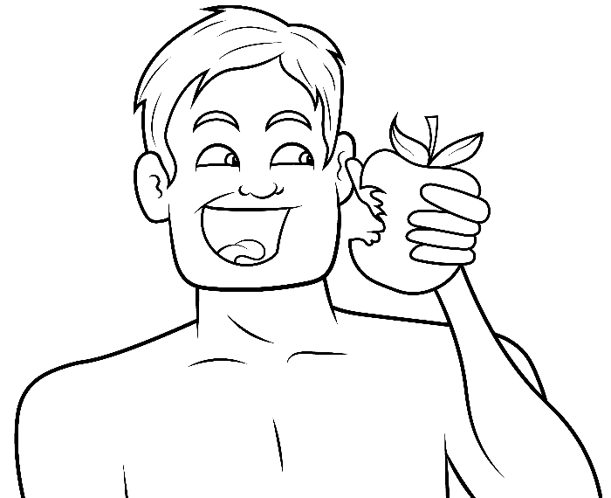
And so…
Adam did
bad.

Slide 11
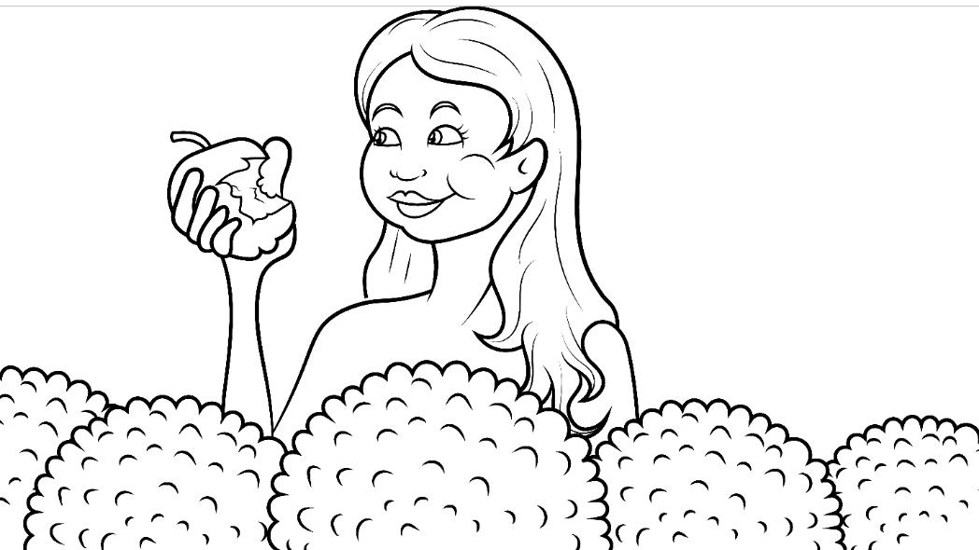
Eve did bad.

Slide 12
Adam and Eve bit and had an apple.

Slide 13
God said to Adam, “Did you eat it ?”
?
?

Slide 14
Adam said,
“Yes. I did.
I did the sin.”

Slide 15
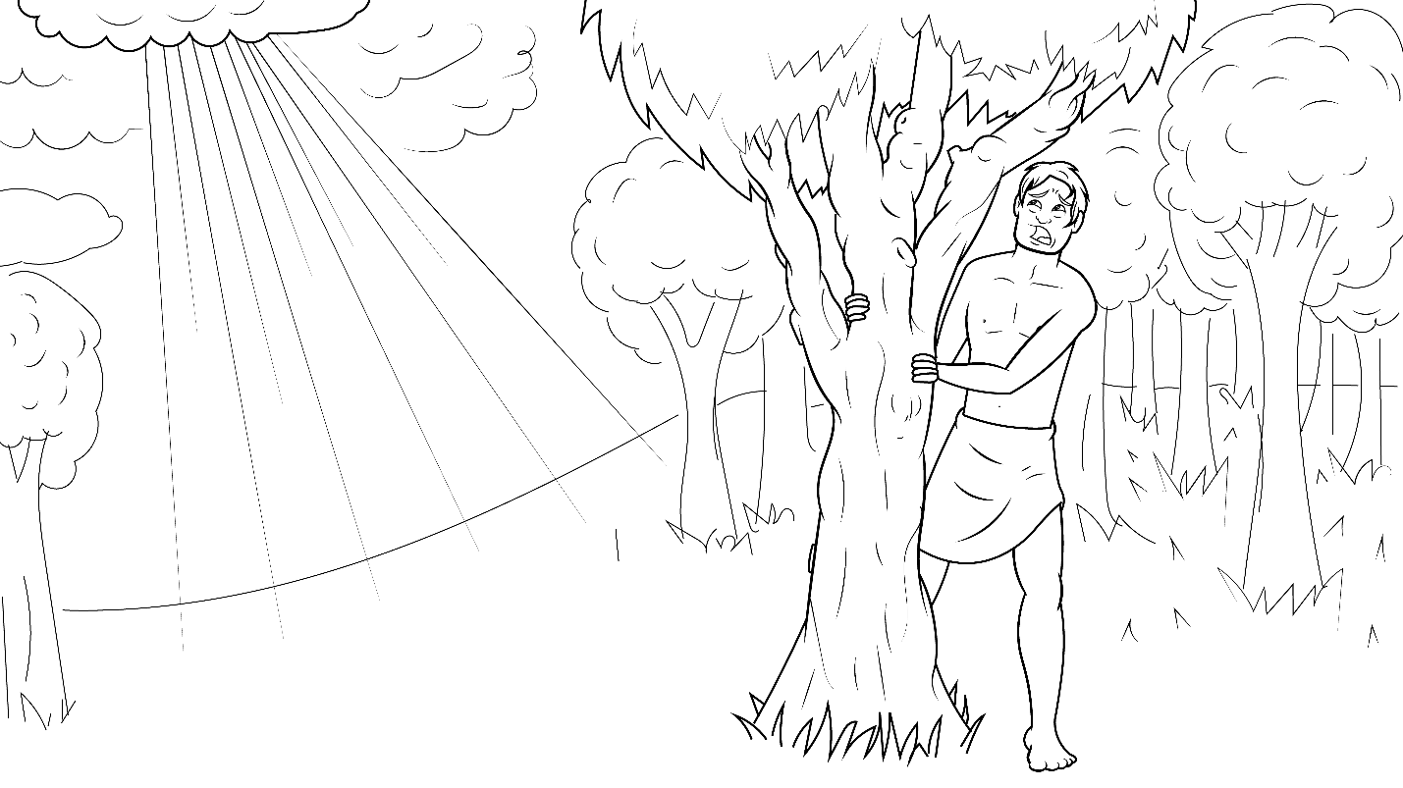
“I did the big sin and then I hid.”

Slide 16
God said to Eve, “Did you eat it ?”
?
?

Slide 17
Eve said,
“Yes. I did.
I did the sin.”

Slide 18
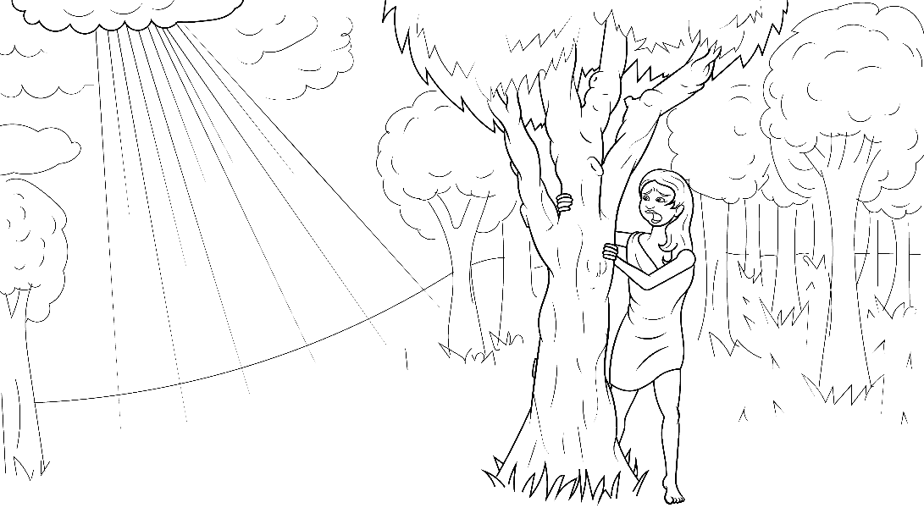
“I did the big sin and then I hid.”

Slide 19
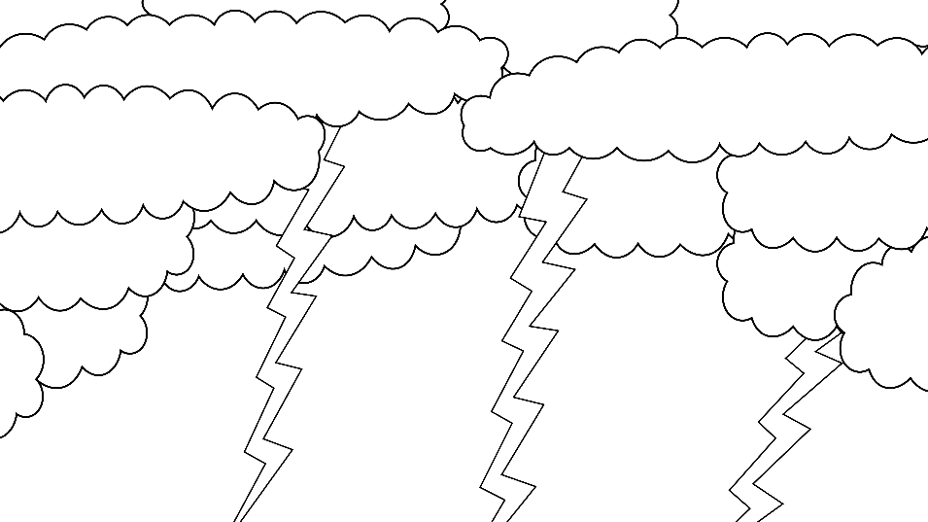
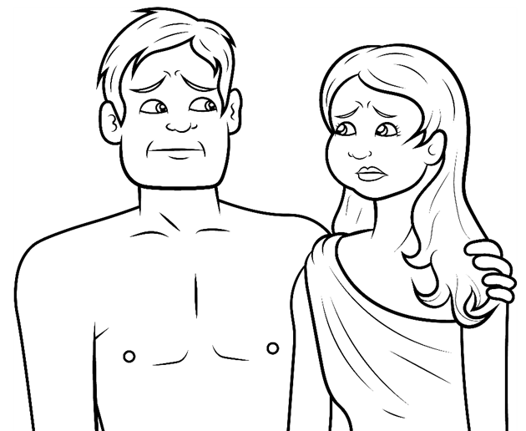
God was mad and sad.

Slide 20
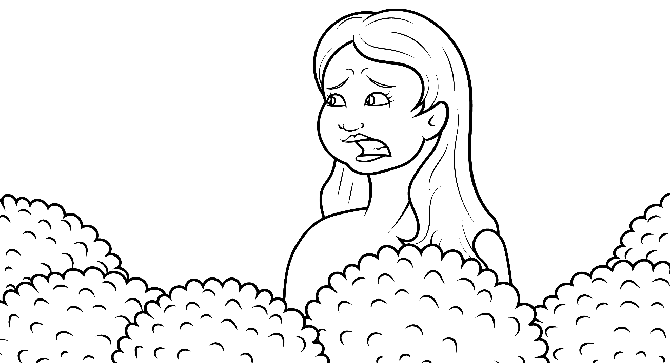
Adam and Eve were bad
and had to go.

Slide 21

But first, God made a skin to get in.

Slide 22
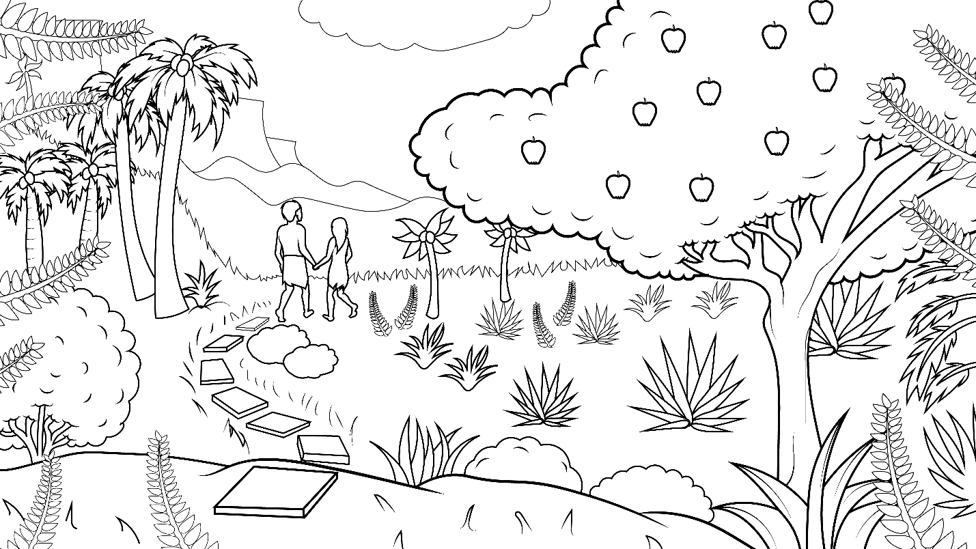

And so, they left their garden home.

Slide 23
The End

Slide 24
1.3 Story Without Illustrations
The Big Fib

Slide 25
The sneaky snake
said a big, bad, fib.
“Hiss, hiss, hiss,” he said a fib.

Slide 26
“You will not die,” came the lie.
“If you bit it, you will be like God.”

Slide 27
And so…Adam did bad.
Eve did bad.
Adam and Eve bit and had an
apple.

Slide 28
God said to Adam, “Did you eat it?”
Adam said, “Yes. I did. I did the sin.
I did the big sin and then I hid.”

Slide 29
God said to Eve, “Did you eat it?”
Eve said, “Yes. I did. I did the sin.
I did the big sin and then I hid.”

Slide 30
Adam and Eve were bad and had
to go.
But first, God made a skin to get in.

Slide 31
And so, they left their garden
home.

Slide 32
The End

Slide 33
Story: Carol Hale
Illustrations: Ivan Mader
Power Point Set Up: Prakash Chandra Giri
Power Point arrangements: Steve March
www.EasyReadEnglish.com
www.EZReadEnglish.org/lower-levels

