Slide 1

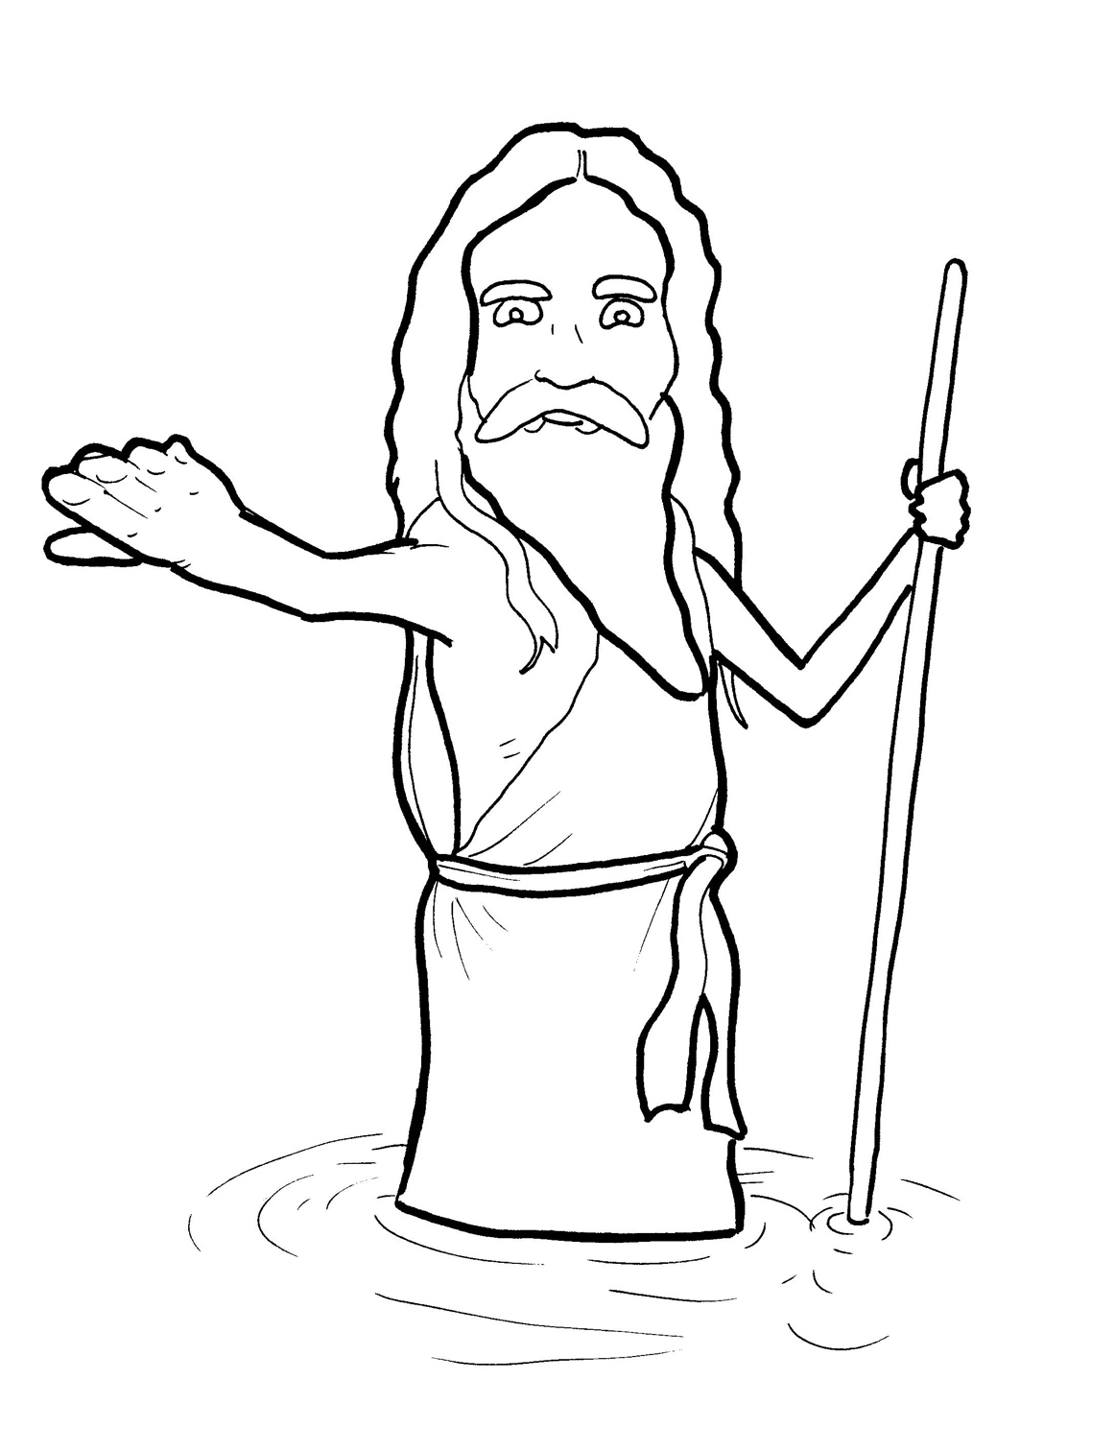
8. John the Baptist Points to Jesus
Part 3
Syllable Divisions

Slide 2
Dividing Words
Into Syllables

Slide 3
Rabbit Words
When you see two consonants
between two vowels,
divide between the consonants.
ra it
bb
rab bit

Slide 4
im por tant
important

Slide 5
un tie
untie

Slide 6
wil der ness
wilderness

Slide 7
bap tist
baptist

Slide 8
san dals
sandals

Slide 9
Mes si ah
Messiah

Slide 10

Tiger Words
When you see one consonant
between two vowels,
divide after the first vowel.
Try this pattern first.
ti er
g
ti ger

Slide 11
Je sus
Jesus

Slide 12
re pent
repent

Slide 13
ho ly
holy

Slide 14
e ven
even

Slide 15
Camel Words
When you see one consonant
between two vowels,
divide after the first consonant.
Try this pattern second.
ca el
m
cam el

Slide 16
des ert
desert

Slide 17
riv er
river

Slide 18
heav en
heaven

Slide 19
Turtle Words
When you see consonant-l-e,
count back three and divide.
tur
t
l
e
tur tle

Slide 20
peo ple
people

Slide 21
Hamster Words
When you see three consonants between two vowels,
divide after the first consonant.
ha
mst
er
ham ster

Slide 22
hun dreds
hundreds

Slide 23
Lion Words
If a word has two vowels together
that make two different sounds,
divide between the two vowels.
lion
li on

Slide 24
Mes si ah
Messiah

Slide 25

Foxes Suffixes
Focus on your base word.
fox es
fox es

Slide 26
point ed
pointed

Slide 27
crowd ed
crowded

Slide 28
repent ed
repented

Slide 29
shined
shined

Slide 30
asked
asked

Slide 31
lived
lived

Slide 32
wait ing
waiting

Slide 33
power ful
powerful

Slide 34
crunch y
crunchy

Slide 35
itch y
itchy

Slide 36
king dom
kingdom

Slide 37
teach ers
teachers

