Slide 1
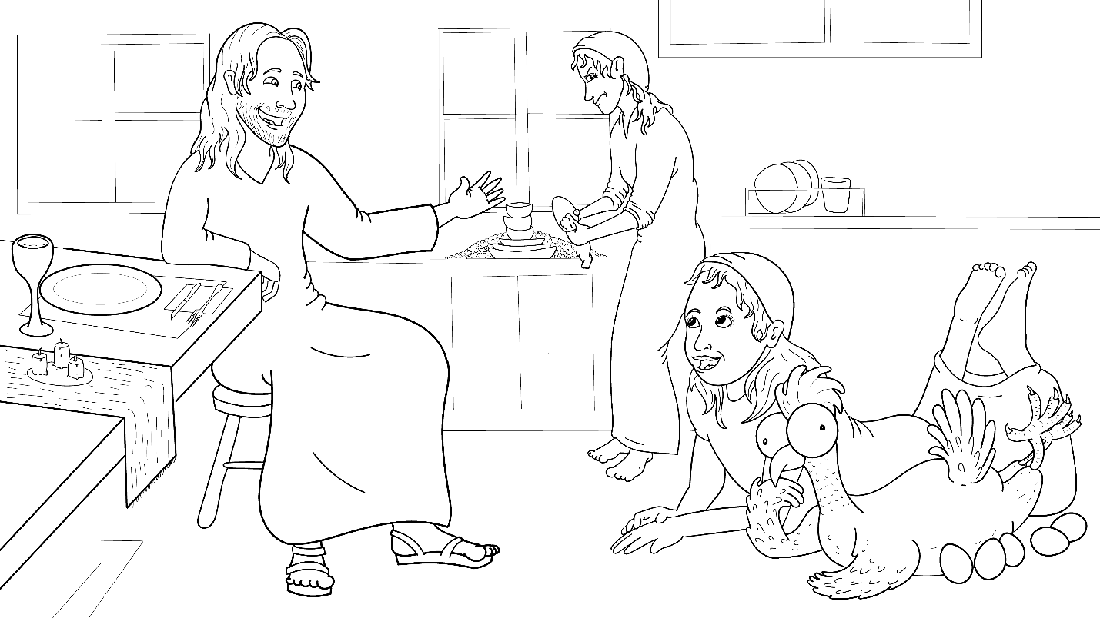
1.2 Story: No Help Yet
Luke 10:38-42
(Martha and Mary)

Slide 2
New Words to Read
get, wet, set, yet
fret* (worry)
help, eggs
hen, pen
Notes:
You can add translations here:

Slide 3
Rule Breakers (spelled)
the
to, do
said

Slide 4
Sight Words
she
no
not

Slide 5
1.2 Story: No Help Yet
I Read, You Read Bible Story
(Martha and Mary)

Slide 6
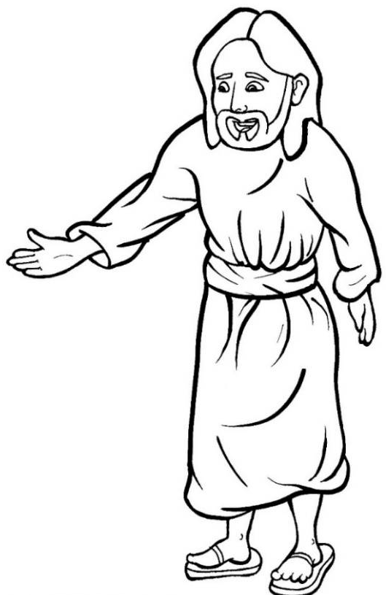
Jesus is coming, quick!

Slide 7
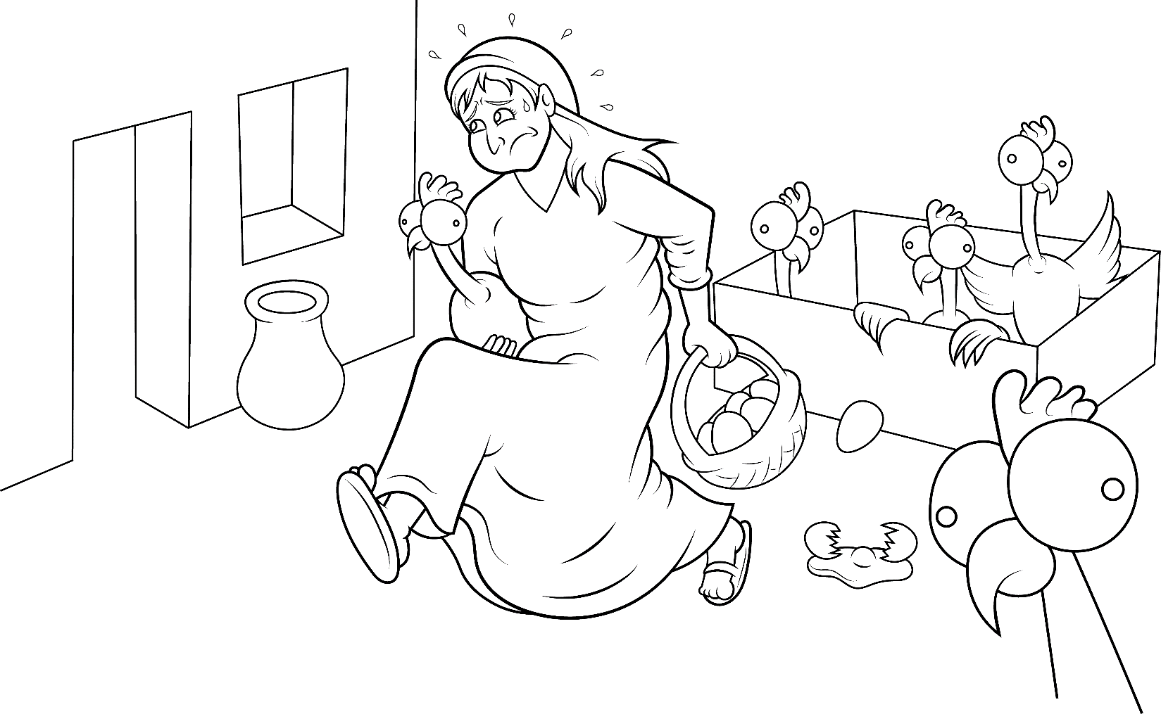
She ran to the pen. Get the hen.
Get the eggs! Get, get, get.

Slide 8
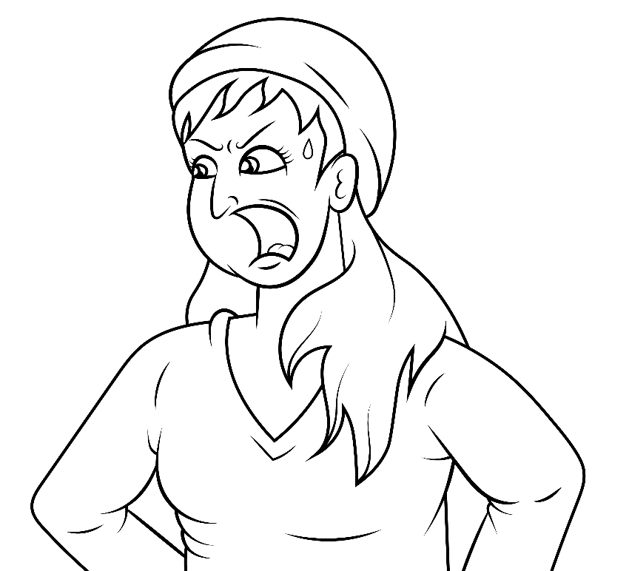
She said, “Help!”

Slide 9
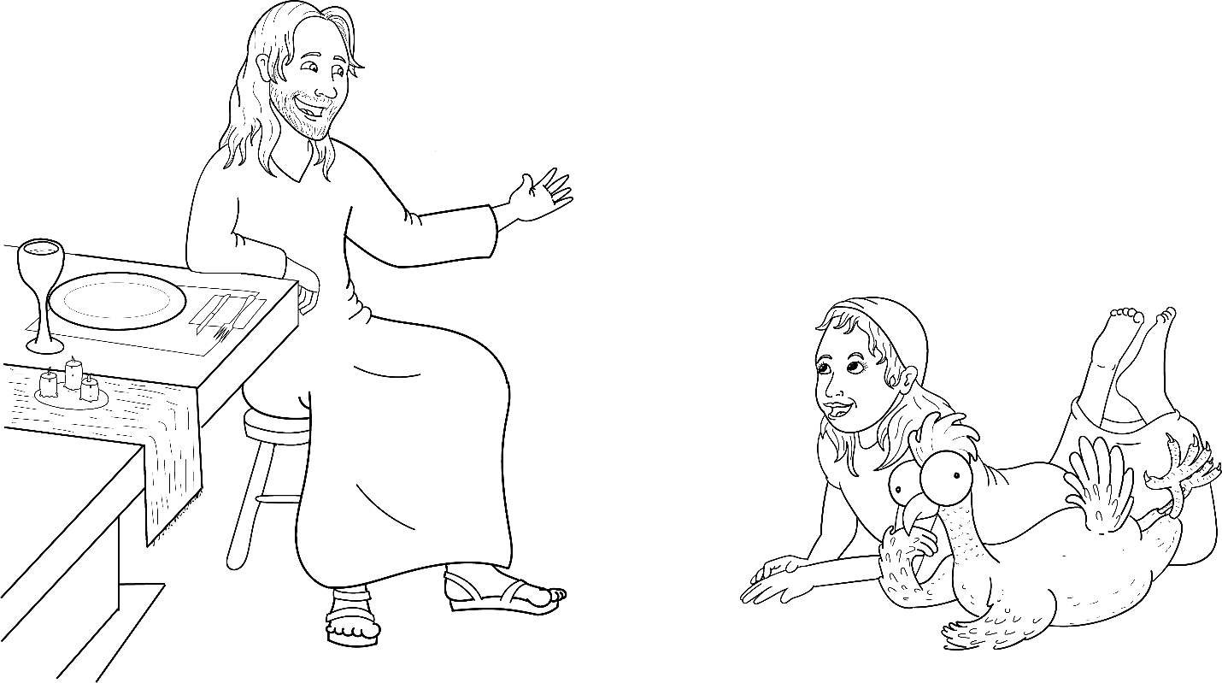
No help yet.

Slide 10
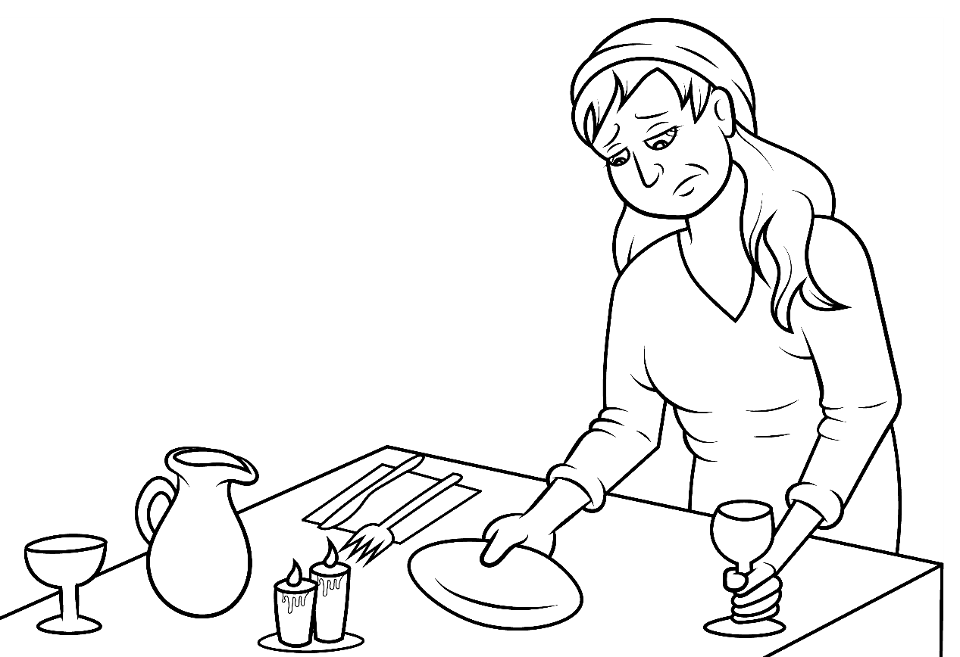
She set the table.
Set, set, set.

Slide 11
She said, “Help!”

Slide 12
No help yet.

Slide 13
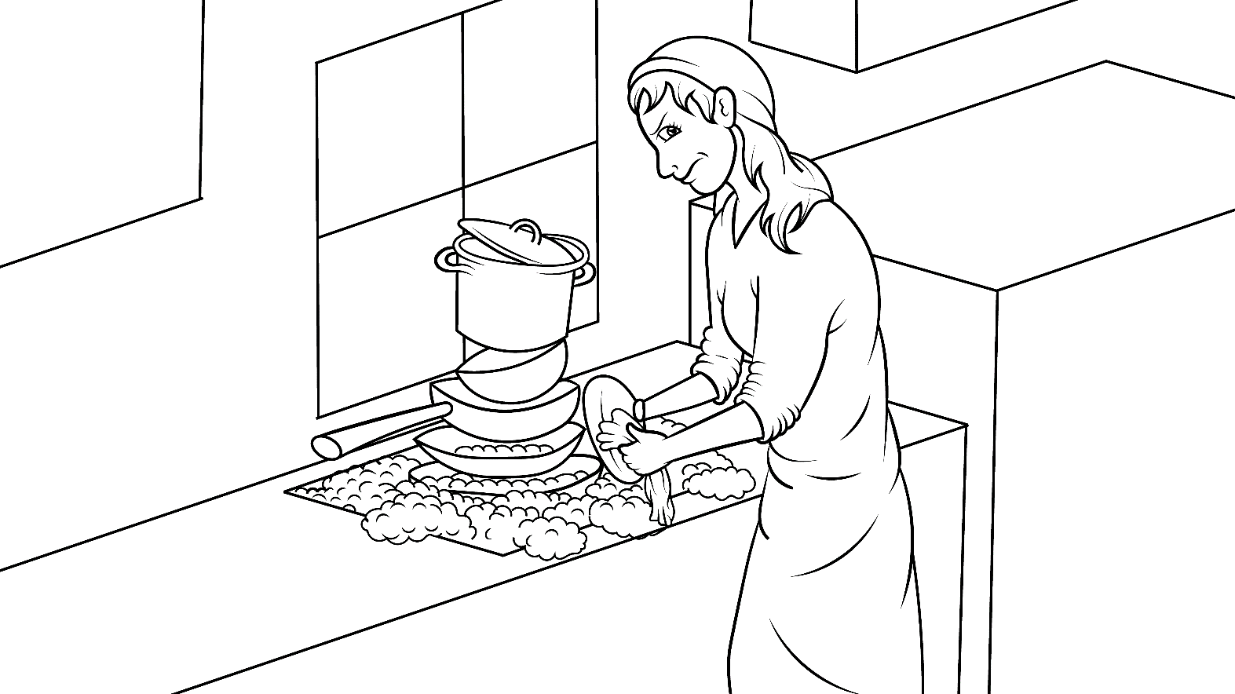
She washed the pan.
Wet, wet, wet.

Slide 14
She said, “Help!”

Slide 15
No help yet.

Slide 16
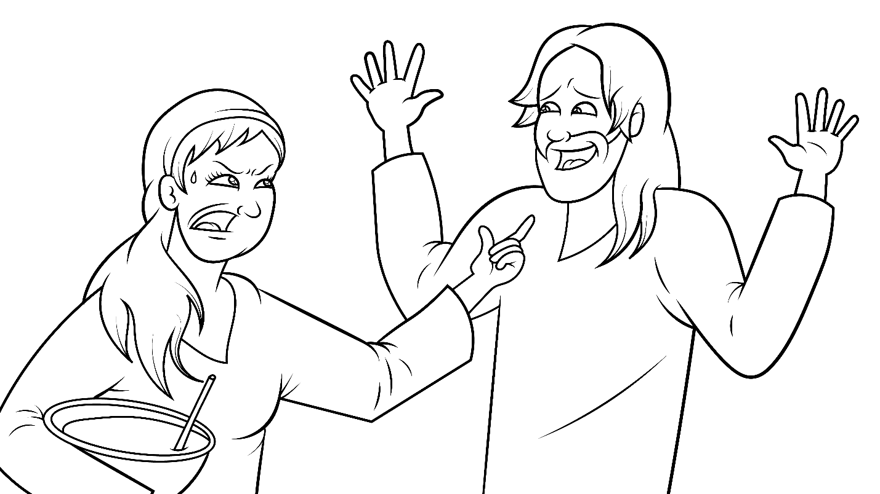
Jesus said, “Stop.
Do not fret.”

Slide 17
“Let us sit.
Let us just sit.”

Slide 18
And so, they did what Jesus said.

Slide 19
They just sat and sat.

Slide 20
The End

Slide 21
1.2 Story Without Illustrations
No Help Yet

Slide 22
Jesus is coming, quick!
She ran to the pen.
Get the hen. Get the eggs!
Get, get, get.

Slide 23
She said, “Help!” No help yet.
She set the table.
Set, set, set.
She said, “Help!” No help yet.

Slide 24
She washed the pan.
Wet, wet, wet.
She said, “Help!” No help yet.
Jesus said, “Stop. Do not fret.”

Slide 25
“Let us sit. Let us just sit.”
And so, they did what Jesus said.
They just sat and sat.

Slide 26
The End

Slide 27
Story: Carol Hale
Illustrations: Ivan Mader
Power Point arrangements: Prakash Chandra Giri
www.EasyReadEnglish.com
www.EZreadEnglish.org/lower-levels

