Slide 1
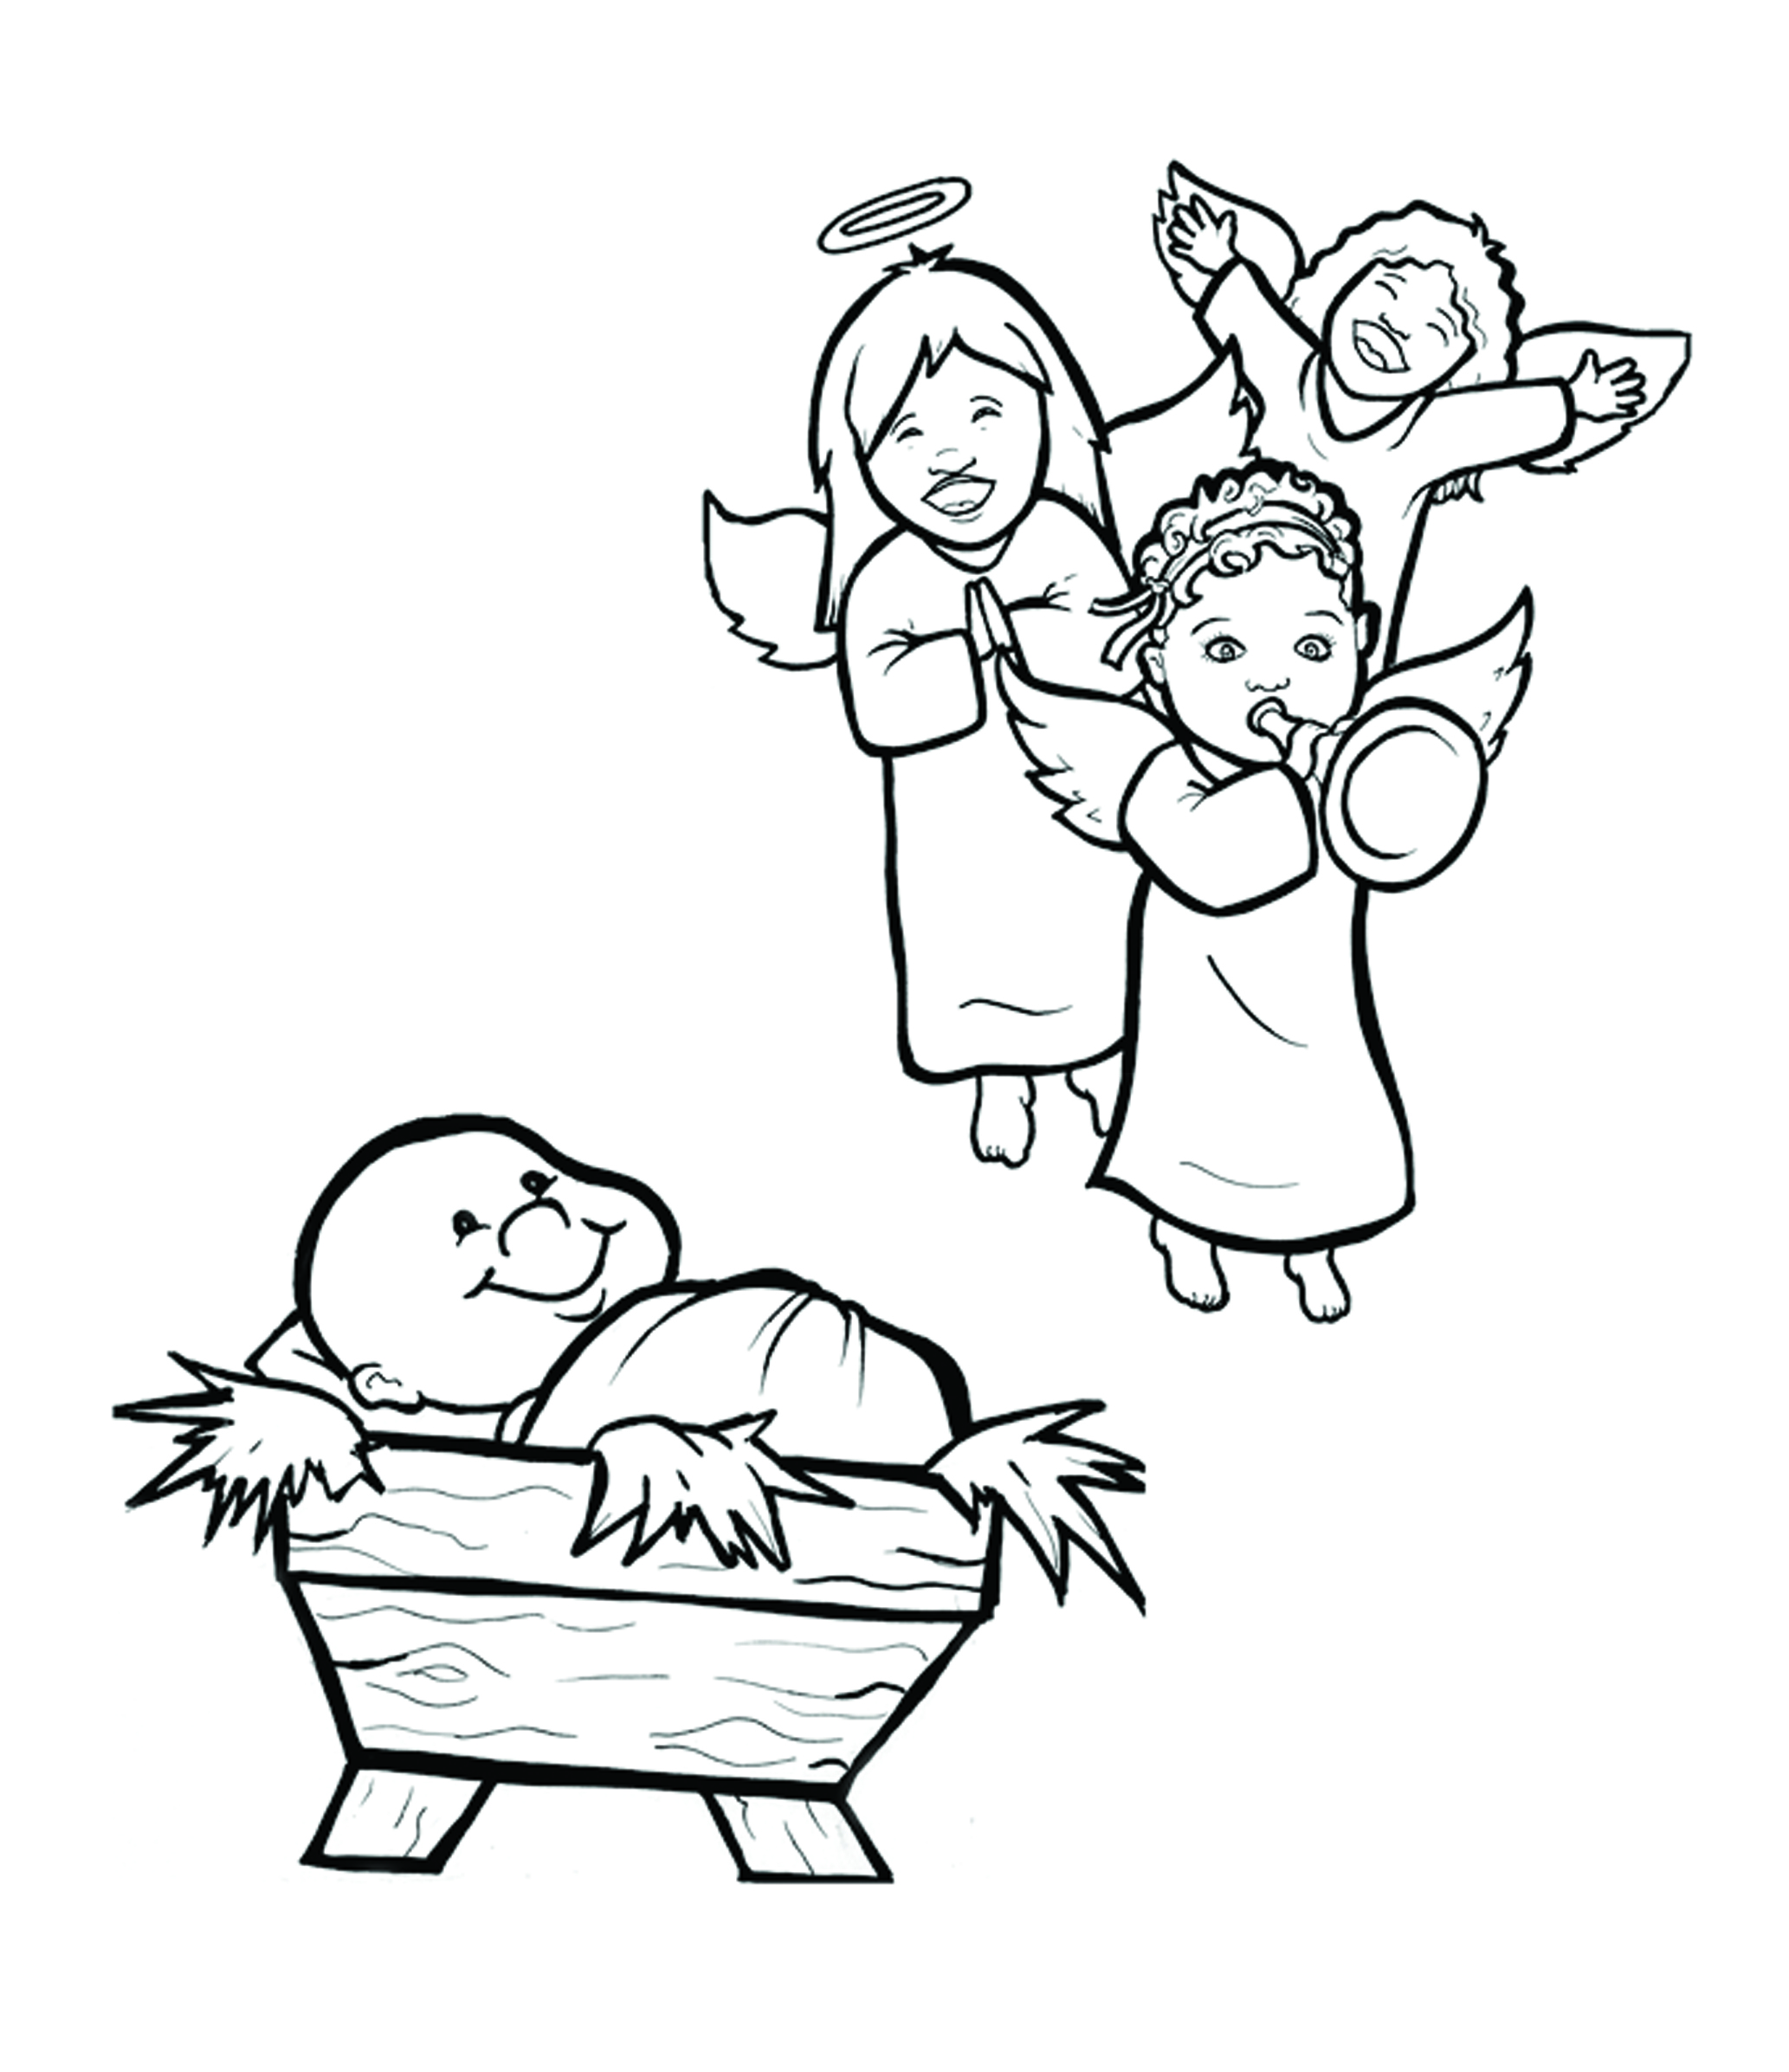
2. Happy Birthday, Jesus!
Part 1
Syllable Charts

Slide 2
Words in Syllable Types

Slide 3
Closed – Short Vowel
A closed syllable has one vowel
followed by one or more consonants,
and the vowel is short.
st
o
p
˘

Slide 4
ask
daz-
trav-
back

Slide 5
smell
felt
them
slept
-ment

Slide 6
trip
strips

Slide 7
top
God
cloth
wob-

Slide 8
us
must
-sus

Slide 9
Open – Long Vowel
An open syllable has one vowel
with no consonant after it,
and the vowel is long.
−
go

Slide 10
ba by
Sa vior

Slide 11
be
she
Je sus

Slide 12
no
Jo seph
mo ment

Slide 13
hu man
ru ler

Slide 14
ba by
wob bly

Slide 15
Silent e – Long Vowel
A silent e syllable has one vowel,
followed by one consonant
and a silent e at the end.
The vowel is long.
−
ca
e
v

Slide 16
made
gave
came

Slide 17
here

Slide 18
time
life
in side
be side

Slide 19
rode
shone

Slide 20
Vowel Teams – Long Vowel
Many vowel teams follow this rule:
When two vowels get together,
the first one names its letter.
So the first vowel will make its long sound,
and the second vowel is silent.
−
e
a
t

Slide 21
wait
pain
laid

Slide 22
day
stay

Slide 23
donk ey

Slide 24
night
bright

Slide 25
room

Slide 26
grew
news

Slide 27
Vowel Teams – Other Sounds
Sometimes vowel teams make other sounds.
oil

Slide 28
out
count ed

Slide 29
down
towns
crowd ed

Slide 30
joy

Slide 31
law

Slide 32
good

Slide 33
R - Controlled
R-controlled syllables have one or more vowels
followed by an “r.”
The “r” changes the sound of the vowel.
o
r
ange

Slide 34
star
hard
barn
dark

Slide 35
her
ru ler

Slide 36
first
birth

Slide 37
for
born
Lord

Slide 38
Consonant – l-e
When you see consonant l-e at the end of a word,
count back three.
The “l-e” makes the /–le/ sound.
pur
p
l
e

Slide 39
peo ple

Slide 40
trav el

Slide 41
Other Sounds – Long Vowel
These syllables or words are closed,
so the vowel should be short,
but the vowel is long.
−
cold

Slide 42
old

Slide 43
Other Sounds – -nk/-ng
The “-nk” and “-ng”
change the sound of the vowel.
bank
thing

Slide 44
sing ing
daz zling

Slide 45
long

Slide 46
ang el

Slide 47
donk ey

Slide 48
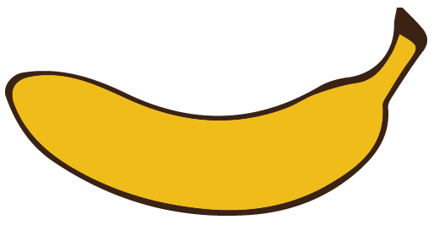
Other Sounds – schwa
The schwa syllable has an “a” that sounds
like the /u/ in banana.
The banana is even shaped like a short u.
ba nan a

Slide 49
Naz a reth

