Slide 1

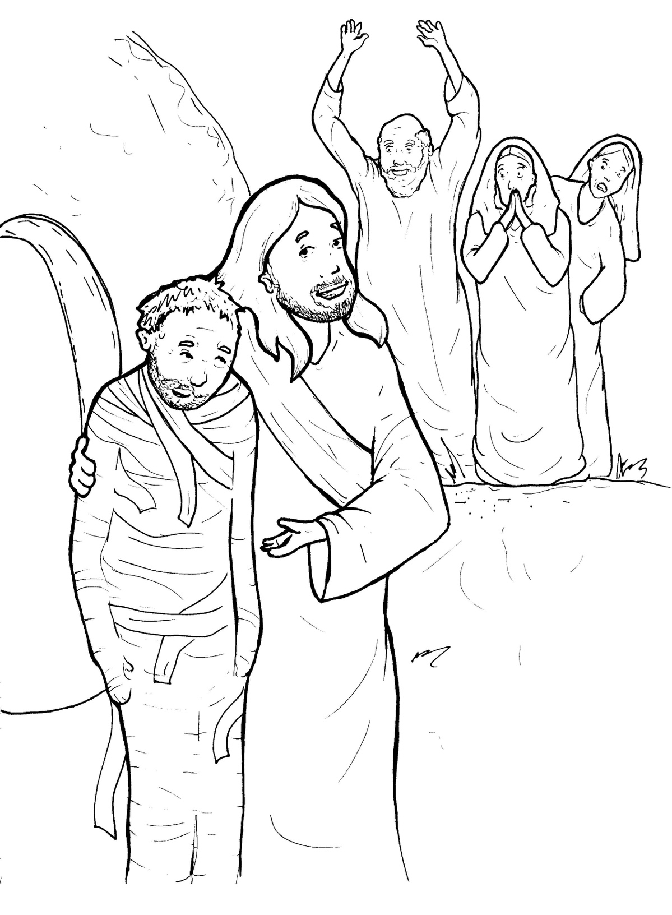
Part 5
33. Lazarus Lives Again
Vocabulary
Original Bible Story

Slide 2

Vocabulary

Slide 3
glorify
(glor - i - FY)
to praise

Slide 4
console
(con - SOLE)
to give someone comfort

Slide 5
resurrection
(res - ur - REC - tion)
to come back to life from the dead

Slide 6
the Christ
(Christ)
the Messiah –
the promised Savior

Slide 7
groan
(groan)
a sad, deep sigh

Slide 8
stench
(stench)
a bad smell

Slide 9
Lazarus
Lives Again
John 11
(selected verses)
World English Bible (WEB)

Slide 10
Now a certain man was sick,
Lazarus from Bethany,

Slide 11
in the village of Mary
and her sister, Martha.

Slide 12
But when Jesus heard it, he said,
“This sickness is not to death,

Slide 13
but for the glory of God,
that God’s Son may be
glorified by it.”

Slide 14
So, when Jesus came, he found
that he had been in the tomb
for four days already.

Slide 15
Therefore, Martha said to Jesus,
“Lord, if you would have been here,
my brother wouldn’t have died.”

Slide 16
Jesus said to her,
“Your brother will rise again.”

Slide 17
Jesus said to her, “I am
the resurrection and the life.

Slide 18
He who believes in me
will still live, even if he dies.

Slide 19
Do you believe this?”

Slide 20
She said to him,
“Yes, Lord.
I have come to believe that

Slide 21
you are the Christ,
God’s Son,
who has come into the world.”

Slide 22
The Jews were with her in the
house and were consoling her.

Slide 23
Therefore, when Mary came
to where Jesus was and saw him,

Slide 24
she fell down at his feet,
saying to him,

Slide 25
“Lord, if you would have been here,
my brother wouldn’t have died.”

Slide 26
Jesus wept.

Slide 27
Jesus therefore, again groaning
in himself, came to the tomb.

Slide 28
Now it was a cave, and
a stone lay against it.

Slide 29
Jesus said,
“Take away the stone.”

Slide 30
Martha, the sister of him who
was dead, said to him,

Slide 31
“Lord, by this time there is a stench,
for he has been dead four days.”

Slide 32
Jesus said to her, “Didn’t I tell
you that if you believed,
you would see God’s glory?”

Slide 33
So, they took away the stone
from the place where
the dead man was lying.

Slide 34
He cried with a loud voice,
“Lazarus, come out!”

Slide 35
He who was dead came out,
bound hand and foot
with wrappings,

Slide 36
and his face was wrapped
around with a cloth.

Slide 37
Therefore, many of the Jews
who came to Mary

Slide 38
and saw what Jesus did
believed in him.

