Slide 1

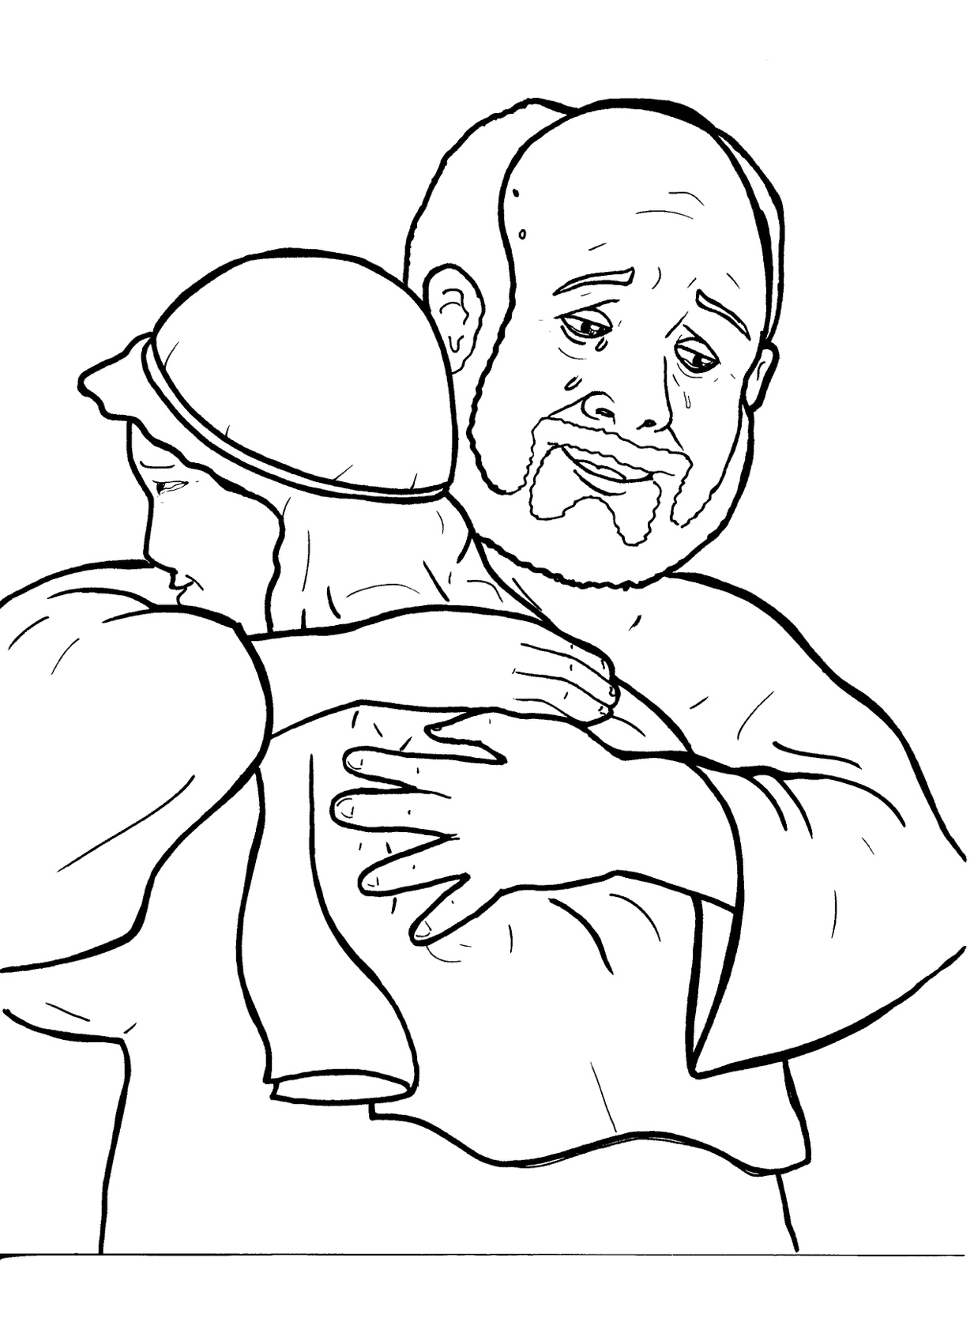
Part 1
24. The Lost Son
Syllable Charts

Slide 2

Words in
Syllable Types

Slide 3
Closed – Short Vowel
A closed syllable has one vowel
followed by one or more consonants,
and the vowel is short.
st
o
p
˘

Slide 4
Timing
Box
hap-
ran
nas-
ask
back
that

Slide 5
Timing
Box
nev-
let
yell
held
spent
-ven

Slide 6
Timing
Box
big
pigs
cit-
sin

Slide 7
Timing
Box
kiss
-til
will
this
-sic

Slide 8
Timing
Box
got
lost
off
job

Slide 9
Timing
Box
un-
-sus
hug
but

Slide 10
Open – Long Vowel
An open syllable has one vowel
with no consonant after it,
and the vowel is long.
−
go

Slide 11
Timing
Box
me
he
be
Je sus
e ven

Slide 12
Timing
Box
so
no
go

Slide 13
Timing
Box
mu sic

Slide 14
Timing
Box
I

Slide 15
Timing
Box
my

Slide 16
Timing
Box
nas ty
cit y
stor y
par ty

Slide 17
Timing
Box
hap py
hung ry

Slide 18
Silent e – Long Vowel
A silent e syllable has one vowel,
followed by one consonant
and a silent e at the end.
The vowel is long.
−
ca
e
v

Slide 19
Timing
Box
gave

Slide 20
Timing
Box
a live

Slide 21
Timing
Box
home

Slide 22
Vowel Teams – Long Vowel
Many vowel teams follow this rule:
When two vowels get together,
the first one names its letter.
So the first vowel will make its long sound,
and the second vowel is silent.
−
e
a
t

Slide 23
Timing
Box
fair
wait

Slide 24
Timing
Box
way
a way

Slide 25
Timing
Box
feed

Slide 26
Timing
Box
mon ey

Slide 27
Timing
Box
par ties

Slide 28
Timing
Box
right

Slide 29
Timing
Box
die

Slide 30
Timing
Box
road

Slide 31
Timing
Box
soon
food

Slide 32
Vowel Teams – Other Sounds
Sometimes vowel teams make other sounds.
oil

Slide 33
Timing
Box
saw

Slide 34
Timing
Box
all

Slide 35
Timing
Box
dead

Slide 36
Timing
Box
now
down

Slide 37
Timing
Box
found

Slide 38
Timing
Box
look
good

Slide 39
R - Controlled
R-controlled syllables have one or more vowels
followed by an “r.”
The “r” changes the sound of the vowel.
o
r
ange

Slide 40
Timing
Box
far
part
party
par ties
farm er

Slide 41
Timing
Box
for
story

Slide 42
Timing
Box
old er
nev er
farm er

Slide 43
Timing
Box
heard

Slide 44
Other Sounds – Long Vowel
These syllables or words are closed,
so the vowel should be short,
but the vowel is long.
−
cold

Slide 45
Timing
Box
told
old er

Slide 46
Other Sounds – -nk/-ng
The “-nk” and “-ng”
change the sound of the vowel.
bank
thing

Slide 47
Timing
Box
drinks

Slide 48
Timing
Box
com ing
any thing

Slide 49
Timing
Box
hung ry

Slide 50

Other Sounds – schwa
The schwa syllable has an “a” that sounds
like the /u/ in banana.
The banana is even shaped like a short u.
ba nan a

Slide 51
Timing
Box
a way
a live

Slide 52
Timing
Box
son
mon ey

