Slide 1

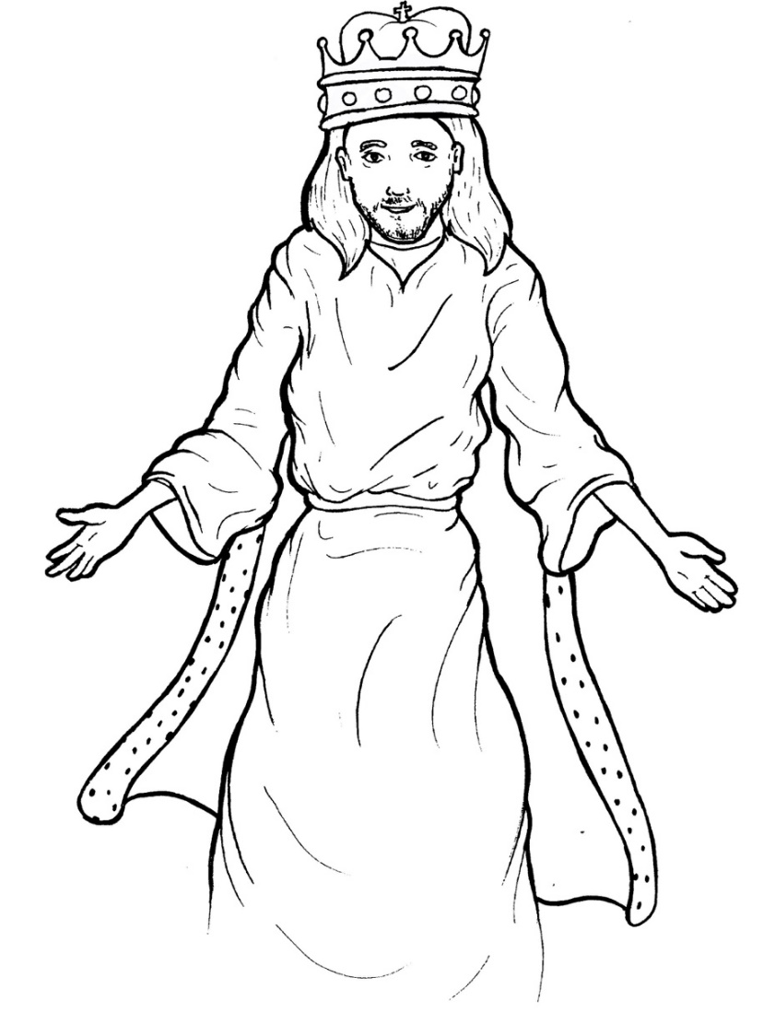
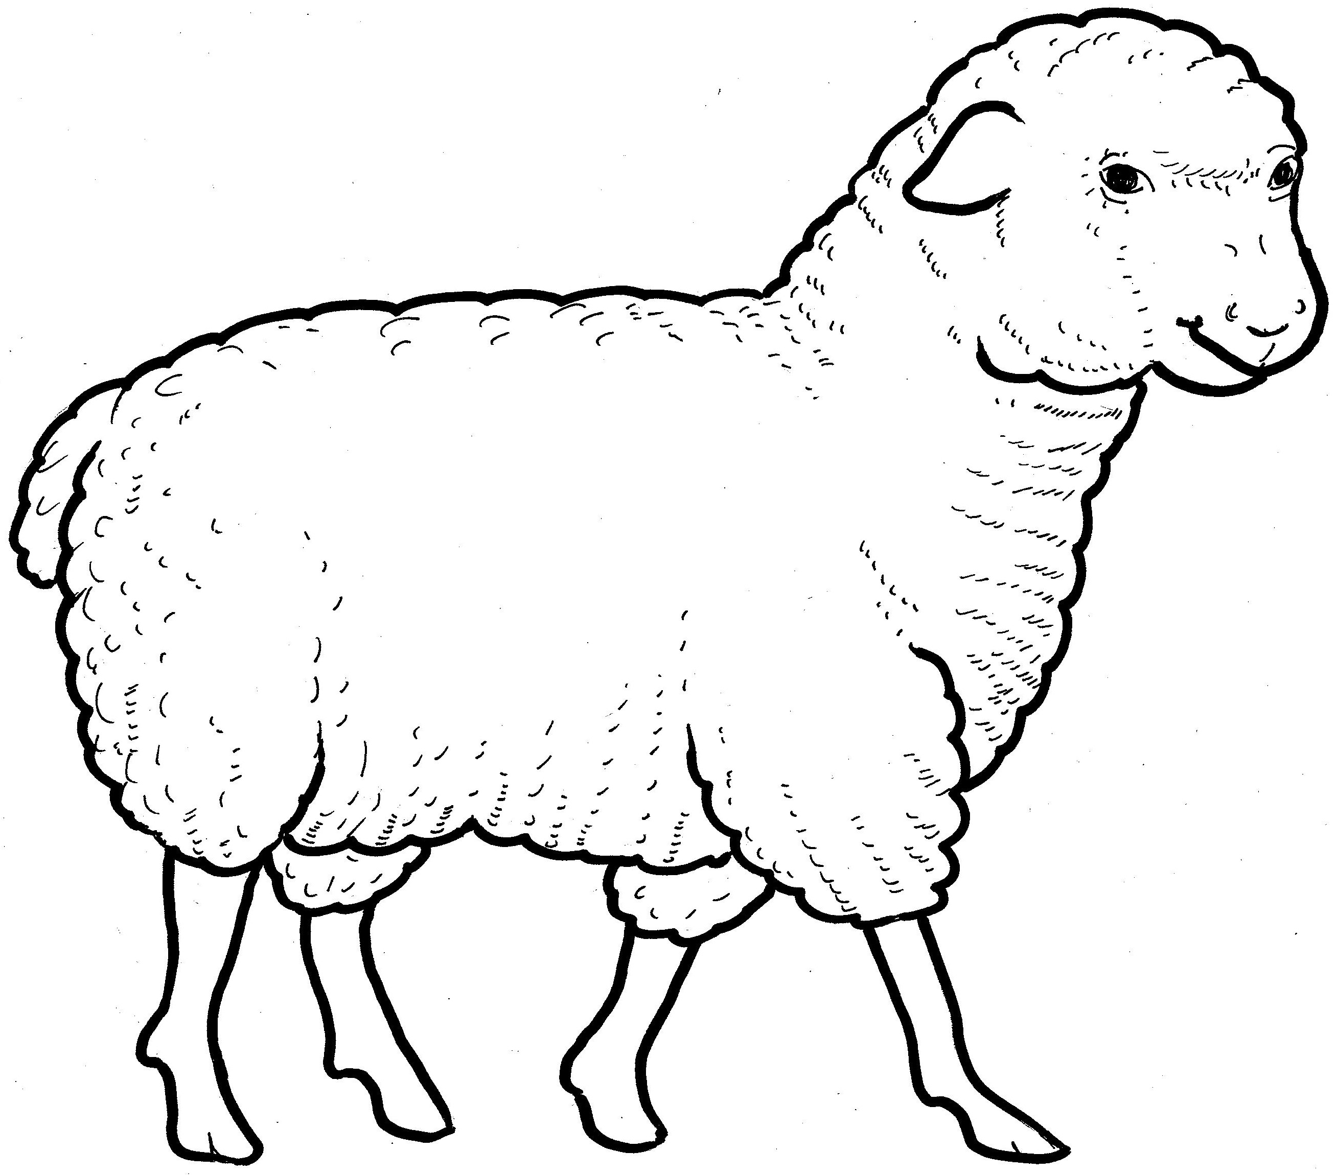
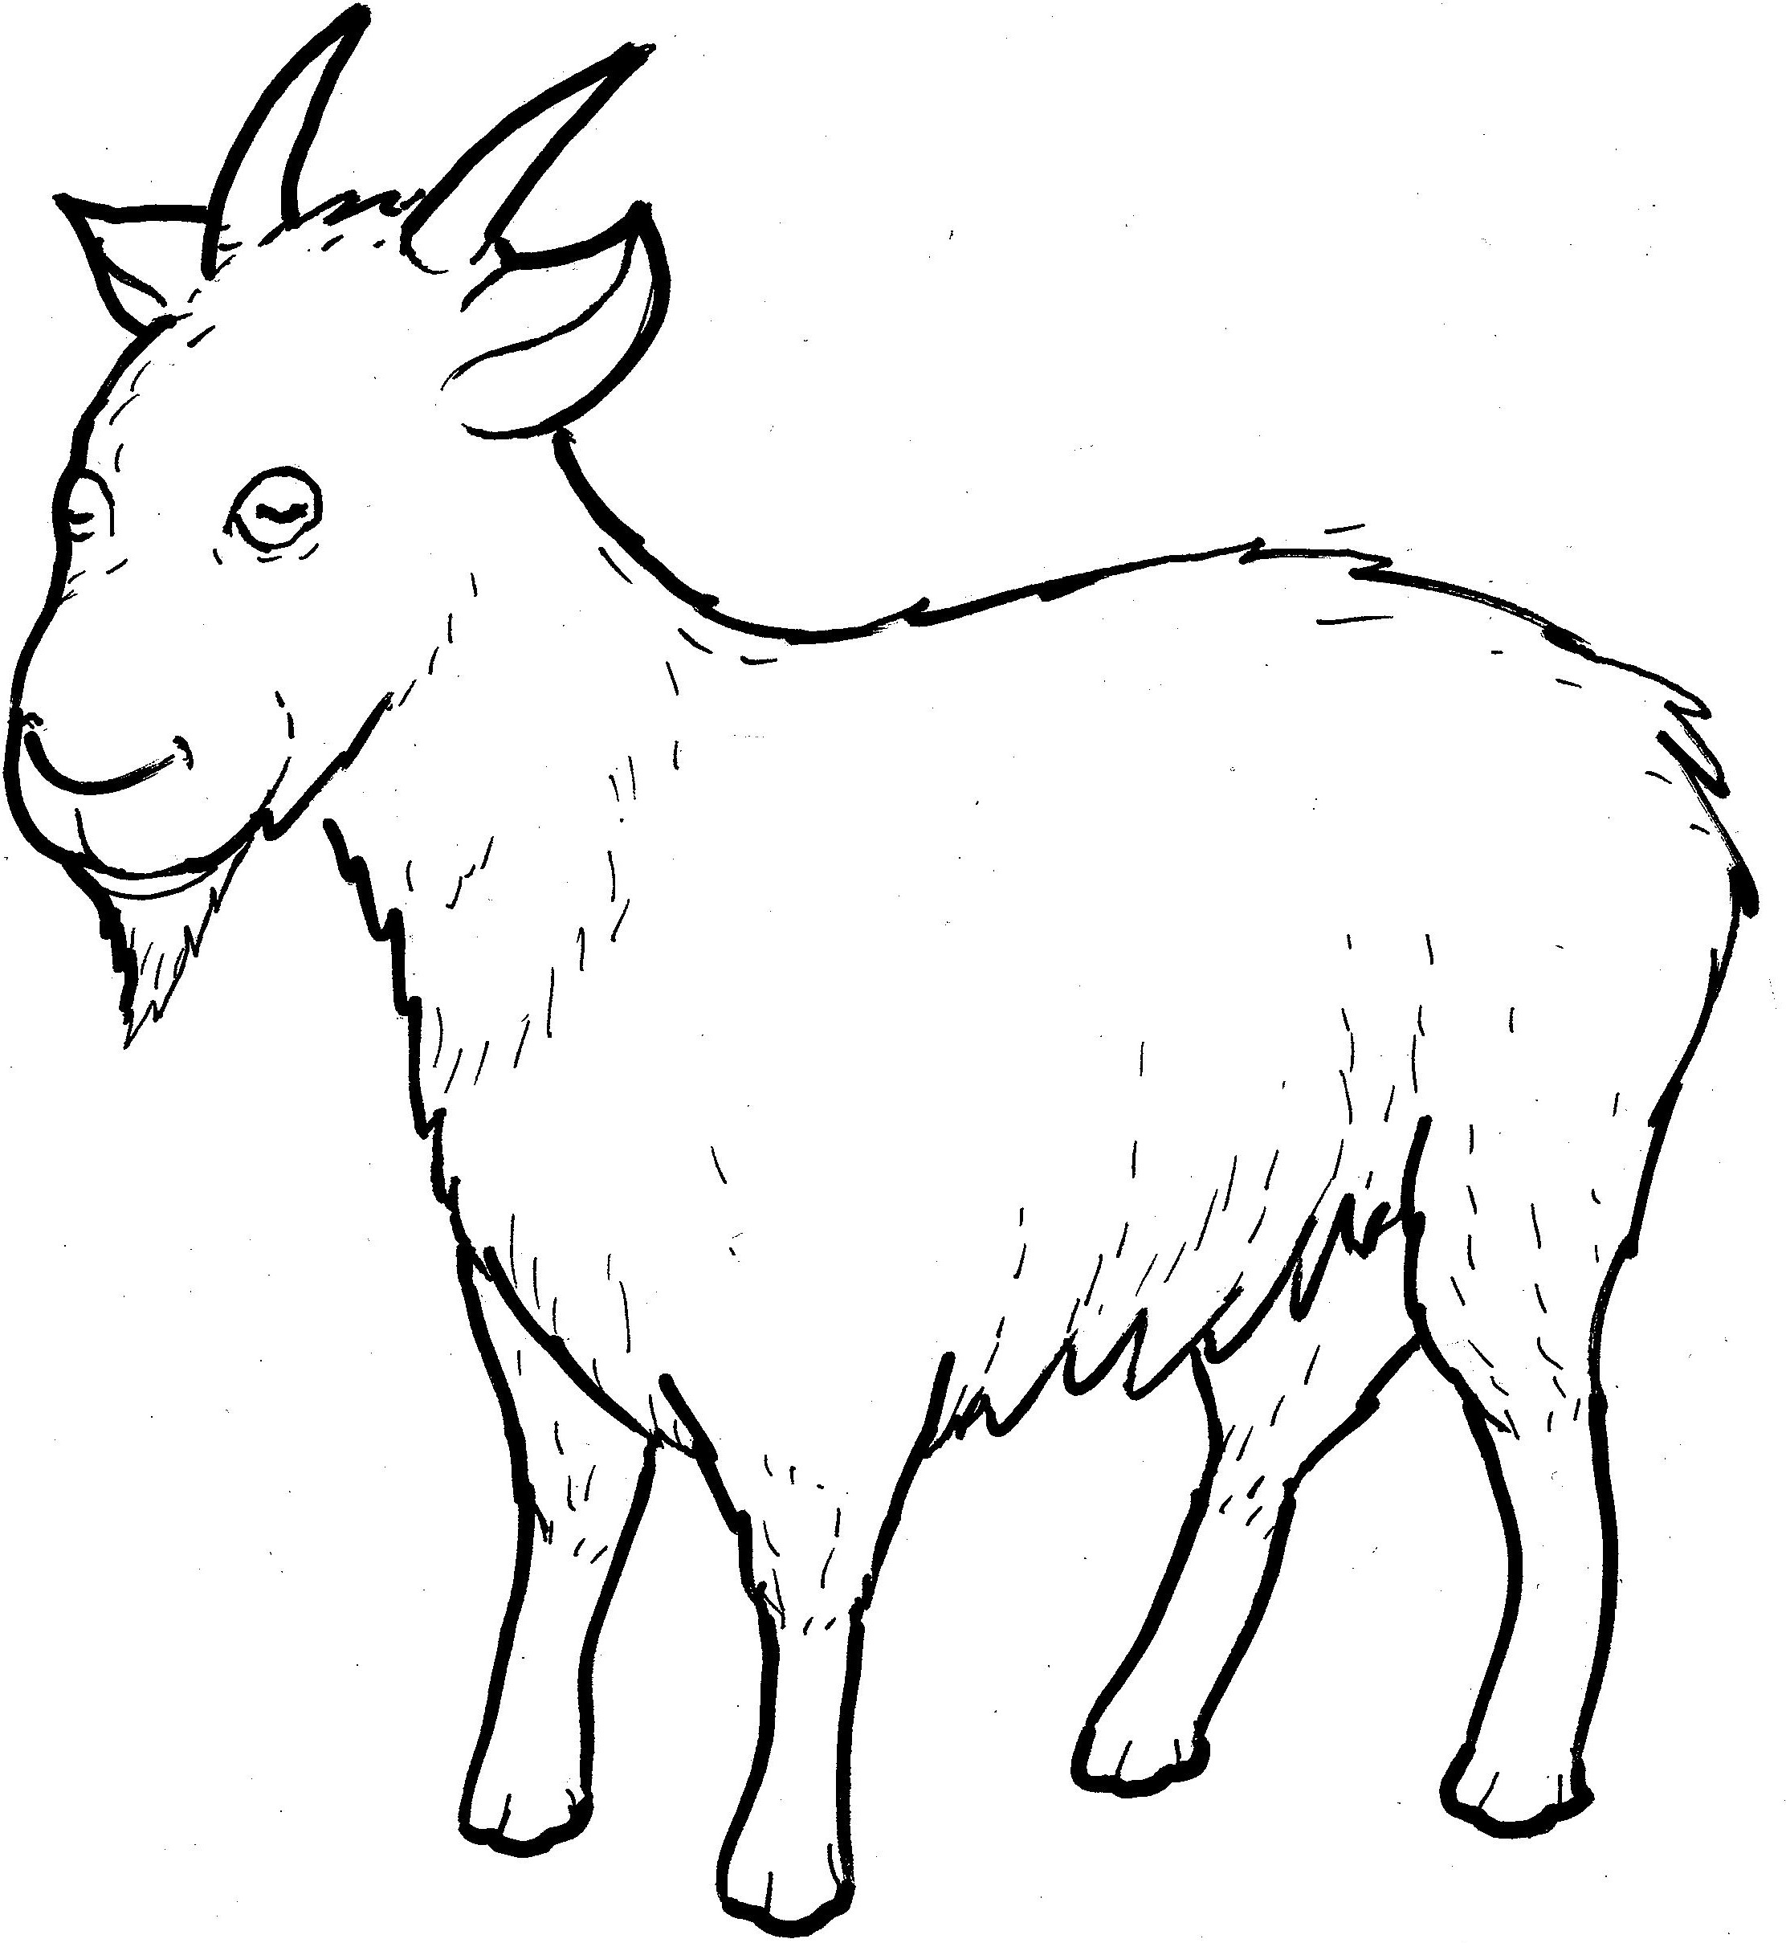
Part 5
27. The Sheep and Goats
Vocabulary
Original Bible Story

Slide 2

Vocabulary

Slide 3
Son of Man
(Son)
a name Jesus called himself to show he was human as well as God.

Slide 4
inherit
(in - HER - it)
to receive things from a person who has died

Slide 5
foundation
(foun - DA - tion)
start

Slide 6
clothe
(clothe)
to get dressed

Slide 7
eternal
(e - TER - nal)
lasts forever

Slide 8
righteous
(RIGHT - eous)
correct and good

Slide 9
The Sheep and Goats
Matthew 25:31-46
World English Bible (WEB)

Slide 10
“But when the Son of Man
comes in his glory,
and all the holy angels with him,

Slide 11
then he will sit
on the throne of his glory.

Slide 12
Before him all the nations
will be gathered, and he will
separate them one from another,

Slide 13
as a shepherd separates
the sheep from the goats.

Slide 14
He will set the sheep on
his right hand,
but the goats on the left.

Slide 15
Then the King will tell
those on his right hand,
‘Come, blessed of my Father,

Slide 16
inherit the kingdom
prepared for you from
the foundation of the world;

Slide 17
for I was hungry
and you gave me food to eat.

Slide 18
I was thirsty
and you gave me a drink.

Slide 19
I was a stranger
and you took me in.

Slide 20
I was naked and you clothed me.
I was sick and you visited me.
I was in prison and you came to me.’

Slide 21
“Then the righteous will answer him,
saying, ‘Lord, when did we
see you hungry and feed you,
or thirsty and give you a drink?

Slide 22
When did we see you as
a stranger and take you in,
or naked and clothe you?

Slide 23
When did we see you sick
or in prison and come to you?’

Slide 24
“The King will answer them,
‘Most certainly I tell you,

Slide 25
because you did it to one of
the least of these my brothers,
you did it to me.’

Slide 26
Then he will say also
to those on the left hand,
‘Depart from me, you cursed,

Slide 27
into the eternal fire
which is prepared for the devil
and his angels;

Slide 28
for I was hungry, and
you didn’t give me food to eat;

Slide 29
I was thirsty, and you
gave me no drink;

Slide 30
I was a stranger, and
you didn’t take me in;
naked, and you didn’t clothe me;

Slide 31
sick, and in prison,
and you didn’t visit me.’

Slide 32
Then they will also answer, saying,
‘Lord, when did we see you hungry,
or thirsty, or a stranger,

Slide 33
or naked,
or sick,
or in prison,
and didn’t help you?’

Slide 34
“Then he will answer them, saying,
‘Most certainly I tell you,

Slide 35
because you didn’t do it
to one of the least of these,
you didn’t do it to me.’

Slide 36
These will go away into
eternal punishment, but
the righteous into eternal life.”

