Slide 1

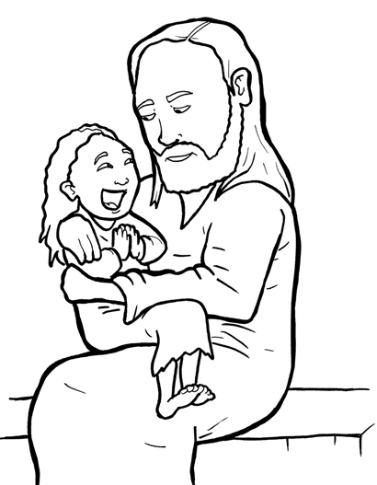
20. A Mother Begs and Believes
Part 3
Syllable Divisions

Slide 2
Dividing Words
Into Syllables

Slide 3
Rabbit Words
When you see two consonants
between two vowels,
divide between the consonants.
ra it
bb
rab bit

Slide 4
suf fer
suffer

Slide 5
hap py
happy

Slide 6
Gen tiles
Gentiles

Slide 7
dis ci ple
disciple

Slide 8

Tiger Words
When you see one consonant
between two vowels,
divide after the first vowel.
Try this pattern first.
ti er
g
ti ger

Slide 9
Je sus
Jesus

Slide 10
e vil
evil

Slide 11
be lieves
believes

Slide 12
mo ment
moment

Slide 13
Camel Words
When you see one consonant
between two vowels,
divide after the first consonant.
Try this pattern second.
ca el
m
cam el

Slide 14
vis it
visit

Slide 15
Turtle Words
When you see consonant-l-e,
count back three and divide.
tur
t
l
e
tur tle

Slide 16
dis ci ple
disciple

Slide 17
lit tle
little

Slide 18
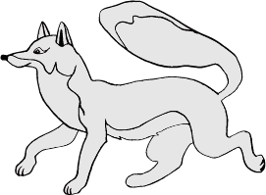
Foxes Suffixes
Focus on your base word.
fox es
fox es

Slide 19
visited
visited

Slide 20
asked
asked

Slide 21
smiled
smiled

Slide 22
scared
scared

Slide 23
begged
begged

Slide 24
healed
healed

Slide 25
believed
believed

Slide 26
suffer ing
suffering

Slide 27
beg ging
begging

Slide 28
cry ing
crying

Slide 29
ly ing
lying

Slide 30
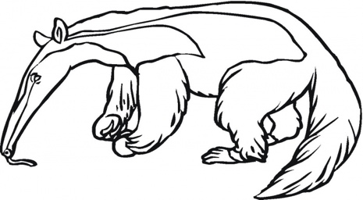
Anteater Words
These compound words are made up of two smaller words.
ant
eater
1
2
ant eater

Slide 31
in side
inside

Slide 32
Other Syllable Divisions
Some words don’t fit so neatly
into standard syllable division patterns.

Slide 33
a way
away

