Slide 1
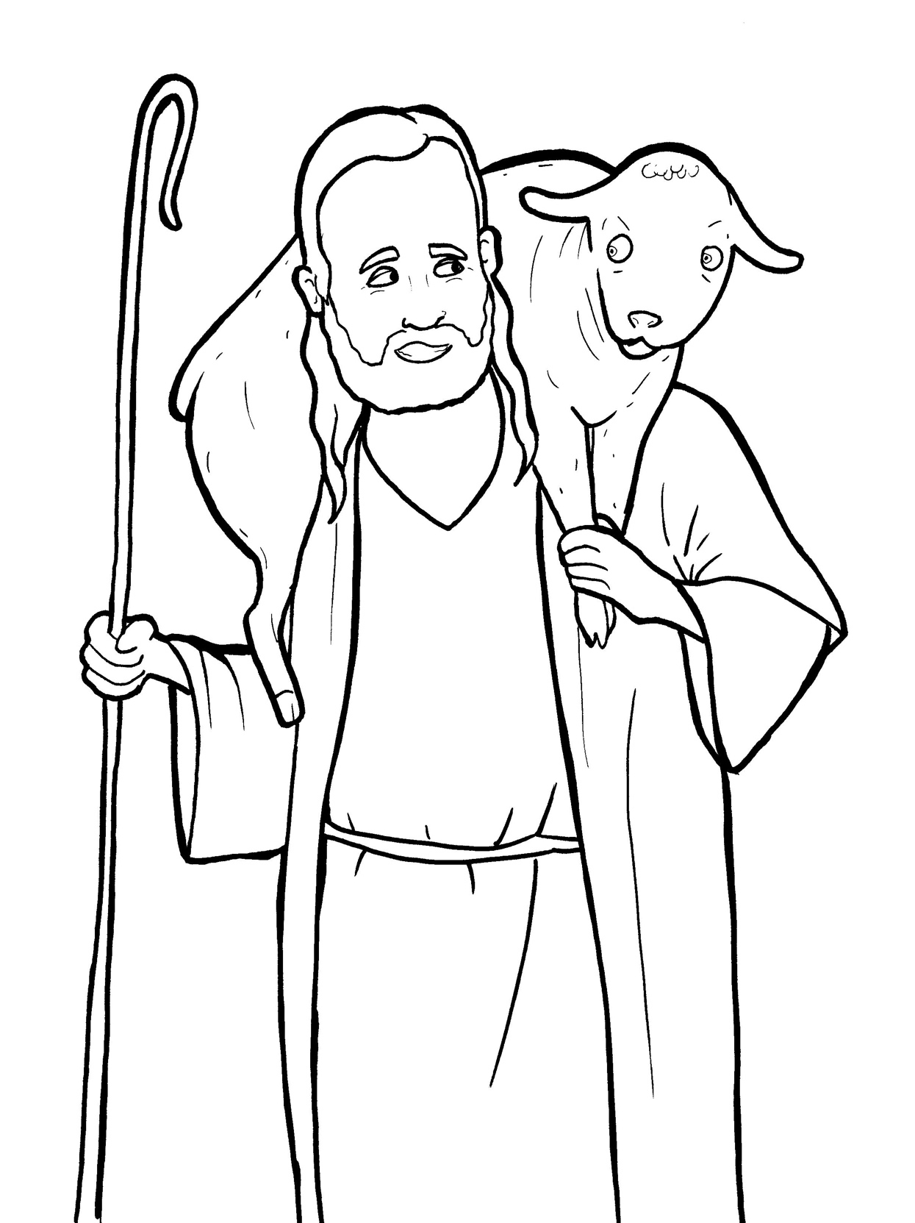
Part 2
22. The Lost Sheep
New Words
Rule Breakers

Slide 2
Other Sounds – Soft C
ce, ci, cy make the soft sound
cent
city
fancy

Slide 3
Timing
Box
rejoice

Slide 4
Other Sounds – Soft G
ge, gi, gy often make the soft sound
gentle
giant
gym

Slide 5
Timing
Box
angels

Slide 6
Silent letters
climb
neighbors

Slide 7
Contractions
The word “contraction” means “the thing pulled together.”
The first word stays the same,
and the apostrophe takes the place of the
missing letters in the second word.
’m
=
am
I
I

Slide 8
didn’t = did not

Slide 9
let’s = let us

Slide 10
New Words
neighbors
grumbled
happiness
wander

Slide 11
Rule Breakers
Words like these do not follow phonetic patterns.
to
you
said
could
two
f
from

Slide 12
is
the
to
one
his
has

Slide 13
was
were
you
there
have
said

Slide 14
says
from
does
some
want
comes

Slide 15
friends
welcome
sorry
mountains
angels
climb

